Slide 1
FaaS and Furious
From zero to serverless in about 10 minutes.
by James McDermott
Notes:
Specific focus on Functions as a Service to get this idea across
you can go zero to serverless in a lot less than 10 minutes
The meaning of the word serverless will become apparent during this talk

Slide 2
We are going to cover:
01 Serverless as a concept.
02 How it’s being used today.
03 How you can use it.

Slide 3
1. Serverless as a concept
A “new” architectural pattern
Notes:
When we talk about service we talk about a new architectural pattern, a different model to follow when building systems.

Slide 4
Evolution
Monolith
Microservice
Function
Microservice
Function
Microservice
Function
Microservice
Function
Function
Function
Function
Function
Function
Notes:
Monolith
Three tier applications
Very heavyweight
Did far too many things
Slow to deploy
Trouble testing them
Microservice
Each part of an application was isolated
Far fewer responsibilities, but they still have multiple
Much faster to deploy
Comparatively lightweight
The model focused on being composable (Docker)
Function
Next step in the evolution
Functions have one responsibility each
Small discrete re-usable pieces of code
There’s an element of a system managing them for you - hence the term serverless
Doesn’t replace the monolith or microservice - but actually work best alongside existing systems, building integrations and helping events flow between your eco-system.

Slide 5
2. How it’s being used today
Why is it being used?
Notes:
Why is it being used - well it’s lightweight, easy to test, and fast to deploy, and like I’ve said it plugs a lot of holes if you run it alongside your existing architecture.

Slide 6
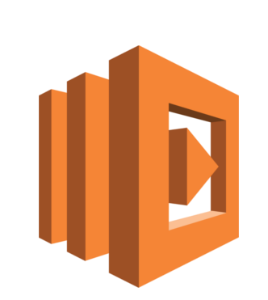
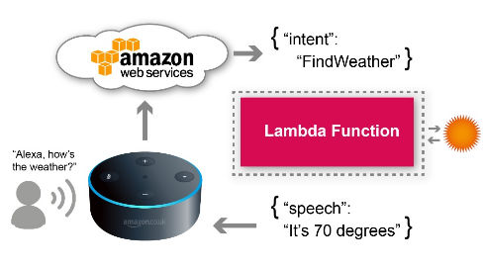




AWS Lambda
Notes:
AWS Lambda is a great example: 1. Code written in language like python, Java, Node.js
2. you install all your dependencies on your local filesystem
3. bundle it as a zip file and upload it to the cloud.
4. here amazon manages all the infrastructure.
5. You don’t have to worry about the server part anymore - hence the term serverless,

Slide 7
Notes:
parsse voice
invoke the function
and return a response

Slide 8
3. How you can use it
If you want to , that is.
Notes:
Why is it being used - well it’s lightweight, easy to test, and fast to deploy, and like I’ve said it plugs a lot of holes if you run it alongside your existing architecture.

Slide 9
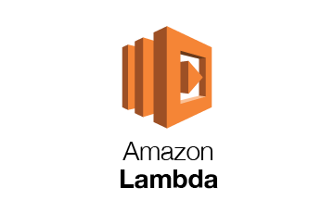

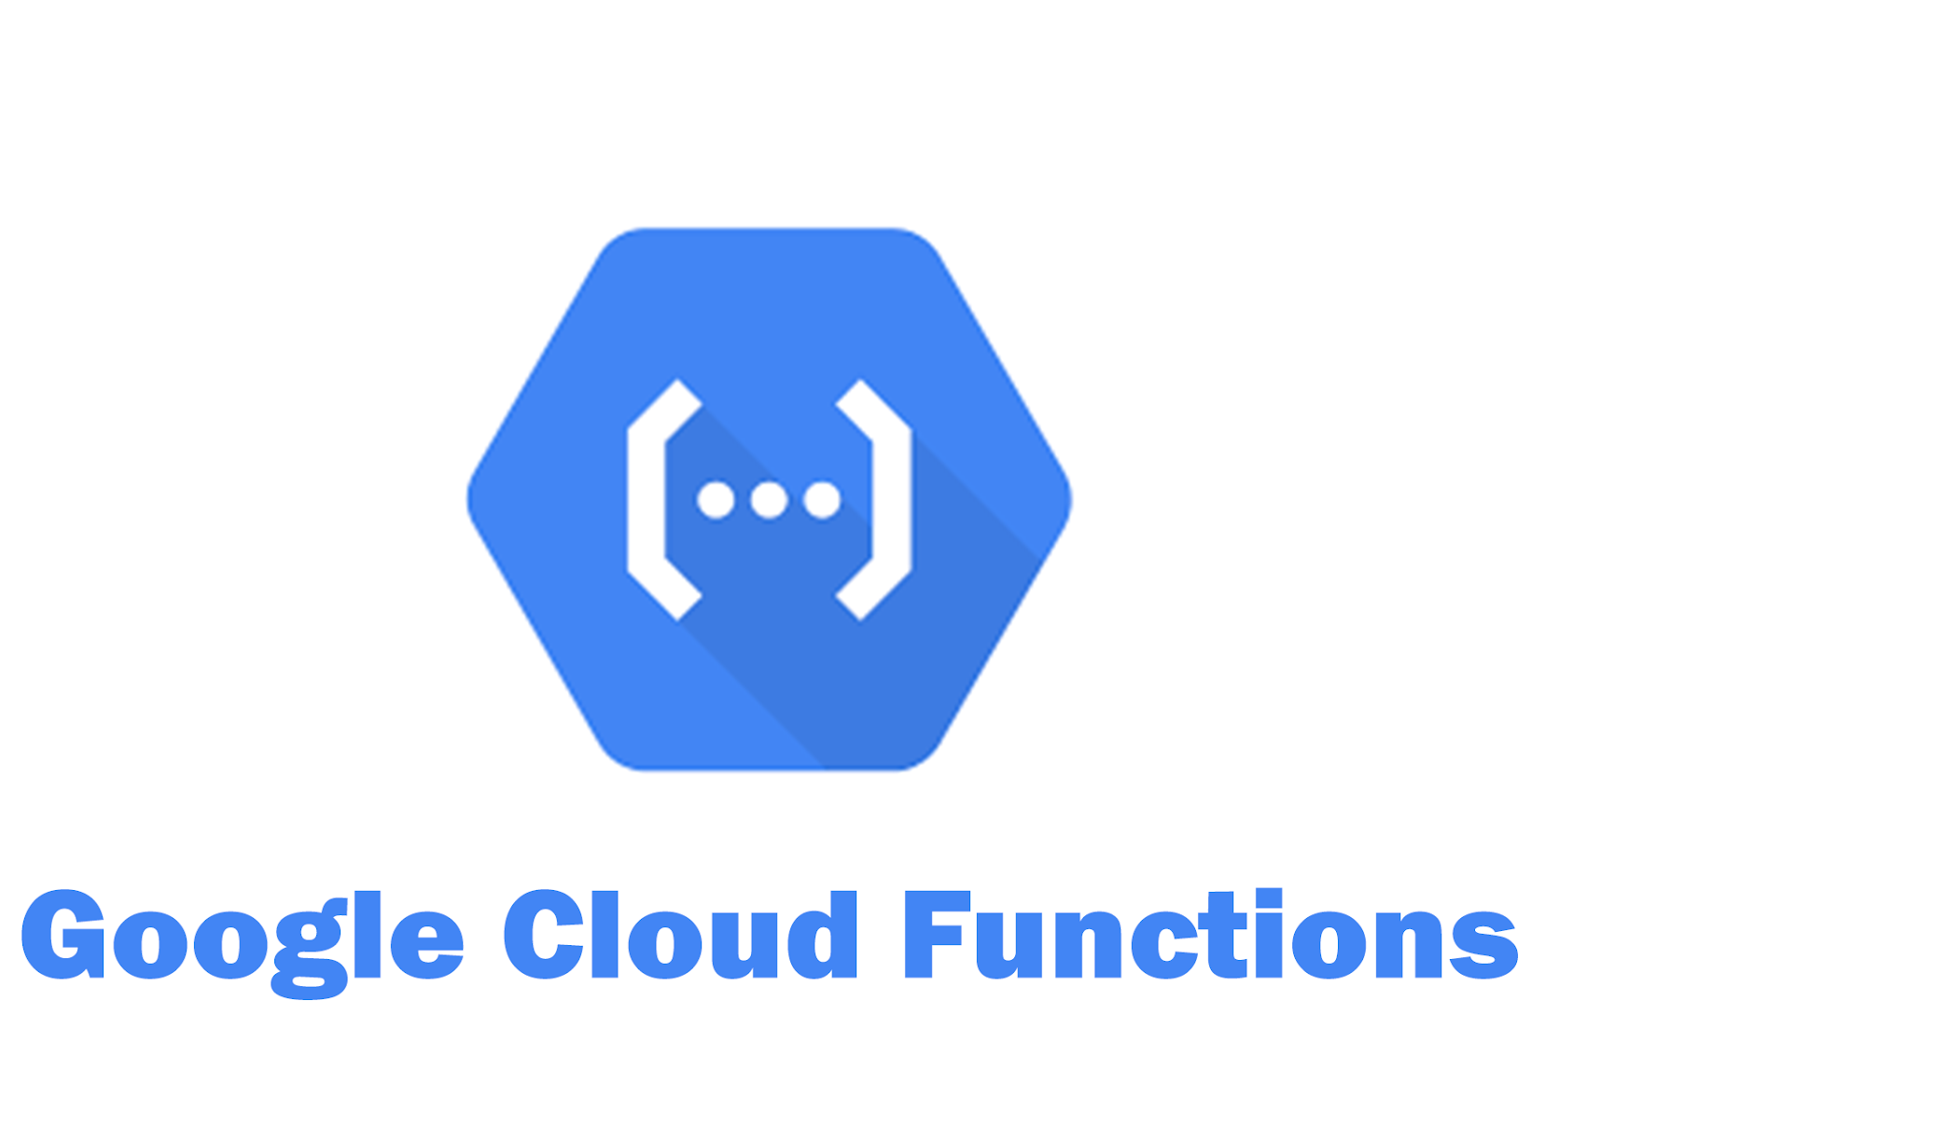

Slide 10


Slide 11



Slide 12
Thanks!

