Slide 1

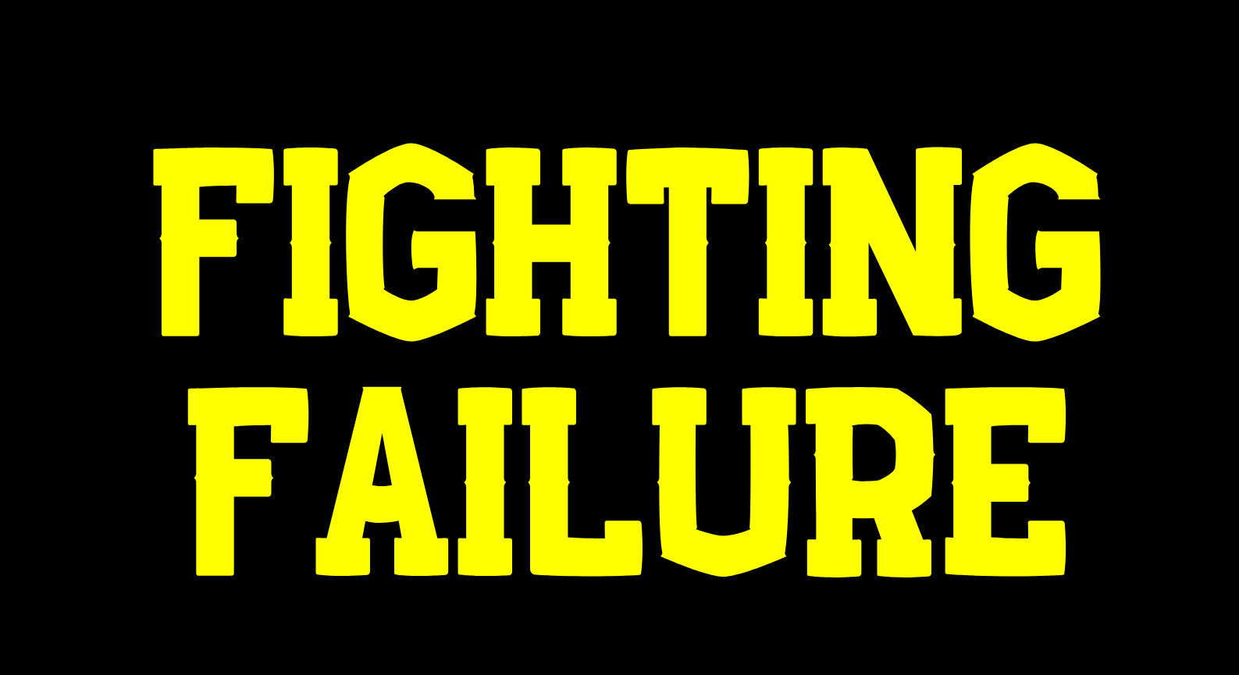

Redbrick presents...
By James McDermott
Notes:
Good afternoon friends, welcome to Redbrick’s week 9 talk - Fighting Failure. Yeah, week 9, it’s wild to think that we are three quarters of the way through this semester, I think I myself only have about 12% of my life in college left, that’s kind of sad, but I’m dealing with it.
Anyways, I digress - welcome to Fighting Failure - a non-tech talk given by a dude from a society which is very much so based in tech. I’m going to refrain from being too preachy- it’s kind of hard to talk about this topic and not come off preachy, just take what I’m saying with a pinch of salt.
Today is a kind of an open discussion, I’ll take questions throughout, don’t feel too intimidated to put up your hand in the middle of this event, I don’t bite, I’m pretty chill, I’m more than happy to answer - if you’ve a question just shoot.
So let’s get straight to and figure out who I am exactly and why I’m giving this talk.

Slide 2
today’s Format 🕒
I will talk for a bit.
You’re going to talk for a bit in groups.
We are going to talk about your group work.
Repeat.

Slide 3
who am i? 🧔🏻
System Administrator in Redbrick.
Final Year in Computer Applications.
50% culchie - 50% coffee
Notes:
My name is James McDermott, you can probably discern from my accent I’m not local to Dublin, I’m very much a country lad. Those in the room who know me will tell you I’m both a former Events Officer and former Chairperson of Redbrick, DCU’s Networking Society. So at the moment, I’m one of Redbrick’s three System Administrator’s, my role in Redbrick states I’m responsible for administration, security, and maintenance of the society’s computer systems.
My personality doesn’t stop there of course, in college as you may gather - I’m in Computer Applications, in fact I’m in final year. It’s a four year course, and I’ve been here for five years… we will talk about why that’s actually a good thing later on.
What else can I say - I like playing games, Pokemon is dope (for the most part), I play music, bass, drums, guitar, trumphet, a smidge of piano if I feel confident enough. I frequent a lot of gigs each month when I can afford it, and yeah I like coffee - to a rather unhealthy extent, and finally I hate the Irish rail services - these are all things you can hear more about on my twitter I swear outside of these topics I rarely talk about anything else.

Slide 4
who are you? 🤨
Notes:
So that’s me - who are you?
I suppose that’s rather vague - who here is doing computing?
Okay now who here is doing something other than computing? For those in the computer courses I’m going to widely assume you’re here because you’re here most week and this is another good ol’ Redbrick event. For my non computing friends - why have you come along today? Would you say the topic is - interesting to an extent? Well I think it’s really interesting. In fact - I spend a lot of my day pensively meditating on failure - it’s not actually as morose as it sounds, I just find it interesting. What I hope to achieve today is a large task - but all the same I’m going to try my best and normalise failure for you.

Slide 5
what is failure? 🤔
Come up with your own definition of failure.
Come up with four scenarios you constitute as a failure.
Notes:
So this is where we stop first today - I want people to get into groups of four. Getting into groups can be daunting, and there’s going to be quite a bit of it today so let’s start with a nice ice breaker, I want every group to come up with their own definition of failure and along with this I want them to come up with four scenarios you constitute as a failure. I’ll give you a few minutes.

Slide 6
what is failure? 🤔
Notes:
Failure is absolutely the most normal, common, everyday occurrence in this world. It comes in spades, it’s either really small or really big and we aren’t great at measuring it. You might think that I sound oddly upbeat about all this - I’m not. I think failure is an ugly word, which often puts unnecessary pressures on us, it’s a word someone else made to limit the scope of our view when it comes to performing tasks. What I mean to say is, it’s a word that acts as a blocker, failure often implies no recovery state, to further routes to success, you’ve reached a dead end and there’s often no way back, and if there is a way back, it’s a long tiresome road.

Slide 7
measuring failure 🧪
Notes:
We are really bad at measuring this stuff - by definition there is no standard unit, nothing to tell us how much we failed - nothing but us, because failure is totally subjective - remember, what some people see as failure, others don’t. Take me for example - I’m of the terribly obnoxious attitude that if I’m not the most worried person about something going wrong - it likely won’t go wrong. It’s totally fine. This is a rather lazy approach towards life, a little blunt, but it works for me, and when it comes to how you measure your success and failures you need to be totally comfortable in how you view them, you need to know just how relaxed you can be in the face of something potentially failing. This is easier for some than others, I understand that.
But as I’ve said, we don’t measure these things well - when a failure occurs we look inwards - What did I do wrong, what could I do better, why am I so bad at this. We really are not nice to ourselves - we should be more nice to ourselves, like scientists.

Slide 8

Notes:
Scientists, in a nutshell, view failure in the most possibly correct, logical and normal way. We all likely did some form of science in secondary school, I think. Ag Science counts too.
Anyways - let’s say a scientist is mixing two liquids together, liquid A and liquid B, which they hypothesize will form a hybrid in the form of liquid C. Well let’s say they carry out this merger and instead they end up with liquid D, it’s unexpected and somewhat upsetting that it didn’t working - but do they look inwards? Do they ask what they did wrong? No - because it’s an experiment. In experiments you’re allowed to get things wrong - likely a scientist will note the expected outcome versus what actually happened. They don’t invest the failure in themselves, but rather in the environment in which the failure occured.

Slide 9
Failures are blameless procedures.
Don’t invest failure in themselves.
Everything is a learning experience.
Notes:
In general a scientist treats a failure as a blameless procedure, they don;t invest the failure in themselves and everything is treated as a new learning experience. Now to say all failures are just experiements is trivialising the nature of failure - sometimes failure is on a much much larger scale.

Slide 10
keep it blameless ❌
Notes:
The first point is really important - the concept of keeping failures and accidents blameless. Mistakes are failures too. This is actually a good principal when working in teams if I’m honest. Some more traditionally minded businesses and organisations possess the cultural instinct to root out a mistake maker and punish them. What do we think of this approach - is it fair to create a culture where we point the finger at one and other? It’s fair to say that the course of action that involves rooting out mistake makers and punishing them has a lot of consequences. Most obviously, it creates incentives to confuse issues, hide the truth and blame others, all of which are ultimately unprofitable and unwelcome distractions. Therefore it is more profitable to focus on trying to recover from a failure, while also figuring out how to prevent such a thing from happening again. Like I said, this is a fair way to work in teams. You shouldn’t be out for anyone’s blood when they mess up because it creates a negative culture which spits in the face at the mere idea of transparency and communication, people obfuscate details. With this said obviously call out behaviour where you see it is unbecoming and unwelcome, but as a principal, keep failures blameless.

Slide 11
types of failure 📋
Macro-failures
Micro-failures
Non-failures
Non-failures Wins
Notes:
There’s a few types of failure - I break them up like this:
There’s macro-failures
There’s micro-failures
There’s non-failures (I just call these wins)
Let’s break here groups and talk about what each one might be and some examples
So what’s a macro-failure? Well, you stop breathing, you're in a car crash, you lose a best friend because you broke their trust - I consider those to be macro-failure, they are particularily tough to reverse - not impossible but tough. They are particularily extreme examples I’m aware, so how about this - macro-failures are failing exams, repeating the year, not getting you CAO points in the leaving certificate - all things that can be mentally tough to bounce back from.
Micro-failures occur all the time, for me they encompass everything from breaking my laptop to giving myself a papercut to I don’t know not getting a good nights sleep.
Finally yeah non-failures or wins, these are simply successes - the things that you did and went right. What is interesting is sometimes you can have macro-failures and micro-failures that over time turn into wins, it’s all about perspective. I failed second year of computer applications the first time around - at the time I though this was the worst thing ever, that there was no going back my life was ruined - I was a bit of a drama queen about it. In hindsight it is the absolute best thing that could have happened to me - I needed to mature, I wasn’t taking college seriously enough - so I took that year and did something with it, I improved my skillsets I started giving Redbrick talks, I became Chair in the that time after being a kick-ass events officer - that failure turned into a win - an most of them can with the right attitude. Here’s how I break it down - you are going to experience failure quite a bit - that’s just how it works.

Slide 12
how it be 🔥
More micro-failures than wins, and more wins than macro-failures.
Notes:
Here’s how I break it down - you are going to experience failure quite a bit - that’s just how it works. You should strive for the above principal - more micro-failures than wins, and more wins than macro-failures. Ideally you have as little macro-failures occur as possible, in time they might even turn into a win for you. You’ll never have more wins than micro-failures, but that’s a good thing because at the heel of the reel all micro-failures consist of are lessons to be learned, and that is a win in itself.

Slide 13
the bright side ☀️
Let’s try turn your failures into wins.
If the failures can’t be turned into wins that’s okay.
Notes:
Take your failures, try to see the bright side if there is one, see how over time this could be a successful thing to happen - if there isn’t such an outcome that’s okay too I’m not expecting anyone here to turn water into wine. Just take a few moments together and brainstorm. This is the last one today I promise.

Slide 14
remember! 👀
Failure is normal.
Keep failures blameless.
Reflection is important.
Failure can be fun 😮
Notes:
I’m just about done, I’ve really enjoyed today it’s been a little different so I just wanna run over the key things - failure is absolutely normal, it happens to everyone. Keep in blameless, for your sake and your team/organizations/friends - you want no barriers to communication. Cannot stress this one enough 0 reflection is so important - taking a moment to look at how you approach something and whether or not it was a good way to do it can yield the most interesting of outcomes, so keep perspective and reflection in mind. Finally, failure can be fun, it’s not all misery, if today hadn’t gone down well I’d get over it, I enjoy it while it lasted and it was something new for me.

Slide 15
thanks
❤️ ❤️ ❤️
Notes:
So on that note, thank you very much for listening! If anyone has any questions shoot - if you’d rather not ask in public just come up to me afterwards :)

