Slide 1
Linux Fundamentals
What you need to know

Slide 2
Today
Difference between the OS and the kernel
Run through the filesystem.
Do some handy command line stuff.
Notes:
Today
if you take one thing away from today, please let it be you know the difference between the kernel and the entire operating system.
People think these terms are interchangeable at the drop of a hat, sometimes they kind of are
But you;re best knowing exactly what is what
Going to look at the file system and it’s structure
specifically going to look at what’s going on in some of the top level dirs
Show you some great stuff on the command line, just as a way for you to move around the filesystem and know what is what

Slide 3
What is Linux?
a family of operating systems.
more specifically it’s an operating system kernel.
hopefully after today you’ll understand the difference.
Notes:
What is Linux
free and open-source software operating systems - highlighting what it means to be free and open-source
Typically packaged in a form known as a Linux distribution - distros, what are they, how are they different
to be more correct, Linux is an operating system kernel - what makes all these distros similar?
these operating systems are built around the Linux kernel
connects the application software to the hardware,
examples of these connections

Slide 4
The kernel, the shell and the operating system.
Think of an operating system as a seed.
The "kernel" of the seed is the core of the operating system, providing operating system services to applications programs.
All of this, is surrounded by the shell of the seed which is what users see from the outside. This is called "userspace".
Notes:
These terms to have quite a bit of crossover in fairness, yet they’re distinct from eachother
You’ll often year one of these words swapped out for another, incorrectly I should add.
The idea of a kernel and it;s relationship with the shell and the operating system is derived from a pretty simple metaphor

Slide 5
Kernel
interacts with CPU, handles memory and manages system hardware devices
all distributions use the same “Linux” kernel, though you’ll find variations here and there.
Notes:
The core of this seed, the kernel itself, has complete control over everything in the system.
one of the first progrms loaded on start up (after bootloader obvs)
Manages peripherals like keyboard, monitors, speakers,etc

Slide 6
Operating System
An operating system is the kernel plus userspace applications that enable users to get something done.
These include your compilers, text-editors, GUI, etc.
The differences you find between distros is on this level.
Notes:
Nothing super new, graphical desktops, system administrator commands,

Slide 7
Shell
provides an interface between the user and the operating system.
Shell != BASH
Notes:
We all know what shells are. allows user to run programs and tasks etc
The shell is within a collections of utilities known as GNU.
The shell will interact with these utilities and pass them along to the kernel
So without the Linux kernel the computer cannot run
without the GNU utilities it can't do anything useful
why operating system is sometimes called GNU/Linux..
quick note: there’s other shells. Most machines it’s BASH (windows linux subsystem, dcu login) but Redbrick login shell is called ZSH.

Slide 8
If you are not already booted into Linux you should do that now

Slide 9
Filesystem
FHS - File Hierarchy System
On a UNIX system, everything is a file; if something is not a file, it is a process.
Notes:
Linking back to earlier - the Kernel is the core program which manage system hardware devices and the shell provides user interface to run the commands.
These command are run throughout different parts the Linux file system
Usually known as the FHS, it’s structured in a hierarchical chain of subdirectories and files.
Important to understand - either a file or a process.
things lik documents, directories, hard-drives, modems, and printers and are just streams of bytes

Slide 10
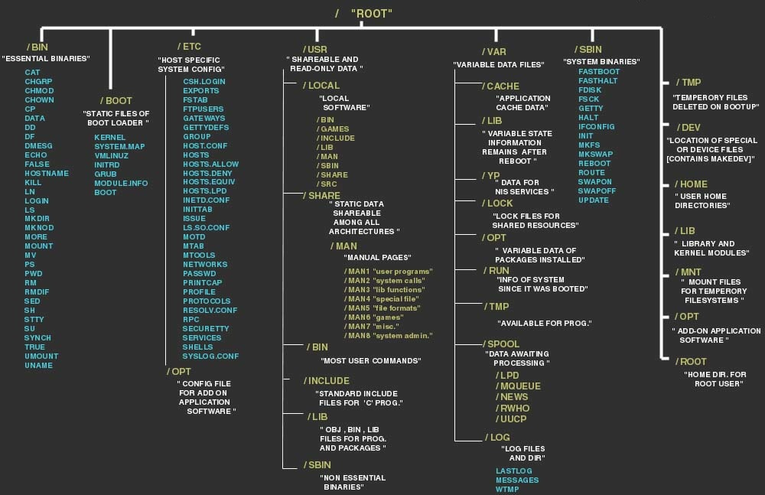

Slide 11
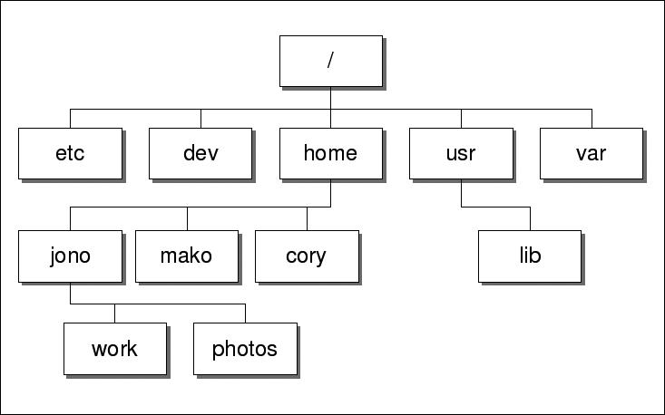
Notes:
/ … top-most directory, just the starting point where all branches come from
/etc … contains all system related configuration files in here or in /etc/sub-directories
/dev … is the location of special or device files (make reference to everything is a file or process here)
/home … aka login directory, where you end up when you login.
/usr … fucking huge amaount of data in here like user binaries, their documentation, libraries, header files, etc
/usr/lib … programming libraries and packages
/var … contains data that is changed when the system is running normally.
make reference to diff between /usr and /var - /var contains variable data whereas /usr should only contain static data.
WHAT isn’t in that diagram
/bin
/boot
/lib
/lost+found
/media
/mnt
/opt
/proc
/root
/run
/sbin
/srv
/tmp

Slide 12
Command Line Time
Notes:
echo foo
foo=bar
echo $foo
ls, ls -a, ls -l
mkdir myDir
cd
pwd
touch file.txt
ls
cp mcdermj7/share/file.txt file.txt
cd …
mkdir deleteME
cd deleteME
touch some.txt && touch some.py && some.c
exit codes … 0 = success 1 = general errors
echo $? shows you the code of your last command
rm some.txt
cd …
rm -r deleteME
find ~ -name file.txt (explain . and / too)
head file.txt
tail file.txt
cat file.txt > beemovie.txt
ls -l (permission time)
chmod 744 / chmod +x
wc, wc -w, wc -l, wc -c (file.txt)
grep “bee” beemovie.txt
grep with sort and less
grep “bee” beemovie.txt | wc -l
sed -i “s/original_word/new_word/” beemovie.txt
sed -i “s/original_word/new_word/g” beemovie.txt
top
htop
man grep (if it asks you which man age you want input one and hit return)

