Slide 1
HackerClub

Slide 2
Today...
is not a deep dive into OOP.
is a brief guide on OOP for problem solving.

Slide 3
Log into Kattis
When logged in search for “Take Two Stones”.
Open a new tab, and search for “pizza2” on Kattis.

Slide 4
Read it...
what is it asking you to find?
what data is it giving you to work with?
what objects can you identify in the description?

Slide 5
Find the nouns (objects and data attributes)
Alice and Bob are playing a new game of stones. There are N stones placed on the ground, forming a sequence. The stones are labeled from 1 to N.
Alice and Bob in turns take exactly two consecutive stones on the ground until there are no consecutive stones on the ground.
That is, each player can take stone i and stone i + 1, where 1 ≤ i ≤ N − 1.
If the number of stones left is odd, Alice wins. Otherwise, Bob wins.
Assume both Alice and Bob play optimally and Alice plays first, do you know who the winner is?

Slide 6
Eliminate duplicates
Alice and Bob are playing a new game of stones. There are N stones placed on the ground, forming a sequence. The stones are labeled from 1 to N.
Alice and Bob in turns take exactly two consecutive stones on the ground until there are no consecutive stones on the ground.
That is, each player can take stone i and stone i + 1, where 1 ≤ i ≤ N − 1.
If the number of stones left is odd, Alice wins. Otherwise, Bob wins.
Assume both Alice and Bob play optimally and Alice plays first, do you know who the winner is?

Slide 7
Classify
Alice and Bob are outputs, so we can call them attributes of the object.
The number of stones is the input so we can call it an attribute also.
The object these are all attributes of is the game. The game has players (Alice and Bob) and a sequence of stones.
The word ground can disregarded in this question.
Finally, our object needs a winner, which will be either Alice or Bob.

Slide 8
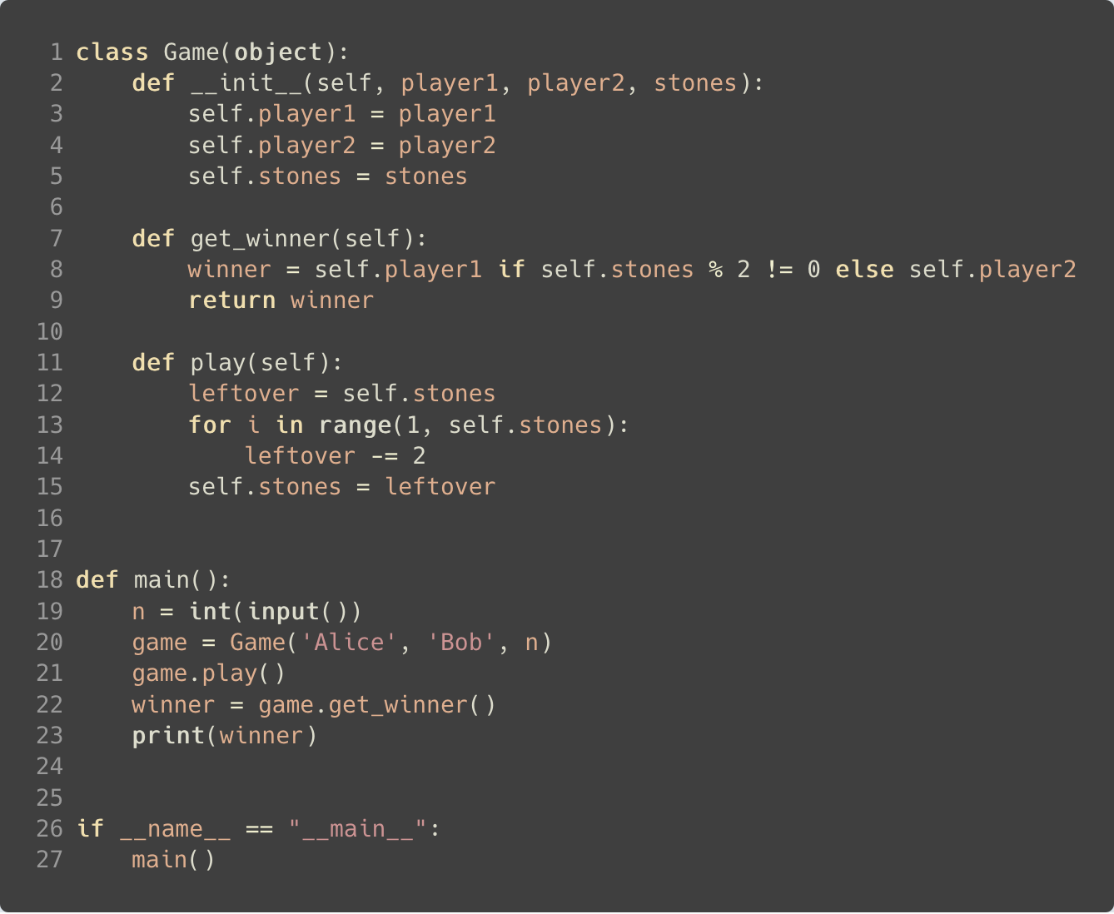
(1.) The game uses 3 pieces of data, player1 (Alice), player2 (Bob), and the number of stones (n).
We initialize the object using the data.
(2.) Calling .play() on the new game object will trigger an algorithm which follows hte rules specified in the problem description.
(1.)
(2.)
(3.) Finally we judge the winner on how many stones are leftover.
(3.)

Slide 9
Questions?

Slide 10
With that done...
Move onto your other tab, and try the “pizza2” problem.
I have a solution so… it can be done.

