Slide 1
Another Intro To Git
How you can learn to love version control.

Slide 2
Our journey
Brief introduction to git.
I’m going to explain some of the fundamentals of git.
I’ll give you a demo.
Then it’s your turn.

Slide 3
Pretext
Software tends to be written by more than one person.
At any given time, different people will be working on different features. Many changes are being made at once.
There needs to be a way to maintain the original source code while working on these features.

Slide 4
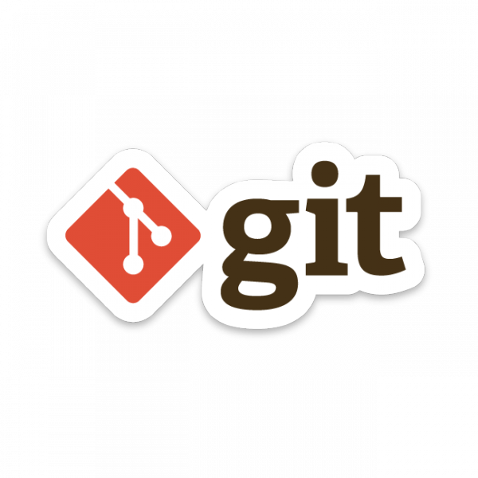
What is Git?
Git is a distributed version control system.
Designed to handle everything from small to large projects.
Created by Linus Torvalds in 2005.
Created to aid the development of the Linux kernel.

Slide 5
What is version control?
Designed to handle everything from small to large projects.
Users keep entire code and history on their local machines.
User can make changes to the codebase without Internet Access.
Except for pushing and pull (but we will get to that later).

Slide 6




Other Version Control Systems?
Yes there are.
We don’t talk about them.

Slide 7
How does git work?
Can be complicated at first. There’s a lot to git.
We are only going to touch on a few key concepts.

Slide 8
Repositories (repos)
The structure which contains of all the files in your project.
Sites such as Github and Gitlab provide free hosting of repositories.
Redbrick has our own hosting service known as Gitea, found at https://git.redbrick.dcu.ie/mctastic

Slide 9
Repositories (repos)
Repos consist of:
all your additions to the project.
the history of how the project has changed over time.
How does git track all this?

Slide 10
Snapshots
Git records what all your files look like at a given point in time.
You decide when to take a snapshot.
You decide what files are included in this snapshot.
How do we take this snapshot?

Slide 11
Commits
The acting of making a snapshot.
A commit can be seen as a change or addition to the repo.
Repos are made up of snapshots, i.e, commits.
What is a commit made up of?

Slide 12
Commits
Commits consist of:
Info on how the files have changed.
A reference to the previous commit, i.e the “parent commit”.
Hash code, e.g - f449c4a98675d4bcba42600b3366df977c1bf44d

Slide 13
Quick Recap
What is version control?
What are repositories?
What are repositories made up of?

Slide 14
Copying Repos
Repos can live on local machine or remote server.
Cloning = copying from the remote server to your local machine
Cloning allows teams to work together

Slide 15
Time to use git
Login on git.redbrick.dcu.ie with your Redbrick username & password.
Go to https://git.redbrick.dcu.ie/mctastic/git-tutorial

Slide 16
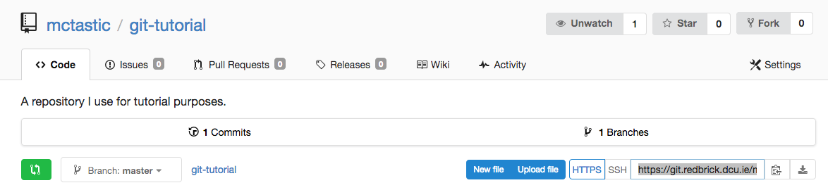
Time to use git
Copy this link
Open up your terminal.

Slide 17
Time to use git
In your terminal type:
git clone https://git.redbrick.dcu.ie/mctastic/git-tutorial
You now have a local copy of the remote repository.

Slide 18
Lets run it
In your terminal type:
make build
java Factorial 4
We have a test for Factorial.java, let’s run it with:
make test

Slide 19
We have an extra file
Some files are generated when you compile a program.
Typing:
git status
Shows us which files have been changed/created.

Slide 20
We have an extra file
We seen that we have a new file called Factorial.class, we want to ignore this.
We make a new file called .gitignore, and inside this file we put the line:
* .class
This ignores all files ending in .class

Slide 21
Pulling
When remote repo commits > local machine commits.
You can’t add anything new until you pull the remote changes to your local machine.
Pulls remote changes to local machine.

Slide 22
There’s a new commit
In your terminal type:
git pull
This adds the newly added pythonTest.sh script I committed to your local repository

Slide 23
Now what happens when we run our tests?
In your terminal type:
make test
The tests fail, because there is no python script called factorial.py, we need to add one.

Slide 24
Pushing
Adding your local changes to the remote repo is called pushing.
Takes place after staging and commit your changes.
Push local changes to remote repo.

Slide 25
Add factorial.py
Now it’s your turn. Write a working version of factorial.py
When you’ve written a working version of factorial.py, do the following:
git add factorial.py
git commit -m “created factorial.py”
git push origin master

Slide 26
Questions? ( feedback )

