Slide 1

in student networks
By James McDermott (mctastic).
System Administrator @ Redbrick DCU.

Slide 2
Student Networks?
Notes:
Student Networks, well what is a student network. Redbrick is an example of a student network. Can I get a quick show of hands to see how many people in this room have heard about Redbrick before today? Simply but yeah Redbrick is the networking and computing society in DCU. Redbrick has a core membership which sign up every year. For these members, Redbrick run various educational events and workshops on just about everything. We also have companies come in and give talks about things like internal infrastructure and culture (talk to me after if you wanna know more about that) But, first and foremost, Redbrick is a network, and it provides members and indeed other societies around DCU with many services, so for example free web spaces, dev spaces, things like mail, a self hosted git, so on and so forth.I’m a System Administrator in Redbrick so I know a little bit about running this shit. So very quickly I’m going to run through how redbrick utilises python for the greater good, and you know, sometimes for the very bad.

Slide 3
useradm
Notes:
So we start with the very very bad Useradm is our internal LDAP tooling, a nice wrap around searching, adding, removing and modifying LDAP user entries. For years it definitely made the life of a sys admin easier, and to a degree it still does.

Slide 4
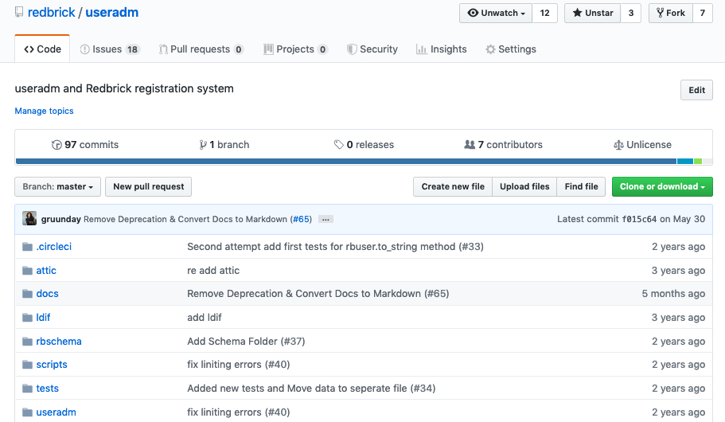
Notes:
But with that said, it’s a headache. It was and is still written in Python 2.7 which is you know on the actual brink of dying a long death. You can even see above that most changes made actually date back 2 or 3 years ago. A long time ago useradm under went a rebase, and a lot of the functionality was lost and no one ever rectified this. So the useradm binary installed on our machines actually contains a lot of features that aren’t in the code base on github at all.
So it’s not very maintainable is it? How do we fix that? Well, you could reverse engineer the binary and cast some spells and see if that works - or you could just you know pay attention to all these red flags and do the sane thing and write a new user management tool. That’s what we are doing and there was a lot of discussion around what to rewrite the tool in, and we decided Python3. In DCU first years all learn Python as their first language, and have modules in Python right up until final year. It’s quite likely the person that comes after me will be more familiar and comfortable with Python than they would be with any other language, so from a maintainability point of view, it makes sense to rewrite our new tooling in Python.

Slide 5
brickbot
Notes:
Brickbot is a bot redbrick runs in it’s discord server. Redbrick does also still run an IRC instance, but the new kids on the block don’t take to IRC as well as the likes of a discord and we need to retain members.

Slide 6
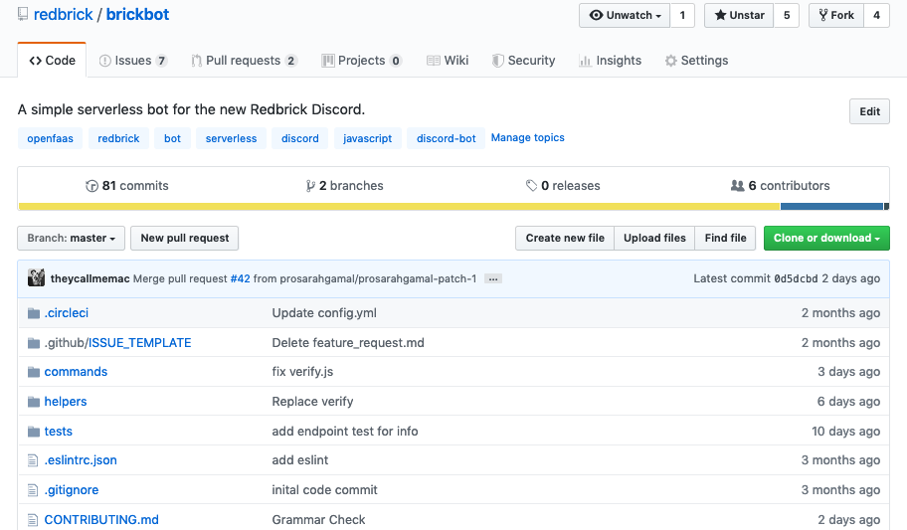
Notes:
Birckbot is mainly written in NodeJS… so why am I talking about it? Well yeah there’s a tiny bit of python visible up there, that’s actually all the testing but that’s not even what I’m going to talk about. Brickbot is written in NodeJS and surprisingly a lot of it’s functionality is written in Python by the likes of myself and members looking to add functionality to it! How can this be? Well it’s kind of a cheating answer, but the answer is serverless.

Slide 7
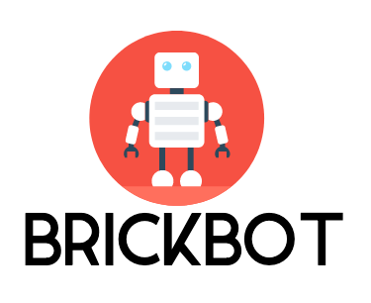


brickbot
Notes:
Okay that’s a bit vague. The answer is OpenFaaS - how many people in this room have heard of OpenFaaS? You can think of it like AWS Lambda’s but self-hosted. It also comes free from the language and file size restrictions of lambda’s too.
Without getting too bogged down in the details, OpenFaaS is a way to turn any docker container into a serverless function. Why build a bot this way? Why add another layer to it? Well it means that all I actually have to do is make http requests to the function. I think that’s pretty simple. It also means that you can extend functionality of the bot with whatever language you want. There’s actually very little restricting you from contributing. So a lot of this functionality here is also Python.

Slide 8
rbvm
Notes:
Okay now to the good but untainable code we have in Python rbvm - redbrick virutal machines, started off as a fork of lib-virt, became something small and practical.

Slide 9
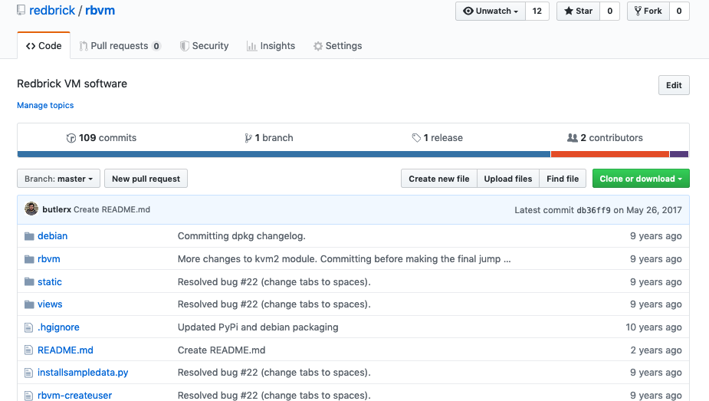
Notes:
Rbvm is the old vm provisioning software and by old I mean really old look up here it literally says 9 or 10 years since any changes.

Slide 10
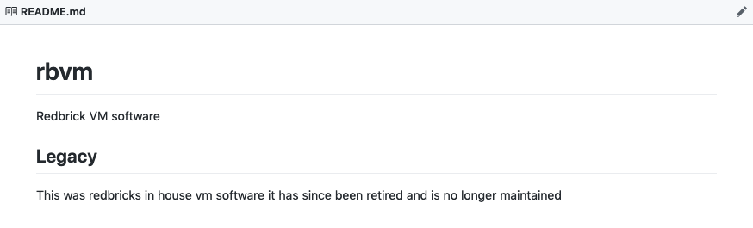
Notes:
So yes you can imagine that it was retired a long time ago, and the reason why isn’t actually that clear to me. So why am I showing you something that has been deprecated?

Slide 11
Does Python have a future in student networks?
Notes:
Because it’s getting a rewrite. Quite likely in Python, because Redbrick is currently building for the future, and likes of Python have a huge place in what the future looks like, specifically as I’ve outlined in our tooling. Redbrick is trying to change the way student networks operate. Web spaces, dev spaces and mail services are all good and well, but that’s been on offer since the 90’s and we want to try something new. Redbrick is currently midway through an re-infrastructure project, the details of which I sadly don’t have time to get into. Our plan is to migrate from the ad-hoc model of yesteryear to a infrastructure as code based small private cloud provider exclusively for DCU computing students. We want to provide students with things like functions as a service, VM’s on demand, and Databases on demand. Cloud services for students, by students. Much of this and indeed the new internal admin tooling is to be written in Python. So, does Python have a place in student networks? In short yes, it’s definitely maintainable for years to come, that is until DCU decided to teach students something else. Until that time though, while it doesn’t scale the best, it can still be used to build reliable tooling.

Slide 12

Thanks!
Email: mctastic@redbrick.dcu.ie
Twitter: theycallmemac_ Github: theycallmemac
Notes:
If you want to get in touch with me here’s my details. If there’s any time left for questions I’m happy to answer, but other than that, thanks for listening!

