Slide 1
Summer
A Redbrick Guide To Upskilling
Notes:
Hi I’m James McDermott. You might remember me from events such as “Automate & Chill”, “Linux Fundamentals”, “BASH Scripting”, and “SISTEM”. Today, we are talking about summer time, and what you should do with it.
Ideally, this talk doesn’t need to be given at all, but if you’re anything like me, you’re kind of lazy and you like to chill and.. I dunno, play fortnite or something... whatever the kids are doing these days.
So anyways…
It’s a bit of an unorthodox talk in ways, but look it’s actually something that you can take stuff from

Slide 2
What do you do with Summer?

Slide 3

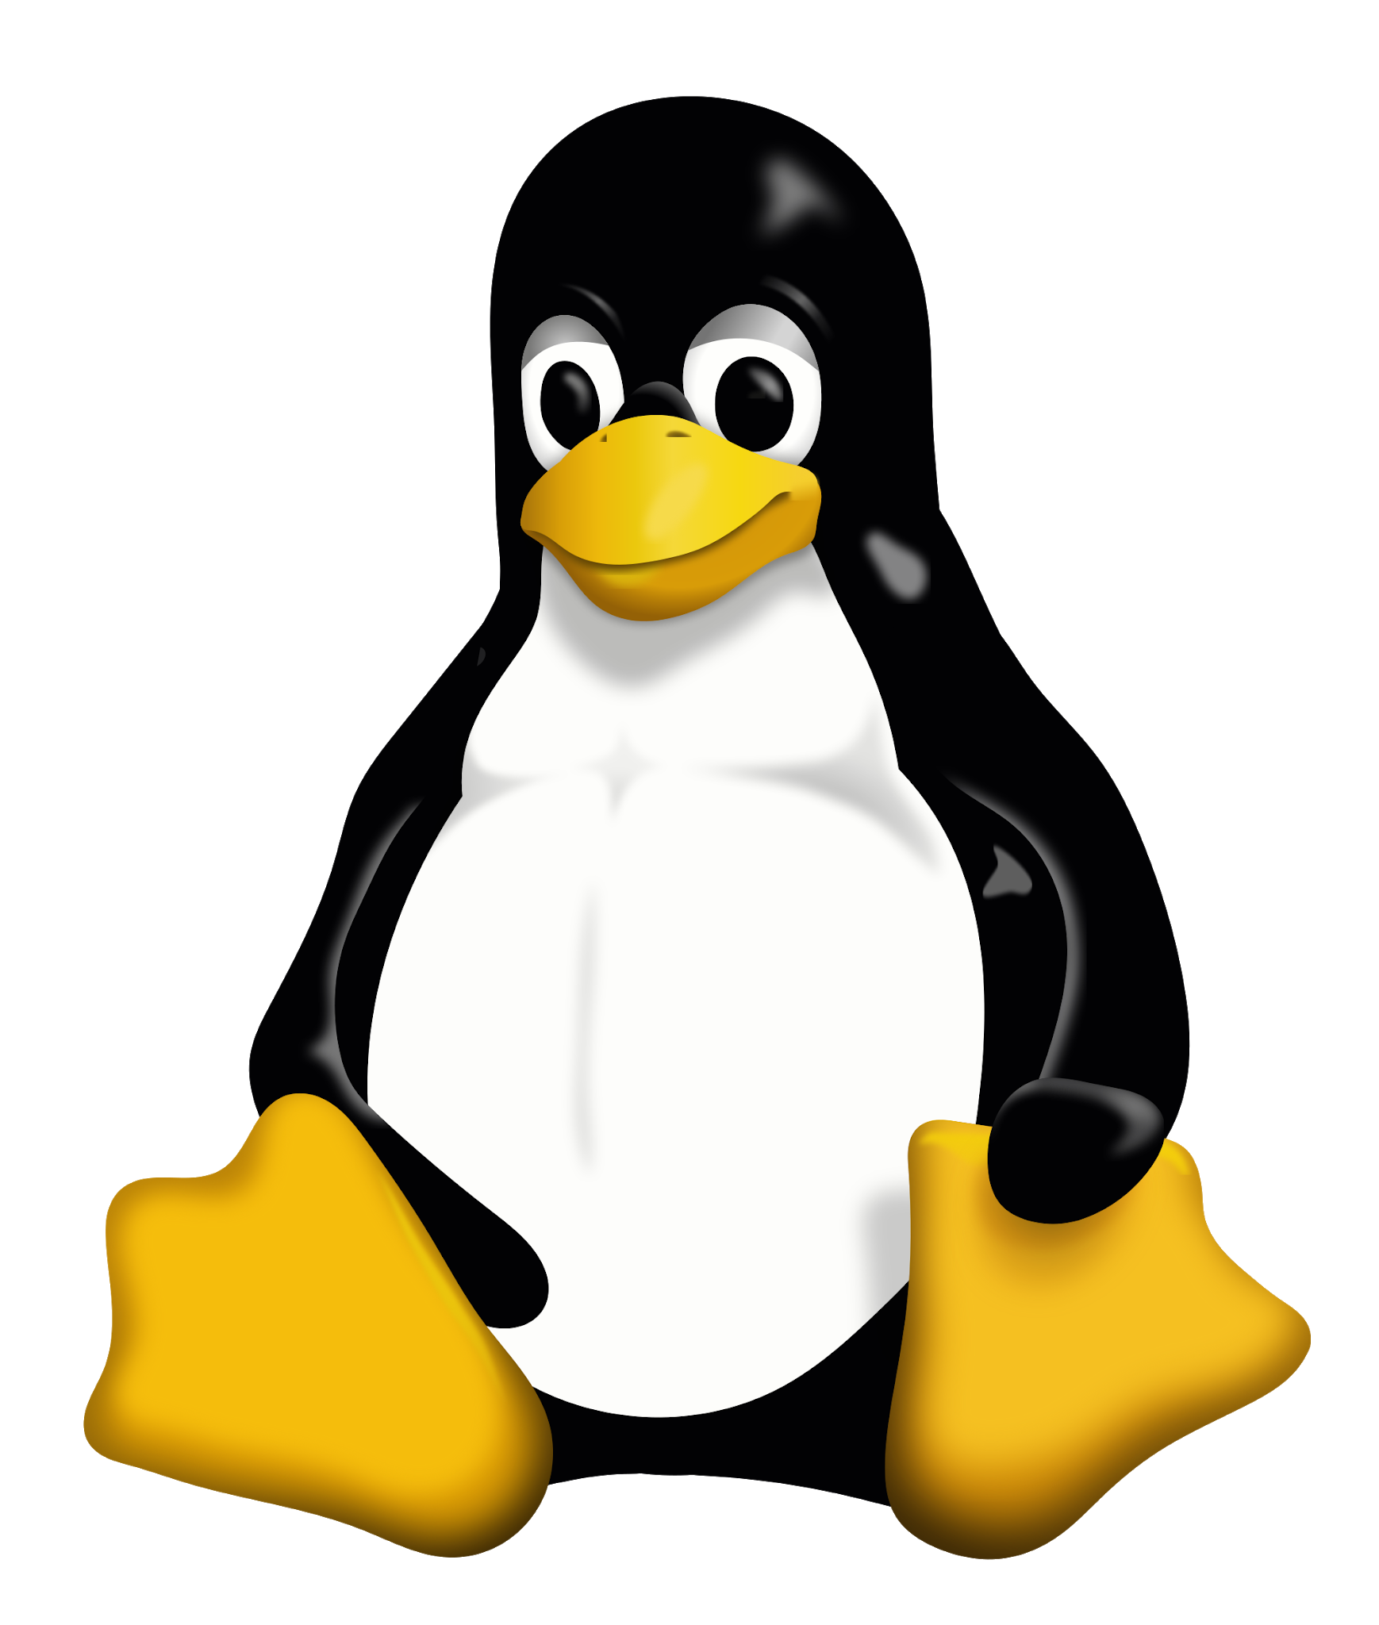



Stay in touch with
Python
Linux
Stuff we did in Redbrick

Slide 4
Python

Slide 5
Linux

Slide 6
Git

Slide 7
The things we covered

Slide 8
Wanna do more?
You can learn about stuff you do next year
You can learn about stuff you’ll never do in college

Slide 9
Second year
Second year is hard.
First semester you have three new “languages” to learn
Second semester has three more new languages :(

Slide 10



Starting off second year...
Prolog
MySQL
32-Bit Assembly

Slide 11
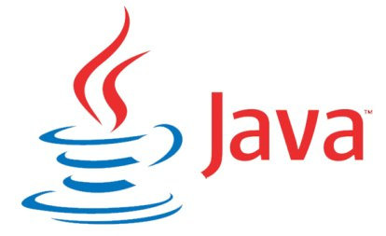

After Christmas..
Java
R
64-Bit Assembly

Slide 12
Resources for Second Year
Java → Understanding OOP with Java (Timothy Budd)
Prolog → The Art of Prolog (Leon S. Sterling & Ehud Y. Shapiro)
R → http://cyclismo.org/tutorial/R/

Slide 13
Third year
It’s quite diff
Very conceptual and theory based in first semester
Project takes the front seat in second semester.

Slide 14
Learning something new
This section is very open to interpretation.
It depends what you want to do.

Slide 15
Learning something new
Shell
C#
Java
C
Go
Swift
Prolog
R
PHP
Javascript
Haskell
Ruby
Assembly
Objective-C
Typescript
C++
Rust
Clojure
MySQL
Elm
Kotlin

Slide 16
Scenario 1: I’m afraid to move away from my dear Python!

Slide 17

Scenario 1: I’m afraid to move away from Python!
Go

Slide 18

Scenario 1: I’m afraid to move away from Python!
Ruby

Slide 19
Scenario 2: I’m ready to move away from Python
Notes:
So what about those who are ready to move away from Python? Who have no apprehensive bone in their body, and no fear of taking the plunge into a new territory?

Slide 20

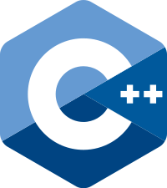
Scenario 2: I’m ready to move away from Python

Slide 21




Yes there are other languages...
Haskell
Rust
Swift
Kotlin

Slide 22
Scenario 3: I want to build stuff

Slide 23
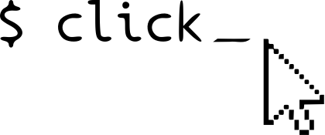
Scenario 3: I want to build stuff
Click
Notes:
There is of course then something else entirely
The world of functional programming
functional programming is a programming paradigm—a style of building the structure and elements of computer programs—that treats computation as the evaluation of mathematical functions and avoids changing-state and mutable data.
It is a declarative programming paradigm, which means programming is done with expressions[

Slide 24
Scenario 3: I want to build stuff
BeautifulSoup
Requests
Selenium
MechanicalSoup/Mechanize
Notes:
There is of course then something else entirely
The world of functional programming
functional programming is a programming paradigm—a style of building the structure and elements of computer programs—that treats computation as the evaluation of mathematical functions and avoids changing-state and mutable data.
It is a declarative programming paradigm, which means programming is done with expressions[

Slide 25

Scenario 3: I want to build stuff
Django

Slide 26
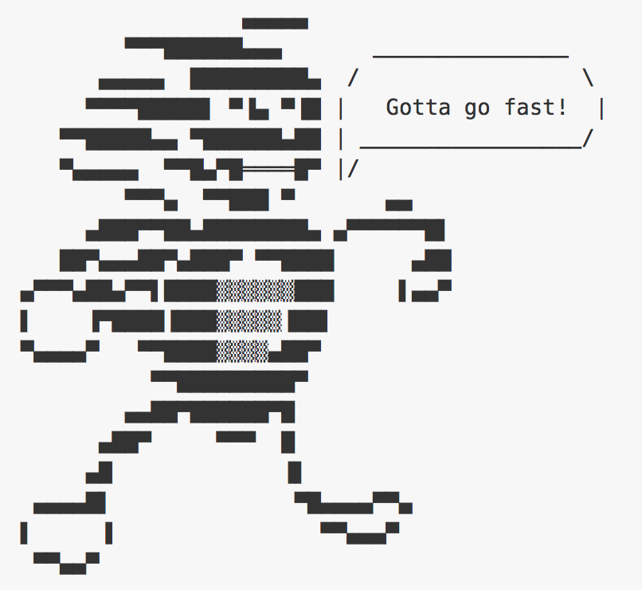
Scenario 3: I want to build stuff
Sanic

Slide 27





Scenario 3: I want to build stuff
Of course, there are just too many to name

Slide 28
Scenario 3: I want to build stuff
https://github.com/kamranahmedse/developer-roadmap/tree/master
Notes:
REACT & VUE MENTION HERE

Slide 29
Projects...
You do one in Third Year
Starting your own personal projects is no harm

Slide 30
Project Ideas
Facebook, Twitter, Reddit Bots
Write your own interpreter
Your personal site (possibly a static site)
Find something that annoys you

Slide 31
Project Ideas
https://github.com/tuvtran/project-based-learning
https://github.com/karan/Projects

Slide 32
Questions?

