Slide 1
BASH
Seizing The Memes Of Production
Notes:
Speaker order:
Intro: Terry
1st iteration: James
2nd: Terry
3rd: James
4th: Terry
5th: James

Slide 2
Bash
Unix Shell & Command Language
Bourne Again Shell
Written by Brian Fox in 1989 to replace the Bourne Shell
https://www.gnu.org/software/bash/
Notes:
What is a shell? -> It's the prompt you get in the terminal.
Command language -> lets you write scripts to automate common tasks
Bourne again -> born-again
Primary login shell in most Linux distributions as well as macOS. Recently, there was a Microsoft Windows version
Commissioned by the FSF. They thought it was so important to a completely free operating syste that they funded it themselves.

Slide 3
Meme Generator Script
Stripped-down version of this script we found
Original author: Navan Chauhan (github.com/navanchauhan)
Generates memes using https://memegen.link/
Source code: https://git.redbrick.dcu.ie/tbolt/bash-talk-2018
Notes:
Encourage audience to visit memegen.link and play with it to see how we might use their API.
It's all in the URL.
We'll be showing step-by-step progression of how to build this script. We'll be going around to help everyone, and the source code for each iteration is available at that link.

Slide 4
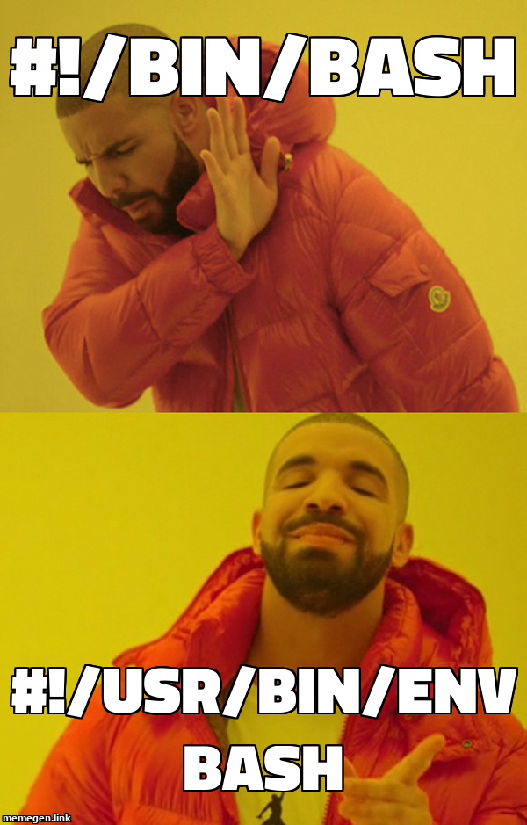

Slide 5
First iteration
Prompt user for meme information
Variables
Fetch meme using curl
File redirection
Notes:
We are going to be dividing this talk into 5 different sections or iterations. If I was you, I’d have a file per iteration, you see every iteration is going to work, they’re all just going to be a little better than the previous version in terms of usability and functionality.
So let’s get started, I want everyone here to power on there machines and fire up a terminal.
We all ready?
Okay so real quick, in this first iteration we will be going over a few things in particular. Firstly you’ll be seeing how to take user input with BASH, and furthermore you’ll see how variables work.
Then we are going to look at curl, curl is a tool to transfer data from or to a server, We are going to use it to get data from the memegen link, which we will have completed with our variables.
There’s a thing you may or may not have heard about called file redirection, it’s a main feature of bash, basically it allows you to direct where your stdout and stderr goes, generating new files in the process. Here we are just directing the output of curl to a file called meme.jpg

Slide 6
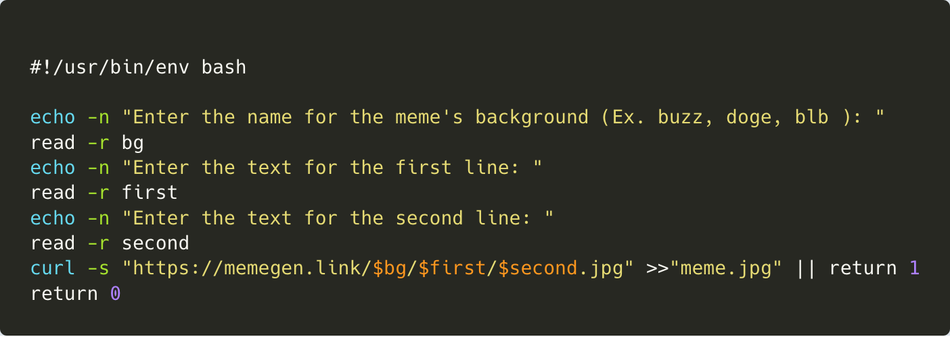

Slide 7
How to run your script
Save your script as meme.sh
On the command line run chmod +x meme.sh
Run ./meme.sh on the command line.

Slide 8
Second iteration
Let the user change the file name
Give a default file name if they don't provide one
Conditionals
Notes:
If statements have a weird syntax in bash compared to other languages.
The condition is surrounded by two square brackets and followed by a semicolon and the "then" keyword.
Every block statement in bash, such as if and case, is closed by the keyword backwards: fi, esac, etc.

Slide 9
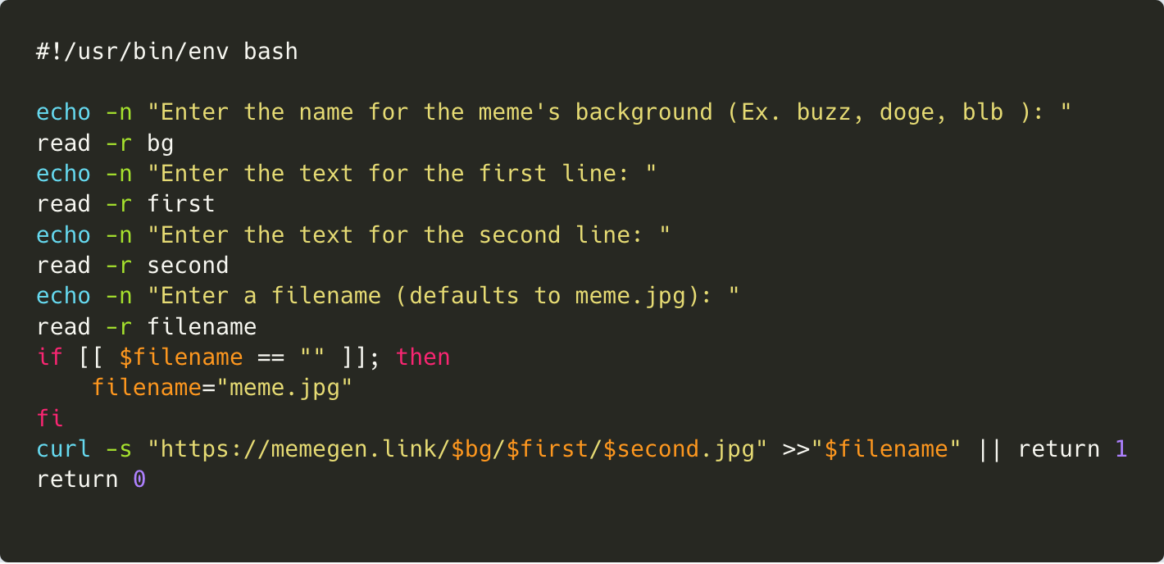

Slide 10
Third iteration
Make the program "scriptable"
But first we need a main function
Notes:
Now yeah, we have a working script, but it’s not scriptable. For something to be scriptable we mean that it can be extended or automated through scripting.
User input is fine, but we’d rather just fill in the meme information as command line arguments. That way it’s all on the one line, making it easier for someone to use. In all, we are just reducing the wait time the exists between you and your meme.
We use functions to separate blocks of code, it’ll make more sense as to why this is done in the next iteration of our program.

Slide 11
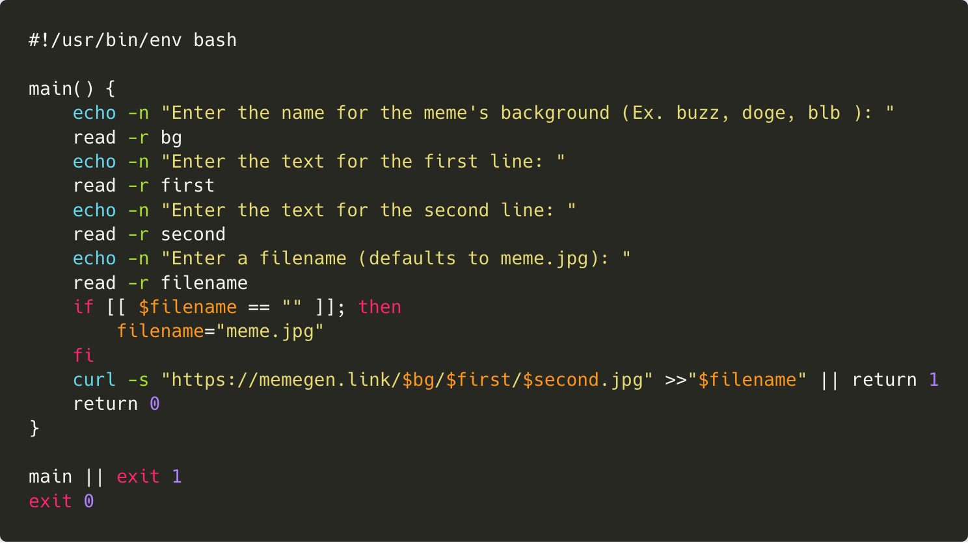

Slide 12
Fourth iteration
Make it only prompt the user if it has to
Add arguments using getopts
Notes:
If we're going to make it scriptable we're going to add arguments.
For each of bg, first, second, etc. we have to check if they aren't already filled by a command line argument.
So we add if statements to check if they're equal to the empty string and only if they are we prompt the user.

Slide 13
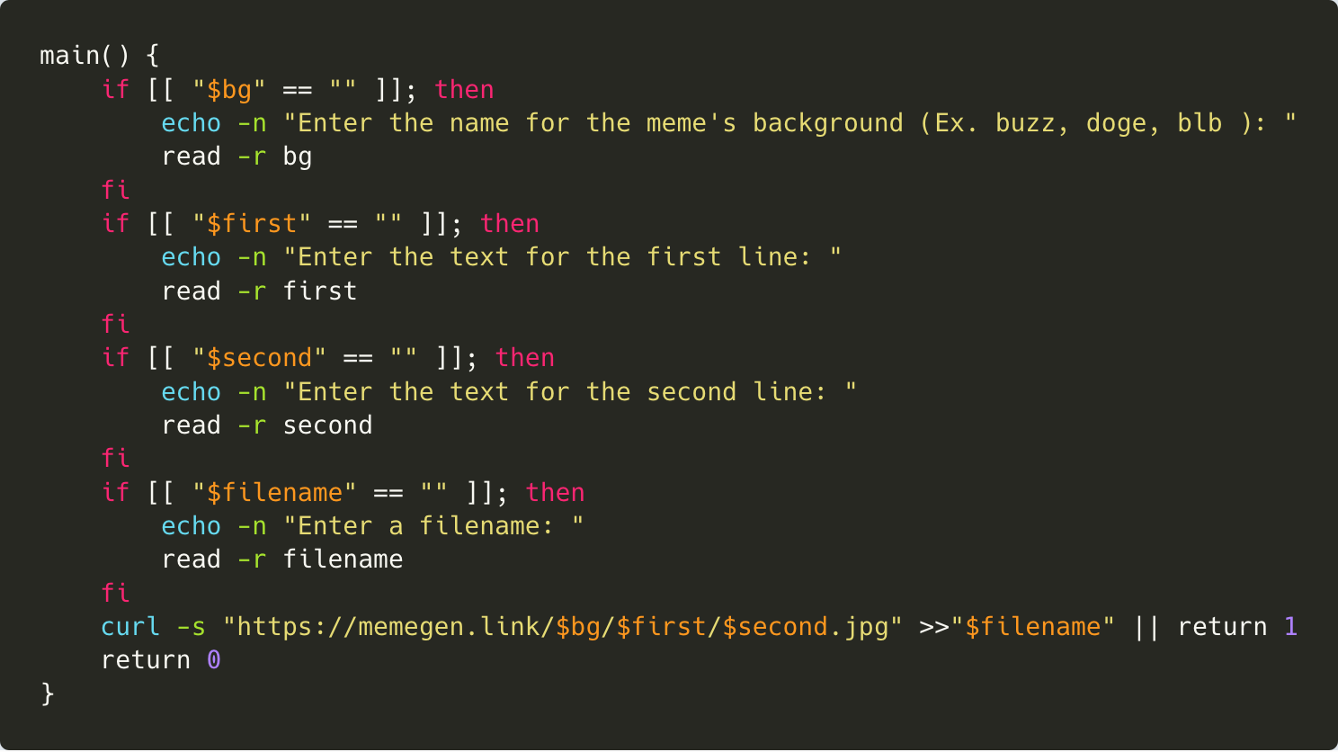

Slide 14
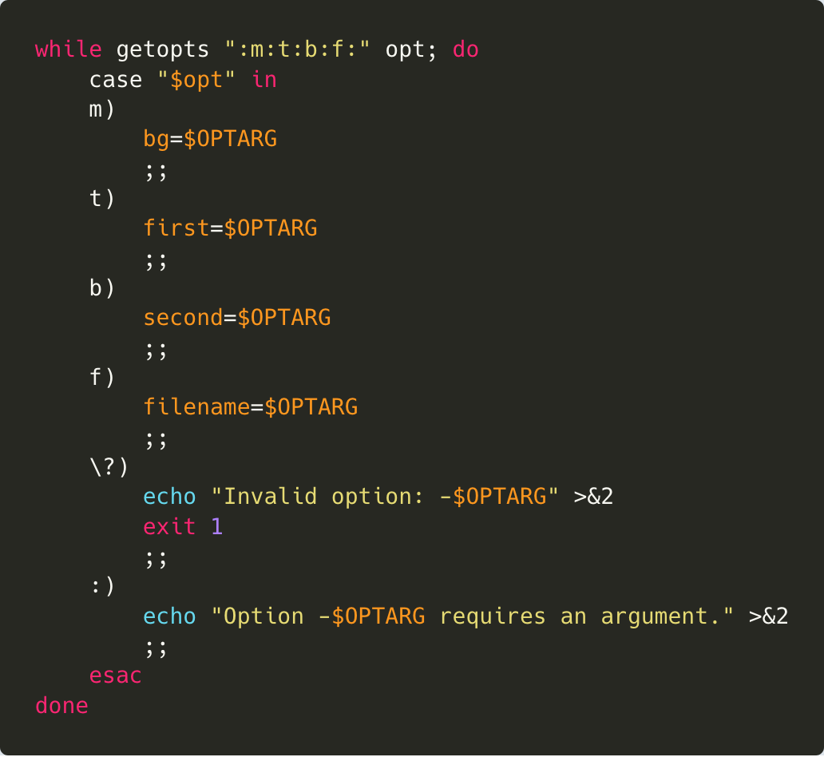
Notes:
getopts is an unusual but very powerful way of parsing command line arguments
a colon at the start disables the default error message - we'll be supplying our own
a colon after an option means that option has a required argument
the question mark is set when an invalid option is given
the colon case is set when an option requires an argument but no argument is given (smiley face)
>&2 means send to standard error

Slide 15
Final iteration
Usability
Usage string
Cat and EOF
Swapping out curl for wget
Notes:
So now it’s working with more functionality. Now we need to provide a section telling the user how to use the script. any good bash script has a help section, and this is a somewhat good bash script.
First off we are going to add a new option, -h which calls a new function we are going to write.
This new function is going to be called “usage”.
The CAT - EOF syntax is very useful for writing out these help sections. This syntax is going to introduce you to a handy way of working with multi-line text in BASH.
We are swapping out curl for wget. wget, for now, you can see as just another way of retrieving content from web servers.
We are swapping from curl to wget for two reasons, curl doesn't escape spaces, while wget does.

Slide 16
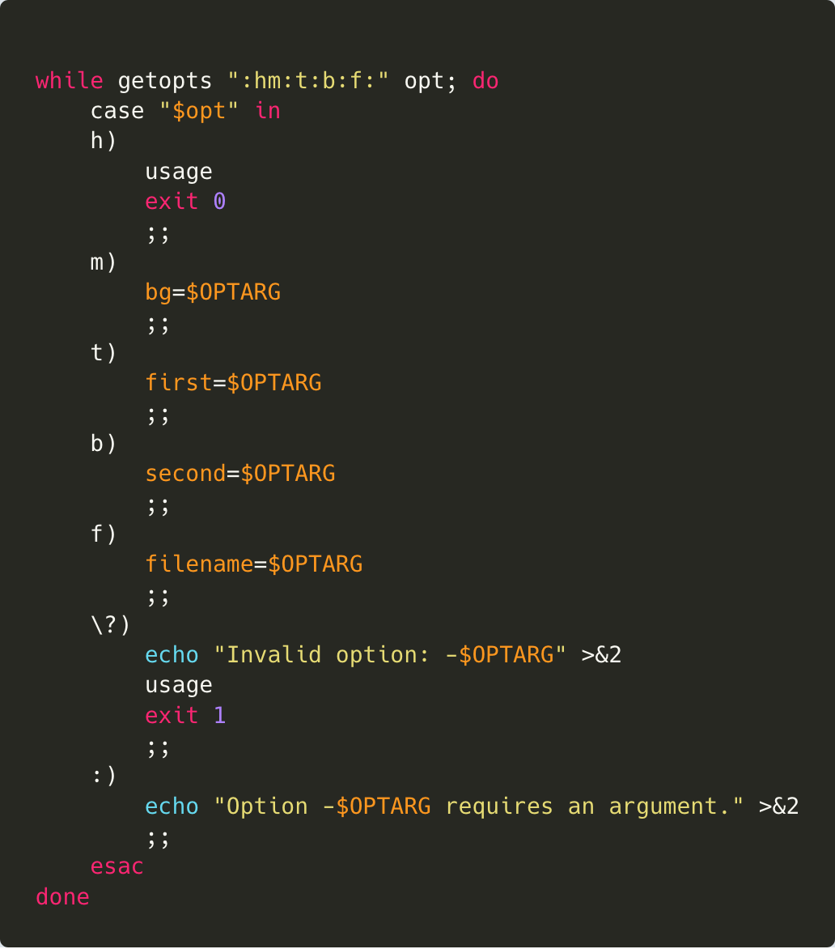

Slide 17
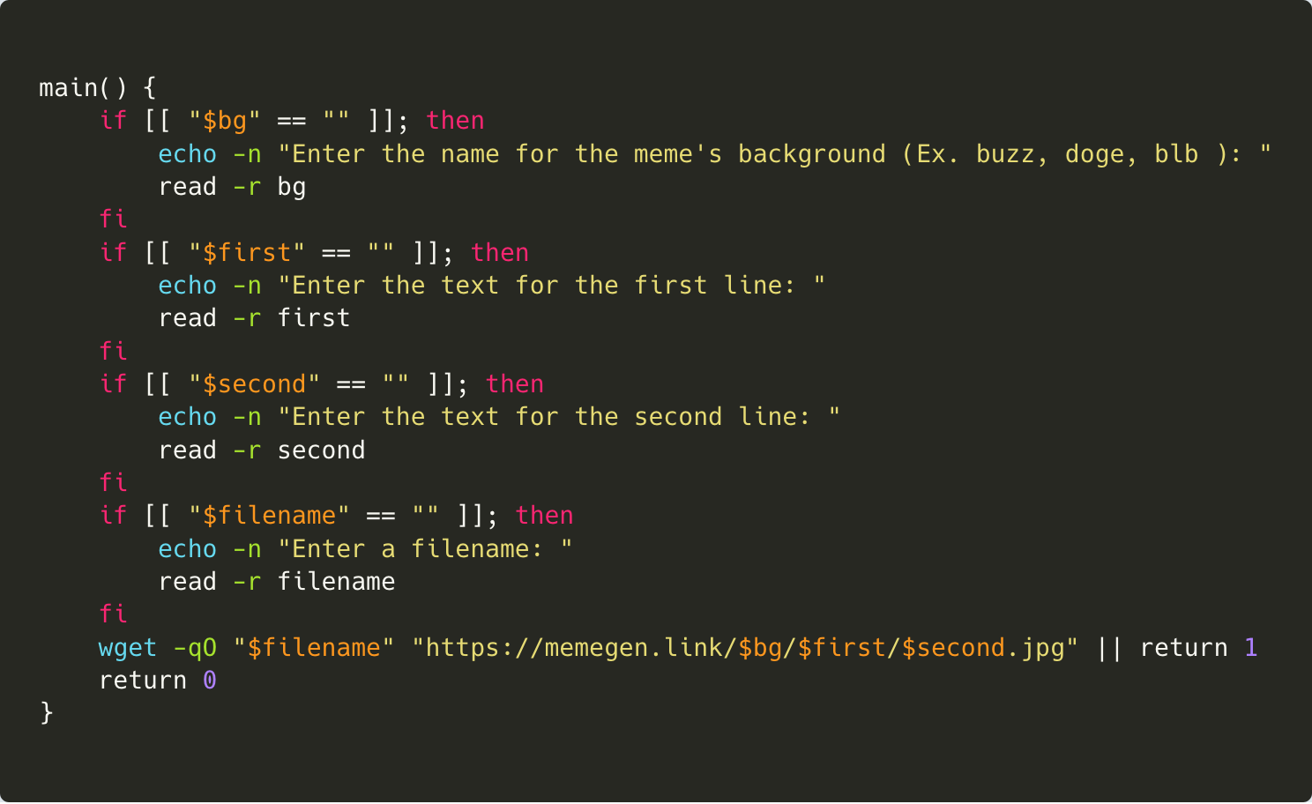

Slide 18
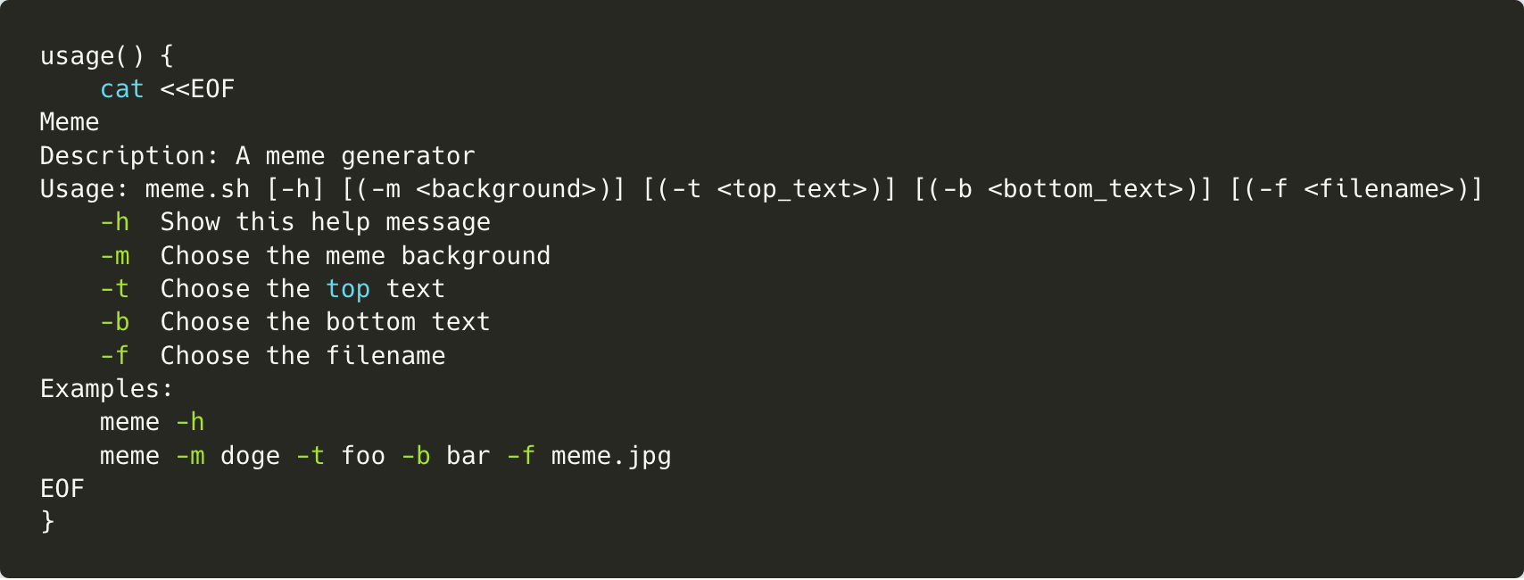

Slide 19
Demo

Slide 20
Who wants Redbrick hoodies?
Go to https://redbrickdcu.typeform.com/to/PiqlH7 and fill out the form !

