Slide 1



Job finder application
Name: Kholoud Abdulla Batis
101506037
Supervisor: Dr. Bandar Ali Al-Rami

Slide 2



Contents
Problem Statement
Flow chart
Objectives
Related Works
Solution
Use Case Diagram
Sequence Diagram
ER Diagram

Slide 3




Problem Statement
People who are looking for jobs and companies that are looking for employees they are have facing difficulty
Lack of a system that makes it easy for them to raise their CVs and categorize them.
The companies did not find any systems that contain a large number of CVs to search for employees easily
The difficulty of finding a job in the current time due to lack of job integration
The difficulty of differential procedures when choosing a suitable employee in the right job
Due to the large pool of applicants, recruiters and hiring managers cannot dedicate sufficient time to each application
The job seeker may waste time and spend a lot of effort searching for a suitable job for him

Slide 4


Solution
Since the people of this generation are focused on their smart phones, I could provide an application
Allow the job seeker and the employer at any time or anywhere
Where the person looking for work he adds his CV
This also categorizes the cv's according to the specific specialty of the applicants
The companies that search for employees enter the application and search in each section for easily collected CVs
The provider or the company that wants employees to publish the work available to it and the details
The job seeker apply for the work he wants
We will allow communication between the provider(HR) and the job seeker through internal chat

Slide 5

Objectives
The system will make it easier for users to use the application
People looking for job will benefit from the application because it makes it simple to upload their CV’s and for employers to access them.
The application will delight companies with easy access to the right employees, saving time and effort
Providers can use the application to post their employment openings and The app allows job seekers to see all available jobs from providers and The app allows the seeker and provider to communicate in real time through a chat feature.

Slide 6
Related works
Related works | LinkedIn application | CareerBuilder | Simply Hired
Similarities | Both of them are easy to use and flexible, support the idea of helping people and are similar in finding job opportunities easily in terms of the employer publishing his search for full or part time employees and that the job seeker can easily find job opportunities Both of them works on android and Ios | Both of them are easy to use and flexible, support the idea of helping people and are similar in finding job opportunities easily in terms of the employer publishing his search for full or part time employees and that the job seeker can easily find job opportunities and seeker can upload his Cv | Advantage: Simply Hired is structured well and it makes keeping candidates organized simple. Simply Hired is the #1 job board right now, so by using them, we are getting the best pool of talent and candidates.
Differences | My app all the features is free, LinkedIn have some premium features that should to pay to use it. LinkedIn is limited to providing job opportunities only and for communication between the employer and the job seeker but my app but the application will be general for everyone and for all needs of providing job opportunities and divided the CV's into categories to make it easier for those looking for employees. | My app all the features is free, CareerBuilder have some premium features that should to pay to use it | Disadvantage: Although the sorting process is easy through Simply Hired when you check candidates to send a message, it un-checks them after the message is sent, so you have to go back through and re-check all applicants to move them. I'd like to have the candidates remain checked and highlighted after I send them a message. It would be great to have messages sent out automatically once we move them into new categories.

Slide 7


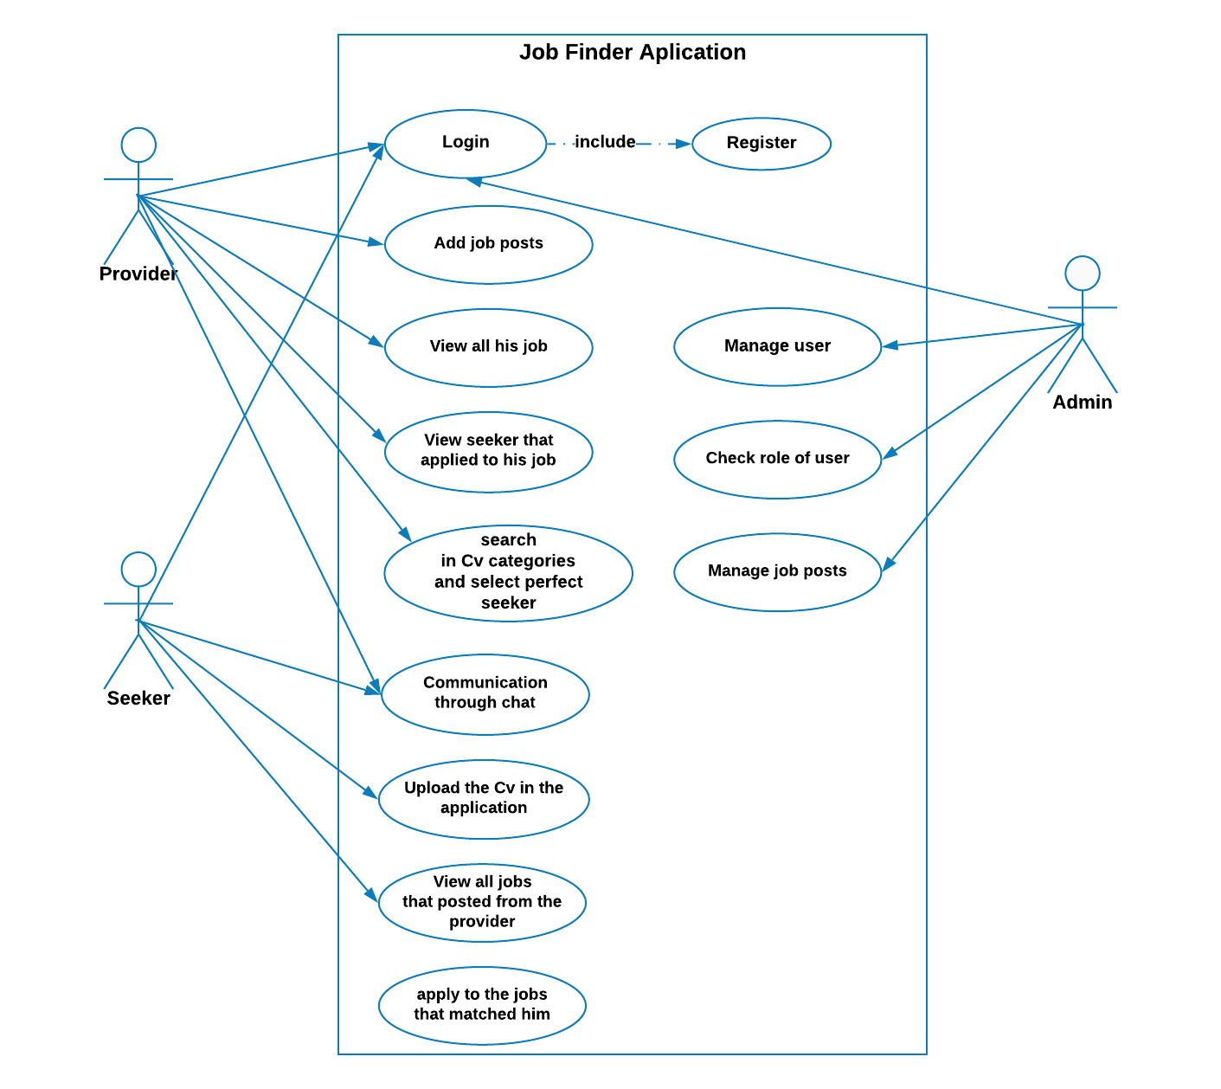


USE CASE DIAGRAM
Tala
Ashrf
Full stack backend
writer
Mairy
Gamel
Teacher
Project manager

Slide 8
FLOW CHART

Slide 9
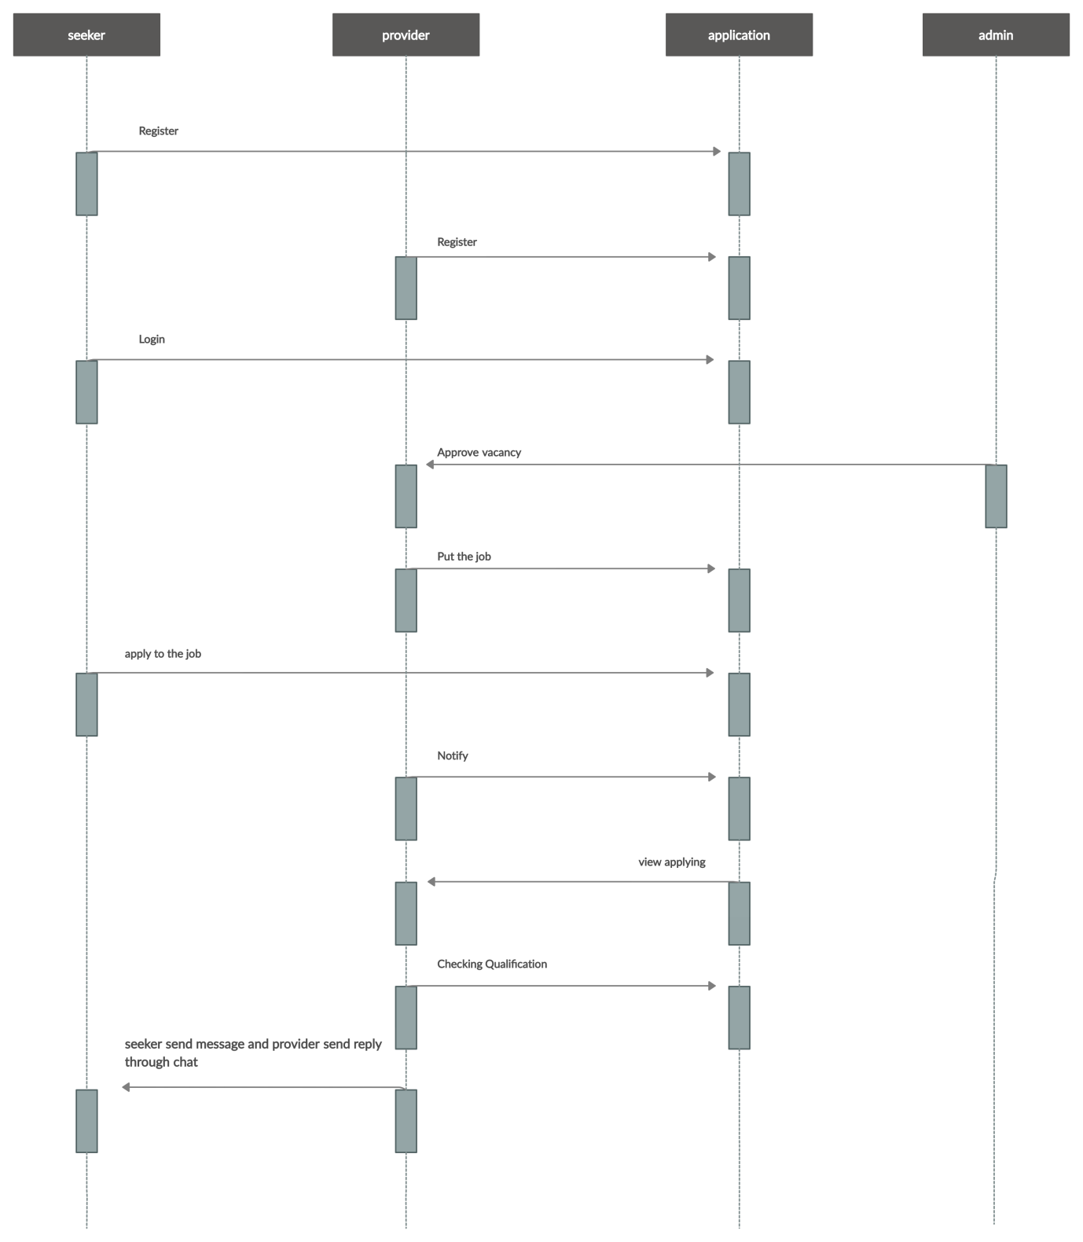
SEQUENCE diagram

Slide 10
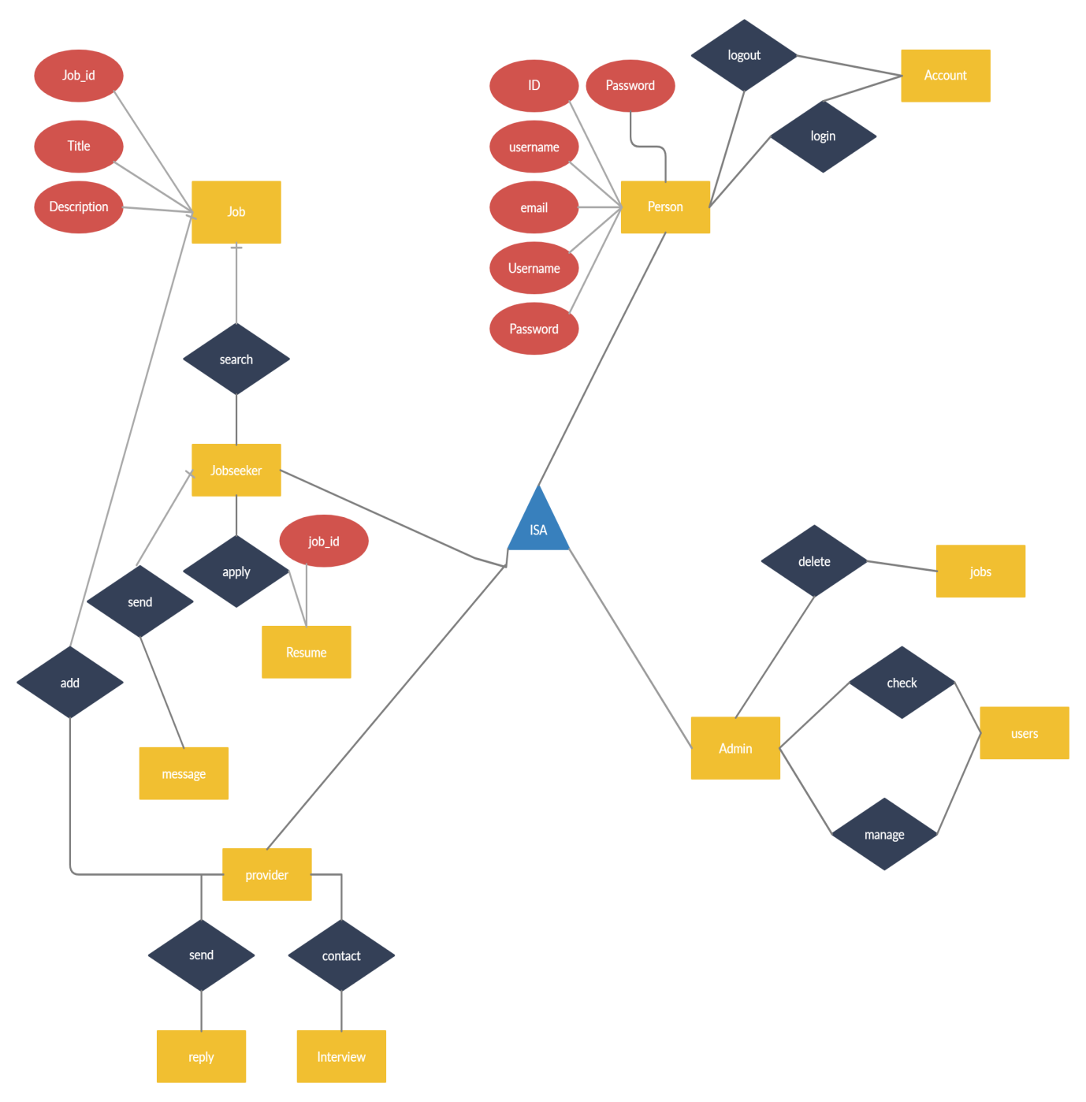
ER diagram

Slide 11


Thank You
Job finder Application
101506037KSA@aou.edu.sa
https://www.linkedin.com/in/khulood-batis-410823122/

Slide 12

Summary

