Slide 1
Introduction To Data Science

Slide 2
Data Science
Data Science is the process of using data to find solutions / to predict outcomes for a problem statement.
Data Science Process Involves:
Business Requirements
Data Collection
Data Cleaning
Data Exploration & Analysis
Data Modelling
Data Validation
Deployment & Optimization

Slide 3
Data Science Application
Banking
Ecommerce
Healthcare
Data Science
Fraud and Risk Detection
Finance
Customer Service
…
Speech Recognition

Slide 4
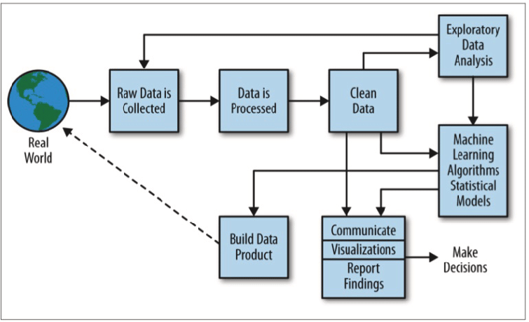
Data Science Process

Slide 5
Data Science Process
Model
Building
Model
Deployment
Collection
Cleaning
Exploratory Data Analysis
Data Engineer
Data Analysts
Machine Learning Engineer
Data Engineer

Slide 6
Job Roles in Data Science
Data Engineer
Data Analyst
Data Scientist
Data modelling
& warehousing
BIG data, Hadoop, Kafka, Spark
SQL (MYSQL) & NoSQL db (mongodb)
Python, JAVA, Scala
ETL tools: Talend,
Apache NIFI, Apache
Airflow, SAS
Expert in Excel
( VLOOKUP, Pivot table)
SQL
Statistics*
Python*
ETL tools: Talend,
Apache NIFI, Apache
Airflow, SAS*
Enterprise Bl tools:
Tableau, PowerBI
Domain knowledge
Statistics
Python or R
SQL
Jupyter notebook,
spark, tableau
Data cleaning and
exploration (pandas,
matplotlib)
Machine learning,
deep learning, NLP
(sklearn, TensorFlow)

Slide 7
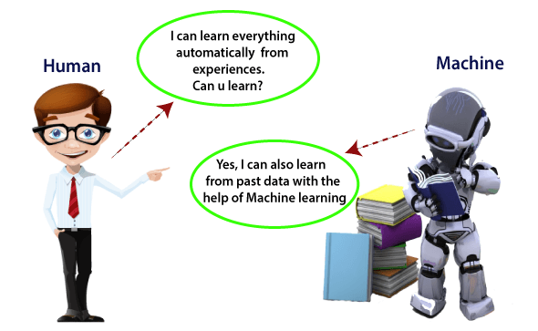
What is Machine Learning?
Machine learning is a branch of artificial intelligence (AI) and computer science which focuses on the use of data and algorithms to imitate the way that humans learn, gradually improving its accuracy.
Machine learning is also often referred to as predictive analytics, or predictive modelling.

Slide 8
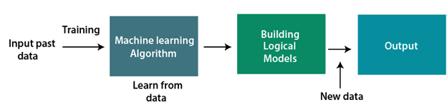
How does Machine Learning Work?
A Machine Learning system learns from historical data, builds the prediction models, and whenever it receives new data, predicts the output for it.

Slide 9
Machine Learning Algorithms
Machine learning uses programmed algorithms that receive and analyse input data to predict output values within an acceptable range. As new data is fed to these algorithms, they learn and optimise their operations to improve performance, developing ‘intelligence’ over time.

Slide 10
Types of Algorithms
Machine Learning
Supervised
Learning
Unsupervised Learning
Reinforcement
Learning
House Price Prediction
Stock Price Prediction
Types of Algorithms
Classification
2. Regression
Customer Segmentation
Market Basket Analysis
Types of Algorithms
Clustering
Association
Driverless Car
Optimized Marketing
--------- Algorithms ---------
Q-Learning, SARSA, DQN, …

Slide 11
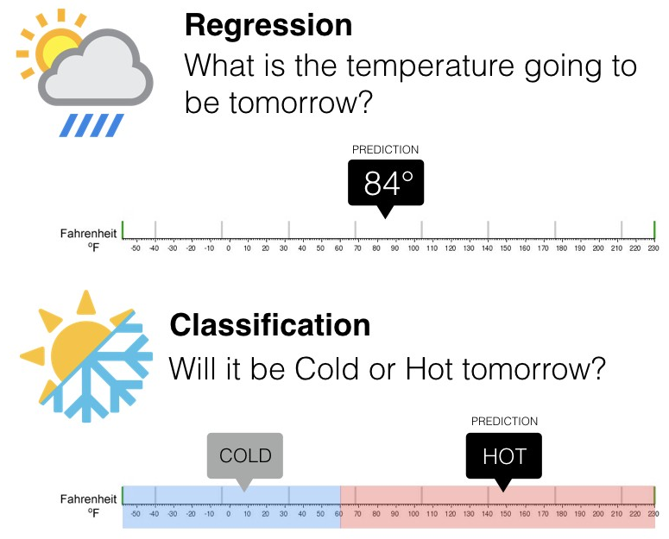
Regression vs Classification

Slide 12
Application of Regression & Classification
Linear Regression
Classification
House Prices
2. Weather
3. Stock Price
Predicted value is continuous
Email is spam or not
Will customer buy life insurance?
Which party a person is going to vote for?
Democratic
Republican
Independent
Predicted value is categorical

Slide 13
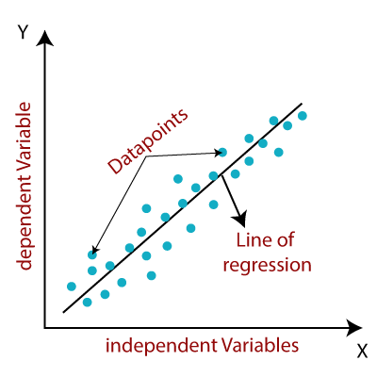
Linear Regression

Slide 14
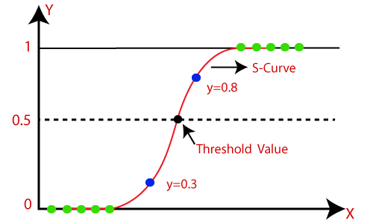
Logistic Regression
Logistic regression is one of the techniques used for classification

Slide 15

Decision Tree

Slide 16

Support Vector Machine

Slide 17
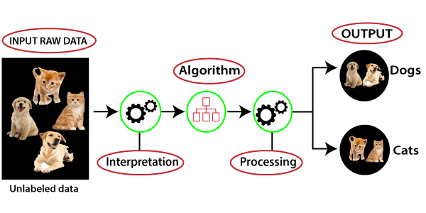
Unsupervised Learning
Unsupervised learning is a type of machine learning in which models are trained using unlabeled dataset and are allowed to act on that data without any supervision.
The goal of unsupervised learning is to find the underlying structure of dataset, group that data according to similarities, and represent that dataset in a compressed format.

Slide 18
Reinforcement Learning
Reinforcement learning is a type of machine learning method where an intelligent agent (computer program) interacts with the environment and learns to act within that.
Reward /Penalty
Q-learning
Agent
Environment
state
Reward

