Slide 1


Team Details
  Team name: Photism
  Team leader name: Khunapat Prapassornchaikul
  Problem Statement: Media, Content & Digital Experiences. FaceFinder turns one shared Google Drive event album into one folder per person, with Gemini picking and sorting the best photos.

Slide 2
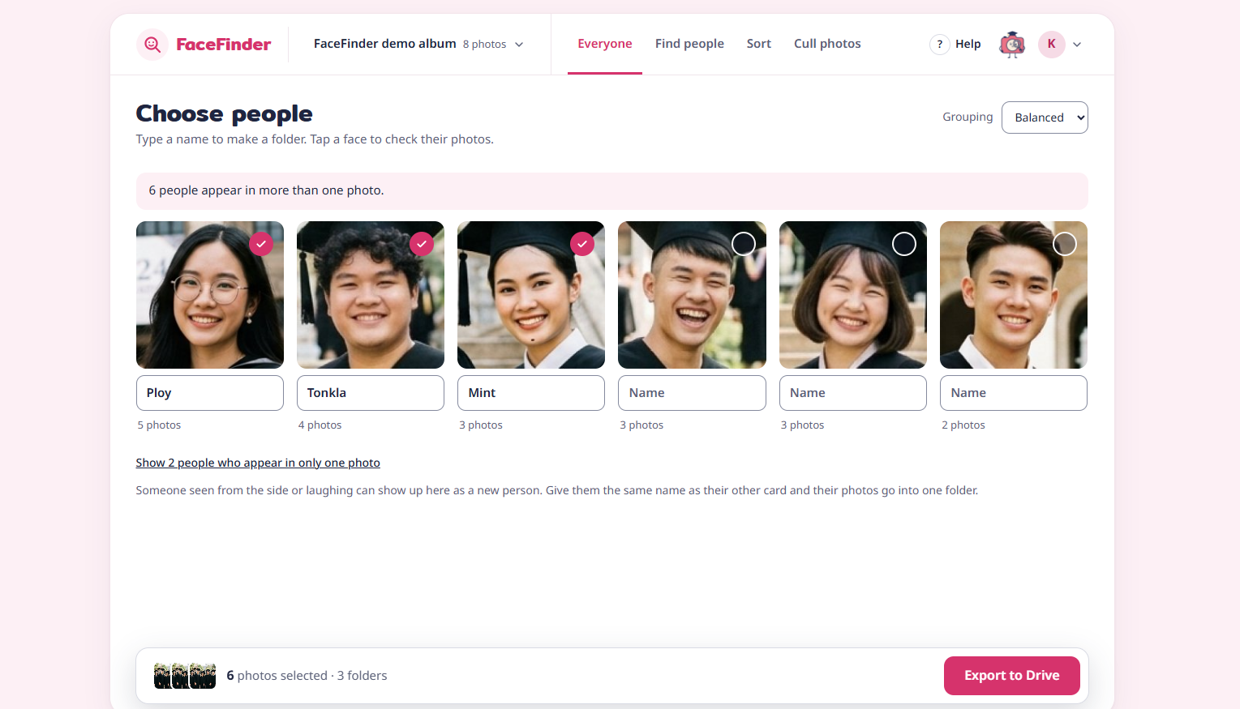
Brief about the idea
The problem
After an event, the photographer shares one Google Drive folder with hundreds of photos. Finding yourself, or sending friends their photos, means an hour of scrolling.
FaceFinder
Scan the album once. A face model groups faces into people; Gemini judges and describes each photo. Then find a person, keep the best shots, sort by description, and copy one folder per person into your Drive. The album is never changed.
The live app on the demo album. The people are made up, created with Gemini.

Slide 3
Opportunities
How is it different?
Event photos usually live in one shared Drive folder, with no face search and no culling. FaceFinder works on any shared Drive folder, for everyone who can open it, and gives back real Drive folders.
How does it solve the problem?
One scan per album. Name a face or upload a selfie to get that person's photos. Gemini suggests keepers with a reason, and sorts by description. One click copies it all to your Drive.
USP
Two AIs, each for its job: a face model decides who; Gemini decides how good and what is in it. Copy-only, no photo library kept, data deletable at any time. Works on a phone.

Slide 4






List of features offered by the solution
Everyone
Every face grouped into people. Type a name to make that person's folder.
Find people + Best 10
One selfie finds a person. Best 10 picks their best shots, each with Gemini's reason.
Cull photos
Keep, Review or Rejected, with reasons: blur, eyes closed, weaker shots of a burst.
Sort by description
Describe a folder in plain words ("throwing caps"). Gemini fills it and suggests folders.
Export to Drive
One folder per person in your own Drive. Copies are made inside Google; never duplicated.
Control and privacy
Choose photos by day or by hand, stop and resume. See what is kept, delete it any time.

Slide 5
Process flow diagram or Use-case diagram
1
Sign in with Google
Reads Drive with the user's own permission
2
Paste a Drive folder link
Private folder? Clear help to request access
3
Choose photos
All, by day, or by hand
6
Export to Drive
Copies, one folder per person
5
Work on the album
Everyone, Find people, Cull, Sort
4
Scan once
InsightFace detects and matches faces; Gemini writes one note per photo
Who uses it: the photographer culls and sorts; guests find themselves; friends share each person's folder.

Slide 6
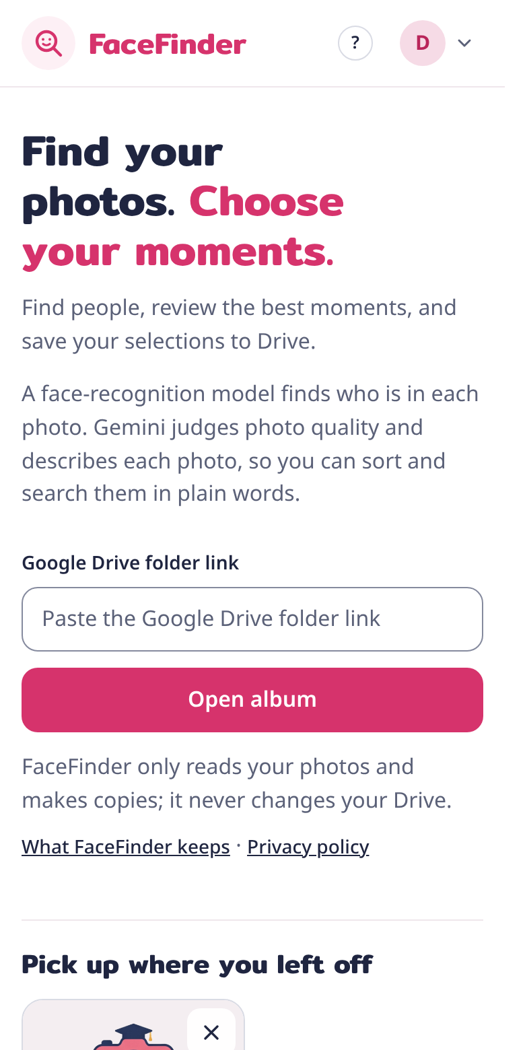
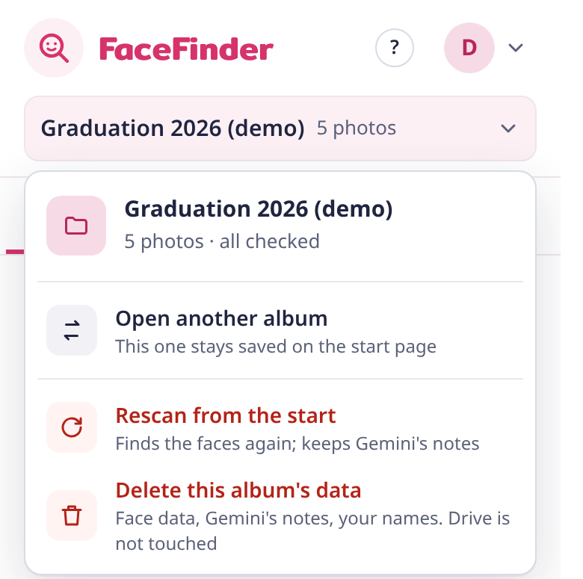
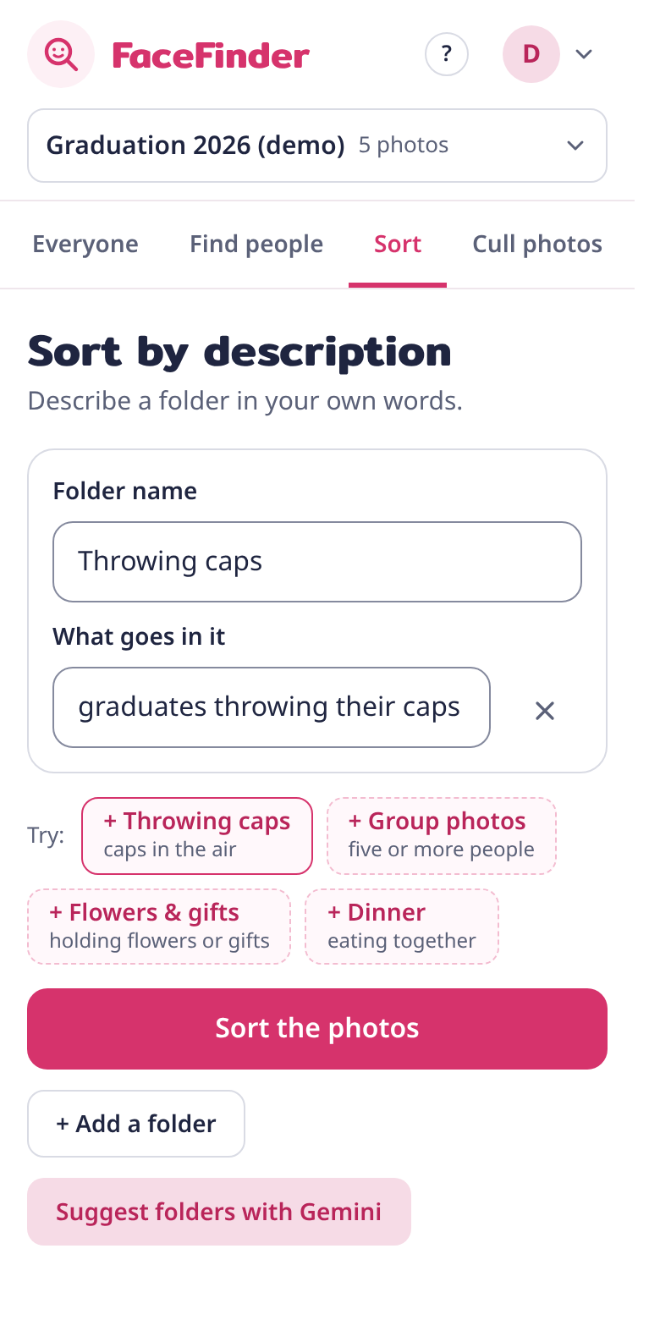
Wireframes/Mock diagrams of the proposed solution (optional)
Phone first
Works from 320 px wide to desktop, with large touch targets and a bottom action bar. Our own pink design and camera mascot.
Start page
Album menu
Sort by description

Slide 7
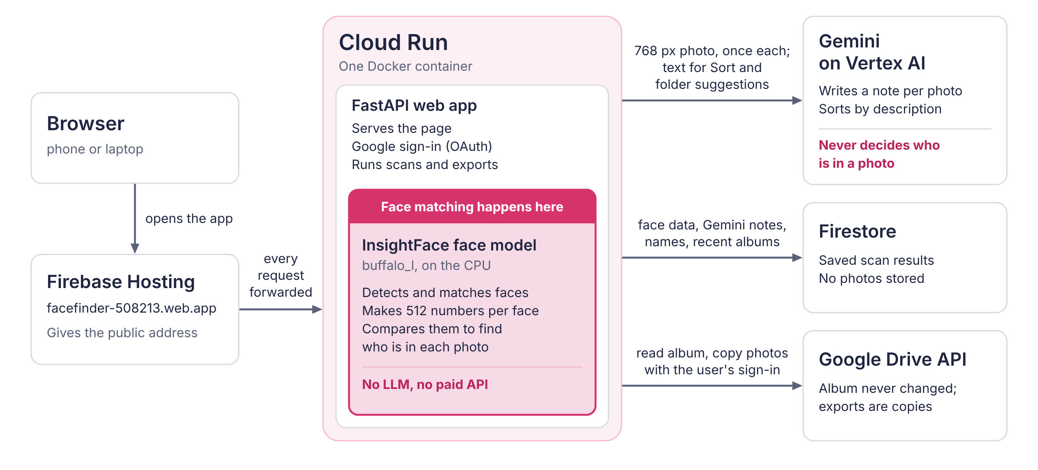
Architecture diagram of the proposed solution

Slide 8
Technologies to be used in the solution
Google Cloud
Cloud Run: runs the app and the face model
Firestore: scan results, Gemini notes, names
Firebase Hosting: the public address
Vertex AI: Gemini, no API key needed
Drive API, Google sign-in: read albums, copy photos
Secret Manager: sign-in secrets
AI models
Gemini 3.5 Flash: photo notes, sorting, folder suggestions
InsightFace buffalo_l: face detection and matching, on CPU
OpenCV: images, burst fingerprints
App and tools
Python, FastAPI: server and background jobs
HTML, CSS, JavaScript: one-file front end
Docker: one container
Tests: 90 Python checks, browser tests
Antigravity, Gemini: testing, demo photos of made-up people

Slide 9
Estimated implementation cost (optional)
What it costs to run
Cloud Run: one 4-vCPU instance; it scales to zero when idle.
Gemini: one image call per photo. Cached notes avoid repeating it for unchanged photos; Sort sends text only.
After the scan: Find people, Cull and Best 10 reuse saved notes, with no new Gemini calls.
Still charged: compute, Firestore storage and reads, as usual. No measured per-album cost is claimed.
Per 1,000 photos
1,000
Gemini image calls, once
~25
text calls for each sort
0
new Gemini image calls to rescan unchanged photos

Slide 10
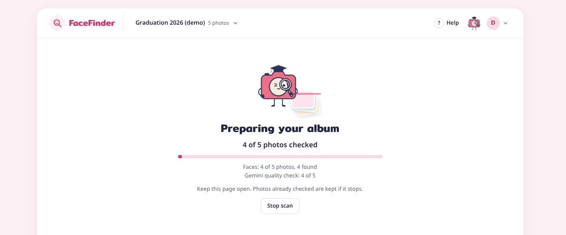
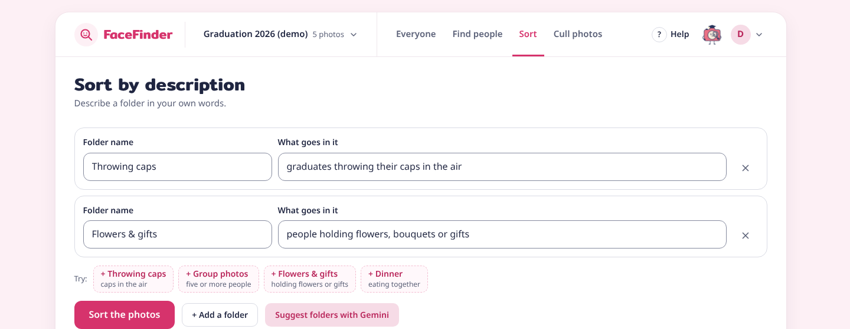
Snapshots of the prototype
Everyone on the live app: name a face to make a folder. Right: scanning, and Sort by description.

Slide 11
Prototype Performance report/Benchmarking
0.75–0.98
face match score for the same person, against −0.05 for a different person
40 of 40
small-face stress test: 40 faces 18 px wide in a synthetic grid
1 min 36 s
one observed live run: 37 photos scanned with Gemini notes (4 vCPU)
28 s
one observed live run: 31 copies exported into 5 Drive folders
16 s
one observed live run: upload a selfie, all 3 of that person's photos found
5.2 s
one observed live run: Stop ends a scan
Scores and the stress test: the repository's automatic tests. Timings: single observed runs on the live app, 17–18 October 2026.

Slide 12
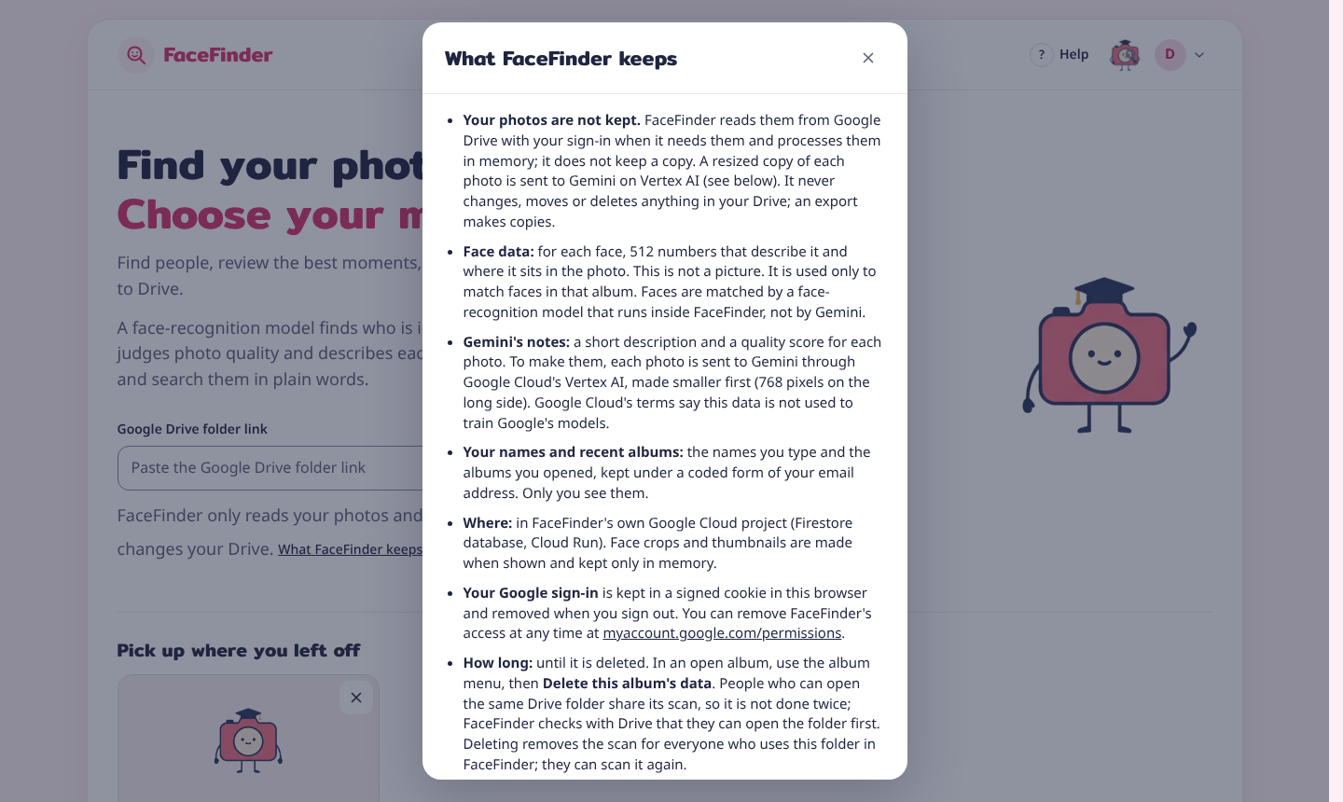
Additional Details/Future Development (if any)
Next steps
Scale: persist job progress in Firestore, then run scans on Cloud Run jobs or Cloud Tasks.
Guest mode: a QR code at the event; each guest finds their own photos.
Commercial use: a commercially licensed face model.
Google verification: no more "unverified app" warning.
Trust today: no photo library kept, a plain list of what is kept, a public privacy policy, and "Delete this album's data".

Slide 13
Provide links to your:
GitHub Public Repository: https://github.com/Khunapat/facefinder
Demo Video Link (3 to 4 minutes): https://youtu.be/1NW303-InI0
Final Product Link: https://facefinder-508213.web.app
For judges
Open the app and sign in with Google. Google may show "Google hasn't verified this app": press Advanced, then Go to facefinder. Open the Sample album card (made-up people created with Gemini) and try Everyone, Find people, Sort and Cull photos.

Slide 14


