Slide 2
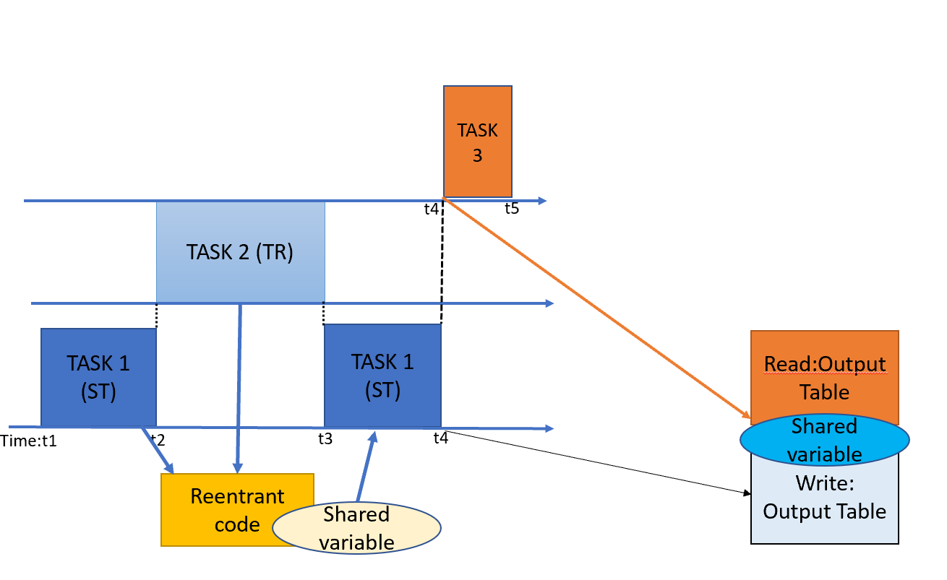
Task T2 may preempt task T1 in an unpredictable manner
Tasks are periodic

Slide 3
Task 1: updating pressure, write into #m10
Task 3: making decision
Read into #m10 & write into #m20
2)Flow rate measurements from sensors
-write #m5
0)Initial pressure with uncertainty
-write #m10
Normal pressure
If ST or TR(event)
Normal pressure
7a) Go to safe flowrate
Steady state condition
6) Evaluate Pressure
& comparison
-write into #m20
3)Reduce misfit by using Kalman Filter algorithm
-Read #m6&m5
Transient event
0&4)Updated pressure
-write into #m10
5)Go to emergency flowrate
-read #m10
Abnormal pressure
1)Calculated flow rate
-write into #m6
7b) Stop pump
Event: 1)Calculated flow rate by task 2
-write into #m6

