Slide 1
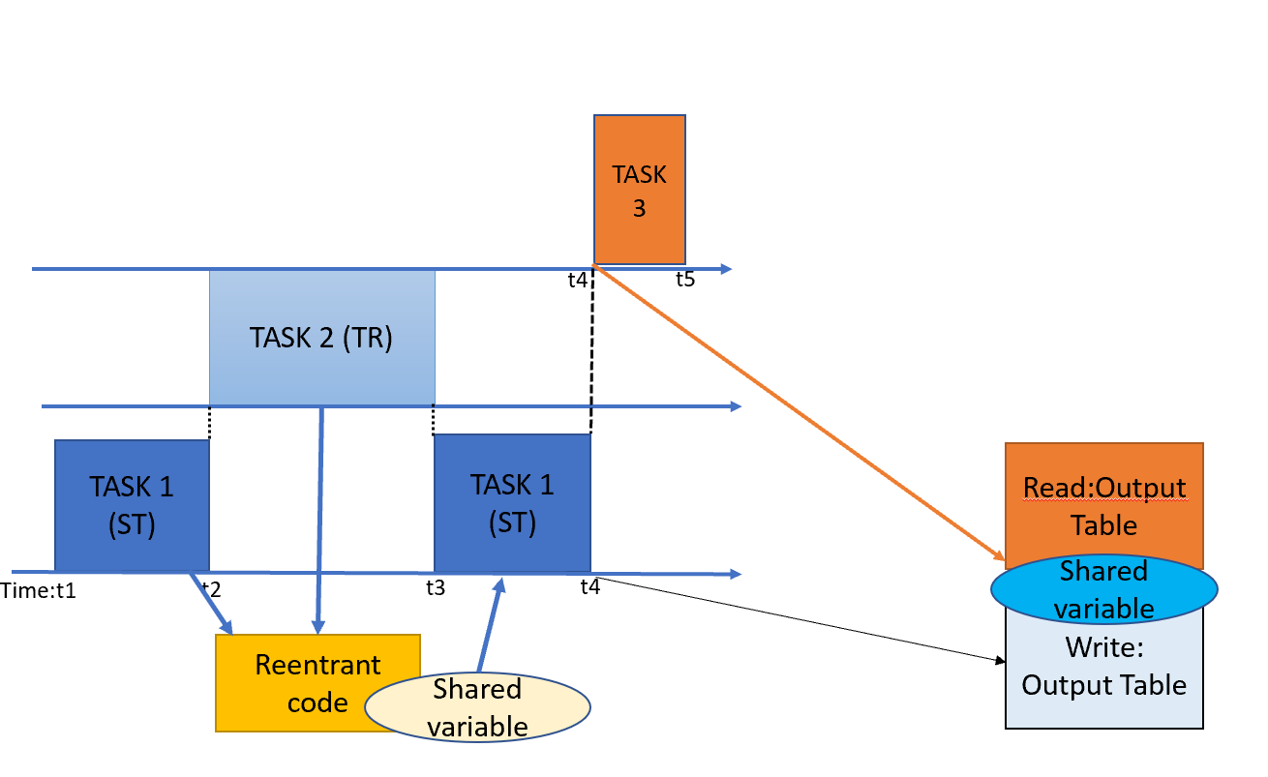
Task T2 may preempt task T1 in an unpredictable manner
Tasks are periodic

