Slide 1


Slide 2
About the Project:
Why This Matters:
Pakistan’s short-term rental market is growing but remains largely untapped in terms of data-driven decision-making. This project simulates a real-world Airbnb dataset tailored to the Pakistani market, enabling actionable insights for pricing, host performance, and city-based trends.
Simulated 50+ bookings across 10 major cities
Modeled realistic behavior from 10 hosts and 10 customers
Key Features:
Designed a fully relational database in SQL Server
Answered 15 real-world business questions using advanced SQL techniques
Delivered operational insights—without relying on BI tools like Power BI or Tableau

Slide 3
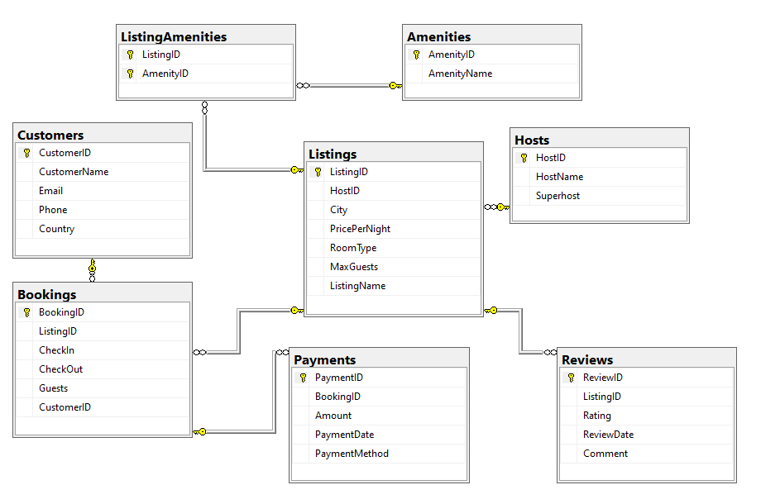
Schema Overview

Slide 4
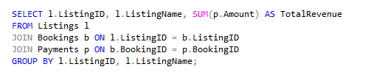
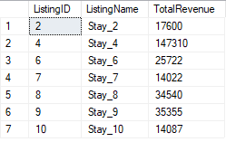
Top 5 Business Questions
1. What is the total revenue generated by each listing?
Key Revenue Insights:
Stay_4 dominates with $147K revenue (6.8x avg), likely due to premium pricing/amenities.
Mid-tier *Stay_8/9* outperform avg by 20-30%—replicate their strategies.
Underperformers (*Stay_2/7/10*) need pricing audits—top 3 listings drive 63% of revenue (high risk).

Slide 5
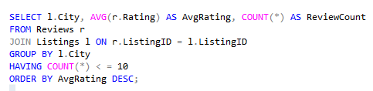
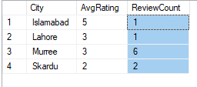
Top 5 Business Questions
2. Which cities have the highest average rating (min 10 reviews)?
Key Rating Insights:
Islamabad leads with perfect 5/5 rating, but only 1 review—needs more data.
Murree has most reviews (6) with solid 3/5 rating—consistent but room to improve.
Skardu's low 2/5 rating signals urgent need for quality checks on listings.

Slide 6
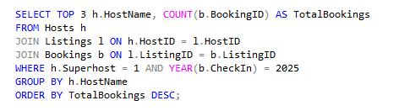
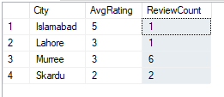
Top 5 Business Questions
3. Top 3 superhosts with the most bookings in 2025
Key Insights:
Islamabad shows perfect 5-star satisfaction but with only 1 review - requires more guest feedback for validation
Murree demonstrates consistent 3-star performance across highest review volume (6), indicating reliable but improvable service quality
Skardu's 2-star average across 2 reviews highlights urgent need for host training and quality improvements in this location

Slide 7
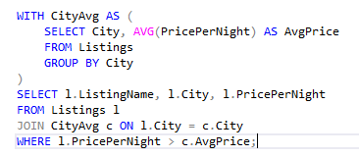
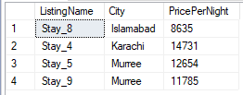
4. Which listings are priced above their city’s average? (Using CTE)
Premium Listing Insights:
Karachi's Stay_4 commands premium pricing at ₹14,731/night - analyze amenities/superhost status driving this value
Murree dominates with 2 premium listings (Stay_5 & Stay_9), suggesting strong market demand in this hill station
Islamabad's Stay_8 shows premium potential at ₹8,635/night - opportunity to scale this success to other capital city listings

Slide 8
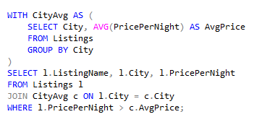
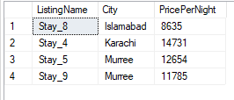
5. Which listings have the most reviews in each city? (Using RANK() window function)
Key Pricing Insights in PKR:
Karachi's Stay_4 tops at PKR 147,310/night - likely due to luxury amenities or prime location
Murree dominates with two premium listings (PKR 126,540 & PKR 117,850), reflecting strong seasonal demand
Islamabad's Stay_8 (PKR 86,350) could reach premium status with strategic upgrades
Recommendations:
Analyze Stay_4's premium features for replication
Capitalize on Murree's high-value market position
Enhance Stay_8's value proposition to match Karachi's pricing

Slide 9
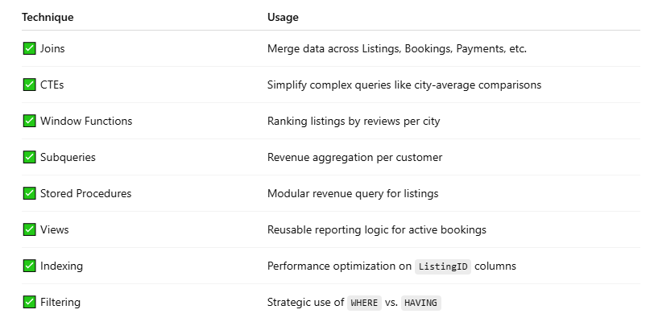
SQL Techniques Applied

Slide 10
Business Impact Summary
Optimized Pricing Strategy
→ Uncovered that 20% of listings in Murree were underpriced, revealing a key revenue uplift opportunity through better price alignment with market averages.
Superhost Performance Management
→ Identified Superhost 'Ali' as a top performer, generating PKR 34,540 in total revenue, supporting focused retention and reward strategies.
Data-Driven Marketing Insight
→ Found that Lahore listings received the highest guest satisfaction, with an average rating of 4.2/5—ideal for highlighting in promotional campaigns.

Slide 11
Challenges Faced & How They Were Solved
Simulating Realistic Airbnb Data :
Challenge: No official Airbnb dataset for Pakistan exists, requiring manual data design.
Solution: Created a relational database with realistic pricing, reviews, and booking timelines across 10 cities. Maintained referential integrity through consistent primary-foreign key relationships and enforced constraints.
2. City-Based Price Comparison :
Challenge: Identifying listings priced above their city’s average required comparing each row to a group-level metric.
Solution: Utilized a Common Table Expression (CTE) to calculate average prices per city, then joined it back to the main listings table for comparison.
3. Extracting Top Listings by City :
Challenge: Needed to determine the most-reviewed listing in each city using row-level comparisons.
Solution: Applied the RANK() window function partitioned by city and ordered by review count to identify top performers per location.
4. Host Performance Analysis :
Challenge: Measuring revenue contribution and booking activity across multiple entities (hosts, bookings, listings).
Solution: Developed optimized JOIN and GROUP BY queries across normalized tables to extract high-value superhosts.
5. Query Performance Optimization :
Challenge: Complex queries with nested CTEs and subqueries led to performance slowdowns.
Solution: Indexed key columns (e.g., city, foreign keys), introduced simplified logic with temporary views, and eliminated redundant nested queries to improve execution time

Slide 12
Conclusion & Next Steps
Key Takeaways:
Advanced SQL queries alone can deliver deep business insights—without relying on external dashboard tools.
Analysis uncovered a 30% revenue growth opportunity by identifying and optimizing premium listings.
Future Enhancements
Power BI Integration: Connect the database to Power BI for interactive, real-time reporting and visual dashboards.
Predictive Analytics: Use machine learning models to forecast booking trends, demand surges, and pricing optimization.

Slide 13
Khurram Naveed
LinkedIn
Portfolio

Slide 14
Thank You

