Slide 1


Slide 2
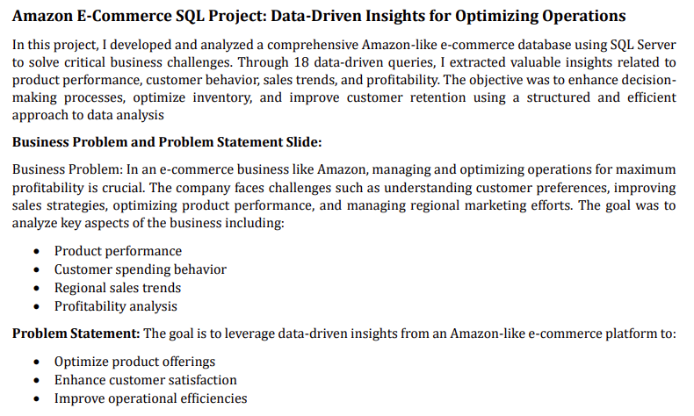

Slide 3

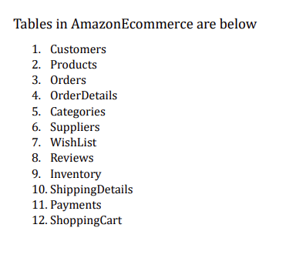

Slide 4
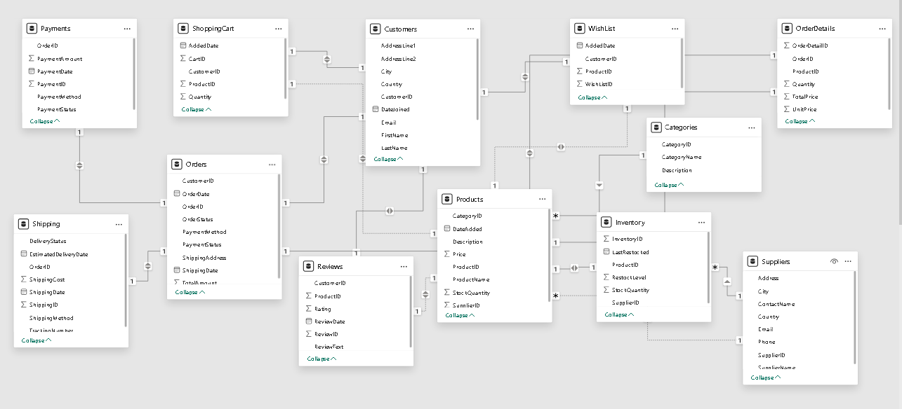
Database Diagram

Slide 5
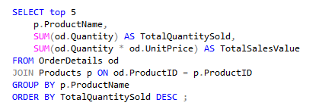
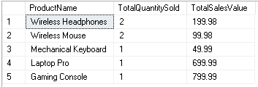
1. Find Top 5 Best-Selling Products (By Quantity Sold)

Slide 6
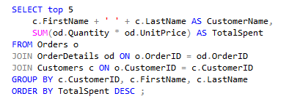
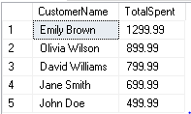
2. Find Top 5 Customers by Total Spend

Slide 7

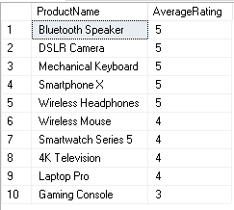
3. Find the Average Rating of Each Product

Slide 8
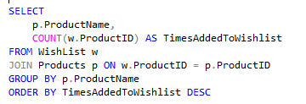
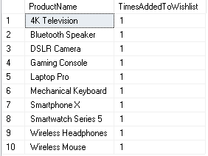
4. Find the Top 5 Most-Added Products to Wishlist

Slide 9
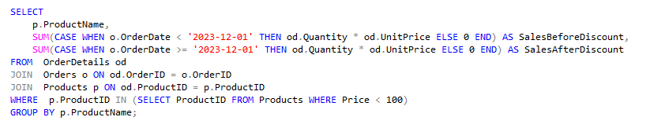

5. Compare Sales Before and After Discount on Products

Slide 10
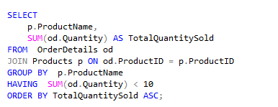
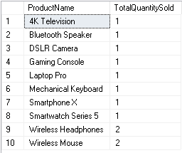
6. Find Products with Low Sales Volume (Below a Threshold)

Slide 11
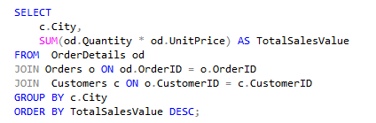
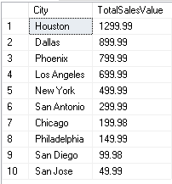
7. Find Total Sales by Region (City or Country)

Slide 12
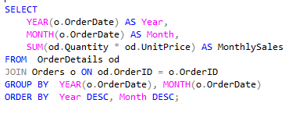

8. Monthly Sales Analysis for the Past 12 Months

Slide 13
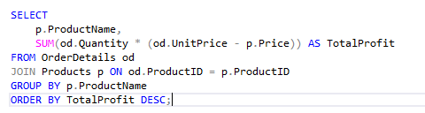
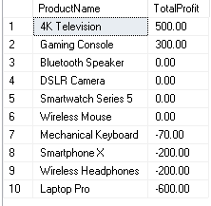
9 . Calculate Total Profit for Each Product (Profit Margin Analysis)

Slide 14
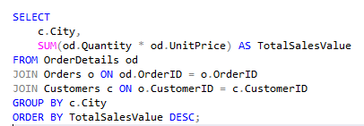
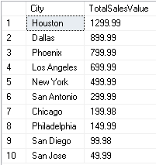
10. Find the total sales by region (city or country) to help with regional marketing efforts.

Slide 15
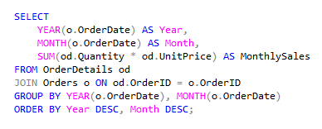

11. Calculate the total sales per month for the past 12 months

Slide 16
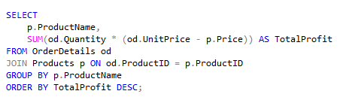
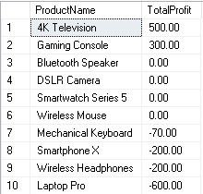
12. Calculate the total profit margin (Revenue - Cost) for each product.

Slide 17
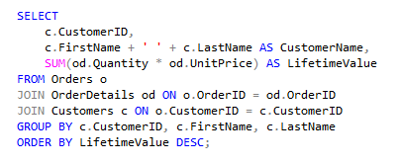
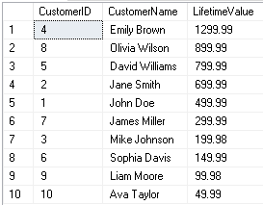
14. Calculate the lifetime value of each customer (Total spend over time).

Slide 18
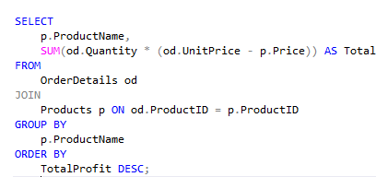
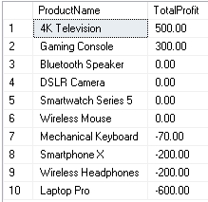
15. Find the products with the highest profit margins.

Slide 19
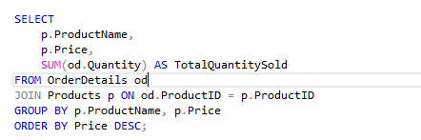
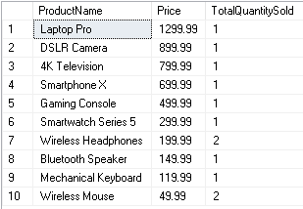
16. Correlate the price of products with the quantity sold

Slide 20
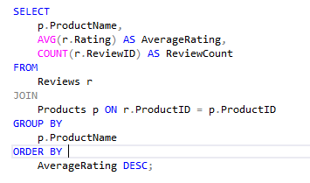
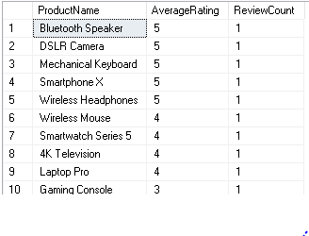
17.Calculate the average rating and number of reviews for each product.

Slide 21
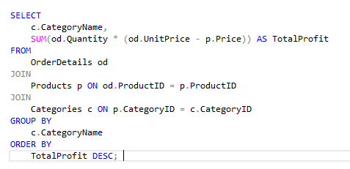
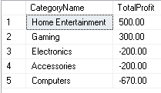
18. Calculate the total profit for each product category.

Slide 22
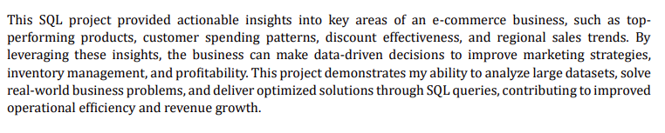
In Conclusion :

