Slide 1
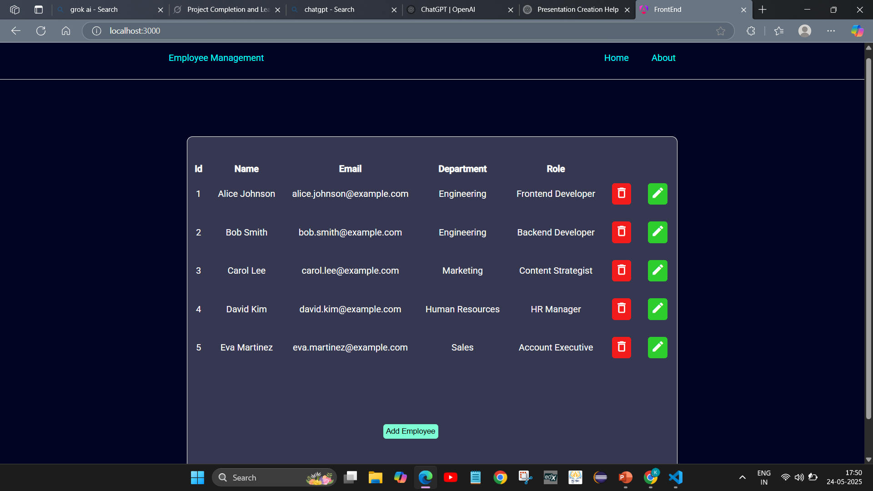
Streamlining Employee Management: A Web App Built with Angular and Express.js
This presentation introduces new web application for efficient employee management.

Slide 2





Technology Stack: A Robust and Scalable Foundation
Angular (Frontend)
Express.js (Backend)
JavaScript
CSS/HTML
Dynamic UI with TypeScript. Component-based for reusability. Version 19 ensures modern development.
Node.js framework for RESTful APIs. Handles data requests and validation. Stores data efficiently in memory.
Core language for dynamic functionality. Manages user interactions, data, and API calls.
Custom CSS for visual appeal. HTML5 for semantic structure. Ensures responsive user experience.

Slide 3




Frontend Details: Angular Implementation
Components
Modular and reusable UI elements. Home Component(to display all Employee Info), Form Component(add/edit),
Error Message Component (To show Errors in the form), About (About the project and unknown route component) and header Component.
Services
EmployeeService handles API communication. It fetches and manipulates all employee data.
Routing
Angular Router provides seamless navigation. Achieves single-page application functionality.

Slide 4

Backend Details: Express.js API
/api/employees
GET
Retrieves all employee records.
/api/employees/:id
GET
Retrieves specific employee by ID.
/api/employees
POST
Creates a new employee entry.
/api/employees/:id
PUT
Updates an existing employee record.
/api/employees/:id
DELETE
Deletes an employee record.
The Express.js backend exposes robust RESTful API endpoints. These endpoints allow for comprehensive data management. They enable retrieval, creation, updating, and deletion of employee information.

Slide 5
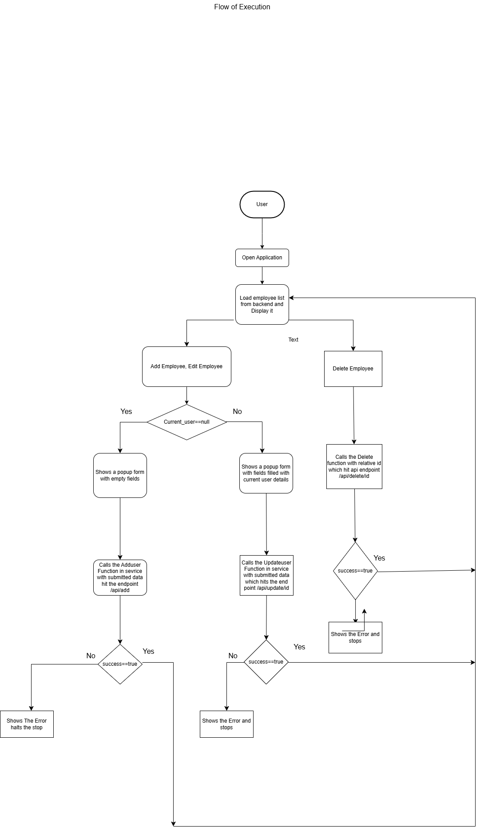
FLOW OF EXECUTION

