Slide 1
GANDHINAGAR INSTITUTE OF TECHNOLOGY
Computer Engineering Department
Academic Year: 2023 - 2024
Facial Emotion Detection System
Presented By
Patel Amisha Chiragbhai(200120116063)

Slide 2
Outline
Introduction
Company
Company Profile
Technology
Work (Job Description)
Outcomes(Benefits)

Slide 3
Introduction
A facial emotion detection system is a technology that analyzes facial expressions from images or videos to reveal information on one’s emotional state.
By analyzing facial features and patterns, machines can make educated guesses about a person’s emotional state.
In the dynamic landscape of the hospitality industry, customer satisfaction is paramount to the success of any restaurant.
Understanding and catering to the emotional experiences of patrons can significantly enhance the overall dining experience.
By employing advanced facial recognition algorithms, the system can detect and interpret various emotions such as happiness, surprise, disappointment, and more, in real-time.

Slide 4
The Facial Emotional Detection System for Restaurants is an innovative solution that uses computer vision and artificial intelligence to analyze facial expressions, providing valuable insights into the emotional states of diners.
The primary goal of implementing such a system in a restaurant setting is to personalize and optimize the overall dining experience.
Through the continuous monitoring of customer’s facial expressions, restaurant staff can gain immediate feedback on the effectiveness of their services, food quality, and ambiance.
This real-time emotional analysis empowers restaurant management to make data-driven decisions, tailoring their offerings and service strategies to meet the specific needs and preferences of their clientele.

Slide 5
Technology
OpenCV (Open Source Computer Vision): A powerful open-source computer vision library that includes tools for facial detection and recognition.
Dlib: A C++ toolkit containing machine learning algorithms and tools for facial recognition.
Convolutional Neural Networks (CNNs): Deep learning models often used for image classification tasks
Data Annotation Tools: Use annotation tools like LabelImg for annotating images with facial expression, crucial for training the model.
Hardware: Depending on the application, consider appropriate hardware like GPUs for faster model training and real-time inference.

Slide 6
Installation and Setup: Learning how to install Ultralytics and its dependencies using Python package managers like pip.
Dataset Preparation: Understanding the importance of curated datasets for training YOLO models. Preparing and organizing datasets with labeled images and annotations to facilitate model learning.
Python: Widely used for its rich ecosystem of libraries and frameworks in the machine learning and computer vision domains.
C++: Utilized for performance-critical components of facial recognition systems.
SQL or NoSQL Databases: Depending on the scale and requirements of the system, databases may be used for storing and managing facial data.

Slide 7
Work
Collect and label data: gather a large and diverse dataset of facial images with different emotions, preferably in restaurant settings. Also label each image with the corresponding emotion category, such as anger, happiness, sadness, etc.
Select Technology Stack: Choose appropriate technologies, frameworks, and libraries for facial detection, emotion recognition, and system development (e.g. OpenCV, TensorFlow, PyTorch).
Data Annotation: Annotate the collected dataset with labeled facial expressions for training the emotion recognition model.
Model Development: Design and train a facial emotion recognition model using deep learning techniques.

Slide 8
Integration with Facial Detection: Implement facial detection algorithms to locate and identify faces within images or video streams.
Testing and Validation: Conduct thorough testing to ensure the accuracy and reliability of the emotion recognition model. Validate the system's performance under various lighting conditions and with diverse facial expressions.
User Interface Development (Optional):Develop a user interface for the restaurant staff to access and interpret the emotional data.

Slide 9
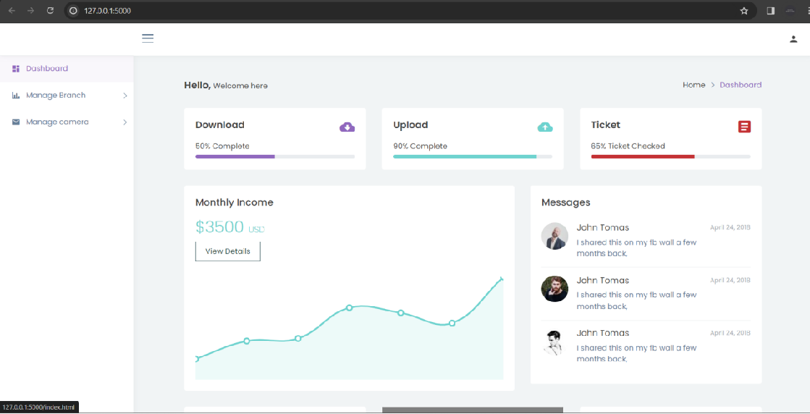
Dashboard Screenshot

Slide 10
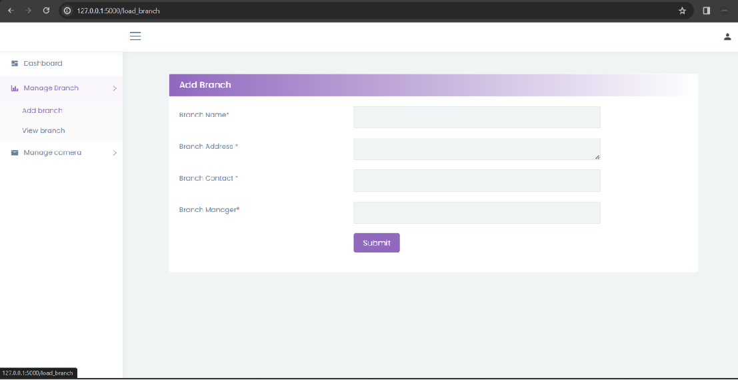
Branch Screenshot

Slide 11
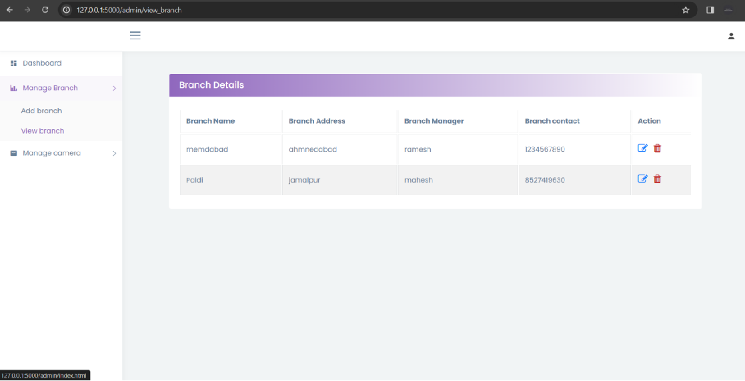

Slide 12
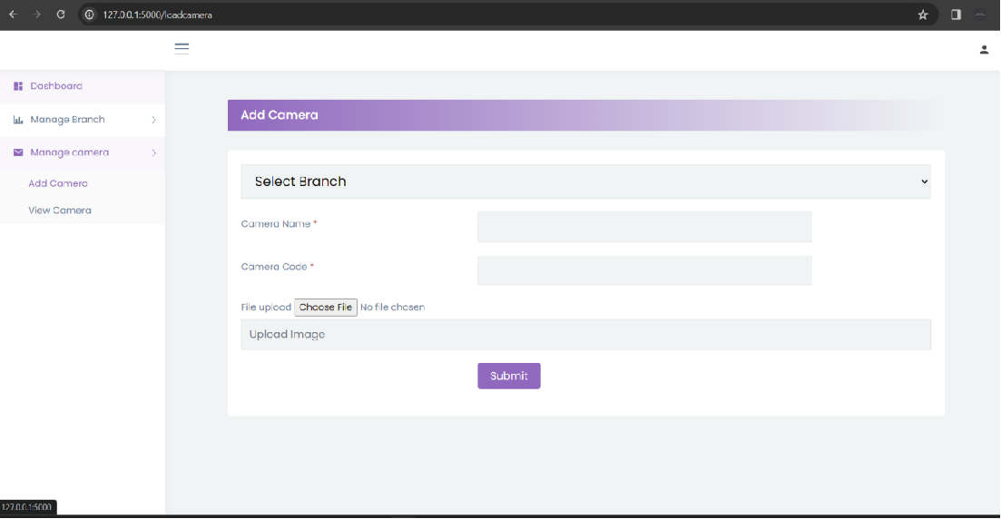
Camera Screenshot

Slide 13
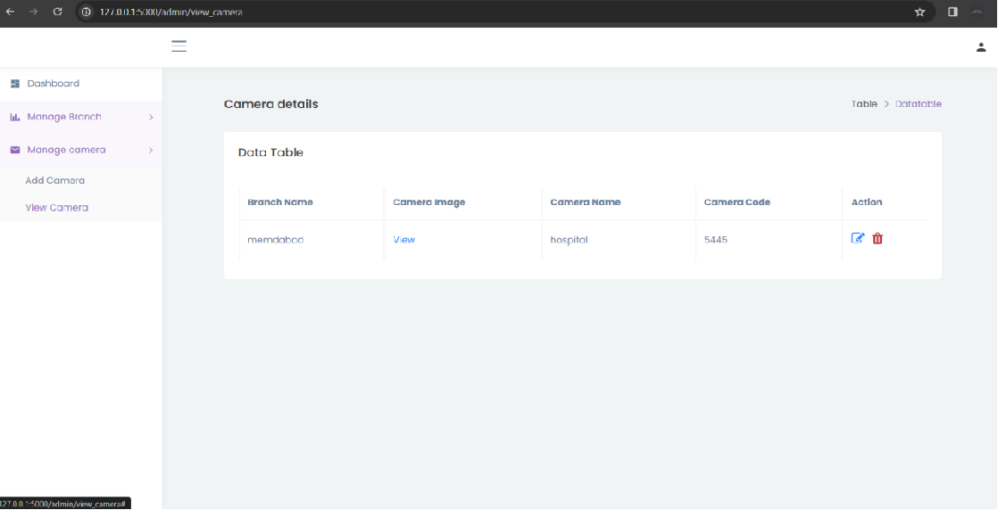

Slide 14
Outcomes
Instantaneous insights into customer emotions during their dining experience.
Ability to personalize services based on individual customer emotions.
Helps optimize the menu by identifying popular dishes and refining offerings based on emotional responses.
Understanding how the restaurant's ambiance affects customer emotions.
Enables adjustments to lighting, music, and decor for a more pleasant and emotionally resonant dining atmosphere.
Identification of staff behaviors impacting customer emotions.
Facilitates the development of emotionally resonant marketing strategies that resonate with customer preferences.

