Slide 1
Improving User Retention in Google Pay: A Simulated Product Analytics Case Study
Analyzing behavioral patterns from 1,000 users to drive strategic retention decisions
Presented by: Khushboo Masih MSc Data Science | Bachelor’s in Business Administration Email: khushboomasih193@gmail.com LinkedIn: https://www.linkedin.com/in/khushboo-masih/
GitHub: https://github.com/Khush505/google-pay-retention-case-study
Date: July 2025

Slide 2
Why Are Google Pay Users Not Returning?
Problem: Google Pay is experiencing low user retention over half of users do not return after their first transaction.
Project Goal: Use simulated data to analyze user behavior and identify strategies to improve 30-day retention.
Approach:
Created a dataset of 1,000 users
Analyzed transaction behavior, offer usage, and device trends
Derived actionable insights using Python (Pandas, Seaborn)

Slide 3
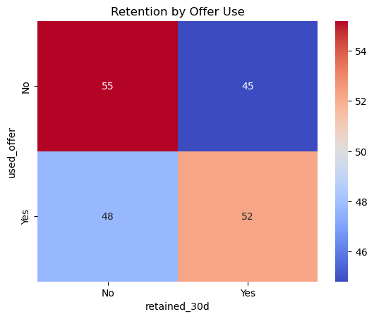
Key Insights from User Retention Analysis
50.6% of users are one-time transactors These users sign up, make one payment, then vanish. This is the biggest churn point.
Offers improve retention by 7.5%
Offer users retained: 52.3%
Non-offer users retained: 44.8% (Offers help, but aren’t enough on their own)
Retention is slightly higher on iOS (50.4%) vs Android (49.0%) (Not huge, but worth segmenting engagement by platform.)

Slide 4
Product Strategy Recommendations to Boost Retention
Trigger a Second-Transaction Offer
Encourage users to return quickly: “Do your 2nd txn in 3 days and earn £20 cashback”
Gamify Repeat Behaviour
Launch a “Cashback Streak” model to reward weekly use
Segment Push Notifications by Device
Optimize Android onboarding flows & iOS push frequency
Monitor for Offer Abuse
High one-time use + offer combo = possible misuse. Add flagging logic.

