Slide 1

Analyzing Covid-19 Tweets Dataset Using Apache Spark and Kafka
Khush Hardikkumar Jani - 40230516
Darshansinh Dilipsinh Devda - 40261713
Pranaykumar Rajeshkumar Chauhan - 40266722
Himanshu Rathod - 40234325
Adriana Danko - 40029681

Slide 2
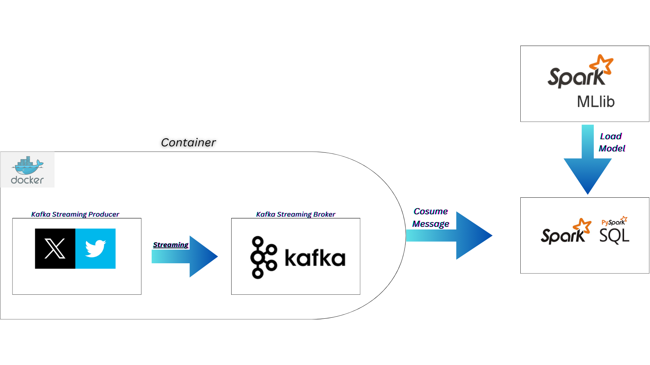
Distributed System Pipeline

Slide 3


Why?
Dockerized Kafka
Apache Spark
Durability
Data durability is ensured through replication of messages across multiple brokers.
Resilient Distributed Datasets (RDD)
Spark's fundamental data structure for distributed processing of data in parallel.
Dynamic Scaling
Fault Tolerance
Decentralization
Isolation
Topics and Partitions
Messages are organized into topics, and each topic is divided into partitions for parallel processing.
Cluster Computing
Scales horizontally by distributing tasks across a cluster of machines.
Spark SQL and DataFrames
Provides a SQL interface and DataFrame abstraction for working with structured data.
Publish-Subscribe Model
Kafka uses a publish-subscribe model for message distribution among multiple producers and consumers.
Parallel Processing
Fault Tolerance
Resource Management
Distributed Storage
Notes:
So, first of all why we have implemented Dockerized Kafka? One of the major reasons is isolation apart from this we have addressed distributed features such as Dynamic Scaling, Fault Tolerance, and Decentralization. We can dynamically scale kafka brokers based on the workload to achieve dynamic scaling. We have used replication factor in kafka topics which help us achieve fault tolerance by creating replicas.
Now, moving towards apache spark. Implementing RDDs helped us achieve parallel processing by parallelly computing the kafka topics and fault tolerance with the help of lineage graph. Also, spark clusters and dataframes helps us further to delve into the processing part.

Slide 4
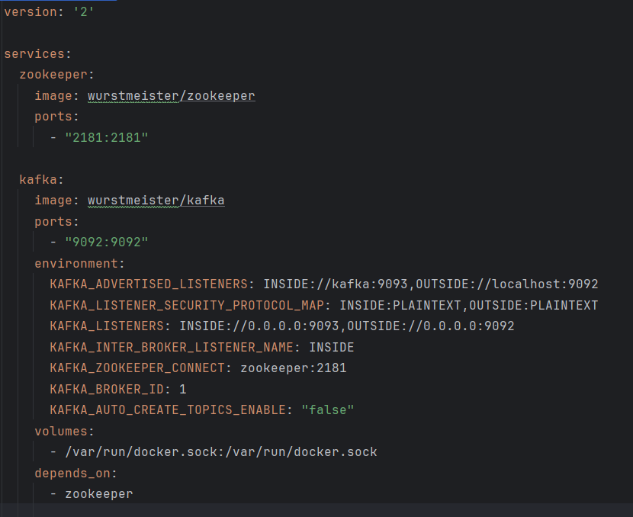
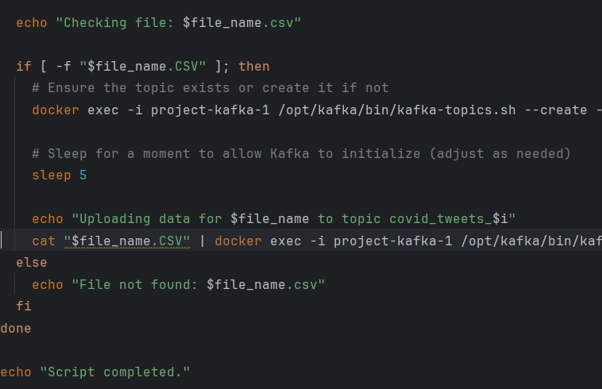
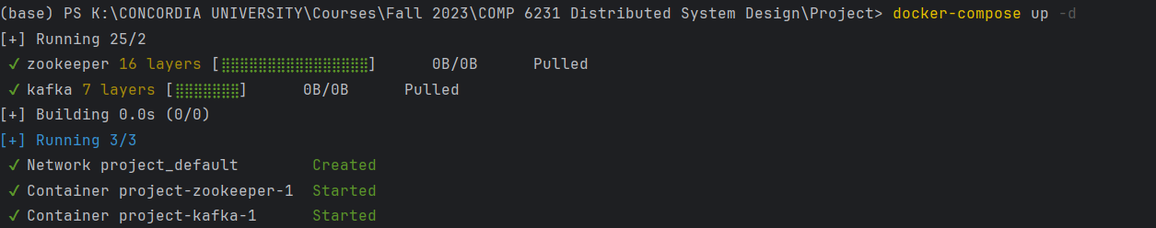
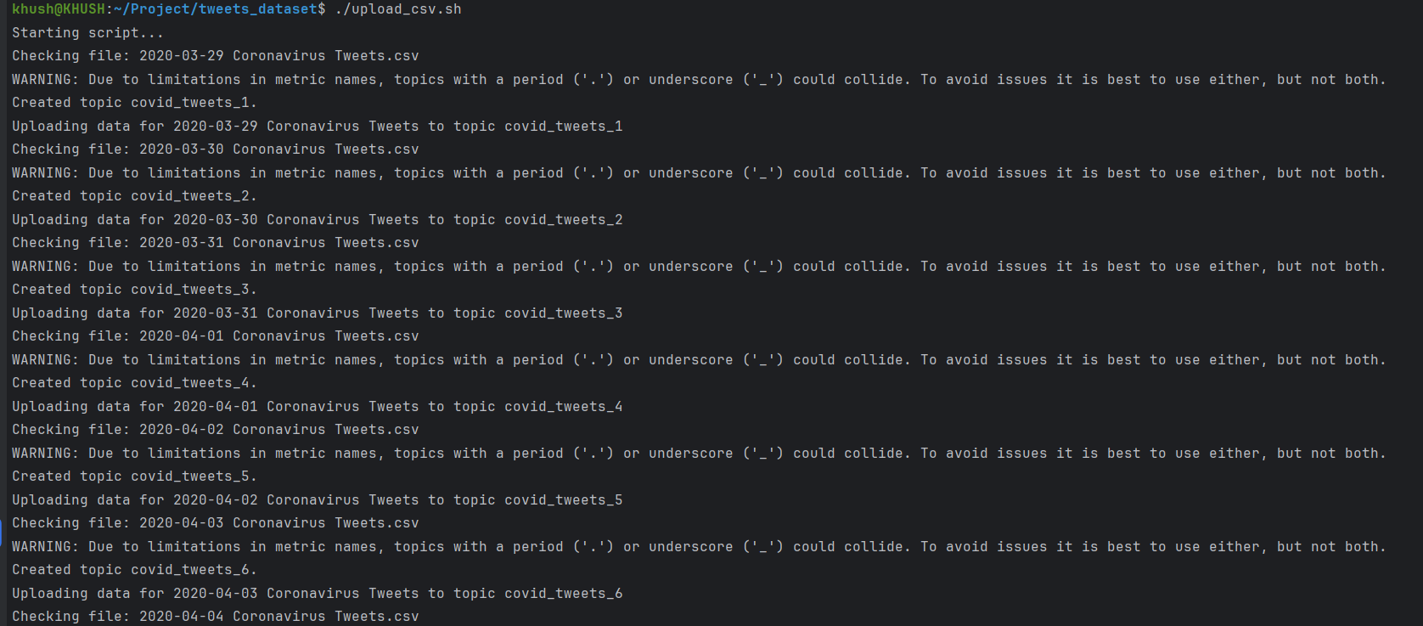
Docker-compose.yml
Upload_csv.sh

Slide 5
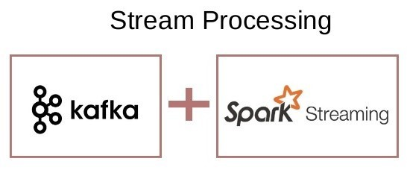
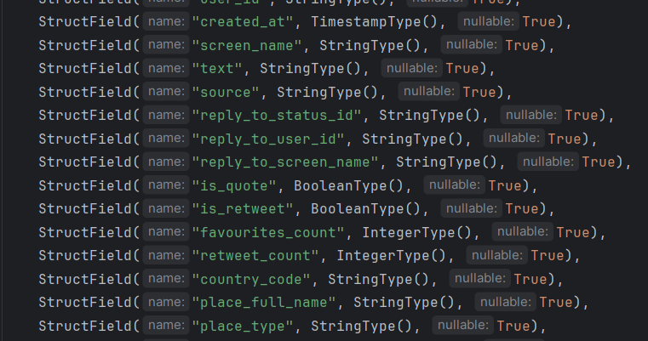
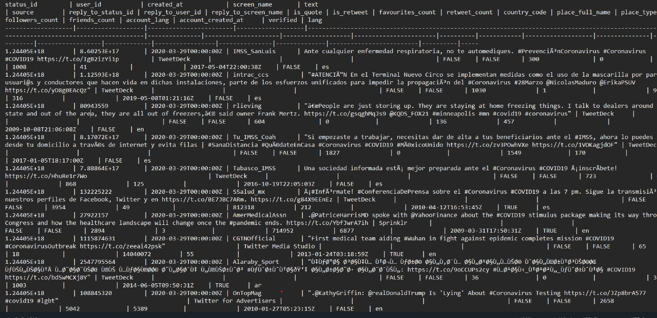
Kafka to Spark Integration
Notes:
Now, the topics created in the dockerized kafka are parallelly supplied into spark via multiple consumer groups. We have setup a spark local environment. And our csv files data have same number of columns, as a reason to this we have created a static tabular structure in spark because columns will remain same just the data will be added. Here, we have attached a screenshot of our data in a tabular structure with the help of which we will further clean this data and will use sentimental and statistical analysis.

Slide 6
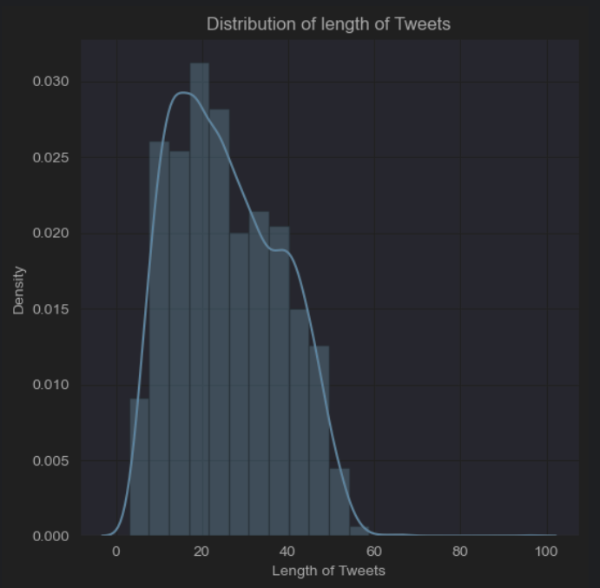
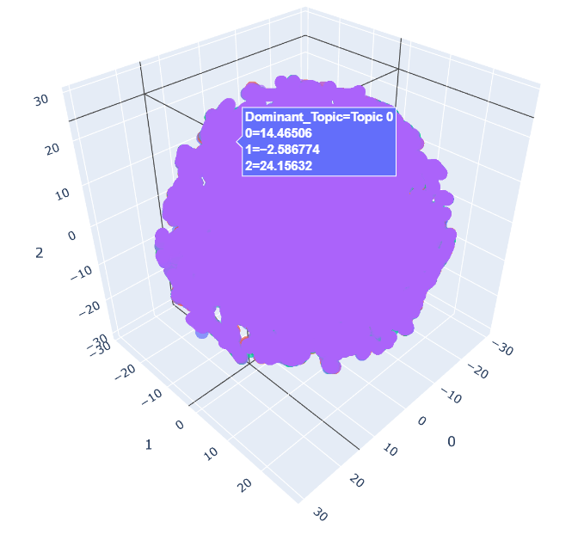
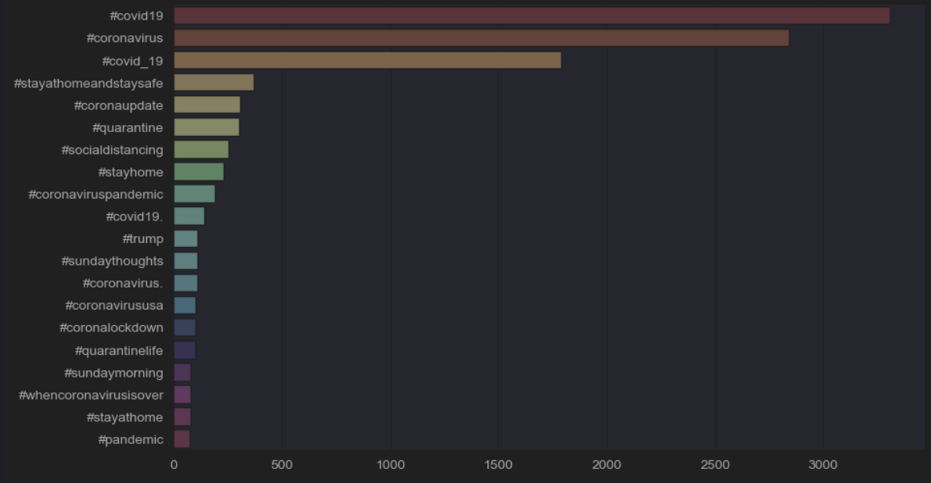

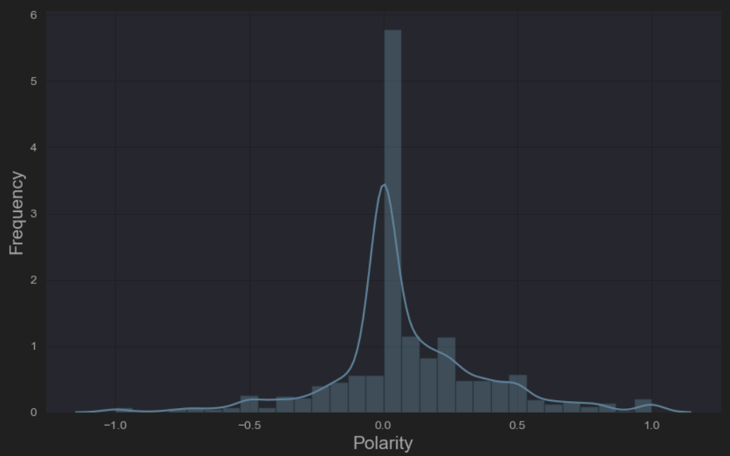

EDA and Statistical Analysis
Distribution of Tweet Lengths
3D t-SNE Plot
Top Hashtags Used
Unique Hashtags Stylecloud
Polarity Plot
Wordcloud

Slide 7
Limitations
Network Configuration and Communication Overhead.
Docker-Host Interaction
Dependency and Compatibility Issues
Integration Complexity and Management
Container Orchestration and Monitoring
Notes:
As we have setup spark locally, continuous interaction between docker and machine can lead to increased communication overhead. Also, while updating the current systems we have to keep in mind about their dependencies as well. While adapting to new systems or upgrading current system, we can face complexities while integrating them. Lastly, by increased scalability we have to continuously monitor our docker environment for any dissruptions in the system.

Slide 8
Future Enhancements
Deploy spark within Docker container
Scalability
Resource Sharing
Fault Tolerance
Scaling multiple instances of kafka consumer
Increases resource sharing
Notes:
While we addressed some of the distributed features of our system, we definitely can enhance the system further by deploying spark in a docker container. This can result in increased scalability, resource sharing as well as fault tolerance. Also, this removes our limitation of docker to host interaction as well.
Apart from this, we can inject multiple instances of kakfa consumer directly into spark which can lead to increased resource sharing.

Slide 9
THANK YOU

