Slide 1

GridPulse
AI-Assisted Grid Optimisation for a Renewable-First Power Grid
Team Renewabulls
IBM Bob AI Innovation Hackathon 2026
(Sustainability)
Manya Verma · Khush Tailor · Netra Vyas · Shourya
1

Slide 2



The Problem
Demand keeps shifting
Who feels this
Electricity demand fluctuates hour to hour, while grid capacity planning still moves slowly.
Grid operators and utility companies balancing live supply and demand every minute of every day.
Renewables are inconsistent
Why it matters
Solar and wind output swings with weather, making supply hard to predict or rely on.
Unmanaged instability risks outages — and unused clean energy gets curtailed, wasting renewable capacity we can't afford to waste.
Operators fly blind
Without timely, data-driven insight, spikes and underperformance are caught late — after instability or lost clean energy has already occurred.
Source: Renewabulls team README — problem statement
2

Slide 3



The Solution
GridPulse is an AI-assisted grid optimisation system: it forecasts demand and renewable generation, detects grid anomalies, and simulates balancing actions — so operators can act faster on data, not guesswork.
→
→
→
→
Live Grid Data
Forecast Demand
& Generation
Detect
Anomalies
Simulate Balancing
Actions
Operator
Decision
Outcome: Faster, data-driven decisions that keep the grid stable while maximising renewable-energy utilisation and reducing curtailment.
Source: Renewabulls team README — solution overview
3

Slide 4


How It Works
System pipeline, built around GridPulse's five core capabilities
Demand Forecasting
72-Hour What-If & Action Generator
Predicts short-term electricity demand from historical + real-time grid data.
Simulates balancing actions, recommends the best one on stability, cost & renewable use.
Renewable Performance Monitoring
AI Operator Brief
Compares expected vs. actual solar/wind output to catch underperformance.
Turns forecasts, anomalies & simulations into a clear, explainable next-step recommendation.
Anomaly & Red-Flag Engine
Flags abnormal grid conditions and assigns severity for early warning.
Pipeline structured from the five features described in the repo README
4

Slide 5
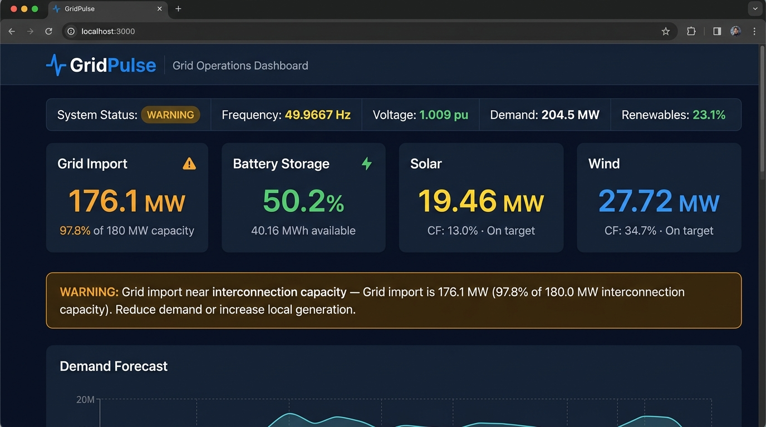

Key Feature: AI Operator Brief
From raw signals to a decision an operator can act on in seconds
Forecast output
↓
Anomaly flags
↓
Simulated actions
Insert product screenshot or short demo GIF frame here
(e.g. Operator Brief panel, dashboard, or What-If simulator)
Plain-language, explainable
recommendation for the operator
Reference: docs/setup-guide.md and demo/screenshots/ in the repo
5

Slide 6

IBM Technologies Used
IBM Bob
watsonx.ai
IBM Cloud / other
✎ TO CONFIRM Add specifics: how Bob was used in the build — e.g. codebase reasoning, agent workflows, scaffolding.
✎ TO CONFIRM Add specifics: which model(s) power forecasting / anomaly detection / the Operator Brief, and how they're called.
✎ TO CONFIRM Add specifics: any IBM Cloud services, Orchestrate, or Granite models used in the pipeline.
This section wasn't filled in on the repo's README yet — replace the boxes above with the exact IBM tools and how each was used before submitting.
6

Slide 7

Results & Impact
What success looks like for a grid operator using GridPulse
Less renewable
curtailment
More stable
grid operation
Faster
decision cycles
Earlier anomaly
detection
7

Slide 8


The Team
Renewabulls
Khush Tailor
Manya Verma
Netra Vyas
Shourya
Team Lead
Member
Member
Member
Implementing Code, interacting with Bob AI
mvp
Research, Repository, Presentation slides
Research and Development
Research and Development, visual formatting
Names from the repo README — add each person's specific contribution above
8

