Slide 1

Netflix Data Analysis & Business Insights
Internship Project — Data Analytics · Khushal Dak
Offer ID: AT/INT/2031082 · Start Date: 22 July 2026
PYTHON
PANDAS
MATPLOTLIB
SEABORN
JUPYTER NOTEBOOK
GitHub Link :-
Khushal-dak/netflix-data-analysis-dashboard: End-to-end Netflix data analysis and interactive Streamlit dashboard covering content type, country-wise distribution, release trends, and exploratory visualization.

Slide 2
Project Overview & Dataset
Dataset at a Glance
8,790
11
Total Records
Key Columns
Key Columns
show_id · type · title · director · country · date_added · release_year · rating · duration · listed_in
Analytical Objective
Prepare the Netflix dataset for reliable analysis and extract meaningful business insights related to content type distribution, geographic concentration, and release-year production trends.
Data Types
Mixed — 1 integer column, 9 string columns, datetime attributes

Slide 3
Task 1 — Data Cleaning & Preparation
STEPS 1–3
1
2
3
Dataset Import & Inspection
Missing Value Investigation
Duplicate Record Verification
Imported with Pandas: 8,790 records, 10 columns
Verified structure, column names, and data types
Confirmed: 1 integer, 9 string columns
Null check via df.isnull().sum()
Result: 0 SQL-style null values detected
All missing data represented as "Not Given" placeholders
Full-row duplication check performed
Result: 0 duplicate rows found
Title-level investigation performed separately — no duplicates

Slide 4

STEPS 4–5
Step 4 — Categorical Standardization
Step 5 — Placeholder Handling & Recovery Testing
Column
Unique Values
Status
Director — 2,588 "Not Given"
Country — 287 "Not Given"
Type
2
✅ Valid
Country
86 incl. "Not Given"
⚠️ Cleaned
Recovery test: 0 titles with valid directors matched "Not Given" entries → Replaced with "Unknown"
Treated as unavailable → Replaced with "Unknown"
Rating
14
✅ Valid
Director
4,528
⚠️ Cleaned
Principle: Missing information was never fabricated — retained as "Unknown" rather than guessed or removed.

Slide 5
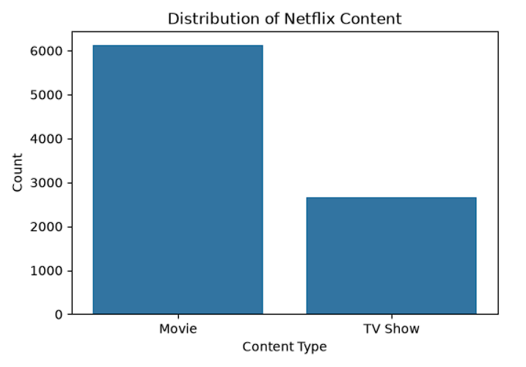
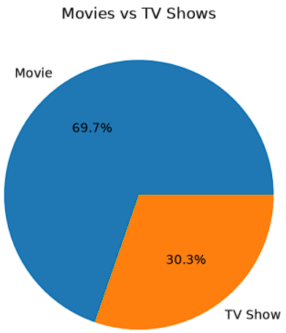
Task 2 — Content Type Analysis
STEPS 1–5
Movies
TV Shows
Key Finding
6,126 titles — 69.7%
Dominant share of catalog
2,664 titles — 30.3%
Significant but secondary segment
Nearly 70% movie-based — strong movie-focused strategy evident

Slide 6
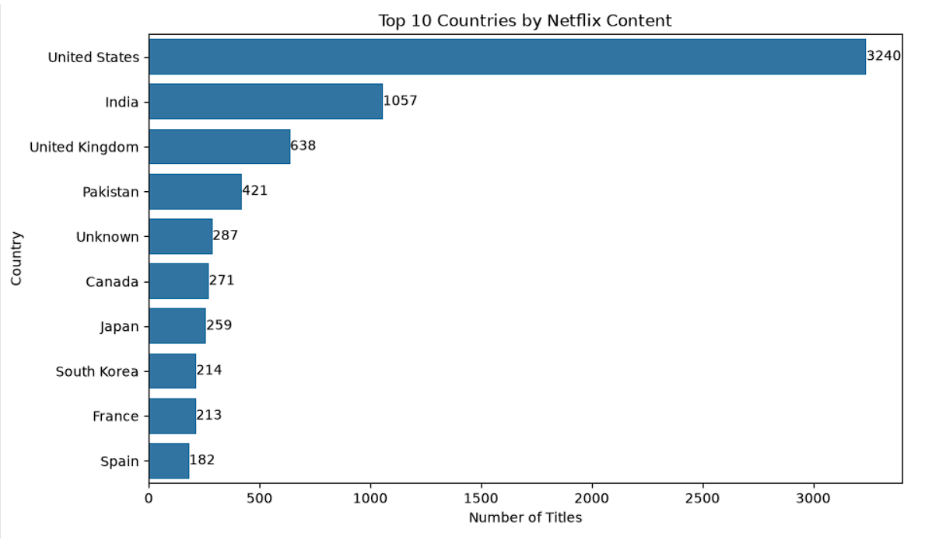
Task 3 — Country-Wise Content Analysis
STEPS 1–4
Top Content-Producing Countries
Country
Titles
United States
3,240
India
1,057
United Kingdom
638
Pakistan
421
Canada
271
Japan
259
South Korea
214
France
213
Spain
182

Slide 7
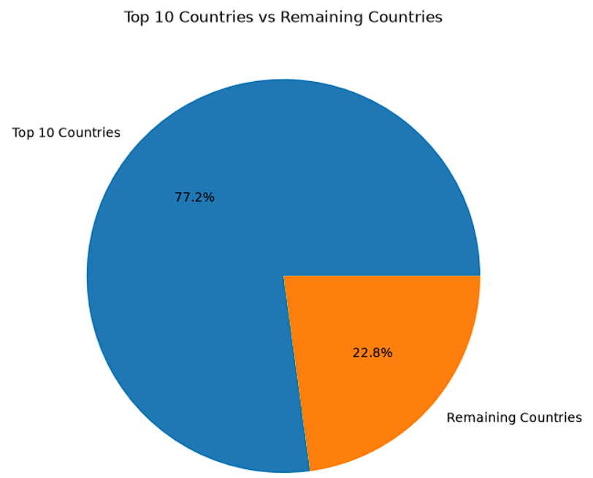
Task 3 — Geographic Concentration
STEP 5 — BUSINESS INSIGHTS
Top 10 Countries
77.2% of total Netflix content
India + UK
Combined 19.3% of catalog
US Dominance
36.9% of all content from United States alone
Long Tail
76 countries share only 22.8% of content

Slide 8
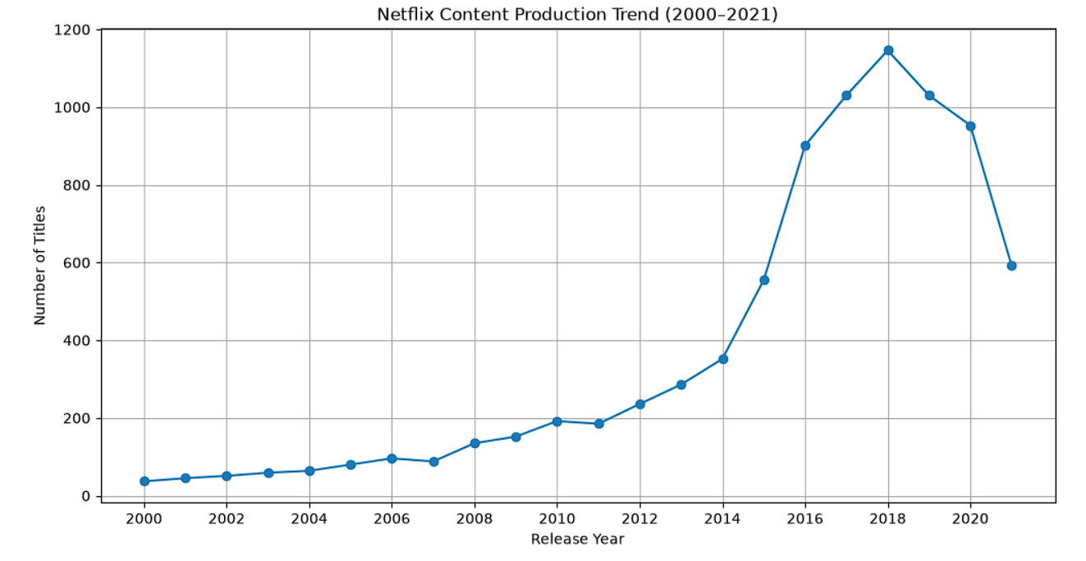
Task 4 — Release-Year Trend Analysis
STEPS 1–3
Dataset Properties
Column: release_year — Integer (int64)
No missing values
Year range: 1925–2021
Methodology
Grouped dataset by release_year
Counted content per year
Calculated year-over-year % growth
1,146
+62%
−38%
Peak Year 2018
2016 Growth
2021 Decline
Highest production year on record
+346 titles — largest YoY increase
−361 titles — largest YoY decline

Slide 9
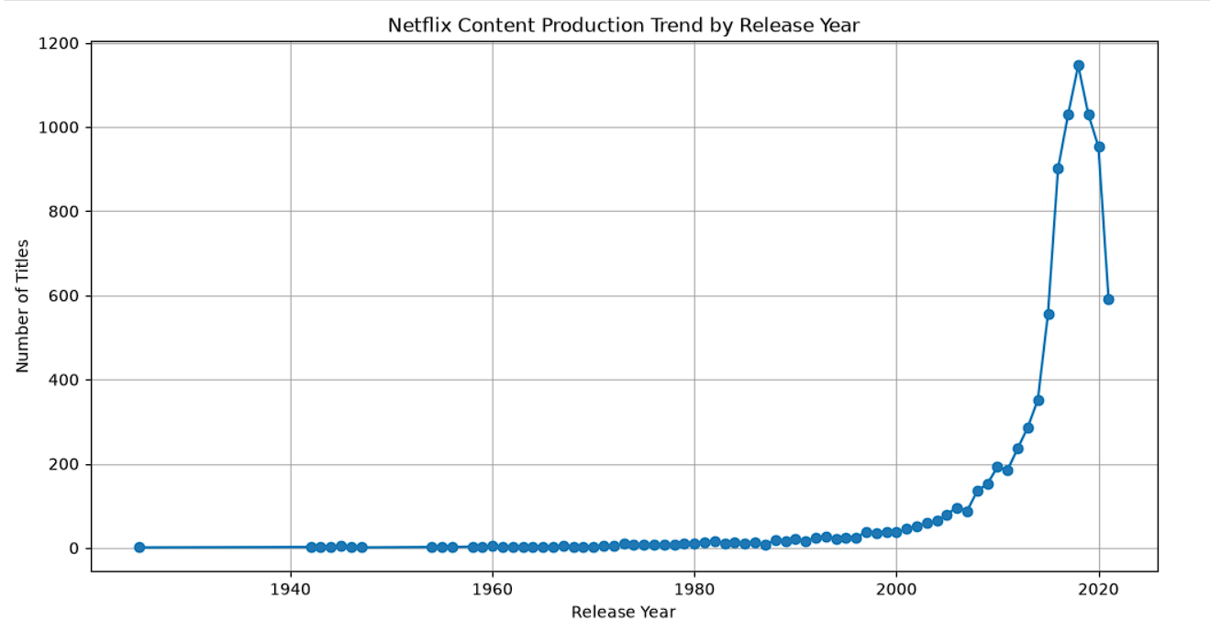
Task 4 — Release-Year Trend Visualizations
STEPS 4–5
2000–2015
1
Steady growth in
content acquisition
2
2015–2018
Explosive expansion
— 2016 peak: +62.34%
2018 Peak
3
1,146 titles
all-time high
4
2018–2021
Sustained contraction
— strategic quality shift

Slide 10

Project Summary
From Raw Data to Business Insights
Task 1 — Data Cleaning
0 nulls · 0 duplicates · Standardized "Not Given" → "Unknown"
Task 2 — Content Type
Movies 69.7% · TV Shows 30.3%
Task 3 — Geography
Top 10 = 77.2% · US leads with 3,240 titles
Task 4 — Trends
Peak 2018: 1,146 titles · 2016 growth: +62.34%
Built an evidence-based analytical workflow from data cleaning to business insight generation — demonstrating proficiency in data validation, EDA, and visualization using Python · Pandas · Matplotlib · Seaborn.

