Slide 1

CARDIOVASCULAR RISK ASSESSMENT
Khushal Gogia
18/09/2023

Slide 2

TRANSFORMING LIVES WITH DATA SCIENCE
Cardiovascular diseases, such as heart attacks and strokes, often manifest with subtle warning signs or risk factors long before a major event occurs
Early detection allows individuals to identify and address risk factors early, reducing the chances of severe health complications.
In essence, early detection using data-driven insights is like having a Crystal Ball that reveals potential health challenges. It empowers individuals to rewrite their health stories, leading to better and longer lives.

Slide 3

DO YOU KNOW?
It's not an exaggeration to say that heart disease is a global epidemic. According to the World Health Organization (WHO), it's the leading cause of death worldwide.
The statistics are staggering. Every year, millions of lives are claimed by heart disease, surpassing any other health condition.
Moreover, heart disease affects people of all ages and backgrounds, dispelling the myth that it's an ailment exclusive to the elderly.

Slide 4
PROJECT OBJECTIVE
One of our key goals is to harness the power of data science to predict cardiovascular risk accurately.
Through advanced analytics and machine learning, I've created a tool that can potentially save lives by identifying risks before they become critical.
Our project is not just about numbers and predictions; it's about people and their well-being.

Slide 5
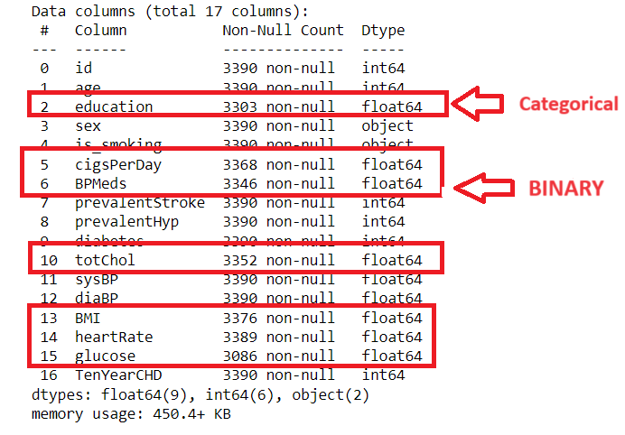
DATA PRE-PROCESSING
HANDLING NULL VALUES
Null values in data can lead to inaccuracies in predictions and insights. In our project, I prioritize data integrity.
I've implemented a systematic approach to handle null values. Instead of ignoring or blindly filling them, I carefully analyze each column.
For Numerical columns, I replaced null values with their median
For Categorical and binary columns, I used mode for handling null values

Slide 6
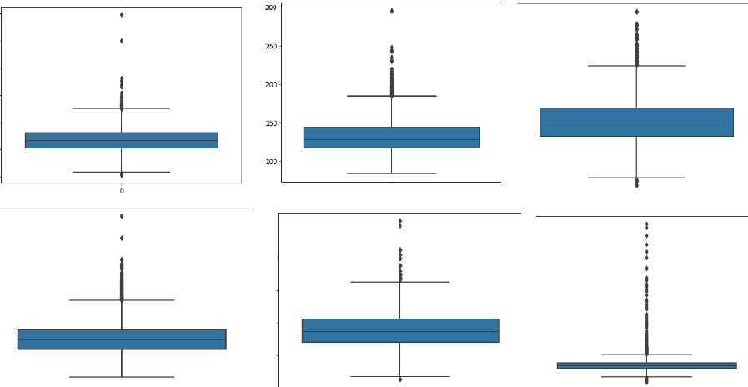
DATA PRE-PROCESSING
Outlier Removal Using IQR Method:
Outliers can distort the accuracy of predictive models. To maintain data quality, we've adopted a two-step approach to outlier handling.
Features with outliers – [totChol, sysBP, diaBP, BMI, heartRate, glucose]
Firstly, we calculate the Interquartile Range (IQR) for each numerical feature, a statistical measure of data spread.
Next, we identify outliers as data points falling below Q1 - 1.5 * IQR or above Q3 + 1.5 * IQR

Slide 7
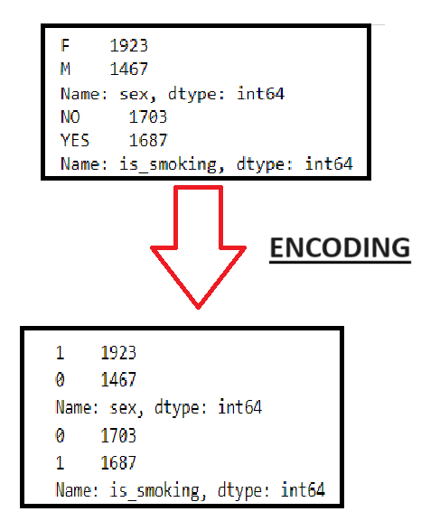
DATA PRE-PROCESSING
Encoding
There were two categorical columns in the data i.e. [sex , is_smoking]
For the process of model building, I converted them into 0 and 1 as you can see on the screen

Slide 8
EDA - EXPLORATORY DATA ANALYSIS

Slide 9
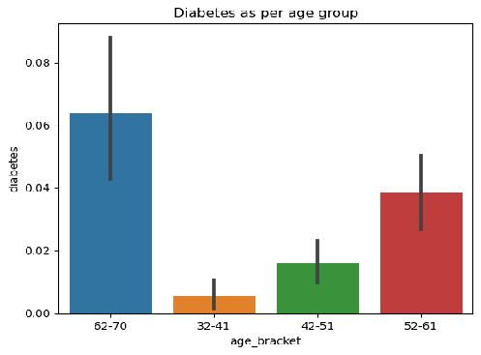
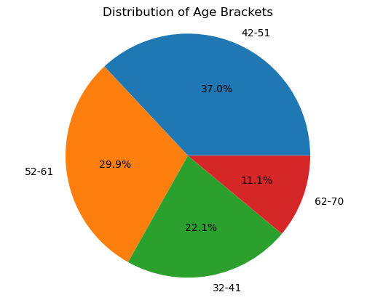
FINDINGS
Most of the data collected is for the Old age people so data might be biased
Old people are more susceptible to diabetes

Slide 10
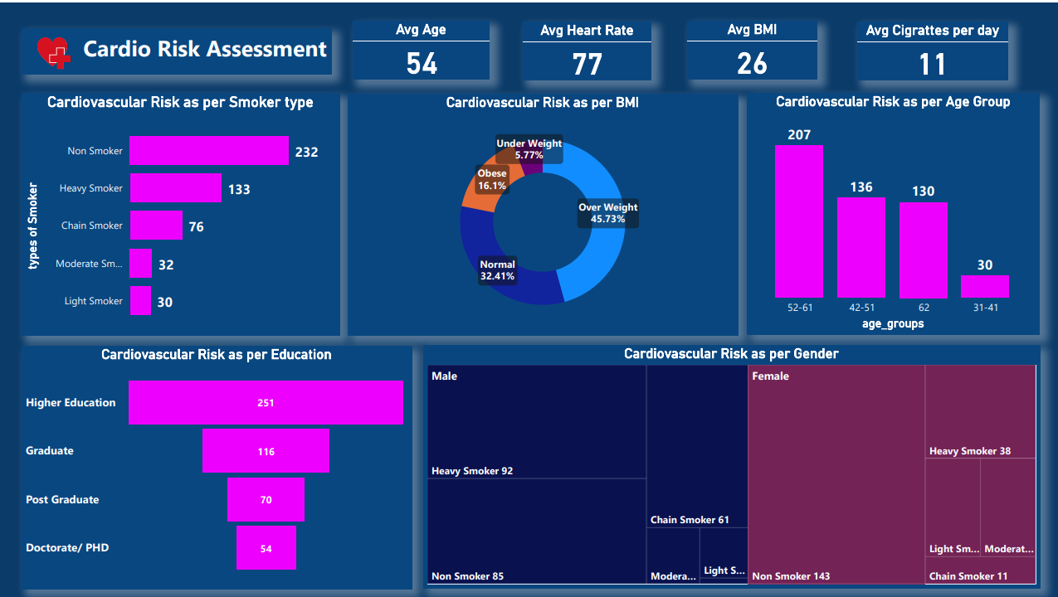

Slide 11
KEY FINDINGS
Interestingly two extremes are more likely for the risk of cardiovascular disease i.e. Non Smoker and Heavy Smoker
Your Educational Background also determines your risk for Cardiovascular Disease, least educated you are, more risk for cardiovascular disease
As per this data, old age people are most likely to have cardio vascular disease
People who have risk for cardiovascular disease smokes an average of 11 cigarettes

Slide 12

MODEL TRAINING
Model training is where the magic happens.
In my project, I wanted to explore how different data scenarios can affect my model's performance.
Specifically, I delved into two scenarios: one with balanced training data and another with balanced training and test data.

Slide 13
SCENARIO 1
In Scenario 1, I explored a more real-world scenario where I focused on balancing only the training data while keeping the test data imbalanced.
To address the class imbalance issue, I applied the Random Over-sampling Technique exclusively to the training dataset. This approach allowed me to create synthetic samples while preserving the original test data distribution

Slide 14
SCENARIO 2
In Scenario 2, my focus was on addressing the challenge of class imbalance, I focused on balancing both train and test data.
To tackle class imbalance, I employed the RandomOverSampler technique, which creates synthetic samples of the minority class. On the training data
This ensured a balanced representation of cardiovascular risk instances.

Slide 15
OUTCOMES
Scenario 1 : While this strategy aimed to mimic a real-world setting, we observed some trade-offs:
Accuracy Score : 87%
Recall Score : 50%
Scenario 2 : Our efforts in balancing the dataset yielded impressive results:
Accuracy Score : 100%
Recall Score : 97%

Slide 16
TRADE-OFFS OBSERVED
The recall score, in particular, showed a noticeable drop compared to Scenario 2
Although Scenario 1 resembles real-world conditions more closely, the trade-offs in recall accuracy highlight the challenges faced when dealing with imbalanced data.
It emphasizes the importance of selecting the most appropriate strategy based on project goals
These scores demonstrate our model's robustness in identifying individuals at risk of cardiovascular issues.

Slide 17
INSIGHTS AND RECOMMENDATION
Focus on improving health literacy among individuals with lower education levels. Provide easily understandable materials and access to educational programs on heart health.
Promote regular health check-ups for older adults, and emphasize preventive measures such as a balanced diet, regular exercise, and stress management to reduce the risk of heart disease.
Develop gender-specific health programs that target these high-risk groups. For male heavy smokers, focus on smoking cessation programs and emphasize the importance of early detection through regular check-ups. For females, promote and maintain healthy lifestyle choices, including regular exercise and a balanced diet.

