Slide 1

ANALYZING GOLD PRICE TRENDS
KHUSHAL GOGIA
02/03/2024

Slide 2

DO YOU KNOW?
Despite its high value, gold is actually edible and is sometimes used as a decoration on food and drinks, adding a touch of luxury to special occasions.
Gold has been used in medicine for centuries and is still used today in treatments for certain medical conditions
Despite its widespread use and popularity, gold is incredibly rare in the Earth's crust. In fact, all the gold ever mined throughout history would only fill about three Olympic-sized swimming pools, highlighting its scarcity and value.

Slide 3

TRANSFORMING LIVES WITH DATA SCIENCE
Forecasting Financial Stability: By analyzing historical trends and patterns in gold prices, data science enables us to forecast future price movements with greater accuracy. This empowers individuals and businesses to make informed decisions and plan for financial stability.
Optimizing Investment Strategies: Advanced modeling techniques allow us to develop predictive models that optimize investment strategies in the gold market. These models provide valuable insights into market dynamics and help investors navigate uncertainties more effectively.
Enhancing Market Transparency: Data science tools facilitate market sentiment analysis, shedding light on the impact of external events and investor sentiment on gold prices. This enhances market transparency and fosters a deeper understanding of price movements

Slide 4

PROBLEM STATEMENT
Analyze historical trends and patterns in gold prices using a comprehensive dataset from Nasdaq.
Dataset spans from January 19, 2014, to January 22, 2024.
Includes key financial metrics for each trading day:
Opening and closing prices
Trading volume
Daily highs and lows

Slide 5
PROJECT OBJECTIVE
Time Series Analysis: Explore historical trends and patterns in gold prices over the specified time period. Identify seasonality, cyclicality, and any discernible long-term trends in the gold market.
Advanced Modeling: Develop predictive models to forecast future gold prices based on historical data. Evaluate and compare the performance of different forecasting algorithms.
Market Sentiment Analysis: Investigate the impact of market events on gold prices. Assess market sentiment and its influence on short-term and long-term price movements.

Slide 6
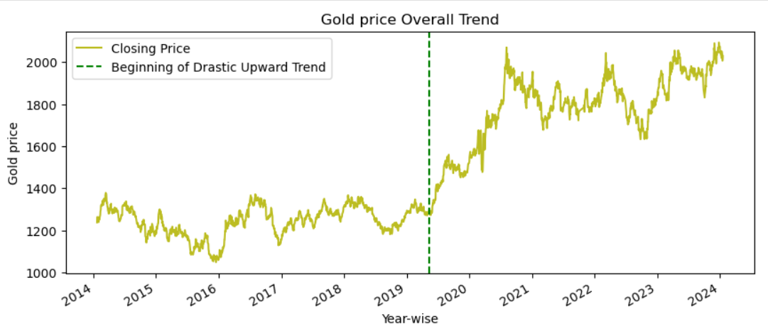
Drastic Upward Trend at the Start of COVID-19
The onset of the COVID-19 pandemic in early 2020 triggered a dramatic surge in gold prices, marking a significant upward trend in the market.
As the global pandemic unfolded, investors sought refuge in safe-haven assets like gold, driving up demand and consequently, prices.
This surge in gold prices during the initial months of the pandemic reflected heightened uncertainty and volatility in financial markets, with investors seeking assets perceived as less risky.

Slide 7
Impact of Federal Reserve Rate Increase in May 2019
In May 2019, the Federal Reserve raised interest rates from 2.25% to 2.50%, signaling a shift in monetary policy.
The Federal Reserve's decision to increase rates had a notable impact on gold prices, with rates rising in response to the anticipated higher borrowing costs.
The rate hike was interpreted by investors as a signal of tightening monetary policy, leading to increased demand for gold as a hedge against inflation and currency devaluation.

Slide 8
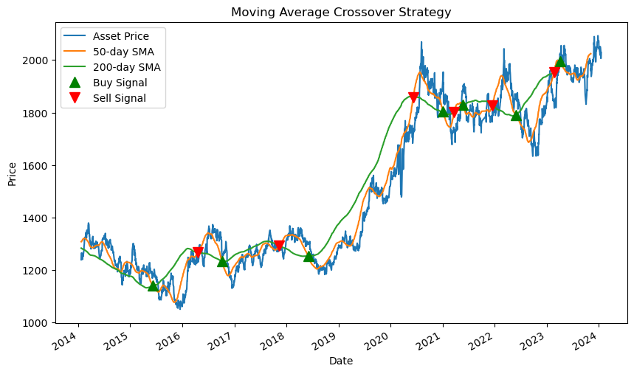
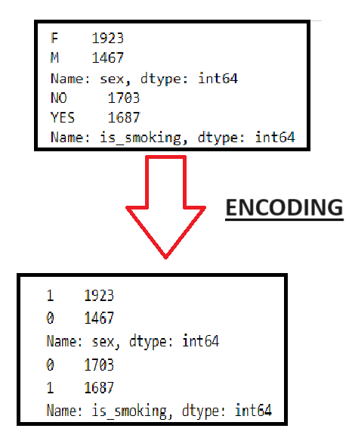
INSIGHTS
The long-term trend from 2016 to 2020 was bullish for gold prices, as both moving averages and price bars were rising steadily.
There is increased volatility post-2020, indicating uncertainty or changing market conditions. The moving averages have crossed over multiple times post-2020, suggesting no clear trend is established during this period.

Slide 9
RECOMMENDATIONS
The price appears to be breaking above a previous resistance level (around 2000) in recent times. This could signal a potential continuation of the upward trend. However, it is important to note that past performance is not necessarily indicative of future results
Consider diversifying your investments to mitigate risks associated with the volatile nature of gold prices post-2020. You can explore other asset classes such as stocks, bonds, commodities, etc.

Slide 10

MODEL TRAINING
Model training is where the magic happens.
Utilizing advanced modeling techniques, such as XG Boost, we have developed robust predictive models for forecasting future gold prices.
Our XGBoost model achieved an impressive R-squared score of 99.5% and a mean squared error of 356, indicating high accuracy and predictive power.

Slide 11
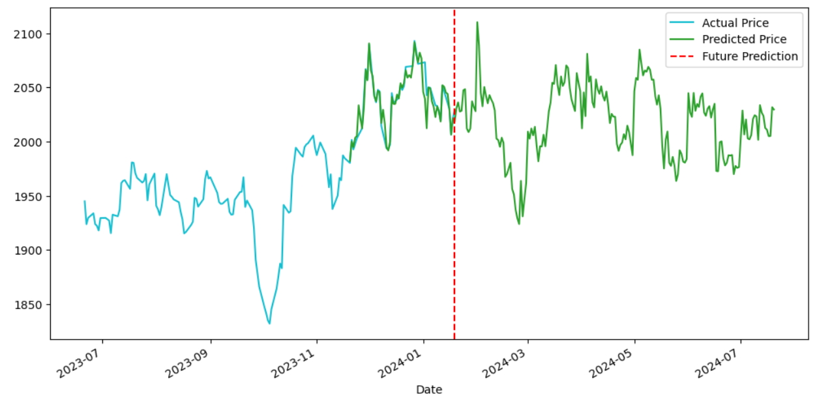
PREDICTION
The prediction graph illustrates the performance of our model, showcasing its ability to accurately forecast gold prices over the specified time period.

Slide 12
INSIGHTS
Gold prices are likely to remain high in the near term due to the prevailing geopolitical and economic uncertainties.
Gold prices may face some downward pressure from lower demand in India and other emerging markets.
Gold prices may experience more volatility depending on the developments of the global events and the actions of the central banks.

