Slide 1

PREDICTING ONLINE SHOPPERS INTENTIONS
Khushal Gogia
23/05/2023

Slide 2
INTRODUCTION
In Today's digital era, online shopping has become increasingly significant, revolutionizing the way people shop and businesses operate.
Online shopping allows customers to browse, compare prices, and make purchases from the comfort of their homes, eliminating the need for physical stores and expanding market reach for businesses.

Slide 3
IMPORTANCE
That is why understanding and analyzing the shoppers intention will give edge to any business against their competitors and could help the business to grow exponentially
Interpreting and analyzing will also help the business to optimize marketing strategies, personalize user experiences, and improve conversion rates.

Slide 4
SIGNIFICANCE
Targeted marketing campaigns – Businesses can leverage our predictive model by doing targeted marketing campaigns
Website Optimization – Optimizing the website as per the need of the shoppers will help the business to rise exponentially
Identify Customers – Our predictive model can help businesses identify customers who are more likely to make a purchase, thereby maximizing sales opportunities.

Slide 5
OBJECTIVE
The Purpose of my Project: to develop a predictive model that can determine the likelihood of a shopper making a purchase.
The Model will leverage online behavior data and relevant characteristics of shoppers to make accurate predictions.
Model’s predictions can assist businesses in tailoring their marketing efforts and enhancing the overall shopping experience.

Slide 6
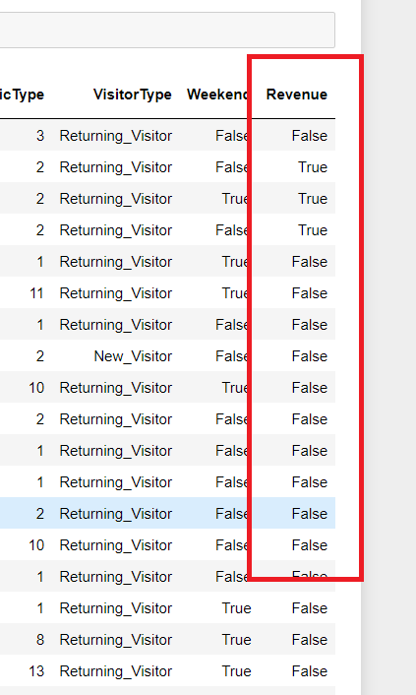
FEATURES & TARGET VARIABLE
Our Target Variable is whether a shopper makes a purchase or NOT (True or False). It serves as the key indicator of conversion and provides valuable insights into customer behavior.
The GOAL is to develop a Predictive Model that accurately determines the likelihood of a shopper making a purchase based on their online behavior and characteristics.
The Features used in the model encompass a wide range of factors that can influence shopper behavior. These include browsing patterns, such as the number of page views, session duration, and time spent on specific pages. Other potential predictors may include traffic sources, device type, Operating system. And also trying to gather whether the visitor is returning visitor or new

Slide 7
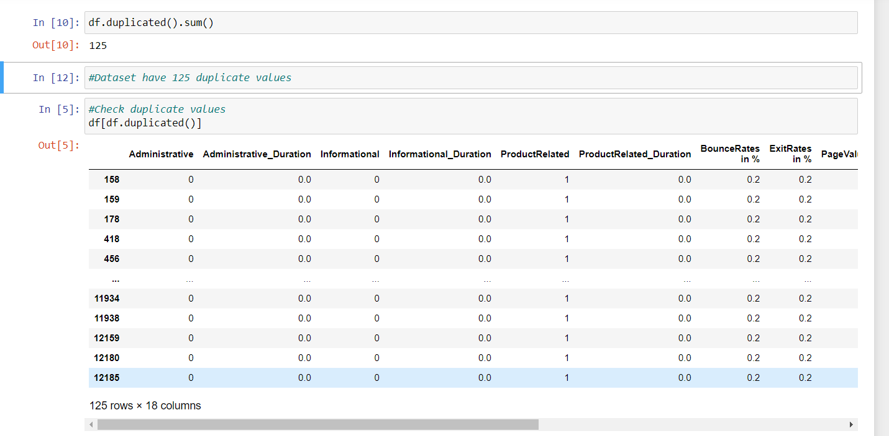
DATA PRE-PROCESSING
Dataset has 125 duplicate values and luckily no null values
Hence, We need to remove duplicate values while cleaning our data

Slide 8
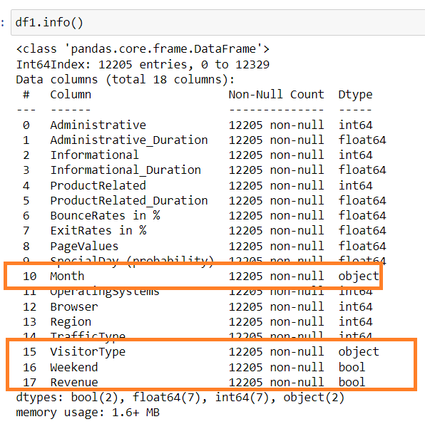
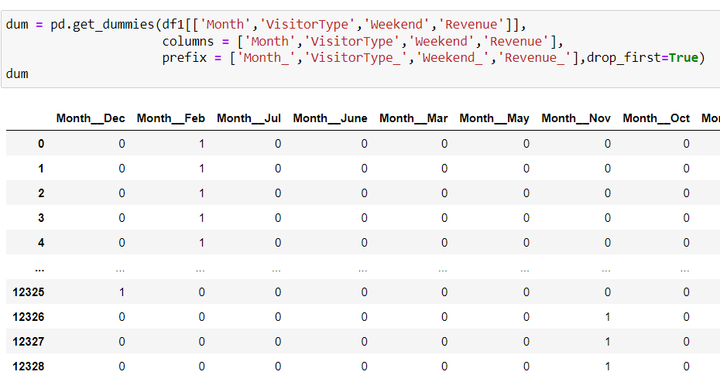
Encoding
Since, we have object and Boolean data type in our dataset, so we needed to encode those variables for the model building
Hence, we can’t use label encoding in month variable.
That’s why I used get_dummies() while encoding

Slide 9
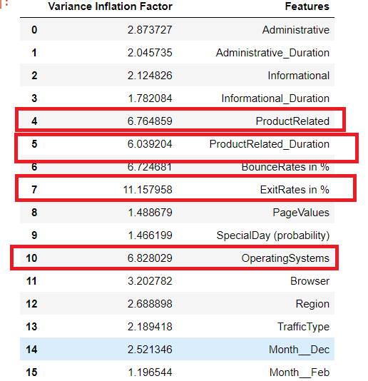
Multi-Collinearity
I had used variance inflation factor method to check multi-collinearity
As shown in the image, data has multi-collinearity problem as many variables having VIF more than 5
So accordingly, I had removed several highly co-related columns

Slide 10
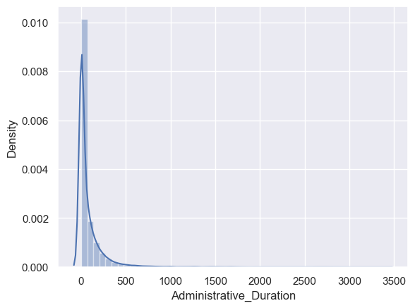
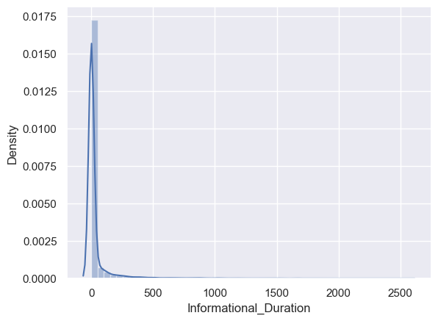
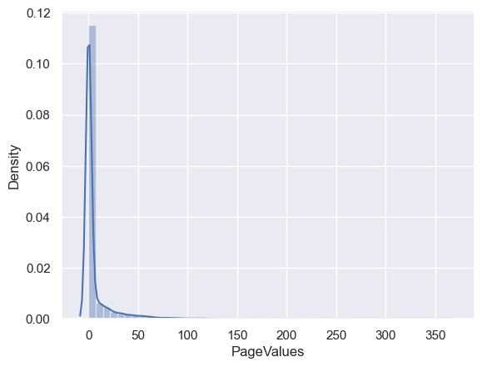
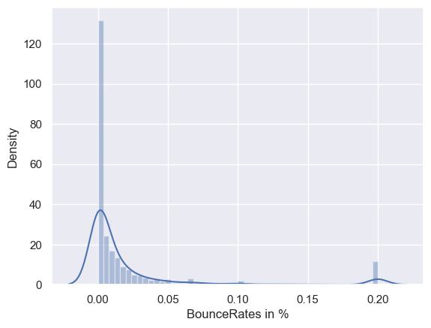
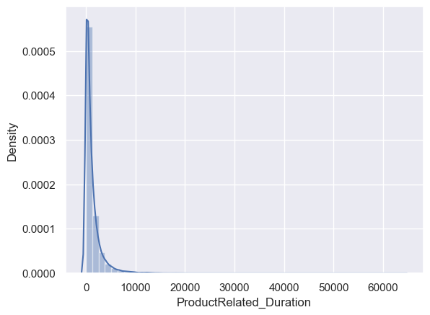
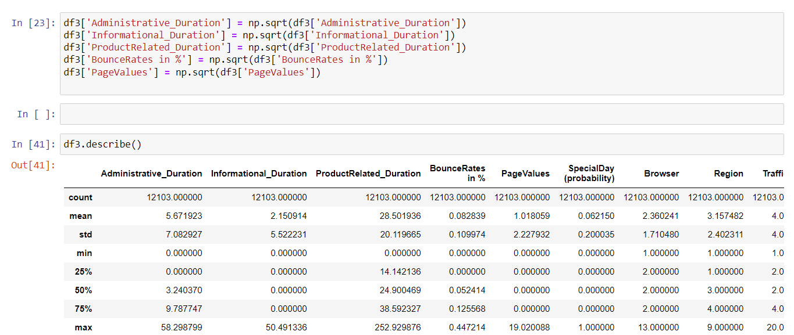
Skewness
As shown in the images, data has Positive Skewness
Hence, I handled skewed data using Square Root Transformation

Slide 11
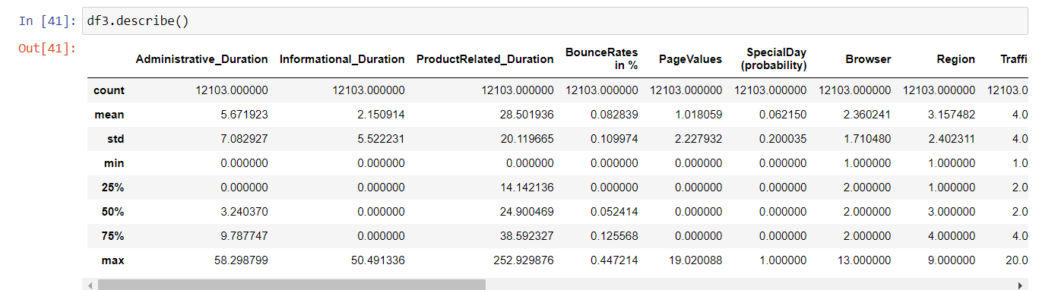
Outliers
Since Difference between Minimum and Maximum value is way too less, then no need to handle outliers

Slide 12
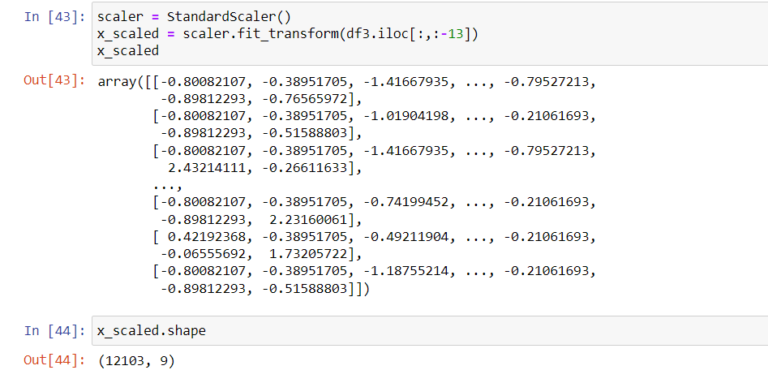
Feature Scaling
Feature scaling has become the necessity as there are different range of data,
and Scaling the data will help in the process of model building

Slide 13
Exploratory Data Analysis (EDA)

Slide 14
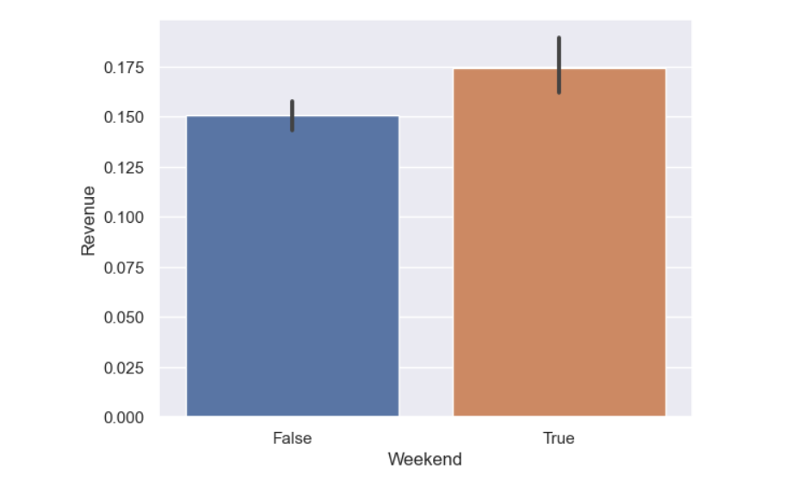
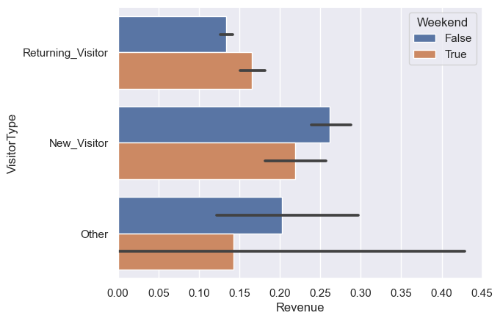
Weekend is more profitable as it generate more visitors who generates Revenue
Mostly New Visitors are generating Revenue on weekends

Slide 15
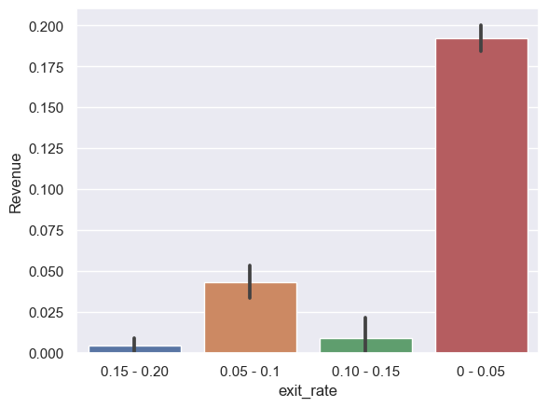
As the data has shown, Lesser the Exit Rates and Bounce Rates, Better for the website

Slide 16
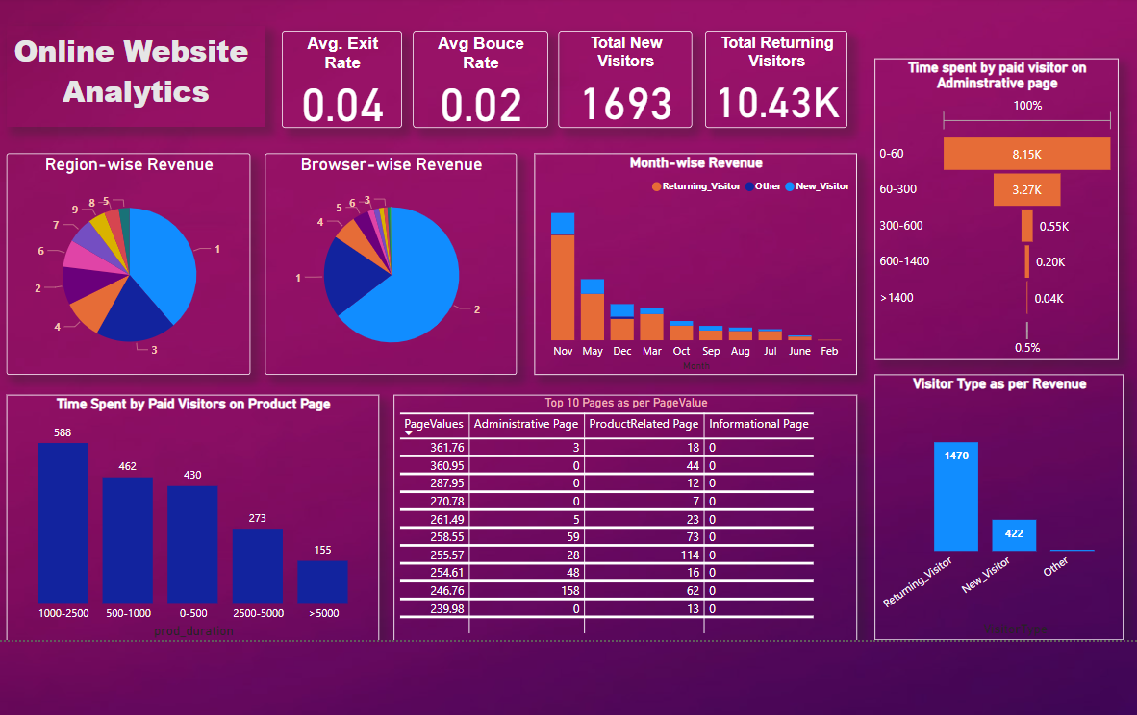

Slide 17
Key Points
#1 Region is where most of the shoppers visit the website
Most shoppers use #2 Browser
Website is not able to attract New Visitors but have really good Retention rate
November is the most Profitable month
People who generally shops from our website spent around 1000 – 2500 seconds on product page

Slide 18
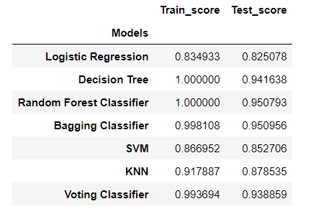
Model Training:
I trained the model using Logistic Regression, Decision Tree, Random Forest, Bagging Classifier, SVM,KNN and Voting Classifier
However, Random Forest and Bagging Classifier seems to more accurate models (as shown in the figure)

Slide 19
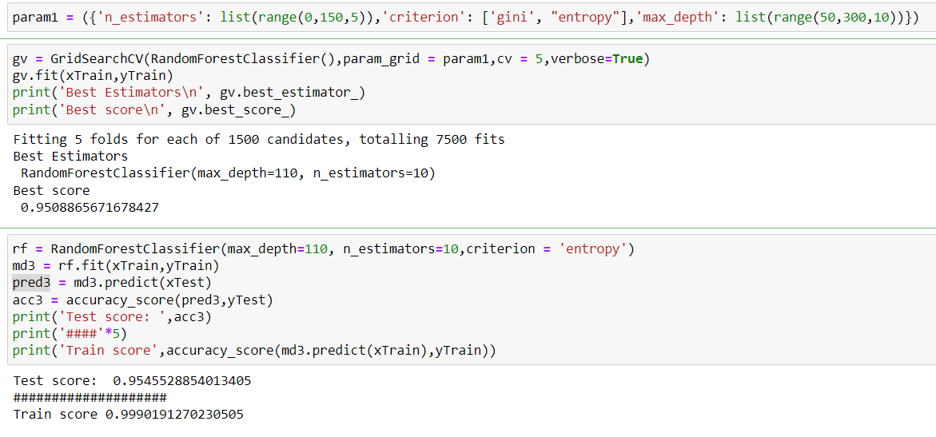
Performance Estimates
I ran GridSearchCV() on Random Forest model for hypertuning and the reliability of the model
Here are the results :

Slide 20
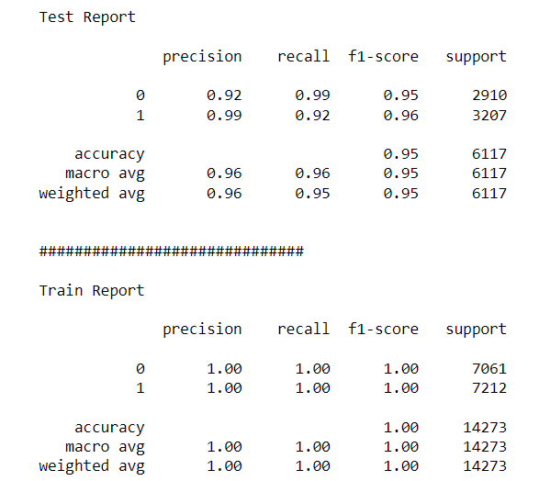
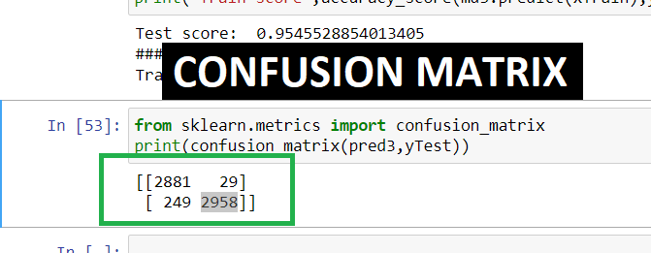
Model Evaluation

Slide 21
Insights and Recommendations:
Target Marketing Efforts: Focus marketing efforts on Region 1 since it attracts the majority of shoppers. Allocate resources and campaigns specifically targeting this region to maximize reach and engagement.
Optimize Website Compatibility: Given that most shoppers use Browser 2, ensure that the website is fully optimized and compatible with this browser. Conduct regular testing and updates to ensure a seamless user experience.
Enhance New Visitor Acquisition: Despite good retention rates, the website is struggling to attract new visitors. Implement targeted marketing strategies to increase brand awareness and attract new users. Consider social media advertising, search engine optimization (SEO), and referral programs to expand the customer base.

Slide 22
Leverage November's Profitability: Capitalize on the profitability of November by launching special promotions, discounts, or exclusive offers during this month. Develop marketing campaigns tailored to the seasonal shopping behavior observed in November to further drive sales.
Focus on Weekend Revenue Generation: Allocate additional resources and marketing efforts to capitalize on the higher revenue generation during weekends. Develop targeted promotions or exclusive deals specifically for weekends to attract more visitors and drive sales.
Nurture New Visitors during Weekends: Leverage the trend of new visitors generating revenue on weekends by tailoring marketing campaigns to this segment. Offer incentives, discounts, or personalized recommendations to encourage new visitors to make a purchase during their weekend visits.

Slide 23
THANK YOU

