Slide 1
Healthcare Applications with IoT
Team:
Patel Khushali
Patel Trisha
Thakkar Shraddha

Slide 2

Objectives
Introduction
IoT in Healthcare
Importance of IoT in Healthcare
Requirements
Architecture of Healthcare System
Sensors
Heartbeat sensor
Temperature sensor
Oximeter sensor
How Application Works
Future of IoT in Health Care
Conclusion

Slide 3
Introduction
What is IoT?
The Internet Of Things is actually a pretty simple concept, it means talking all the physical places and things in the world and connecting them to the internet.
When something is connected to the internet, that means that it can send information or receive information, or both. This ability to send and/or receive information makes things “SMART”.

Slide 4
IoT in Healthcare
What is IoT in Healthcare?
With the Internet of Things, you can configure a centralized network of interconnected devices to generate and exchange data within a single framework.
All of this data can also be tracked and collected in real-time, allowing for the passive accumulation of analytical materials.
In terms of improving medical equipment, this means that a typical hospital can become an intelligent hospital.
It is an advanced facility where we can track and manage everything simultaneously while all data is collected in a central database.
These technological features open up myriad opportunities to improve the convenience, efficiency, and even budget saving of modern hospitals.

Slide 5

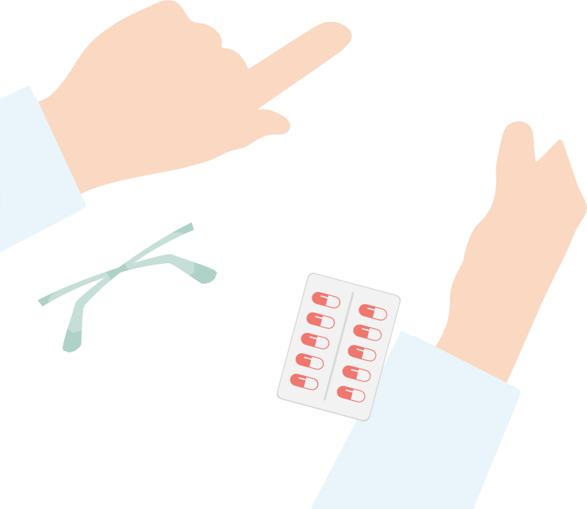



Importance of IoT in Healthcare
We can consider an IoT healthcare facility as a collection of ubiquitous computing that mainly deals with external activities. In healthcare,
IoT- based healthcare systems collect a variety of patient data and get inputs from doctors medical professionals. Continuous glucose monitoring for insulin pens is the best example of this.
All these devices can communicate with each other and take important actions that would provide timely help to save someone’s life. After collecting the data, an IoT healthcare device would send this critical information to the cloud so that doctors can act upon it.
From this, we can say that the potential application of IoT in healthcare can improve not only a patient’s health but also the health care employee productivity and hospital workflows.

Slide 6
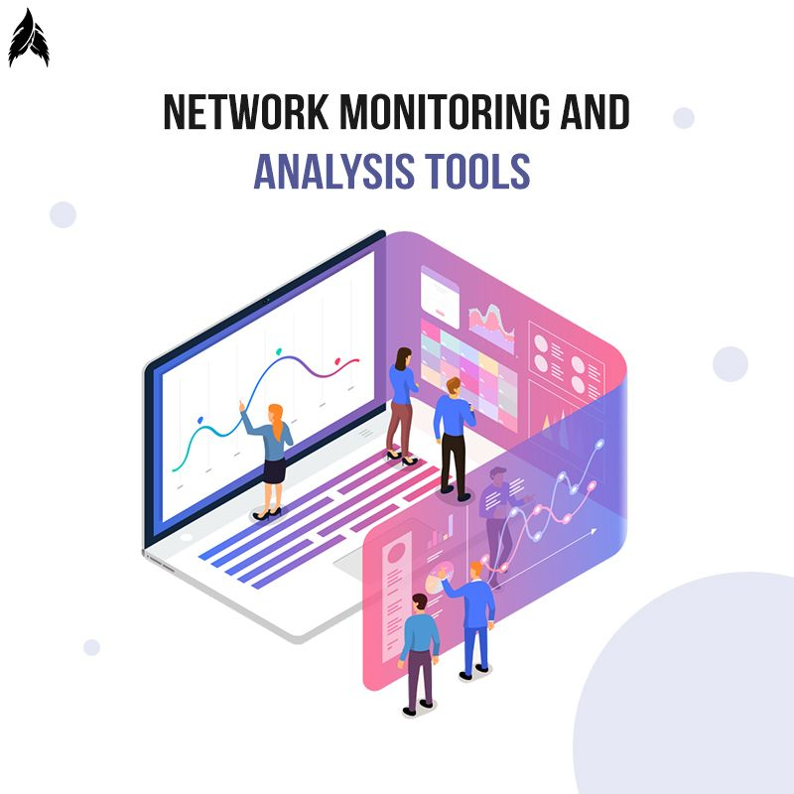
Requirements for IoT setup
Sensors
Pulse-rate sensor
Oxygen sensor
Temperature sensor
Controller
ESP8266 node MCU (Microcontroller)
For Monitoring
PC
Mobile
Tablet
Fuzzy neural network
LAN and WAN Connectivity
Router and switches
Wireless Access Point
Cloud

Slide 7
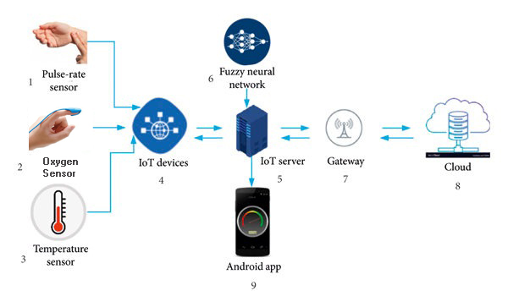
Architecture of Healthcare System

Slide 8
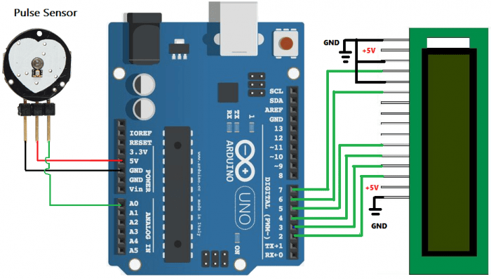
Heartbeat Sensor
Heartbeat Sensor is an electronic device that is used to measure the heart rate. i.e. speed of the heartbeat.
Heart beat sensors are designed to give digital output heart beat when a finger is placed on it.

Slide 9
Pulse sensor has three pins.
Ground: Connected to the ground of the system.
Vcc: Connect to +5V on the Arduino.
Signal: Connect the signal pin to the A0 of Arduino.
The Potentiometer is used to control the screen contrast of the LCD.
Pulse Rate | Class
>100 | High
72 to 100 | Normal
<72 | Low

Slide 10
Temperature Sensor
Take the sensor nearer to the human body. Or place the finger on to sensor
It will show the temperature in Celsius on the LCD display which is attached with Arduino.
The normal human body temperature is 97 to 98.6 F. if temperature captured beyond the limit then it will notify the person.
Temperature | Class
<99 | No fever
99 - 101 | Fever
101.3 - 103 | High fever
>103.1 | Very high fever

Slide 11
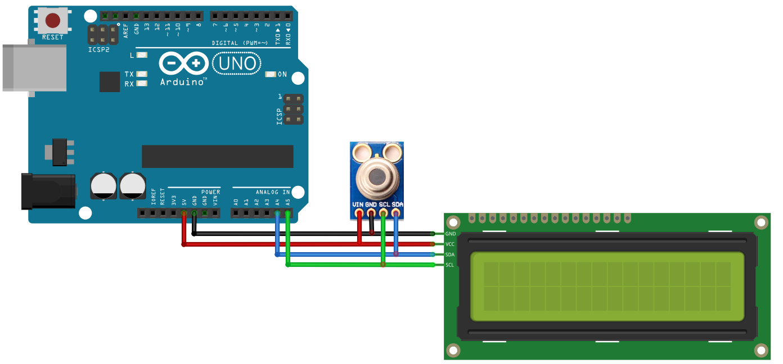
IR temperature sensor has 4 pins:
Vcc in is connected with 5v supply of Arduino uno.
GND of IR temperature sensor is connected with GND of Arduino uno.
SDA (serial data) of IR temperature sensor is connected with A4 of Arduino uno.
SCL (serial clock) of IR temperature sensor is connected with A5 of Arduino uno.
IR temperature sensor
LCD

Slide 12
Oximeter sensor
Pulse oximeter is a used to measure the oxygen saturation level of the blood.
It can rapidly detect even small changes in oxygen levels. These levels show how efficiently blood is carrying oxygen.
The finger is placed on the sensor it will measure oxygen and display on the LCD attached with Arduino.
A normal level of oxygen of human body is usually 95% or higher.
If the oxygen level captured lower than 95% then it will notify the person.
It’s also called SPo2 Sensor.

Slide 13
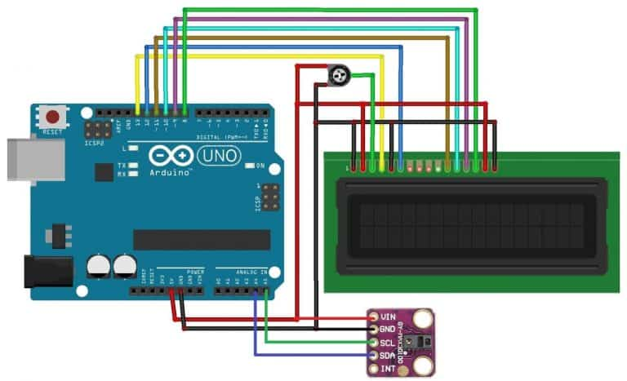
SPo2 sensor with Arduino
Connect the Vin pin of sensor to Arduino 5V or 3.3V pin.
Connect the GND pin of sensor to Arduino GND pin.
Connect the SCL pin of sensor to Arduino A5 pin.
Connect the SDA pin of sensor to A4 pin.
Connect the Vin pin of sensor to Arduino 5V or 3.3V pin.

Slide 14
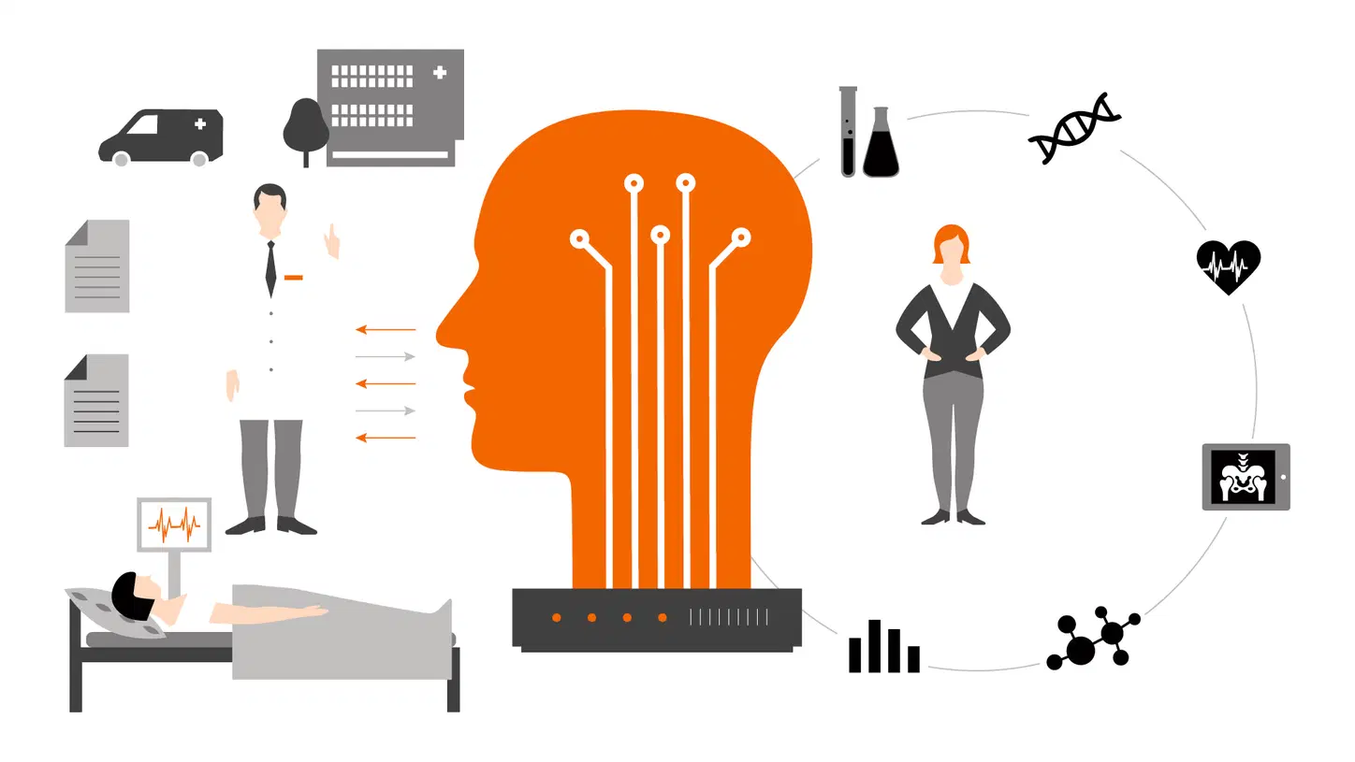
How Application Works
Data Collection through Sensors
The system consists of three sensors: body temperature sensor, pulse rate sensor, and oxygen sensors.
These three sensors are connected through Arduino board to collect and classify the patient data.
Controller
Controller receives data from sensor
Controller nodes have algorithms to compute signals.
It sends data the neural network.
IoT Devices
This is collection of Sensors and the controller.

Slide 15
How Application Works
Fuzzy neural network
Neural networks focus on perceiving patterns.
The fuzzy logic systems are good at explaining how the decision is made.
This process begins with a “fuzzy neuron,” and the process of the fuzzy neuron is divided into two steps:
(I) Evolution of a fuzzy neuron model.
(ii) Development of the model and its algorithm that consolidate fuzziness into the neural system.
IoT Server
Server consists the data collected from neural network.
Cloud
Data collected from IoT Server arrives at cloud through Gateway.
Gateway provides the way from IoT Server to cloud.
These data accessible from everywhere and every person connected through system.
Some analysis done at this step.

Slide 16
Future of IoT in Healthcare
We can consider an IoT unit as a device with a sensor that can interact with the physical world and send information to the Internet. All these IoT based healthcare devices can communicate with each other to take important actions that would provide timely help or even save a life.
After collecting passive data, IoT healthcare devices would send this critical information to the cloud so that doctors can act upon it. IoT- based healthcare services possible to customize for more critical conditions like operation theatre, intensive care unit patients, new-born babies, and more complex patients and these services not only improve a patient’s health and help in critical situations but also the productivity of health employees and healthcare organizations’ workflows.

Slide 17
Conclusion
IoT changes the way the facilities are delivered to the healthcare industry and continues to hold the promise of being truly transformational in the term of healthcare delivery to everyone’s benefit.
These technologies improve the product, causing a larger effect by bringing together minor changes.

Slide 18

Thank You!!

