Slide 1

Organ Sharing: Finder and Donation System
Final Review Project - II
KHUSHALI PATEL
Under The Supervision of Prof. A. R. Kazi

Slide 2
Content of Presentation
Abstract
Introduction
Purpose of System
Tool and Technologies used
Architecture of System
Worked Carried out till date
System Diagram
Screenshot
Conclusion
Timeline Chart
References

Slide 3
Abstract
The blood and organ sharing Finder and donation application is a web-based platform developed using PHP MySQL that enables users to search for blood and organ donors and recipients. The application allows users to register and create profiles where they can provide their details, including blood type and organ donation status. Users can search for donors based on their location, blood type, and organ requirement.
The application matches donors with recipients and allows users to send donation requests. The system sends notifications to users regarding donation requests, matching, and other relevant information. Users can leave feedback and rating for donors and recipients. The application is secure, with proper data encryption, user privacy protection, and regular backup. The application is expected to facilitate blood and organ donations and improve the chances of successful transplantation.

Slide 4
Introduction
Blood and organ donation play a crucial role in saving lives and improving the health of people in need. However, the process of donating blood or organs can be cumbersome and complicated, often leading to a shortage of donors. The development of a user-friendly mobile application that simplifies the donation process can help to increase the number of donors and save more lives.
The project aims to create a platform that brings donors and recipients together and makes the donation process simple and convenient. The system allows donors to register and create their profile with their personal data and blood group information. On the other hand, recipients can search for donors based on their blood type, location and availability.

Slide 5
Purpose of System
Organ Sharing Finder and Donation System is a PHP MySQL project aimed at creating a platform that connects organ donors with individuals who require organ transplants. The system enables the registration of organ donors and provides a database of potential organ recipients, allowing for effective matching and organ allocation.
The system is designed to be user-friendly and easily accessible. Users can register on the platform and create profiles that include their medical history and organ donation preferences. The system also provides a search function that enables potential organ recipients to search for suitable donors based on a range of criteria, including blood type, location, and organ availability.
The Organ Sharing Finder and Donation System is a vital platform that connects organ donors with individuals in need of transplants, providing an essential service that can save lives.

Slide 6
Tools and Technologies
Project Type | Web Application
Programming Language | Backend Technology: PHP 8.2 Frontend Technology: HTML, CSS, JAVASCRIPT
Database | MySQL
IDE Tool | Sublime, Visual Studio
Software | XAMPP / Wamp

Slide 7
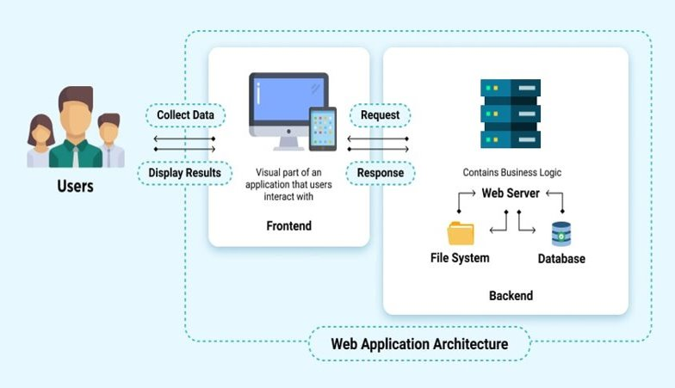
Architecture of System

Slide 8
Worked carried out till date
ADMIN
Admin can view all the details in brief like total blood group listed, registered donor list, and total enquiries received.
Admin can manage blood group (Add/ Delete).
Admin can view a list of donors and have the right to delete and hide the detail of donor.
Admin can manage query which is received by users.
Admin can website pages.
Admin can update the contact details of the website.
Admin can view the request of blood that is received by the donor.

Slide 9
DONOR / RECIPIENT
A welcome page for users. If any users want to donate their blood/organ, they must register with us.
User can change their password.
Users can view the about us page.
User can view their Request Received.
Users can view/update the profile page.
Recipient can view and contact with donor.
Users can contact with admin the through contact us page.
Recipient can search the donor according to city and blood group.

Slide 10
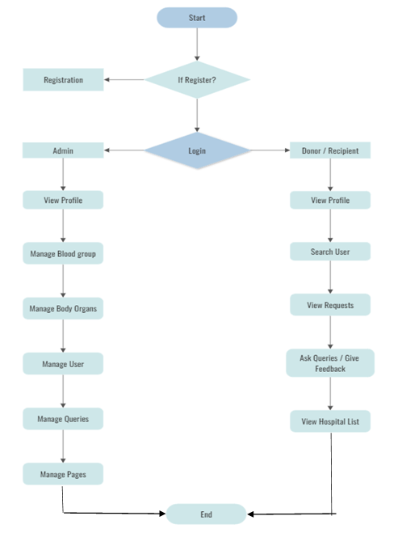
System Design
System Flowchart
NO
YES

Slide 11
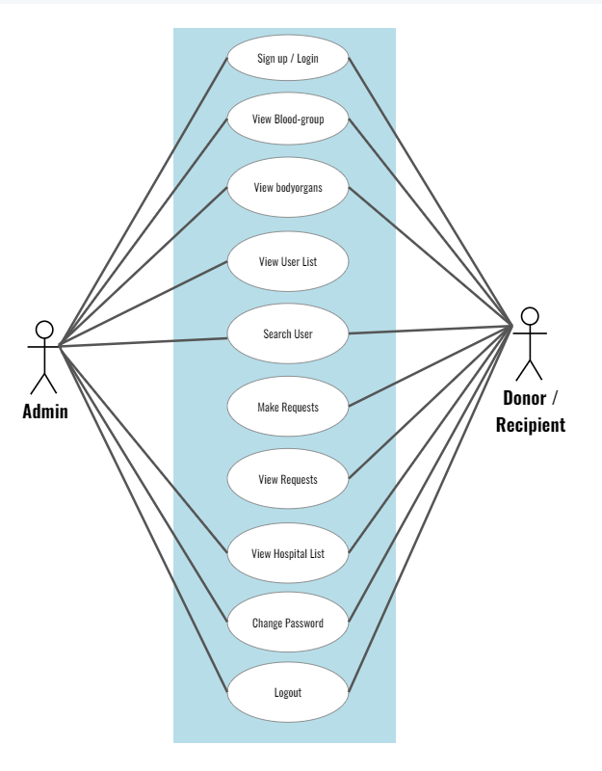
Use-case Diagram

Slide 12
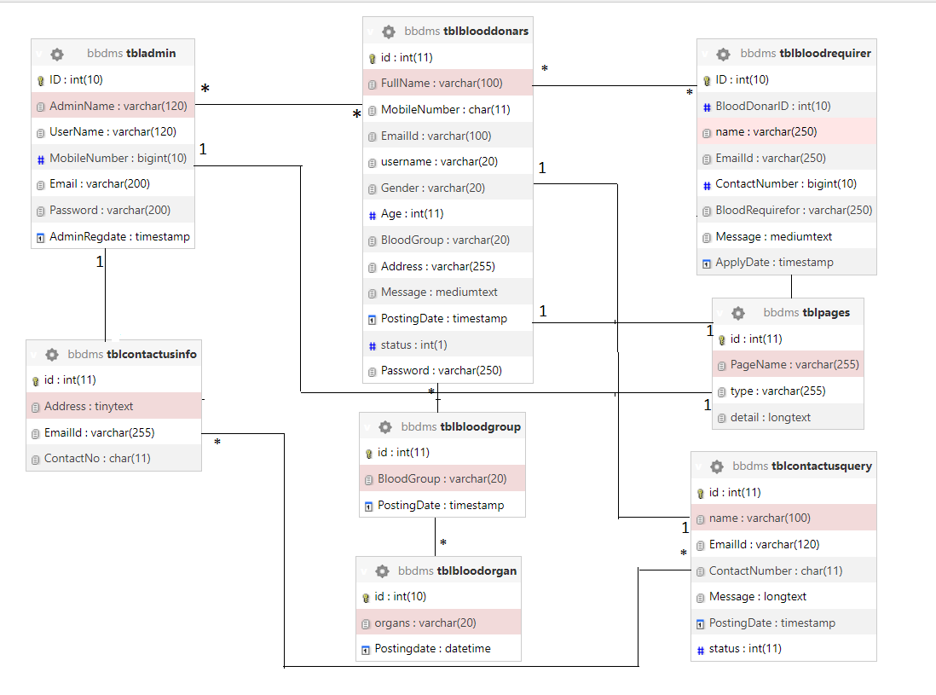
Class Diagram

Slide 13
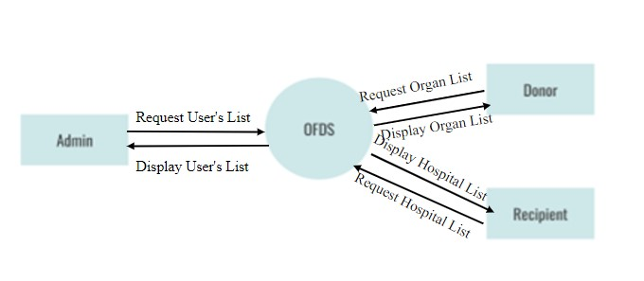
Data Flow Diagram
Level 0: Context

Slide 14
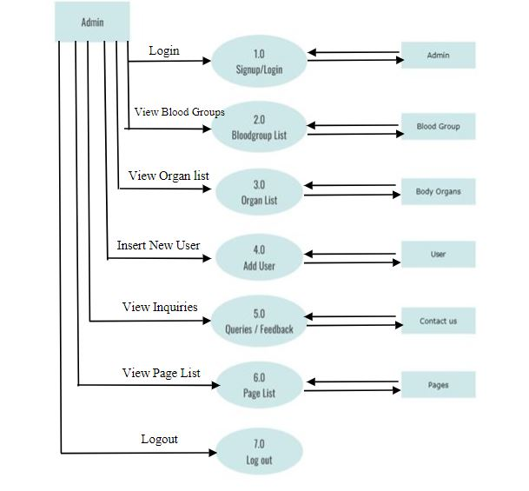
Level 1: Admin

Slide 15
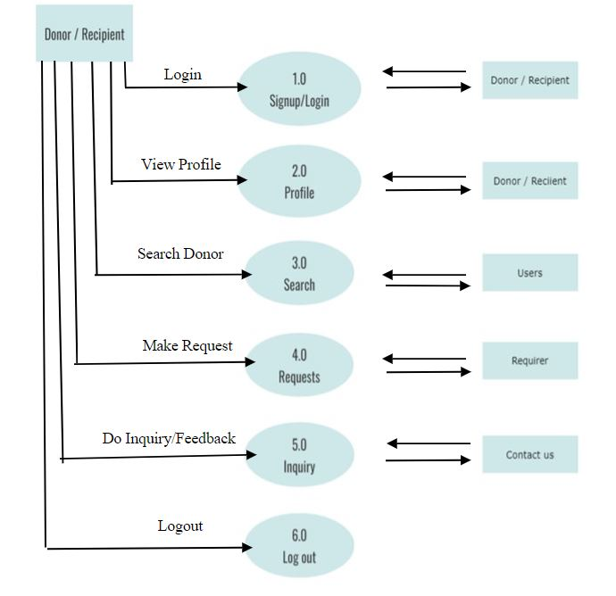
Level 1: Donor/Recipient

Slide 16
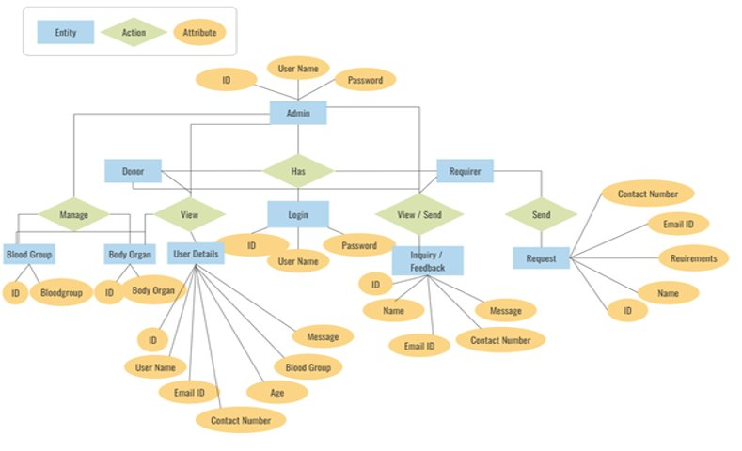
Entity Relationship Diagram

Slide 17
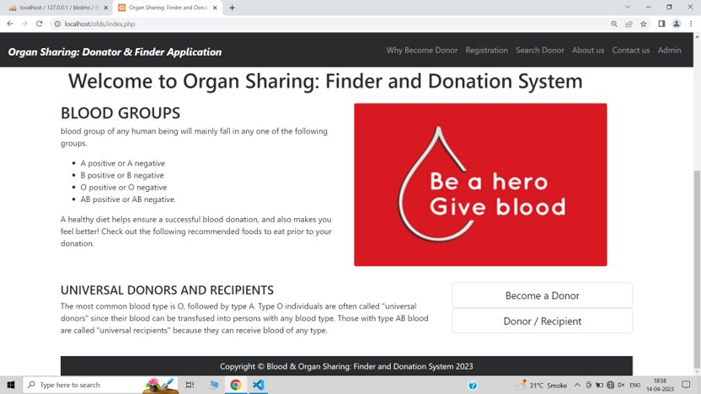
Screenshot
Home Page

Slide 18
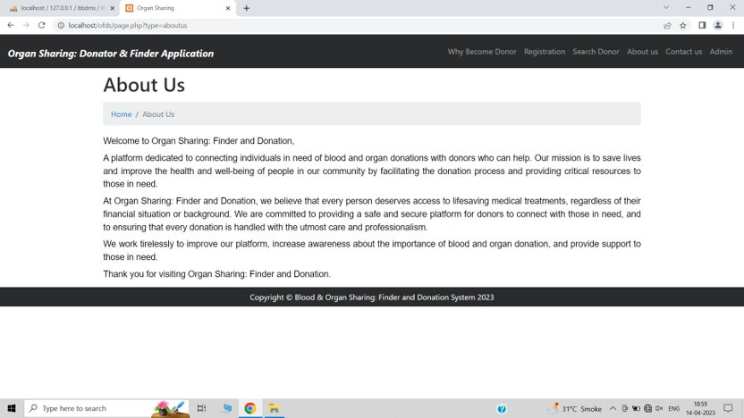
About us

Slide 19
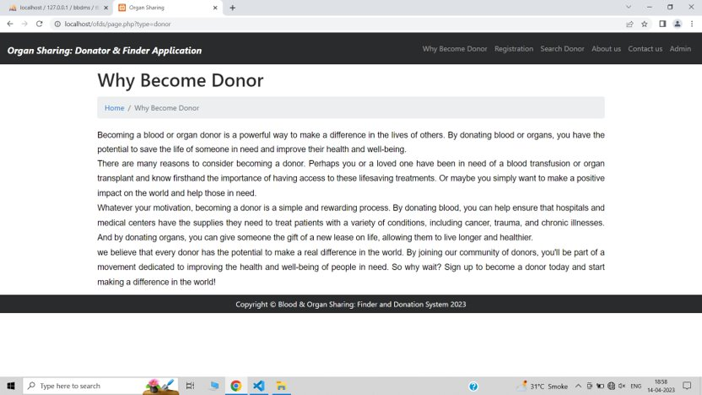
Why become donor

Slide 20
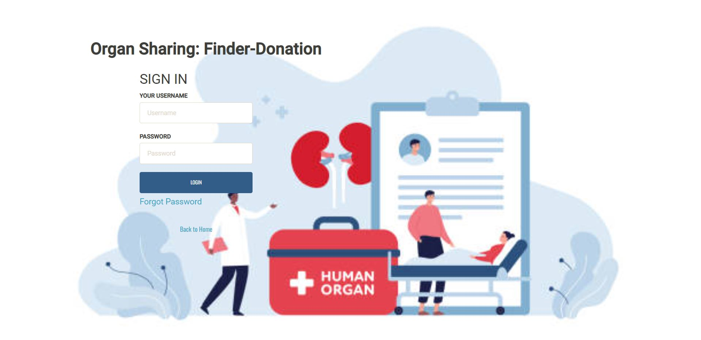
Login Page

Slide 21
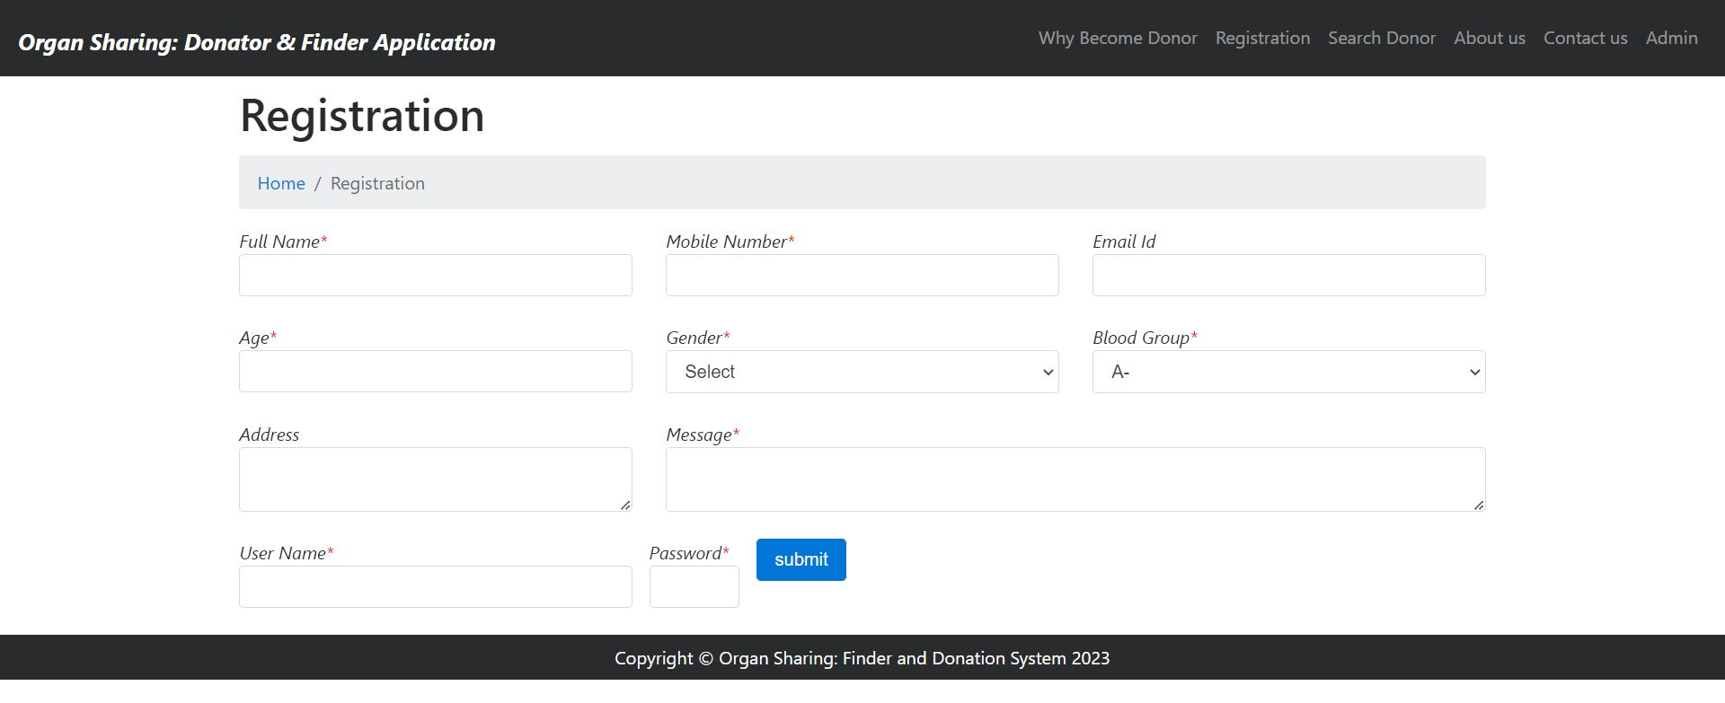
Registration Page

Slide 22
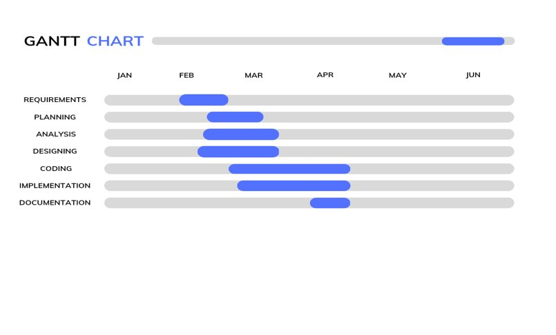
Timeline Chart – Gantt Chart

Slide 23
Conclusion
A blood and organ donation PHP MySQL project is a vital system that can help save lives by facilitating the donation process. The system will provide a platform for donors and recipients to connect and donate blood or organs. The project will be divided into various modules, each with specific functionalities such as user management, search and matching, donation management, notification, reporting, admin panel, security, and feedback and reviews.
The feasibility study of the project has shown that it is technically, economically, operationally, legally, and socially feasible. The project will be financially viable, with a clear ROI and will be user-friendly, easy to navigate, and require minimal training. The system will be designed to comply with all relevant laws and regulations and promote awareness and education about blood and organ donation.
A blood and organ donation PHP MySQL project has the potential to make a significant impact on society and improve patient outcomes. It is crucial to conduct a thorough feasibility study and develop a well-designed system with robust features to ensure its success.

Slide 24
References
Website References
W3Schools - https://www.w3schools.com/ W3Schools provides a comprehensive tutorial on web development, including PHP and MySQL. This website can be useful for developers who are just starting with web development.
PHP.net - https://www.php.net/ PHP.net is the official website for the PHP programming language. It provides a comprehensive documentation and reference guide for PHP developers.
MySQL Documentation - https://dev.mysql.com/doc/ The MySQL documentation provides a comprehensive guide to the MySQL database, including installation, configuration, and usage.
Book References
"PHP PROGRAMMING" by Dr. Shyam Chawda
"MySQL Workbench: Data Modeling & Development" by Michael McLaughlin
"Learning PHP, MySQL & JavaScript: With jQuery, CSS & HTML5" by Robin Nixon

Slide 25
THANK YOU!!

