Slide 1

Que-less
Save time. Stay safe.
Shopping in the new normal.

Slide 2
Problem Statement
To address Social Distancing in Outlets and Supermarkets
In this pandemic era, it is advisable to avoid long queues and crowds. So does that imply store shopping is a thing of the past?
It is inevitable that one may continue to be homebound; not venture out and just rely on online delivery. For, it is human nature to crave in-person interactions and indulge in outdoor activities.
It is also imperative that the economy should not be hampered in the light of low consumer confidence and fear of contracting the virus in crowded closed areas.

Slide 3
Solution

Slide 4
Overview App Page Flow Overview
Home Page
Marketplace Selection
1.
Customers to use this page for registration and sign-in.
A working phone number is mandatory to assist with contact tracing if anyone tests positive.
2.
Upon sign-in, user must be directed to this page and select the marketplace that he/she wants to visit.
The application automatically detects the user’s location and auto-fills the city and locality, based on which stores are displayed.
Token generation
Guidelines & Token Mgmt.
3.
4.
Once the user selects the store, a set of time slots are displayed based on the store’s timings.
The customer is allotted a token number, using which he/she can visit the store. If a desired time-slot is not available, the user can choose to waitlist
Once the token is generated, it is displayed to the user. A set of guidelines are also listed.
The user will be provided option to cancel the token if he/she is not able to make it. The token will auto-expire 10 min into the start of the assigned time-slot. Such time slots will be made available to other waitlisted users.

Slide 5




Architecture
Components
User Interface
Server
Application logic
1. Authentication
2. Detect locality
3. Display and selection of Marketplace
4. Selection of timeslot
5. Generation of token
6. Operation Engine Execution -
Operational Hour of Marketplace
Determine selected marketplace’ capacity to accommodate people in accordance with social distancing norms
Availability of slots
7. Allocation of token and time of visit
Database
API

Slide 6
Flow
Logical flow and user actions
Login and Authentication
Home Page
Token and Time slot Allocation
Waitlist, cancellation & guidelines
Visit and Token expiration
Login (Options : Social Media, Phone number, Email)
If phone/email is selected option, user is authenticated through OTP received respective option (phone/email)
Auto-detect city and locality. User verifies the same. If not correct, can change the city/locality
Display list of marketplaces near to the users current location within a certain radius
User selects marketplace
User selects a date
Based on the date, selected marketplace’s operation hours, capacity & current visitors, available time slots are displayed to user for selection
User selects time slot
A token number is generated and displayed to user
User is shown a confirmation page displaying token and shopping guidelines
User doesn’t get a desired time slot, and selects waitlist. If a slot gets available, then user gets a push notification
User can cancel token up to one hour prior to booked time slot
User arrives at store per token details and displays token at counter
If token is not presented 10 minutes into start of selected timeslot, token will auto expire

Slide 7
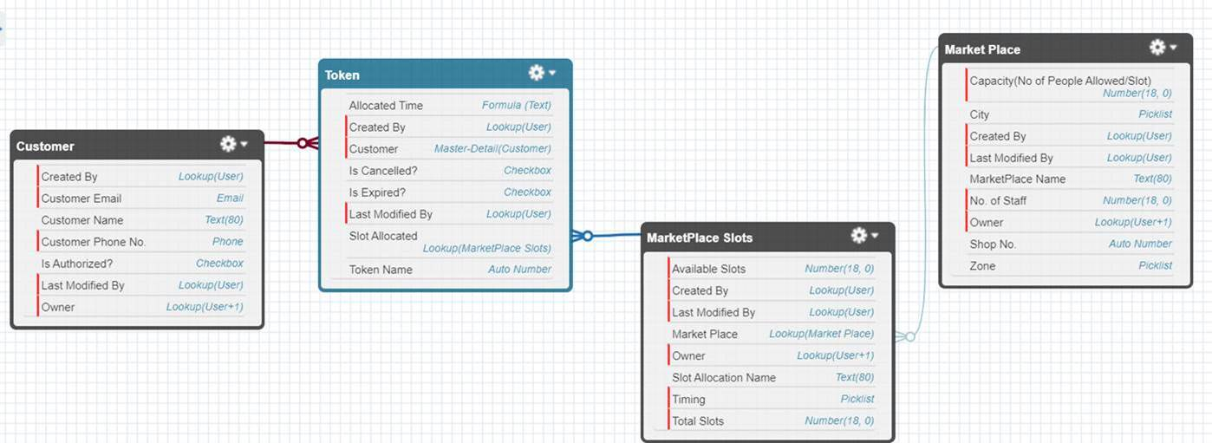
Object Model
Database tables and relations

Slide 8
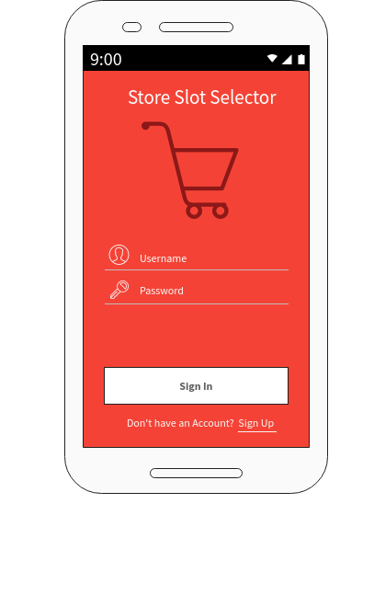
SCREEN 1 Home Page

Slide 9
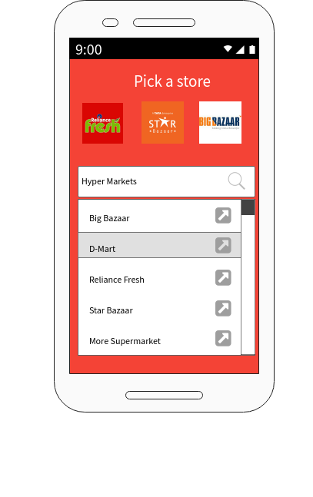
SCREEN 2 Marketplace Selection

Slide 10
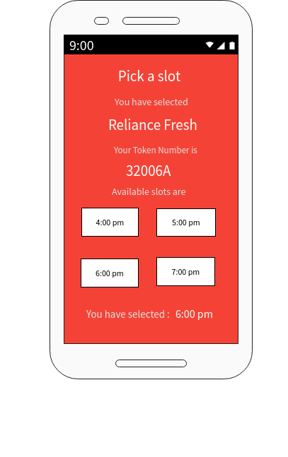
SCREEN 3 Token Generation

Slide 11
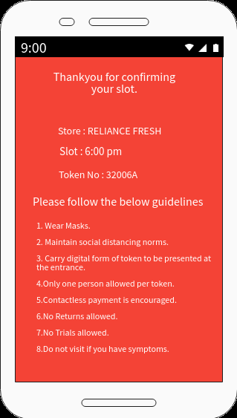
SCREEN 4 Confirmation

Slide 12
Roadmap
Where we are?
The solution has gone through ideation and preliminary discovery phase.
Current phase involves landscape assessment, high level architecture proposals and user-experience discussions.
Next Phase will involve following activities :
Scale the app for enhanced mobile support by developing as a native mobile app to be published on play store.
Build separate UI for store to manage all store related data
Scale the app to be used for Mall, Multiplex, gyms etc.

Slide 13
Team
Ideate. Deliver.
Mentor : Chitra Venkatachalapathy, Jita Susan Jacob
Team members : Khushboo Upadhyay, Shinsi Fathima Rahman, Surabhi Kumari, Supriya U Kukkillaya

