Slide 1
Hospital Appointment Management System
Database Management System Project
Submitted By
Khushboo Raizada (2410990967)
B.Tech CSE
Chitkara University
Faculty Coordinator: Mr. Sachin Garg
:
Chitkara University Institute of Engineering and Technology,
Chitkara University, Punjab

Slide 2
Table of Contents
Introduction
Problem overview
Scope of the Project
Entities and Attributes
Relationships
ER Diagram
ER To Relational Schema
Queries
Relational Algebra to SQL
Procedures
Triggers
Views
Conclusion

Slide 3
Introduction
The healthcare industry is vital for society, with hospitals managing thousands of patients, staff, and processes daily. Traditional paper-based record-keeping is prone to errors, delays, and inefficiency.
The Hospital Management System (HMS) is a digital solution that integrates all hospital departments into a single system, ensuring smooth information flow and efficient operations.
Key Modules:
Patient Management – Registration, admission, discharge, transfer
Doctor & Staff Management – Scheduling, duty allocation, staff records
Medical Records – Secure storage of patient history, diagnostics, prescriptions
Appointments – Easy booking, reduced waiting time
Billing & Accounting – Automated bills, payments, insurance claims
Inventory & Pharmacy – Tracking medicines, equipment, and supplies
Benefits: Faster processes, accurate records, reduced errors, secure data handling, and improved efficiency.

Slide 4
Problem Overview
Hospitals are complex organizations that handle a wide range of activities such as patient care, staff coordination, billing, pharmacy services, laboratory testing, and inventory management. Traditionally, many hospitals still depend on manual methods like paper records, registers, and handwritten files to store and track information. This approach creates several problems, including delays, human errors, and difficulties in maintaining and retrieving records.
Some of the common issues faced in hospitals without a computerized system include:
1. Time Consuming : Registering a patient , booking an appointment , or retrieving old records take a lot of time and cause delays
2. Billing Errors: Manual billing increases the chances of mistakes, which may cause disputes between patients and hospital administration.
3. Data Security Concerns: Paper records are not secure, and unauthorized can easily access them.
4. Relationship Management issues : A single patient may have multiple appointments and one doctor may treat many patients. In a manual system, it is very difficult to track such relationships.

Slide 5
Scope of the Project
The scope of this project is to design and develop a system that can streamline and automate the daily operations of a hospital. The system will be capable of handling various tasks such as patient registration, appointment scheduling, doctor and staff management, billing, pharmacy services, and inventory control. By using this system, hospitals can reduce paperwork, improve efficiency, and ensure that information is easily available whenever needed.
The project covers the following areas:
1. Patient Services: Registration, admission, discharge and maintaining complete medical history.
2. Doctor and Staff Services: Storing details of doctors and hospital staff, managing their schedules, and assigning duties.
3. Appointments: Allowing patients to book appointments with doctors and view availability.
4. Billing and Accounts: Generating accurate bills for patients and managing payment details.
5. Pharmacy and Inventory: Keeping track of medicines, medical supplies, and equipment availability.

Slide 6
Objectives of the Project
The main objective of this project is to design and implement a system that simplifies and automates the various operations of a hospital. The system aims to provide an efficient way to manage patient information, staff details, billing, and other essential hospital activities while ensuring accuracy, reliability, and security of data.
The specific objectives are as follows:
1. To reduce paperwork and manual effort by computerizing hospital operations.
2. To maintain accurate and up-to-date patient records, including personal details, medical history, and treatment information.
3. To simplify appointment booking and scheduling of doctors, reducing waiting time for patients.
4. To automate billing and payment processes, ensuring accuracy and transparency.

Slide 7
Significance of the Project
The Hospital Management System plays an important role in improving the overall functioning of a hospital by replacing traditional manual methods with a computerized approach. This project is significant because it provides a reliable and efficient solution to handle large amounts of hospital data and day-to-day operations.
The key significance of the project includes:
1. Improved Efficiency – Automates routine tasks such as patient registration, billing, and appointment scheduling, which reduces workload on hospital staff.
2. Time Saving – Enables faster access to patient records and quick report generation, saving time for both doctors and patients.
3. Error Reduction – Minimizes human errors in patient records, billing, and inventory management.
4. Better Patient Care – Ensures accurate medical history and timely access to information, which helps doctors provide better treatment.
5. Secure Data Handling – Protects sensitive patient and hospital information through authorized access and secure storage.

Slide 8
Entities and Attributes
1. Patients
Attributes:
patient_id (Primary Key)
name
dob (Date of Birth)
gender
phone
email
street
city
2. Doctors
Attributes:
doctor_id (Primary Key)
name
specialization
phone
email
shift_time
dept_id (Foreign Key)

Slide 9
Entities and Attributes
3. Departments
Attributes:
dept_id (Primary Key)
name
location
head_of_dept
4. Rooms
Attributes:
room_id (Primary Key)
room_type
capacity
availability_status
5. Appointments
Attributes:
appointment_id (Primary Key)
patient_id (Foreign Key)
doctor_id (Foreign Key)
date
time
status
6. Billing
Attributes:
bill_id (Primary Key)
patient_id (Foreign Key)
appointment_id (Foreign Key)
amount
payment_status
payment_date

Slide 10
Relationships
1. Patients – Appointments
Relationship Name: Book
Type: One-to-Many
Description: A patient can book many appointments, but each appointment is linked to one patient.
Keys: Appointments.patient_id → Patients.patient_id
3. Departments – Appointments
Relationship Name: Conducts
Type: One-to-Many
Description: A department can conduct multiple appointments, but each appointment is linked to one department.
Keys: Appointments.dept_id → Departments.dept_id
2.Doctors – Appointments
Relationship Name: Schedules
Type: One-to-Many
Description: A doctor can have multiple appointments, but each appointment is with one doctor.
Keys: Appointments.doctor_id → Doctors.doctor_id
4. Rooms – Appointments
Relationship Name: Held In
Type: One-to-Many
Description: A room can host multiple appointments over time, but each appointment is held in one room.
Keys: Appointments.room_id → Rooms.room_id

Slide 11
Relationships
5. Departments – Doctors
Relationship Name: Belongs To
Type: Many-to-Many
Description: A department can have many doctors, but each doctor belongs to one department.
Keys: Doctors.dept_id → Departments.dept_id
_________________________________________
7. Patients – Billing
Relationship Name: Generates
Type: One-to-Many
Description: A patient can have multiple bills, but each bill belongs to one patient.
Keys: Billing.patient_id → Patients.patient_id
6. Rooms – Patients
Relationship Name: Allocated
Type: One-to-Many
Description: A room can be allocated to many patients over time, but at a given time a patient is assigned to one room.
Keys: Patients.room_id → Rooms.room_id
_______________________________________
8. Appointments – Billing
Relationship Name: Linked With
Type: One-to-One
Description: Each appointment generates one bill, and each bill corresponds to one appointment.
Keys: Billing.appointment_id → Appointments.appointment_id

Slide 12
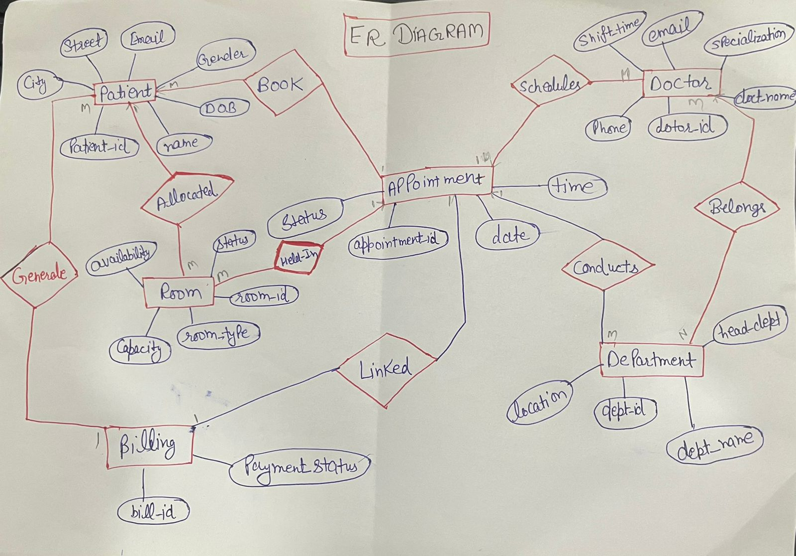
ER Diagram

Slide 13
Relational Algebra to SQL
1. Get names of patients who booked appointments.
RA :- π_name (Patients ⨝ Appointments).
SQL :- SELECT DISTINCT p.Name
FROM Patient p JOIN Appointment a
ON p.patient_id = a.patient_iD;
2. List patients with appointment status ‘Complete’.
RA :- π_name (σ_status=‘Complete'(Patients ⨝ Appointments))
SQL :- SELECT DISTINCT p.Name
FROM Patient p JOIN Appointment a
ON p.patient_id = a.patient_id WHERE a.Status = 'Completed';

Slide 14
Relational Algebra to SQL
3. List doctors with specialization ‘Cardiology’.
RA :- π_name(σ_specialization='Cardiology'(Doctors))
SQL :- SELECT doct_name FROM Docto rWHERE
specialization = 'Cardiologist';
4. List doctors working in the ‘Neurology’ department.
RA :- π_name(σ_name='Neurology'(Departments ⨝ Doctors))
SQL :- SELECT DISTINCT d.doct_name
FROM Doctor d JOIN Department dept ON
d.dept_id = dept.dept_id
WHERE dept.dept_name = 'neurology';

Slide 15
Relational Algebra to SQL
5. Get department names with their head of department. RA :- π_name, head_of_dept (Departments) SQL :- SELECT dept_name,
head_dept FROM Department;
6. Get departments with more than 1 doctors.
RA :- π_name(σ_count>1Departments ⨝ Doctors))
SQL :- SELECT dept.dept_name
FROM Department dept
JOIN Doctor d
ON dept.dept_id = d.dept_id
GROUP BY dept.dept_id, dept.dept_name
HAVING COUNT(d.doctor_id) > 1;

Slide 16
Relational Algebra to SQL
7. Find names of patients and their allocated room IDs.
RA :- π_patient.name, room_id(Patients ⨝ Rooms)
SQL :- SELECT p.name, r.room_id
FROM Patient p
JOIN Room r
ON p.room_id = r.room_id;
8. List patients in ICU rooms.
RA :- π_name(σ_room_type='ICU'(Patients ⨝ Rooms))
SQL :- SELECT DISTINCT p.name
FROM Patient p
JOIN Room r
ON p.room_id = r.room_id
WHERE r.room_type = 'ICU';

Slide 17
Relational Algebra to SQL
9 . Find patients who had an appointment but no bill generated.
RA :- π_name(Patients ⨝ Appointments) − π_name(Patients ⨝ Billing)
SQL :- SELECT DISTINCT p.name
FROM Patient p
JOIN Appointment a
ON p.patient_id = a.patient_id
LEFT JOIN Billing b
ON p.patient_id = b.patient_id
WHERE b.patient_id IS NULL;
10. Get names of patients with pending bills.
RA :- π_name(σ_payment_status=‘pending’(Patients ⨝ Billing))
SQL :- SELECT DISTINCT p.name
FROM Patient p
JOIN Billing b
ON p.patient_id = b.patient_id
WHERE b.payment_status = 'Pending';
K

Slide 18
Procedures
A Procedure (Stored Procedure) in MySQL is a pre-written SQL code that is saved in the database and can be executed whenever needed.It works like a function that performs a specific task (such as inserting data, updating records, or generating reports).
--Think of a procedure as: “Write the logic once, reuse it many times.”
Why Use Procedures?
Avoid writing the same SQL queries again and again
Improve performance (queries are pre-compiled)
Increase security (you control what the user can access)
Helps organize business logic inside the database
Makes code cleaner and easier to maintain

Slide 19
Procedures
1. Stored Procedure for Adding a New Patient
Problem Statement:
The hospital administration needs a function-like shortcut to add and store the details of a new patient in the database efficiently and accurately.
SQL QUERY:
DELIMITER //
CREATE PROCEDURE add_patient(
IN p_id INT,
IN p_name VARCHAR(100),
IN p_dob DATE,
IN p_gender VARCHAR(10),
IN p_phone VARCHAR(15),
IN p_email VARCHAR(100),
IN p_street VARCHAR(100),
IN p_city VARCHAR(50),
IN p_room_id INT
)
BEGIN
INSERT INTO Patient
VALUES (p_id, p_name, p_dob, p_gender, p_phone, p_email, p_street, p_city, p_room_id);
END//
DELIMITER ;

Slide 20
Procedures
2. Stored Procedure for Updating Billing Payment Status
Problem Statement:
To update the payment status of a bill in the Billing table.
SQL Query:
DELIMITER //
CREATE PROCEDURE update_payment_status(
IN p_bill_id INT,
IN p_status VARCHAR(50)
)
BEGIN
UPDATE Billing
SET payment_status = p_status
WHERE bill_id = p_bill_id;
END//
DELIMITER ;

Slide 21
Triggers
A Trigger in MySQL is a special type of stored program that automatically executes (fires) in response to specific events on a table.
These events are usually:
INSERT
UPDATE
DELETE
Triggers run without being called manually.They execute automatically whenever the defined action occurs.
Think of a trigger as:“Do something automatically whenever the data changes.”
Why Use Triggers?
Automate actions — No need to write code again and again
Ensure data accuracy — Useful for maintaining data integrity
Perform automatic updates — price changes, stock updates, timestamps
Monitor changes — useful for logs, tracking, audit trails
Prevent invalid data — validate before insert/update

Slide 22
Triggers
1. TRIGGER FOR INSERT DATA
Problem Statement:
When a new patient/member is added, the system should automatically record the entry.
SQL TRIGGER:
DELIMITER //
CREATE TRIGGER department_after_insert
AFTER INSERT ON Department
FOR EACH ROW
BEGIN
INSERT INTO log_table
(table_name, action_type, action_time, record_id, details)
VALUES (
'Department',
'INSERT',
NOW(),
NEW.dept_id,
CONCAT(
'dept_name=', NEW.dept_name,
', location=', NEW.location,
', head_dept=', NEW.head_dept
)
);
END//

Slide 23
Triggers
2. Trigger for Delete Data
Problem Statement:
To store deleted patient details in a log table automatically.
SQL TRIGGER:
CREATE TRIGGER patient_after_delete
AFTER DELETE ON Patient
FOR EACH ROW
BEGIN
INSERT INTO log_table
(table_name, action_type, action_time, record_id, details)
VALUES (
'Patient',
'DELETE',
NOW(),
OLD.patient_id,
CONCAT(
'patient_name=', OLD.patient_name,
', gender=', OLD.gender,
', phone=', OLD.phone,
', city=', OLD.city,
', room_id=', OLD.room_id
) );
END//

Slide 24
Views
A View in MySQL is a virtual table that is created from a SQL query.
It does not store data physically; instead, it displays data from one or more tables as if it were a real table.
--Think of a view as: “A saved SQL query that behaves like a table.”
Why Use Views?
Simplify complex queries
Instead of writing long joins repeatedly, store the query as a view and use it like a normal table.
Improve security
You can hide sensitive columns and show only required data to the user (example: hide passwords, contact numbers).
Better organization
Views help organize frequently used queries cleanly.
Real-time updated data
Since a view fetches data from tables, any update in the original tables automatically appears in the view.

Slide 25
Views
1. View for Displaying Upcoming Appointments
Problem Statement:
The hospital staff needs a simple way to view upcoming appointments along with patient and doctor details in one place.
SQL QUERY:
CREATE VIEW Upcoming_Appointments AS
SELECT
a.appointment_id,
p.patient_name AS patient_name,
d.doct_name AS doctor_name,
a.date,
a.time,
a.status
FROM Appointment a
JOIN Patient p ON a.patient_id = p.patient_id
JOIN Doctor d ON a.doctor_id = d.doctor_id;

Slide 26
Views
2. View for Displaying Billing Summary
Problem Statement:
The billing staff needs an easy way to view bill details along with patient name, doctor name, appointment date, and payment status in one place.
SQL Query:
CREATE VIEW Billing_Summary AS
SELECT
b.bill_id,
p.patient_name AS patient_name,
b.payment_status,
a.date,
d.doct_name
FROM Billing b
JOIN Appointment a ON b.appointment_id = a.appointment_id
JOIN Patient p ON a.patient_id = p.patient_id
JOIN Doctor d ON a.doctor_id = d.doctor_id;

Slide 27
Conclusion
The Hospital Appointment Booking System successfully demonstrates how a database-driven approach can improve hospital operations. The project efficiently manages patient records, doctor details, appointments, billing, and room allocation using relational database concepts. By implementing tables, relationships, queries, procedures, triggers, and views, the system reduces manual work, improves data accuracy, and ensures better organization of hospital data.Stored procedures help in performing repeated tasks easily, triggers automate important actions like logging changes, and views provide simplified access to useful information. Overall, this project provides a reliable and structured solution for hospital management and lays a strong foundation for future enhancements.

Slide 28


