Slide 1
PROJECT PRESENTATION OF WEB DEVELOPMENT FRAMEWORK USING PYTHON (24CAI1105)
On
INVENTORY MANAGEMENT SYSTEM
Submitted By: Supervised By:
Khushboo Jain - 2410993045 Mr. Pavan Ambulkar Sir
Ishleen Kaur - 2410993197 Mentor, CSE-AI
Gurleen Kaur - 2410993030
Liza - 2410993056
Department Of Computer Science And Engineering
(Artificial Intelligence)
Chitkara University, Punjab

Slide 2
Table of Contents
Introduction
Problem Statement
Technical Details
Key Features
Project Highlights
Bonus Feature(optional)
Conclusion
References/Links used

Slide 3
Introduction
INVENTORY MANAGEMENT SYSTEM
TEAM MEMBERS :-
Khushboo Jain - 2410993045
Ishleen Kaur - 2410993197
Gurleen Kaur - 2410993030
Liza - 2410993056
Goal :- The main goal of this system is to efficiently automate and optimize the process of tracking, updating, and managing inventory with the ultimate goal of reducing costs and improving operational efficiency.

Slide 4
Problem Statement
Aim :- The aim of this is to streamline inventory management, reduce manual effort, and improve the accuracy and efficiency of inventory tracking, ensuring that businesses can maintain optimal stock levels and respond quickly to changing market demands. The system also offers advanced reporting tools, helping businesses track trends and make informed decisions on restocking and discontinuing products. With automated alerts and notifications, businesses can proactively manage stock levels and prevent disruptions in the supply chain.
Some research for this project is done from various web development tutoring sites and channels.

Slide 5
Technical Details
LANGUAGES USED :-
HTML: HTML forms the structural skeletal of webpages.
CSS: CSS is used to style the inventory system’s interface.
JavaScript: JavaScript adds interactivity to the inventory system, allowing for dynamic updates and form validation.
FRAMEWORKS USED :-
Flask: Flask is used as backend framework that handles data processing, routing and API creation. It also uses RESTful APIs that perform core operations like inventory management, user handling and order processing.

Slide 6
Technical Details
Django: It serves as the frontend framework which consumes Flask APIs to display real-time data to users. It also manages templates and views to present data interactively.
Bootstrap: It ensures a responsive and user-friendly design. Also, it provides pre-designed UI components for faster and consistent frontend development.
INTEGRATIONS OVERVIEW :-
Flask handles backend logic and provides APIs. Django consumes these
Flask APIs to render content on the frontend. This separation improves
modularity, scalability, and maintainability of
the system.

Slide 7
Application Modules of Django
1. Accounts Application
Engineered a robust user authentication and authorization module enabling secure registration, login, and session management functionalities.
Incorporated advanced access control mechanisms, ensuring user-role segregation and data confidentiality.
2. Main Application
Devised an intelligent core system for warehouse orchestration, inventory lifecycle oversight, and real-time order fulfillment.
Seamlessly integrated barcode scanning capabilities to expedite inventory validation and streamline stock transactions.

Slide 8
Application Modules of Django
3. Secondary Application
Constructed a dynamic frontend ecosystem encompassing feature listings, solution overviews, pricing structures, client portfolios, integrations, analytical reports, and other auxiliary interfaces.
Ensured consistent UI/UX paradigms across static content pages using reusable templates and Django's templating engine.
“It is a tri-modular Django-based system unifying secure user authentication, intelligent warehouse, inventory automation & a dynamic suite of static and analytical interfaces for end-to-end inventory management.”

Slide 9
Django: The Interactive Frontend
FUNCTIONS AND INTEGRATIONS :-
Serves as the user-facing layer of the system.
Consumes data from Flask APIs to dynamically render live inventory status, updated order lists logged-in user information.
Utilizes HTTP requests to fetch and display the most current data.
REAL-TIME DATA REFLECTION :-
When a form is submitted in the Flask backend:
The data is processed and persisted to the database.
Flask immediately exposes the updated data via its API.
Django retrieves this data through API calls, ensuring real-time synchronization on the frontend.

Slide 10
Flask: The Engine Behind the Logic
ROLES AND RESPONSIBILITIES :-
Acts as the primary logic handler for all operational tasks.
Processes and validates form submissions related to placing and updating orders, managing inventory records handling user registration and login.
Implements RESTful APIs that expose data in structured JSON format.
API Testing with POSTMAN :-
POSTMAN is extensively used to:
Test all API endpoints (GET, POST, PUT, DELETE)
Validate request payloads and response structures
Simulate real-world API usage during development and debugging

Slide 11
Key Features
Order Management - Easily create, update, and track customer orders in real time. Streamlines the order lifecycle from placement to fulfillment.
Inventory Tracking - Monitor stock levels with automatic real-time updates. Stay informed with low-stock alerts and movement history.
Warehouse Management - Manage multiple warehouses and their inventory flows. Track inward/outward movements and stock transfers.
Integrations - Seamlessly connect with third-party systems and services. Designed to support API-based extensions and plug-ins.
Barcode Scanning (Admin Only) - Admins can scan barcodes for instant product access. Speeds up stock-taking while maintaining security control.
Pricing Page - Showcases flexible pricing plans with tiered features. Helps customers choose the right package for their needs.

Slide 12
Key Features
Features Overview - Highlights system capabilities and core tools. Gives users a quick glance at what’s included.
Customer Feedback - Collects user reviews and testimonials for credibility. Used to refine and improve user experience over time.
Login & Signup - Secure login system with user role management. Supports both general users and admin accounts.
Reports & Analytics - Generate detailed reports on inventory and orders. Includes visual dashboards and exportable summaries.
Solutions - Tailored modules for various industries and use cases. Adapts to small businesses, warehouses, and retail chains.

Slide 13
Project Highlights
Upcoming slides include the relevant screenshots of our running project.

Slide 14
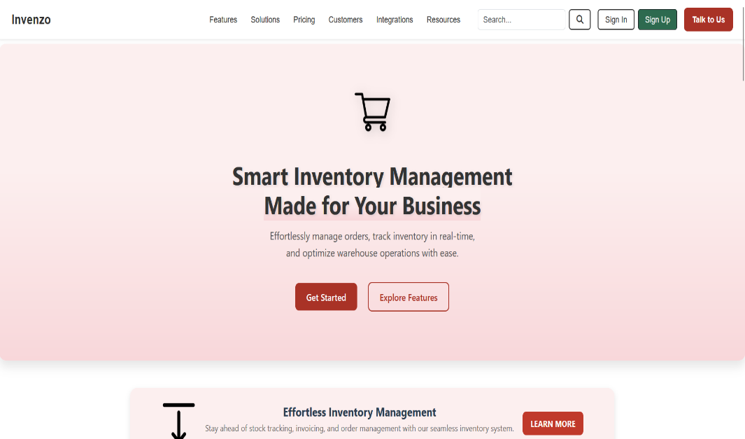
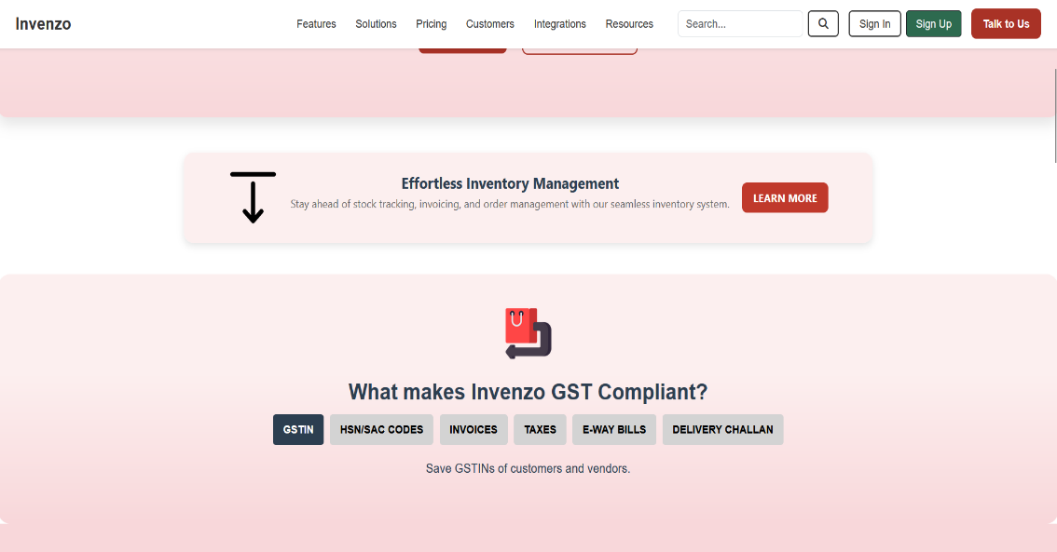
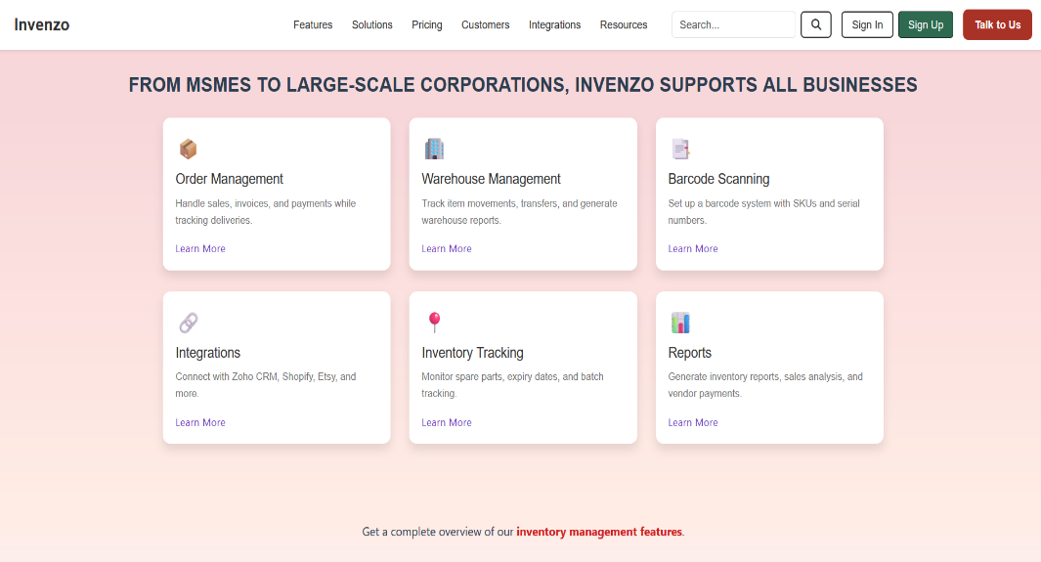
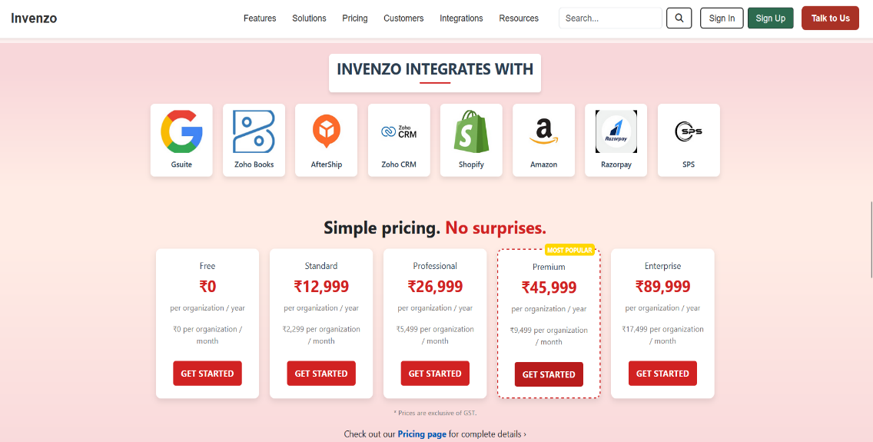
Project Highlights

Slide 15
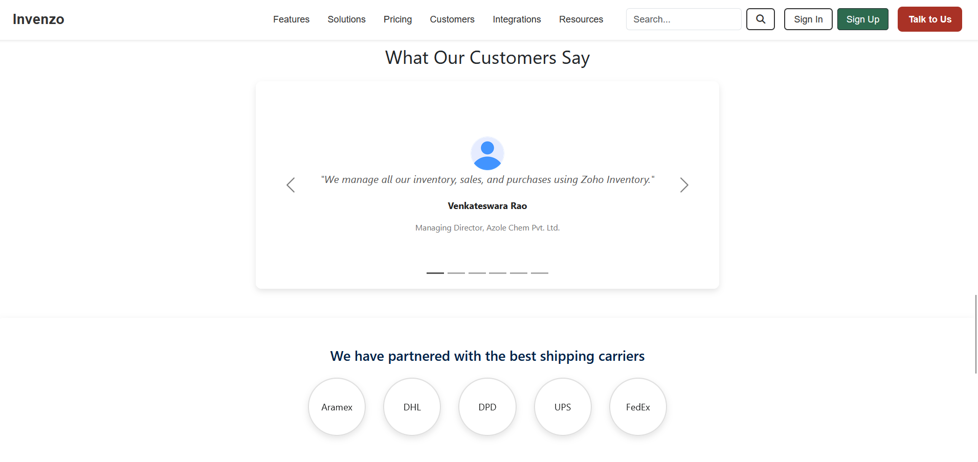
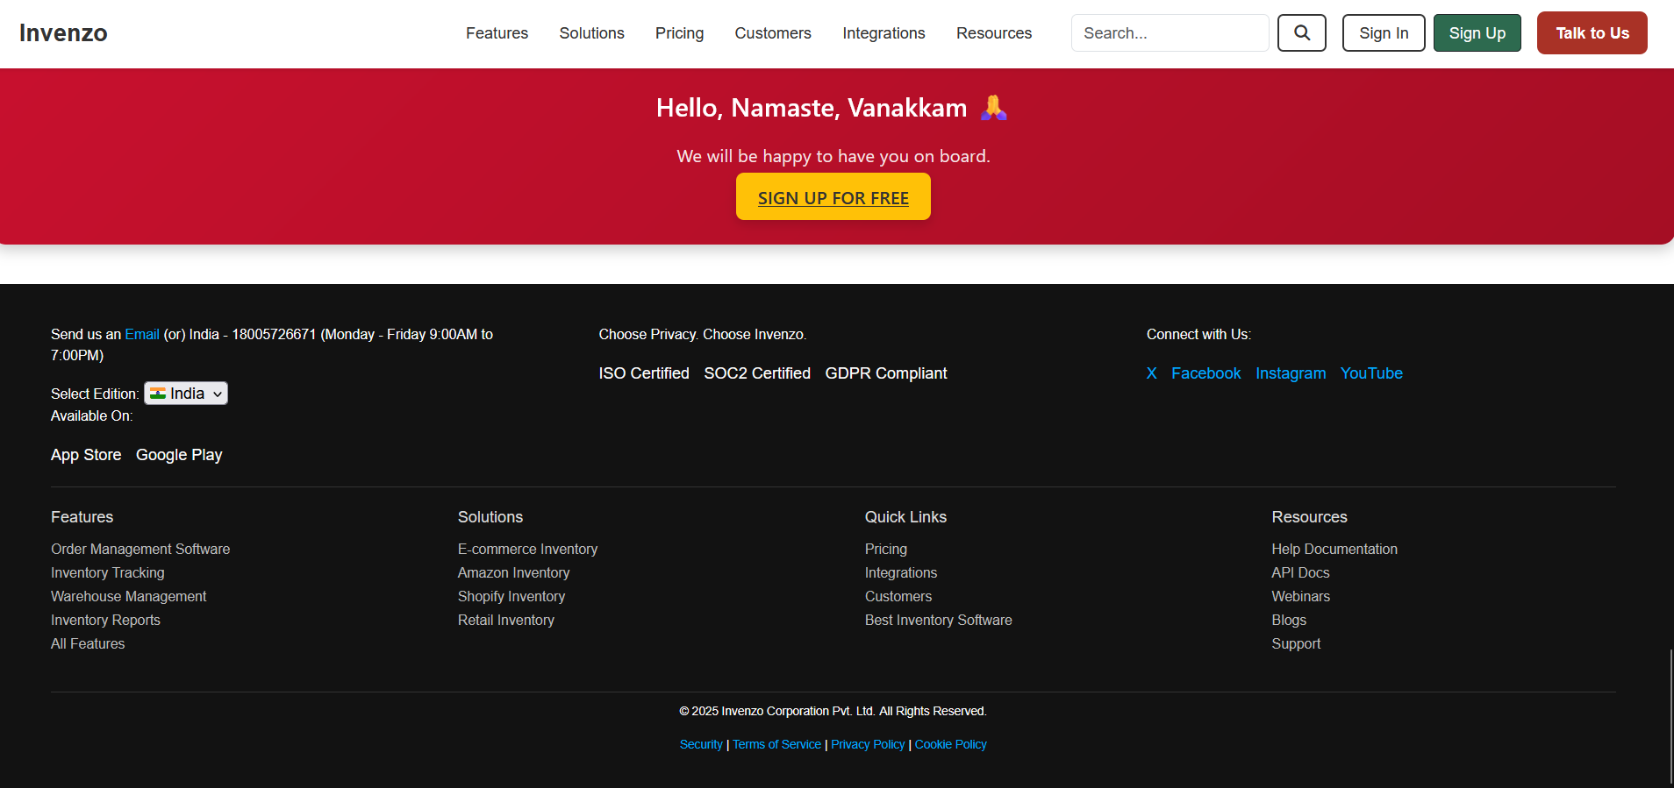
Project Highlights

Slide 16
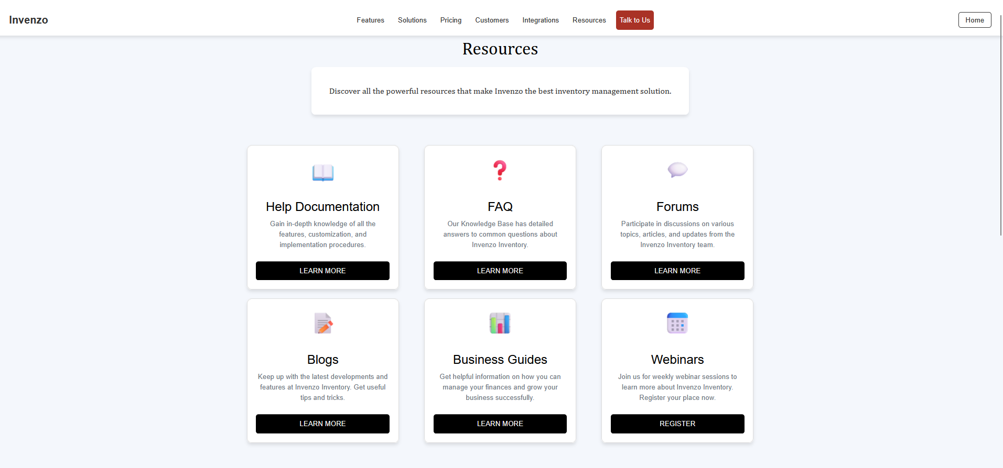
Project Highlights

Slide 17
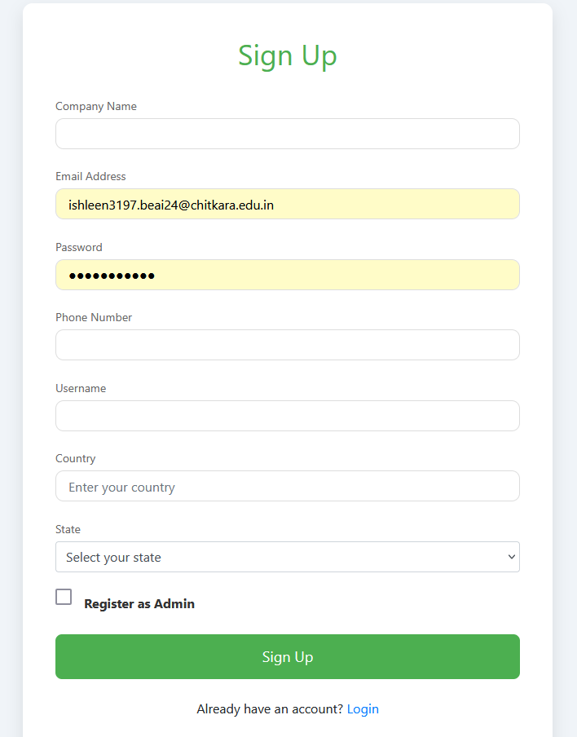
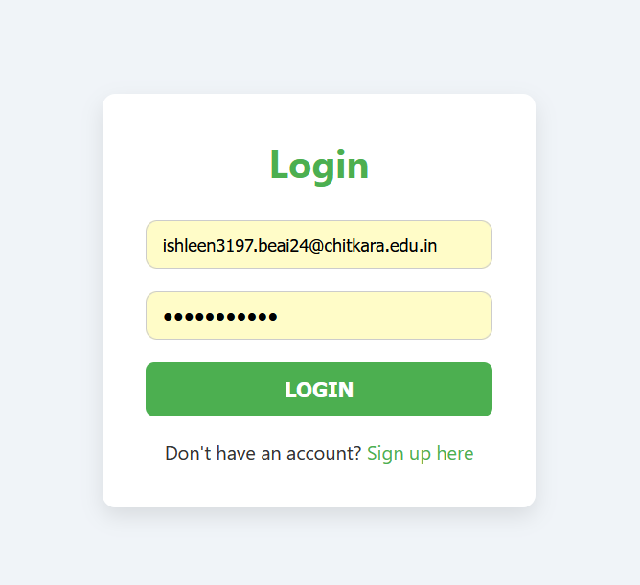
Project Highlights

Slide 18
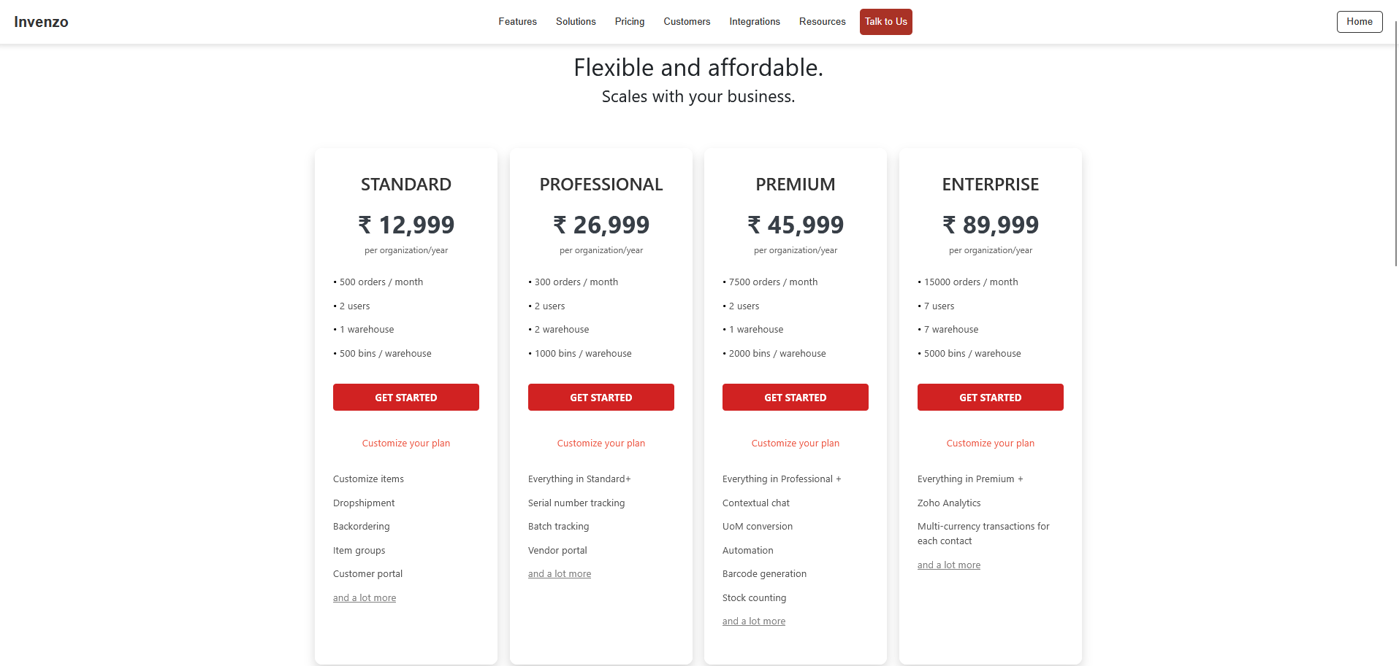
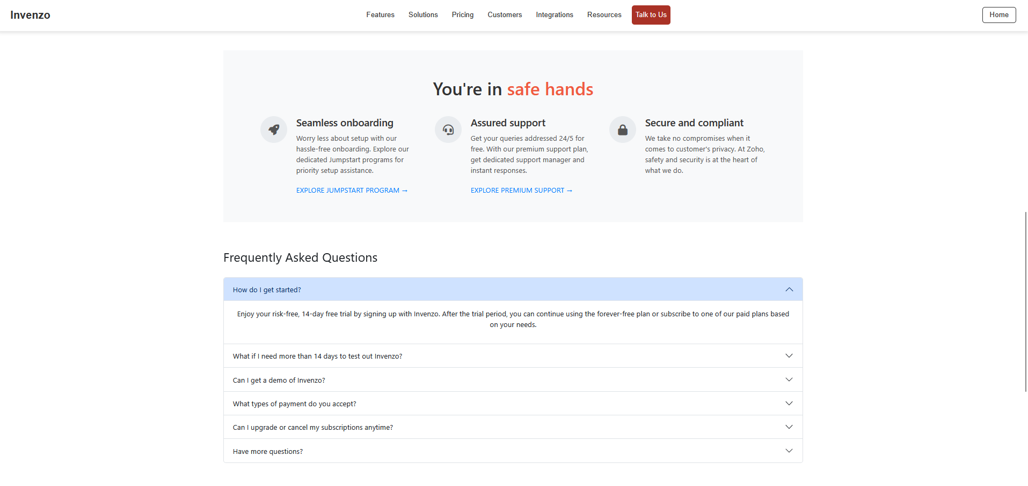
Project Highlights

Slide 19
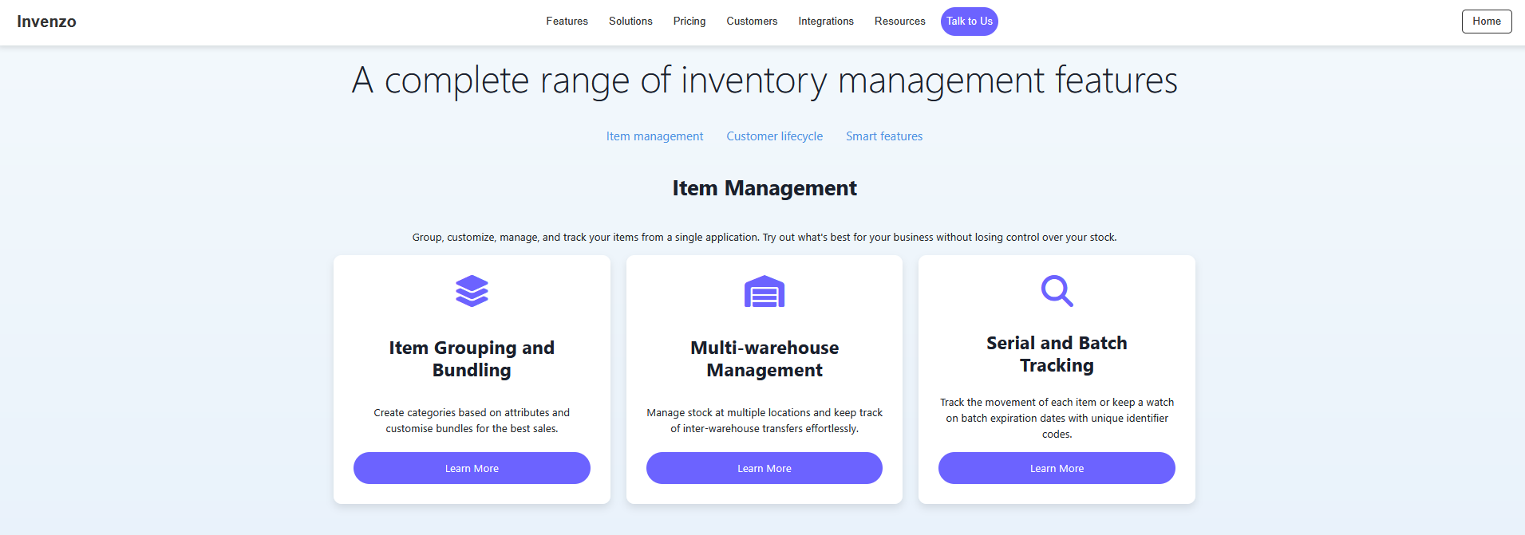
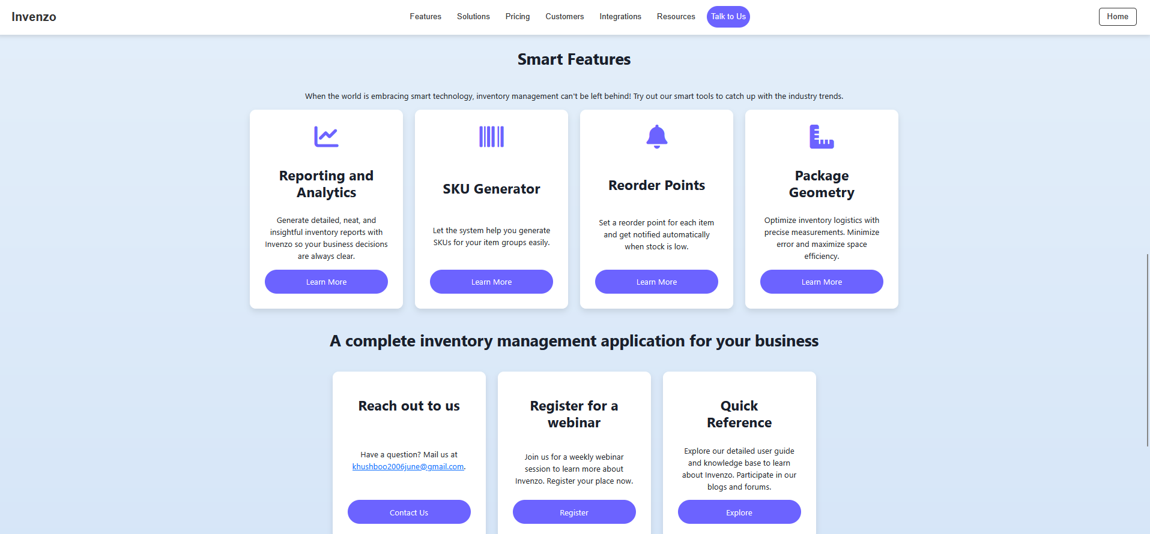
Project Highlights

Slide 20
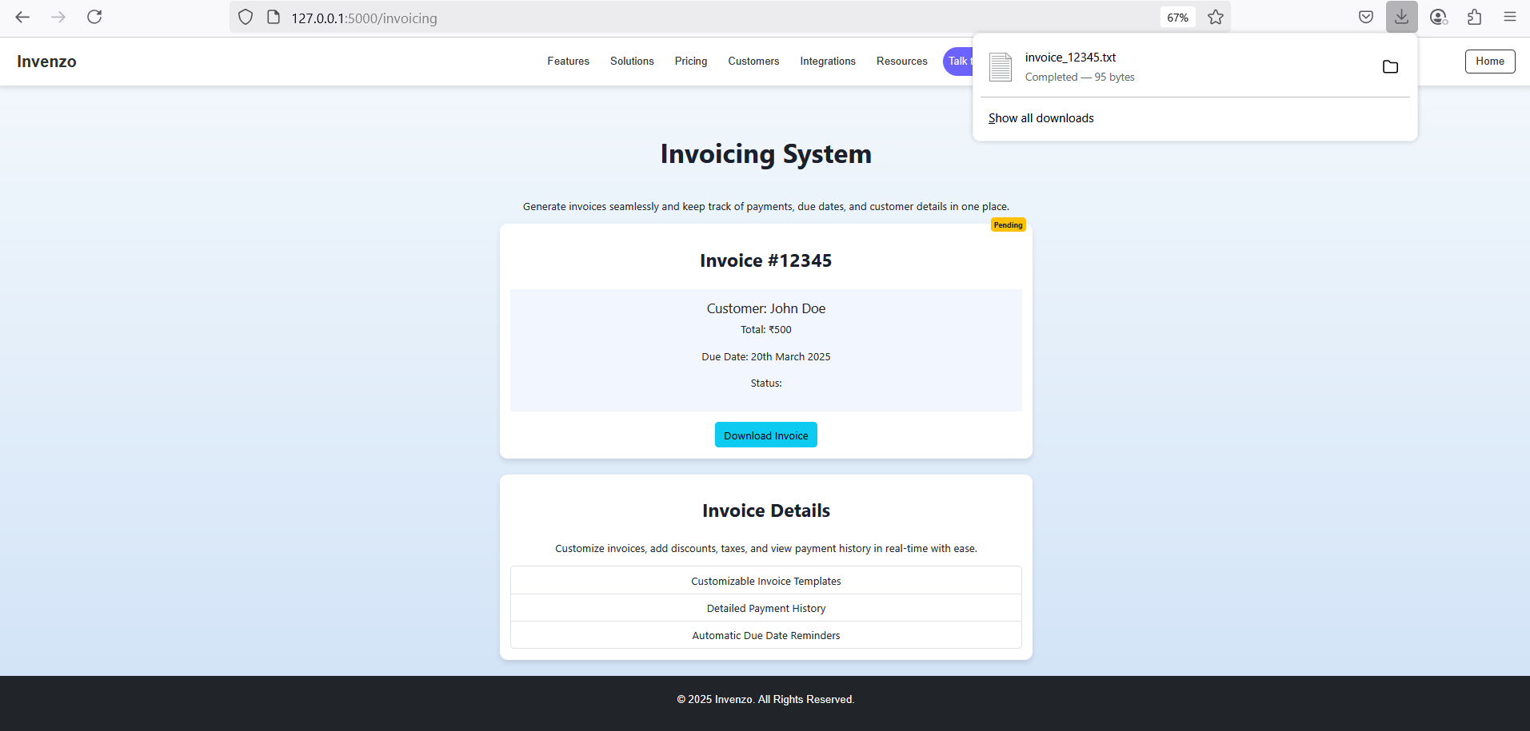
Project Highlights

Slide 21
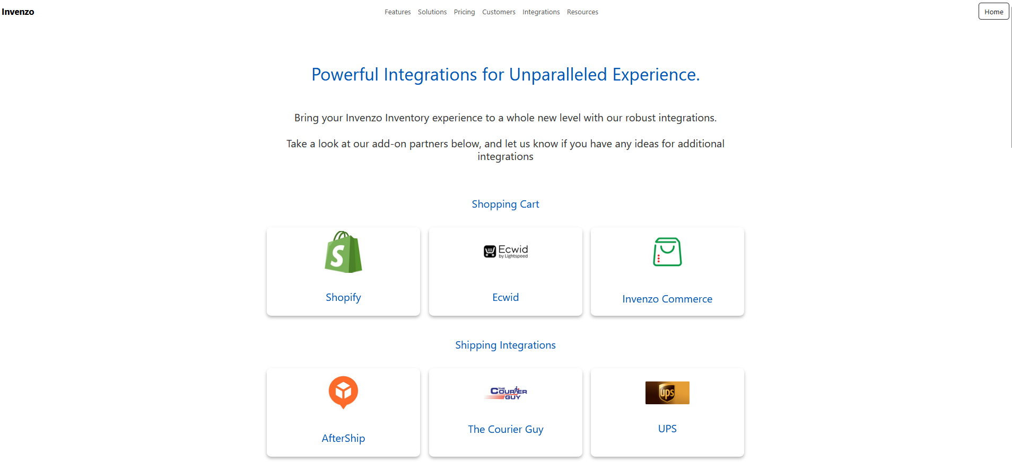
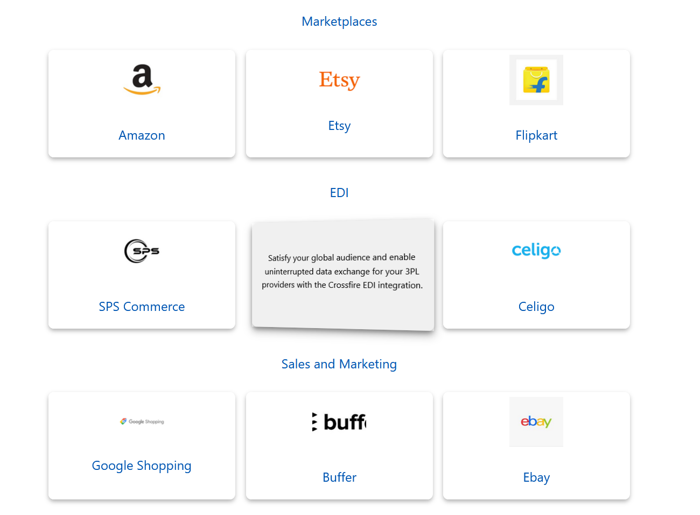
Project Highlights

Slide 22
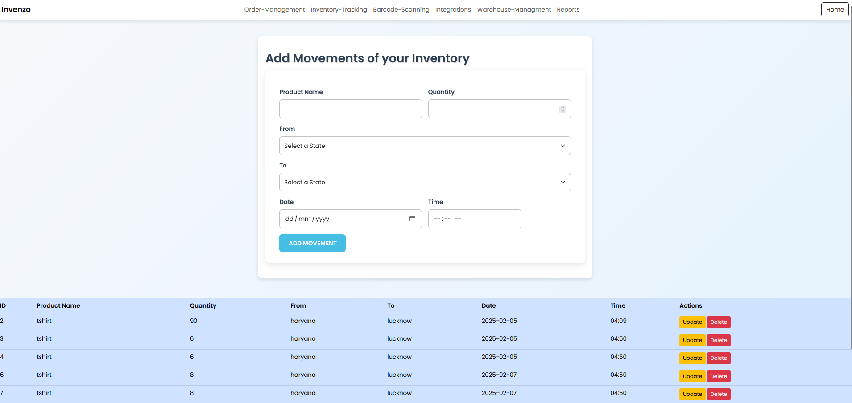
Project Highlights

Slide 23
Conclusion
Here’s the conclusion of an Inventory Management System :-
Improves Efficiency: Automates key tasks like stock tracking, reordering, and reporting, saving time and reducing errors.
Reduces Costs: Prevents stockouts and overstocking, helping businesses minimize waste and storage costs.
Enhances Decision-Making: Provides real-time data and detailed reports for informed decision-making.
Streamlines Operations: Facilitates smooth inventory management across multiple locations and integrates with other business systems.
Boosts Customer Satisfaction: Ensures timely product availability and accurate order fulfillment, improving customer experience.

Slide 24
References/Links used
References used in the project are:-
Sir Pavan Ambulkar’s provided course notes
W3Schools website
Several YouTube channels like:-
CodeWithHarry
ApnaCollege

Slide 25
Thank You

