Slide 1
IPL AUCTION – SQL FINAL PROJECT REPORT
By-khushboo
Bidding on batters
Task 4
1
6
Task 1
Task 5
2
7
Task 2
Task 6
3
8
Task 3
Task 7
4
9
Bidding on Bowlers
Additional Questions
5
10

Slide 2
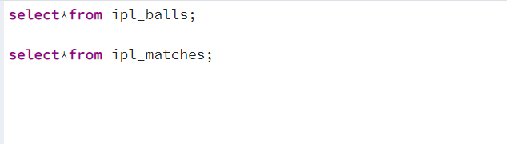
Bidding on batters
/* BIDDING OF BATTERS */
-- I read the raw data first by using sql codes:
-- As per the case study provided there are 5 types of batters
-- 1) Aggressive batsman, 2) Anchor batsman, 3)Finishers, 4)Big hitters,
5)Rotators of strike.
-- Bowlers are important in an IPL team for several reasons some of them are:
-- 1. Wicket-taking ability, 2. Control, 3. Ability to bowl in different situations,
4. Ability to bowl in different conditions

Slide 3

Task 1

Slide 4
SELECT batsman, SUM(batsman_runs) AS Total_runs,
COUNT(ball) AS Total_balls,
SUM(batsman_runs) / cast(count(ball) as decimal) * 100 AS strike_rate
FROM ipl_balls
GROUP by batsman
HAVING count(ball) >= 500
ORDER BY strike_rate DESC
LIMIT 10;

Slide 5
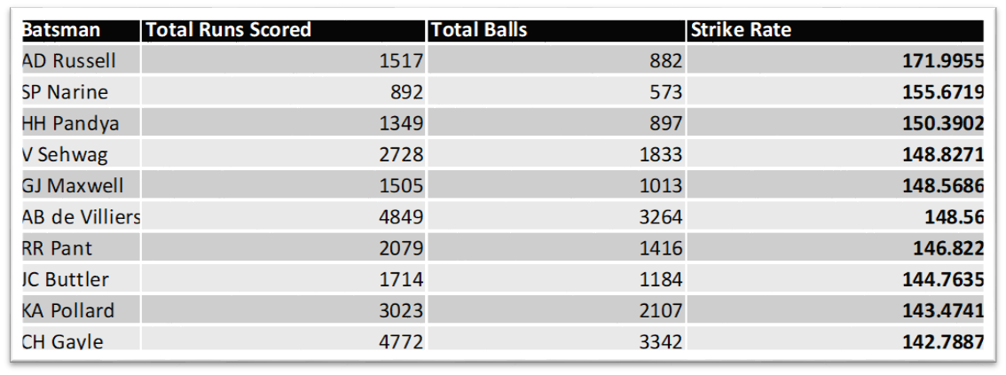
Result Table: These are top 10 payers to bid in the auction with high Strike Rate who have faced at least 500 balls in IPL so far.

Slide 6
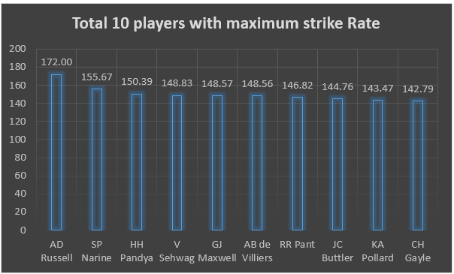
Task 1: Top 10 players with maximum Strike Rate

Slide 7
Task 2

Slide 8
TOP 10 ANCHOR BATSMANS LIST SHORTLISTING BY SQL CODE
SELECT *
FROM
(SELECT a.batsman,
COUNT(DISTINCT(EXTRACT(year FROM b.date))) AS season_played,
SUM(a.batsman_runs) / COUNT(DISTINCT a.id) AS average
FROM ipl_balls AS a
FULL JOIN ipl_matches AS b ON a.id = b.id
GROUP BY a.batsman
ORDER BY average DESC
) AS c
WHERE c.season_played > 2
LIMIT 10;

Slide 9
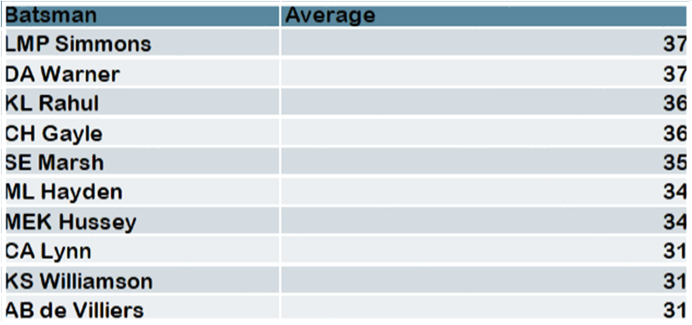
Result Table: These are top 10 players to bid in the auction with good Average who have played more the 2 IPL seasons

Slide 10
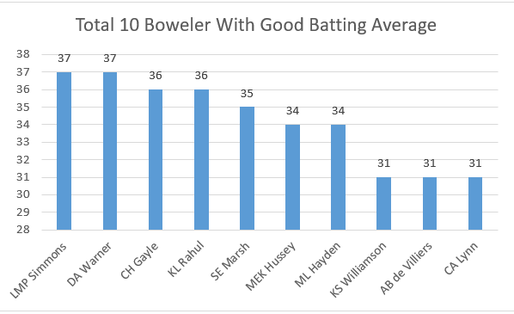
Task 2 : Top 10 Players with Good Batting Average

Slide 11

Task 3

Slide 12
SELECT batsman, total_runs, total_runs_in_boundaries, boundary_percentage
FROM
(SELECT a.batsman,
COUNT(DISTINCT(EXTRACT(year FROM b.date))) AS season_played,
SUM(a.batsman_runs) AS total_runs,
SUM(CASE WHEN a.batsman_runs IN (4, 6) THEN a.batsman_runs ELSE 0 END) AS total_runs_in_boundaries,
SUM(CASE WHEN a.batsman_runs IN (4, 6) THEN 1 ELSE 0 END) AS total_boundaries,
CAST(SUM(CASE WHEN a.batsman_runs IN (4, 6) THEN a.batsman_runs ELSE 0 END) AS DECIMAL) / NULLIF(SUM(a.batsman_runs), 0) * 100 AS boundary_percentage
FROM ipl_balls AS a
FULL JOIN ipl_matches AS b ON a.id = b.id
GROUP BY a.batsman
HAVING COUNT(DISTINCT(EXTRACT(year FROM b.date))) > 2
ORDER BY total_runs_in_boundaries DESC) AS c
LIMIT 10;

Slide 13
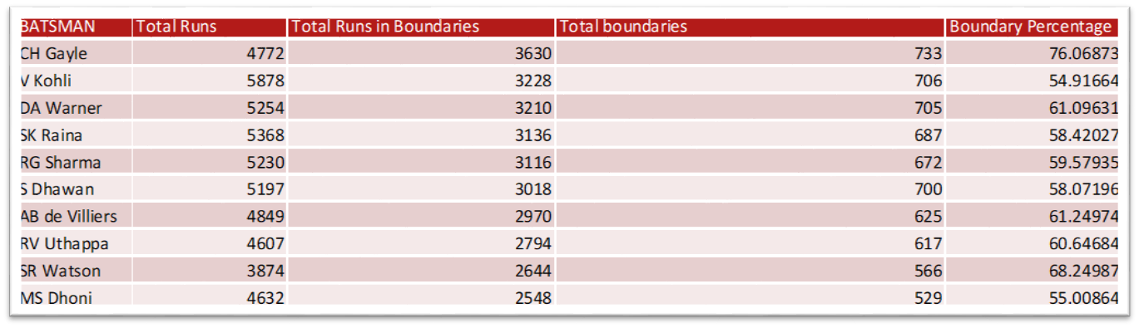
Result Table: These are top 10 Hard-hitting players to bid in the auction who have scored most runs in boundaries and have played more the 2 IPL season.

Slide 14
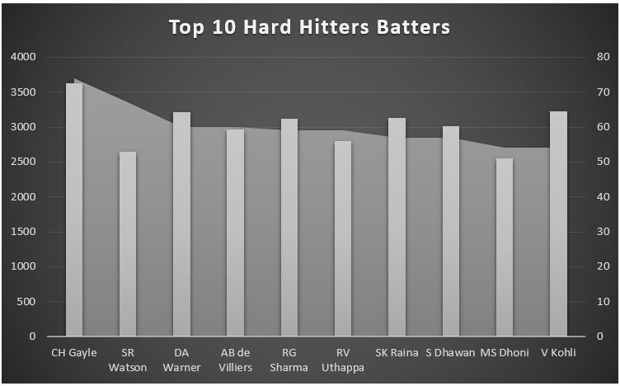
Based on the above graph and the top 10 hard hitter batsman data, to select 2-3 players of hard hitting batsman I will select them based on the Boundary_percentage and Boundary_count who have highest i.e CH Gayle, SR Watson and RG Sharma.

Slide 15
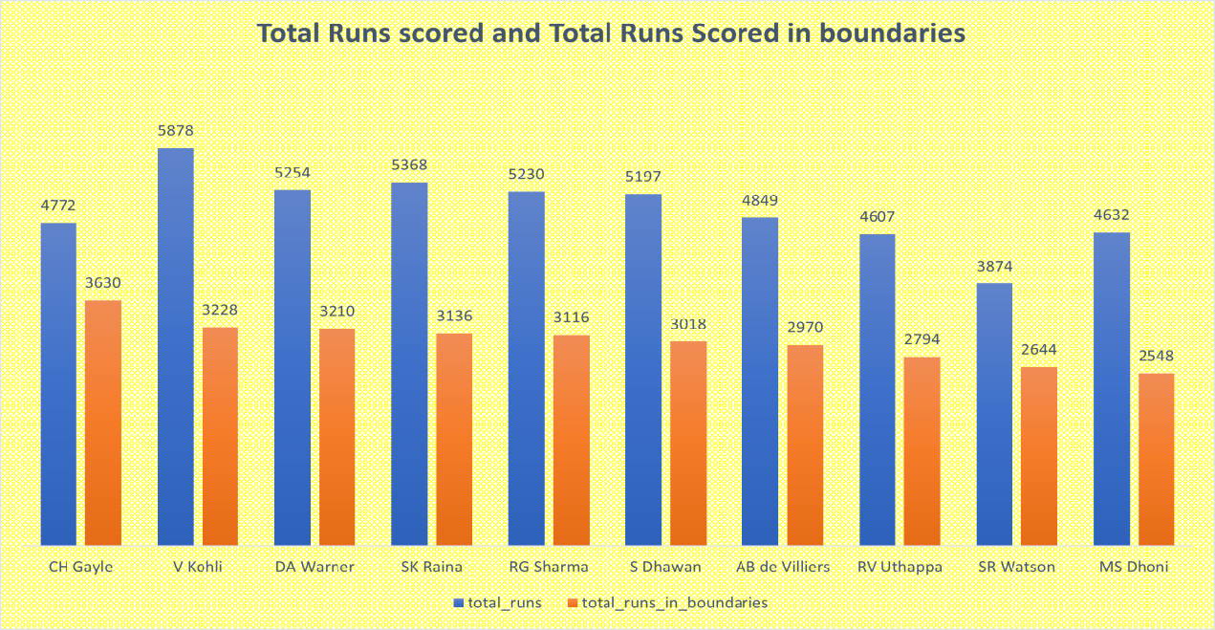
Comparison between total runs scored and run scored by boundaries

Slide 16
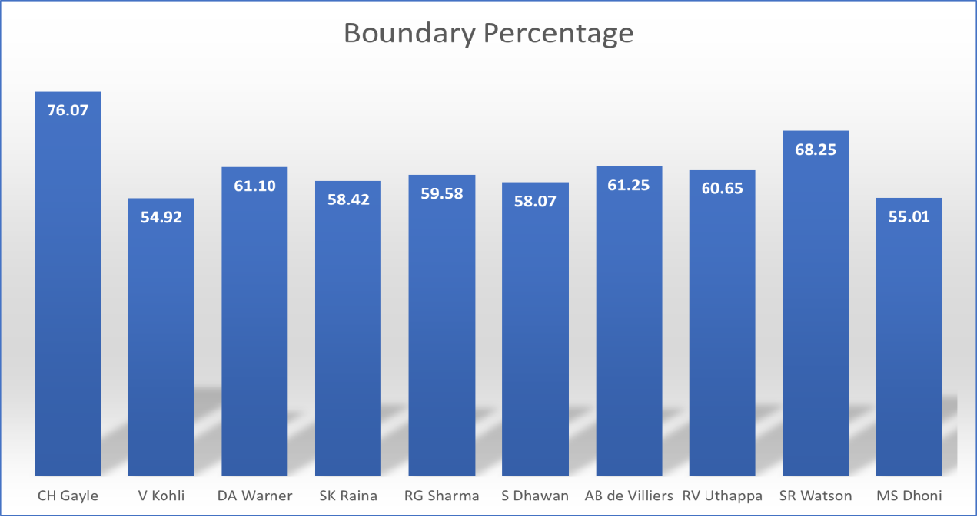

Slide 17
Bidding on Bowlers
-- Bowlers are important in an IPL team for several reasons some of them are:
-- 1. Wicket-taking ability, 2. Control, 3. Ability to bowl in different situations,
4. Ability to bowl in different conditions

Slide 18
Task 4

Slide 19
SELECT bowler,
ROUND(SUM(total_runs) / (CAST(COUNT(ball) AS DECIMAL) / 6), 2) AS Economy
FROM ipl_balls
GROUP BY bowler
HAVING COUNT(ball) >= 500
ORDER BY Economy ASC
LIMIT 10;

Slide 20
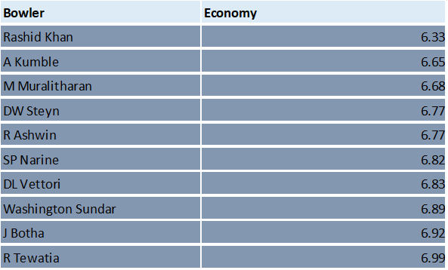
Result Table: These are top 10 bowler with the great economy to bid in the auction who have bowled at least 500 balls in IPL

Slide 21
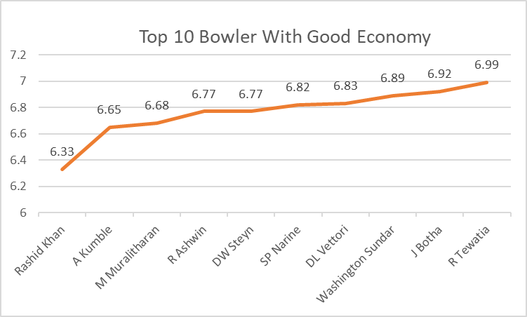
From the above graph and the top 10 economy bowlers for 2-3 bowler for IPL Auction I will select those bowlers whose economy is lowest i.e., Rashid Khan, A Kumble and M Muralitharan.

Slide 22
Task 5
Wicket
taking
bowlers
Strike rate of a bowler
can be calculated by
the number of balls
bowled divided by the
total wickets taken.

Slide 23
TOP 10 WICKET TAKER BOWLER LIST SHORTLISTING BY SQL CODE
select
bowler,
COUNT(is_wicket) as total_wicket,
count(ball) / cast(sum(is_wicket) as decimal) as strikerate
FROM ipl_balls
GROUP BY bowler
HAVING COUNT(ball) > 500
ORDER BY Strikerate asc
LIMIT 10;

Slide 24
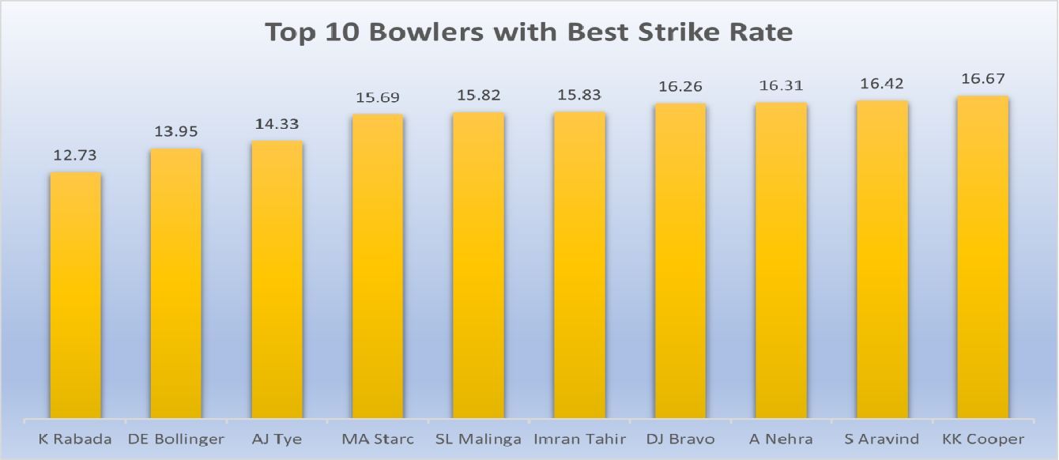

Slide 25
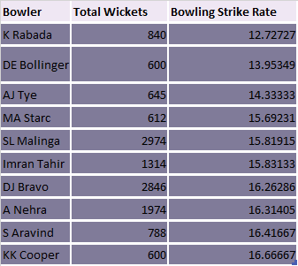
Result Table: These are top 10 Bowlers with the best bowling strike rate to bid in the auction and who have bowled at least 500 balls in IPL so far

Slide 26
Task 6
ALL
ROUNDERS

Slide 27
create table batter_sr
as
select
batsman ,
sum(case when extras_type = 'wides' then 0 else total_runs end ) as total_runs,
count(case when extras_type = 'wides' then null else ball end) as No_of_balls,
ROUND(cast(sum( case when extras_type = 'wides' then 0 else total_runs end ) as decimal(10,2)) /
nullif(count(case when extras_type = 'wides' then null else ball end),0) * 100, 2) as strike_rate
from ipl_balls
group by
batsman
having count(ball) > 500
order by strike_rate desc;

Slide 28
create table bowler_sr
as
select
Bowler,
count(ball) as no_of_balls,
count(case when is_wicket = 1 then 1 else null end) as wickets_taken,
round(count(ball)/ cast(count(case when is_wicket = 1 then 1 else null end) as decimal(10,2)),2) as
strike_rate
from ipl_balls
group by bowler
having count(ball) > 500
order by count(case when is_wicket = 1 then 1 else null end) desc;

Slide 29
CREATE TABLE bowling_strikerate AS (
SELECT bowler AS player,
COUNT(is_wicket) AS total_wicket,
COUNT(ball) / CAST(SUM(is_wicket) AS decimal) AS bowling_sr
FROM ipl_balls
GROUP BY bowler HAVING COUNT(ball) > 500 ORDER BY bowling_sr ASC);
CREATE TABLE batting_strikerate AS (
SELECT batsman AS player,
SUM(batsman_runs) AS Total_runs,
COUNT(ball) AS Total_balls,
SUM(batsman_runs) / CAST(COUNT(ball) AS decimal) * 100 AS batting_sr
FROM ipl_balls GROUP by batsman HAVING count(ball) >= 500
ORDER BY batting_sr DESC);
SELECT a.player, a.batting_sr, a.total_runs,b.player, b.bowling_sr, b.total_wicket
FROM batting_strikerate AS a
INNER JOIN bowling_strikerate AS b ON a.player = b.player
GROUP BY a.player, a.batting_sr, a.total_runs, b.player, b.bowling_sr, b.total_wicket
ORDER BY batting_sr DESC
LIMIT 10;

Slide 30
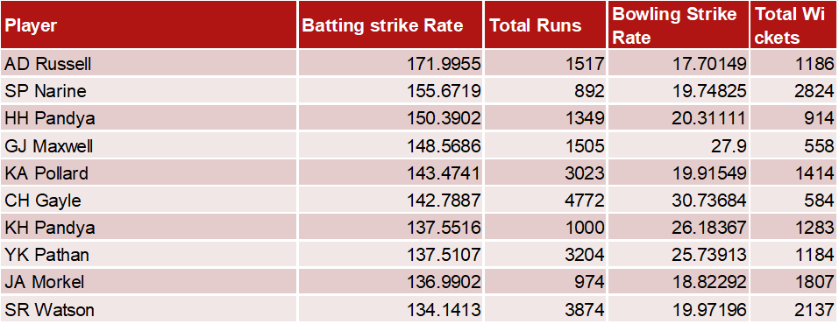
Result Table: These are top 10 All Rounders to bid in auction with the best batting as well as bowling strike rate and who have faced at least 500 balls in IPL so far and have bowled minimum 300 balls.

Slide 31
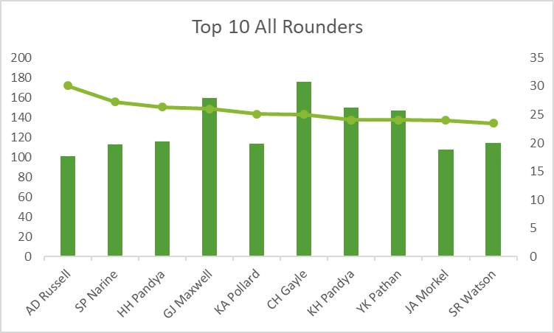
those All Rounders whose strike rate of batting is highest and strike rate of bowling is lowest i.e.,KA Pollard,JA Morkel and GJ Maxwell

Slide 32
Wicket
Keeper

Slide 33
The wicket keepers is selected based on the following criteria:
1.Total wickets took by each player as a fielder should be greater than 50.
2.By using Dismissal kind and the count of caught, stumped the players whose catches
and stumps together more than 50.
3.By using the stumps count whose no.of stumps greater than 10.
4.Finally calculating the catch stumpting percentage by the total wickets divided by total
catches and stumps and along with the who's total stumpings is greater than 10.
Selection Criteria For the Wicket Keeper:

Slide 34
Top 10 Wicket Keeper
create table wicket_keepers
as
SELECT fielder, COUNT(*) AS total_wickets,
SUM(CASE WHEN dismissal_kind IN ('caught', 'stumped') THEN 1 ELSE 0 END) AS total_catches_stumps,
SUM(CASE WHEN dismissal_kind = 'stumped' THEN 1 ELSE 0 END) AS total_stumpings,
ROUND((SUM(CASE WHEN dismissal_kind IN ('caught', 'stumped') THEN 1 ELSE 0 END)::numeric /
COUNT(*)::numeric) * 100, 2) AS catch_stumping_percentage
FROM ipl_balls
WHERE dismissal_kind IS NOT NULL
GROUP BY fielder
having COUNT(*) > 30 and SUM(CASE WHEN dismissal_kind IN ('caught', 'stumped') THEN 1 ELSE 0 END) > 30
and
SUM(CASE WHEN dismissal_kind = 'stumped' THEN 1 ELSE 0 END) > 10
order by total_wickets desc ;

Slide 35
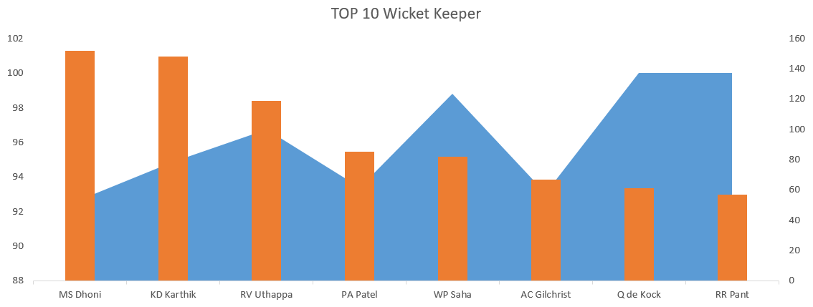
Based on the above chart and the top wicket keepers data I will select the wicket keeper who's stumpings are high and then having higher catch-stumping percentage i.e., MS Dhoni has higher stumpings.

Slide 36
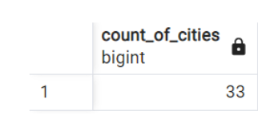
1. Get the count of cities that have hosted an IPL match
Note: table ipl_matches contains the ipl matches data and table ipl_balls contains the ipl balls data
SELECT COUNT(DISTINCT city) AS count_of_cities
FROM ipl_matches;

Slide 37
2. Create table deliveries_v02 with all the columns of the table ‘deliveries’ and an additional
column ball_result containing values boundary, dot, or other depending on the total_run
(boundary for >= 4, dot for 0, and other for any other number)
(Hint 1: CASE WHEN statement is used to get condition-based results)
(Hint 2: To convert the output data of the select statement into a table, you can use a
subquery. Create table table_name as [entire select statement].
CREATE TABLE deliveries_v02 AS
SELECT *,
CASE
WHEN total_runs = 0 THEN 'dot'
WHEN total_runs >= 4 THEN 'boundary'
ELSE 'other'
END AS ball_result
FROM ipl_balls;

Slide 38
3. Write a query to fetch the total number of boundaries and dot balls from the deliveries_v02 table.
SELECT ball_result, COUNT(*) AS count
FROM deliveries_v02
WHERE ball_result IN ('boundary', 'dot')
GROUP BY ball_result;
BALL_RESULT | COUNT
boundary | 31468
dot | 67841

Slide 39
4. Write a query to fetch the total number of boundaries scored by each team
From the deliveries_v02 table and order it in descending order of the number
of boundaries scored.
SELECT batting_team, COUNT(*) AS total_boundaries
FROM deliveries_v02
WHERE ball_result = 'boundary'
GROUP BY batting_team
ORDER BY total_boundaries DESC;
BATTING_TEAM | TOTAL_BOUNDARIES
Mumbai Indians | 4118
Royal Challengers Bangalore | 3800
Kings XI Punjab | 3780
Kolkata Knight Riders | 3739
Chennai Super Kings | 3496
Rajasthan Royals | 3041
Delhi Daredevils | 3022
Sunrisers Hyderabad | 2306
Deccan Chargers | 1387
Pune Warriors | 733
Delhi Capitals | 659
Gujarat Lions | 624
Rising Pune Supergiant | 290
Rising Pune Supergiants | 242
Kochi Tuskers Kerala | 231

Slide 40
5. Write a query to fetch the total number of dot balls bowled by each team and order it in
descending order of the total number of dot balls bowled.
BOWLING_TEAM | TOTAL_DOT_BALLS
Mumbai Indians | 8714
Royal Challengers Bangalore | 7955
Kolkata Knight Riders | 7894
Kings XI Punjab | 7679
Chennai Super Kings | 7593
Rajasthan Royals | 6665
Delhi Daredevils | 6520
Sunrisers Hyderabad | 5248
Deccan Chargers | 3306
Pune Warriors | 1900
Delhi Capitals | 1338
Gujarat Lions | 1095
Rising Pune Supergiant | 698
Kochi Tuskers Kerala | 626
Rising Pune Supergiants | 539
SELECT bowling_team, COUNT(*) as total_dot_balls
FROM deliveries_v02
WHERE ball_result = 'dot'
GROUP BY bowling_team
ORDER BY total_dot_balls DESC;

Slide 41
6. Write a query to fetch the total number of dismissals by dismissal kinds where dismissal
kind is not NA
DISMISSAL_KIND | COUNT_OF_DISMISSALS
caught | 5743
bowled | 1700
run out | 893
lbw | 571
stumped | 294
caught and bowled | 269
hit wicket | 12
retired hurt | 11
obstructing the field | 2
SELECT dismissal_kind, COUNT(*) AS count_of_dismissals
FROM ipl_balls
WHERE dismissal_kind != 'NA'
GROUP BY dismissal_kind
ORDER BY count_of_dismissals DESC;

Slide 42
7. Write a query to get the top 5 bowlers who conceded maximum extra runs from the
deliveries table
SELECT bowler, SUM(extra_runs) AS total_extra_runs
FROM ipl_balls
GROUP BY bowler
ORDER BY total_extra_runs DESC
LIMIT 5;
BOWLER | TOTAL_EXTRA_RUNS
SL Malinga | 293
P Kumar | 236
UT Yadav | 226
DJ Bravo | 210
B Kumar | 201

Slide 43
8. Write a query to create a table named deliveries_v03 with all the columns of the
deliveries_v02 table and two additional columns (named venue and match_date) of
venue and date from table matches
select * from deliveries_v02;
CREATE TABLE deliveries_v03
AS
SELECT deliveries_v02.*,
ipl_matches.venue,
ipl_matches.date_column AS match_date
FROM deliveries_v02
JOIN ipl_matches
ON deliveries_v02.id = ipl_matches.id;

Slide 44
9. Write a query to fetch the total runs scored for each venue and order it in the descending order of total runs scored.
SELECT
venue,
SUM(total_runs) AS total_runs_scored
FROM deliveries_v03
GROUP BY venue
ORDER BY total_runs_scored DESC;

Slide 45
venue | total_runs_scored
Eden Gardens | 23658
Wankhede Stadium | 23390
Feroz Shah Kotla | 22947
M Chinnaswamy Stadium | 20237
Rajiv Gandhi International Stadium, Uppal | 19484
MA Chidambaram Stadium, Chepauk | 17821
Sawai Mansingh Stadium | 14264
Punjab Cricket Association Stadium, Mohali | 10987
Dubai International Cricket Stadium | 10402
Sheikh Zayed Stadium | 8830
Punjab Cricket Association IS Bindra Stadium, Mohali | 7021
Maharashtra Cricket Association Stadium | 6780
Sharjah Cricket Stadium | 5924
M.Chinnaswamy Stadium | 5127
Dr DY Patil Sports Academy | 4810
Subrata Roy Sahara Stadium | 4755
Kingsmead | 4353
Brabourne Stadium | 3842
Dr. Y.S. Rajasekhara Reddy ACA-VDCA Cricket Stadium | 3746
Sardar Patel Stadium, Motera | 3746
SuperSport Park | 3653
Saurashtra Cricket Association Stadium | 3316
Himachal Pradesh Cricket Association Stadium | 2897
Holkar Cricket Stadium | 2872
New Wanderers Stadium | 2292
Barabati Stadium | 2278
JSCA International Stadium Complex | 2056
St George's Park | 2033
Newlands | 1764
Shaheed Veer Narayan Singh International Stadium | 1741
Nehru Stadium | 1363
Green Park | 1298
De Beers Diamond Oval | 897
Vidarbha Cricket Association Stadium, Jamtha | 882
Buffalo Park | 799
OUTsurance Oval | 529

Slide 46
10. Write a query to fetch the year-wise total runs scored at Eden Gardens
and order it in the
descending order of total runs scored.
SELECT
EXTRACT(YEAR FROM match_date) AS year,
SUM(total_runs) AS total_runs_scored
FROM deliveries_v03
WHERE venue = 'Eden Gardens'
GROUP BY year
ORDER BY total_runs_scored DESC;
YEAR | TOTAL_RUNS_SCORED
2018 | 2885
2019 | 2651
2015 | 2386
2013 | 2304
2017 | 2194
2010 | 2167
2016 | 2073
2012 | 2012
2011 | 1854
2008 | 1843
2014 | 1289

Slide 47
Conclusion:
Throughout the project, several SQL queries were used to retrieve and manipulate data from different tables, including “ipl_balls" and “ipl_matches".
The tasks covered various aspects of IPL data analysis, such as calculating batting and bowling statistics, determining venue-wise performance, identifying dismissals, and finding top performers based on different criteria.

Slide 48
Thank You

