Slide 1






Executive Productivity Agent
Executive Dashboard Preview
AI-Powered Assistant for Executive Commitments
CURRENT EXECUTIVE
“From scattered information to clear action”
Arjun Malhotra
TECHNOLOGY STACK
UNRESOLVED ACTION
OVERDUE TASK
Vendor list to Raghav
Reschedule Meridian Call
Emails / Meetings / Voice
Productivity Agent
Executive Brief & Actions
Academic Evaluation Deck — Executive Productivity Agent
Slide 1 of 10

Slide 2





Problem Statement & Objective
Fragmented Information Overload
Automated Executive Intelligence
Executives receive critical commitments across disparate channels:
Build an AI assistant to streamline unstructured data into actionable intelligence:
High-volume Emails & Threads
Extract commitments automatically via Local LLM
Meeting Action Items & Notes
Resolve context across email threads
Unstructured Voice Notes
Identify explicit ownership & status
Answer natural language executive queries
KEY BOTTLENECKS
• Scattered commitments & missed follow-ups
• Unclear task ownership & overdue deadlines
• Hours spent manually consolidating context
PRIMARY GOAL
“Help executives stay informed, focused, and in control.”
Executive Productivity Agent
Slide 2 of 10

Slide 3




Solution Overview
END-TO-END SYSTEM PIPELINE
1. Extraction Agent
2. Thread Resolver
3. Brief Generator
4. Query Agent
Extracts structured commitments, owner identities, counterparty, deadlines, status, and source context using Qwen2.5:3b.
Connects related email messages into single threads to accurately determine the active state of commitments.
Organizes tasks into 5 actionable executive views:
Handles natural-language questions via `/ask` endpoint:
• My Actions • Waiting on Others
• Unclear Ownership • Overdue
• Completed
“What did I promise Raghav?”
“What tasks are overdue?”
Executive Productivity Agent
Slide 3 of 10

Slide 4
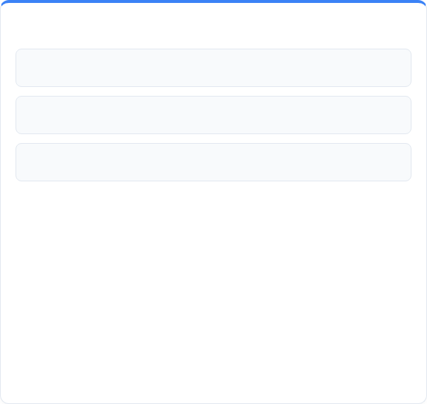

Inputs, Sources & Assumptions
Emails (emails.json)
Data Availability: Structured JSON input sources are made accessible to the system.
Meeting-related and commitment-bearing email threads
Owner Identification: Commitments contain contextual signals to identify the responsible party.
Meetings (meetings.json)
Deadline Context: Deadlines are either explicitly stated or contextually inferred.
Meeting transcripts, topics, and captured action notes
Thread Continuity: Email messages with matching subjects belong to the same thread context.
Latest Context Wins: The latest relevant message in a thread represents current commitment state.
Voice Notes (voice_notes.json)
Text/content recorded from executive voice memos
Executive Productivity Agent
Slide 4 of 10

Slide 5




Complete System Architecture
1. INPUT LAYER (DATA SOURCES)
2. AI AGENTS LAYER (PYTHON LOGIC + LOCAL LLM RUNTIME)
3. BACKEND API LAYER (PYTHON FASTAPI) REST API SERVICE
4. FRONTEND PRESENTATION LAYER (REACT + VITE + TAILWIND CSS)
Executive Productivity Agent
Slide 5 of 10

Slide 6





End-to-End Process Flow
STEP 1
STEP 2
STEP 3
STEP 4
STEP 5
STEP 6
STEP 7
Data Ingestion
Commitment Extraction
Thread Resolution
Task Classification
Brief Generation
FastAPI Endpoint
React Dashboard
Reads emails, meetings, & voice JSON files.
Qwen2.5 parses task, owner, deadline & status.
Groups related emails & isolates latest context.
Categorizes into My Actions, Overdue, Waiting, etc.
Outputs structured executive brief dataset.
Exposes /brief & /ask REST endpoints.
Displays dashboard, calendar & Ask Agent UI.
Core Automation Value
“AI transforms unstructured communication into structured executive actions.”
Executive Productivity Agent
Slide 6 of 10

Slide 7

AI Tools & Technology Stack
Tool / Technology | System Role | Implementation Details
Ollama | Local LLM Runtime | Runs the language model locally on host machine without external cloud dependencies.
Qwen2.5:3b | Language Model | Extracts structured commitments and performs natural-language context reasoning.
Python Agents | AI Orchestration | Implements extraction logic, thread resolution algorithm, brief generator, & query handler.
FastAPI | Backend API Layer | Serves REST endpoints (/brief, /brief/refresh, /ask). (Not an AI model)
React + Vite | Frontend UI | Provides interactive dashboard, task views, and Ask Agent chat. (Not an AI model)
React Calendar | Calendar UI | Renders scheduled commitments and task deadlines on an interactive calendar.
AI / LLM COMPONENTS
APPLICATION COMPONENTS
Ollama + Qwen2.5:3b + Python Agent Logic
FastAPI REST Backend + React/Vite Frontend UI
Executive Productivity Agent
Slide 7 of 10

Slide 8







Working Prototype — Executive Dashboard
Executive Productivity Dashboard — Good Morning, Arjun Malhotra!
1
1
0
1
3
MY ACTIONS
OVERDUE
WAITING
UNCLEAR
COMPLETED
MY ACTIONS & ATTENTION NEEDED
SEPTEMBER 2026
Send updated vendor list to Raghav
• Sep 23: Send Vendor List
• Sep 25: Deliver Q3 Deck
• Sep 30: Expense Variance
Source: email_thread_04 • Deadline: Sep 23
Confirm Mumbai office lease renewal ownership
Source: meeting_notes_02 • Needs clarification
Reschedule Meridian Logistics call
Source: voice_note_01 • Overdue
Prototype interface rendered from project sample data
Executive Productivity Agent — Evaluated on Sample Data
Slide 8 of 10

Slide 9



Ask Agent — Natural Language Interaction
Query endpoint: POST /ask
Executive Productivity Agent
Slide 9 of 10

Slide 10

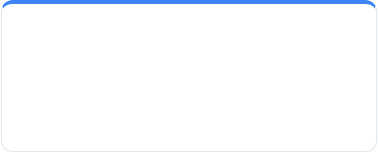


Demo, GitHub & Future Scope
Video Walkthrough
Source Code
• Real Gmail / Outlook API integration
2–3 minute walkthrough of working prototype.
Complete repository & setup instructions.
• Automated Voice-to-Text pipeline
• Multi-user support & permissions
• Executive analytics & mobile app
EXECUTIVE PRODUCTIVITY AGENT
From scattered communication → structured commitments → actionable executive intelligence.
Academic Project Evaluation — Executive Productivity Agent
Slide 10 of 10

