Slide 1

COVID-19
Big problem in the world

Slide 2
Application features
Shows the graph of the covid total recovered and death data
Display all over the world’s covid data
It’s automatically updated with the data

Slide 3
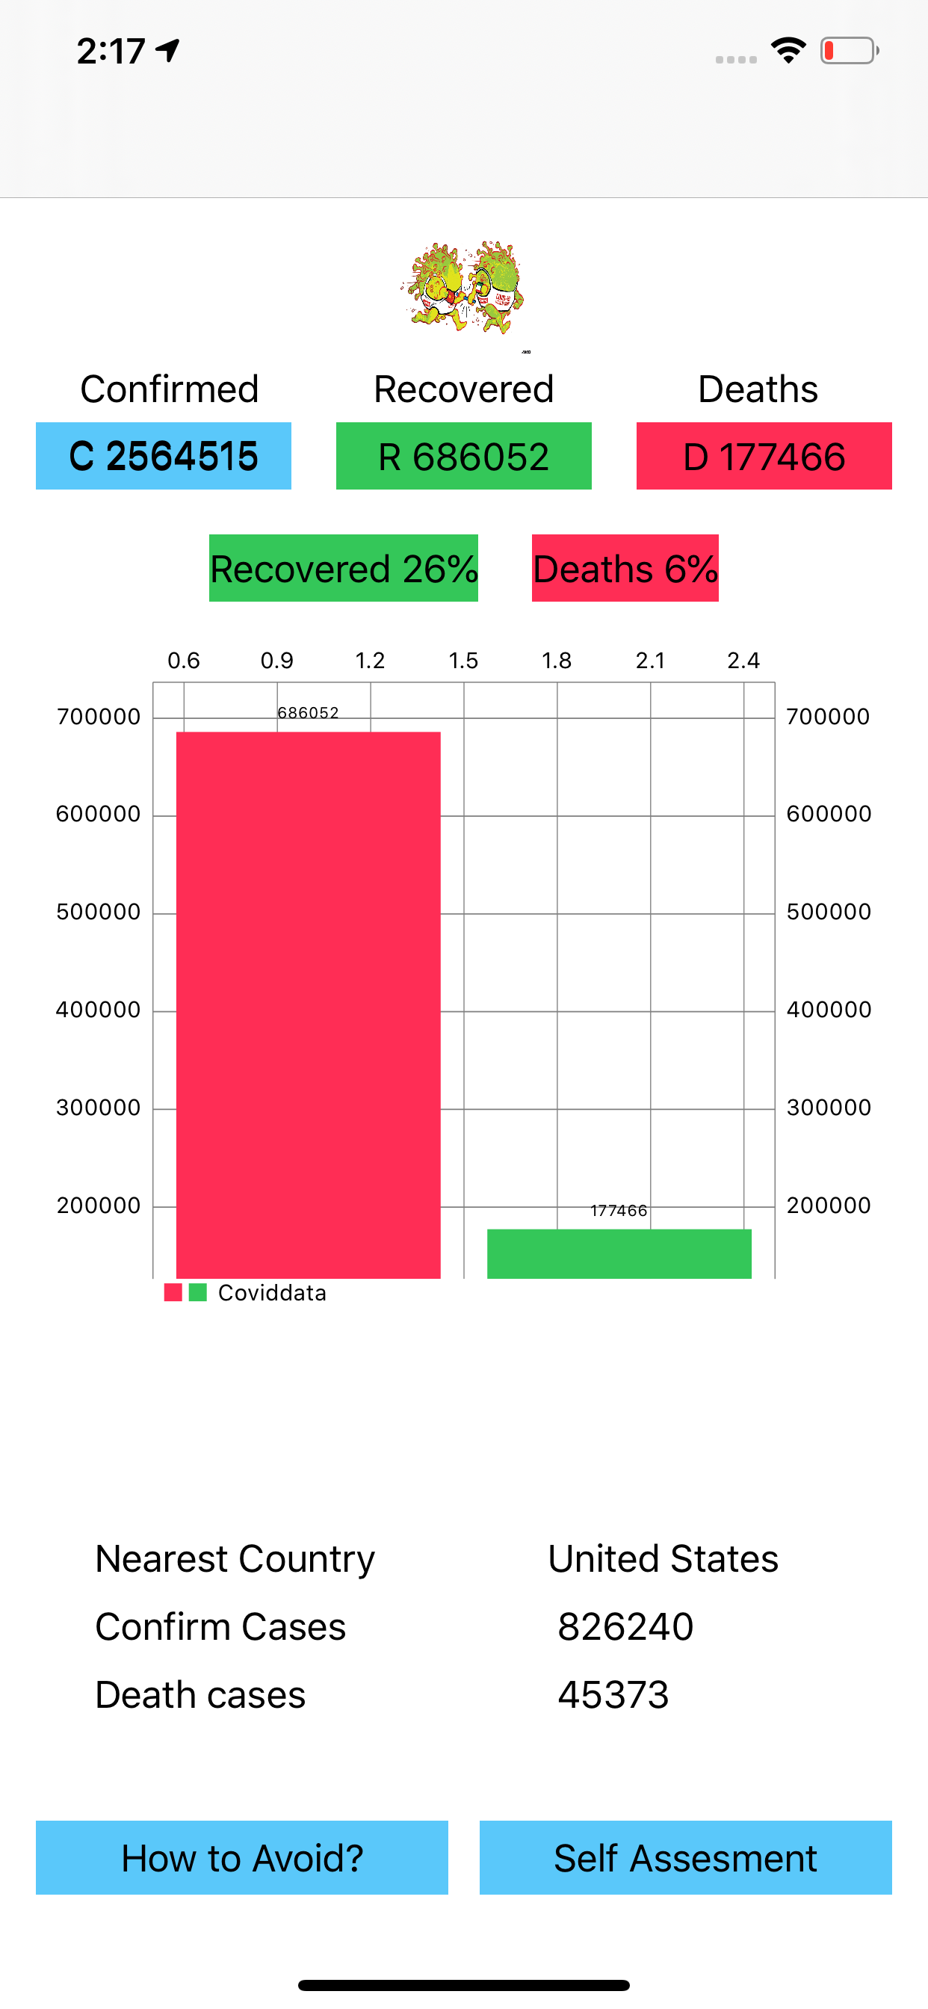
Overview of App
In this Application User can see the global data of the Covid-19.
User can see the graph of that data.
User can see the nearest Country’s Covid data.
User can give self-assessment through this application.

Slide 4
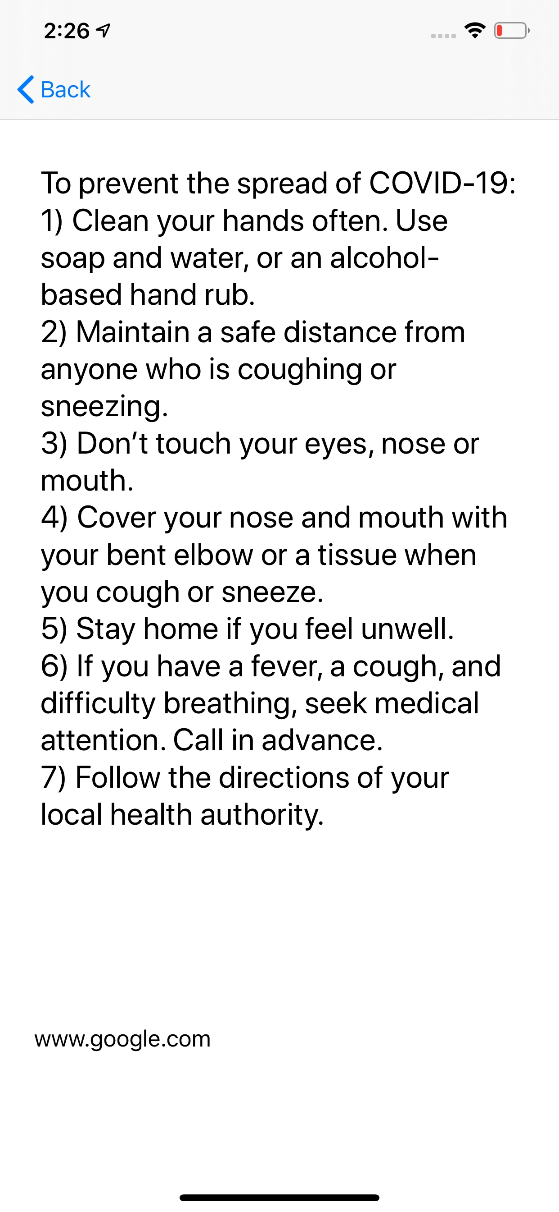
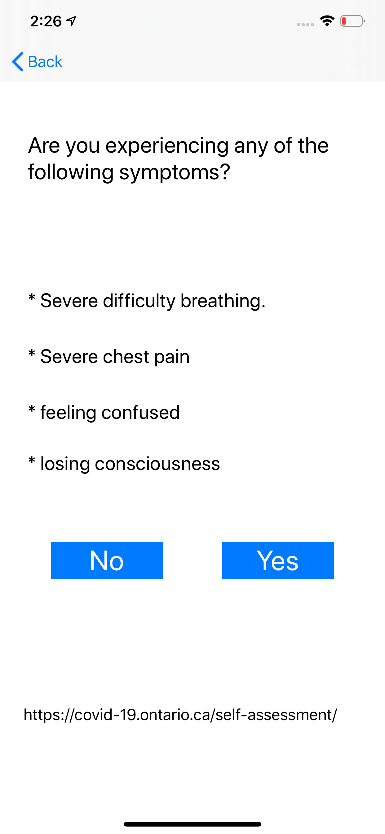
Screenshots about the App

Slide 5
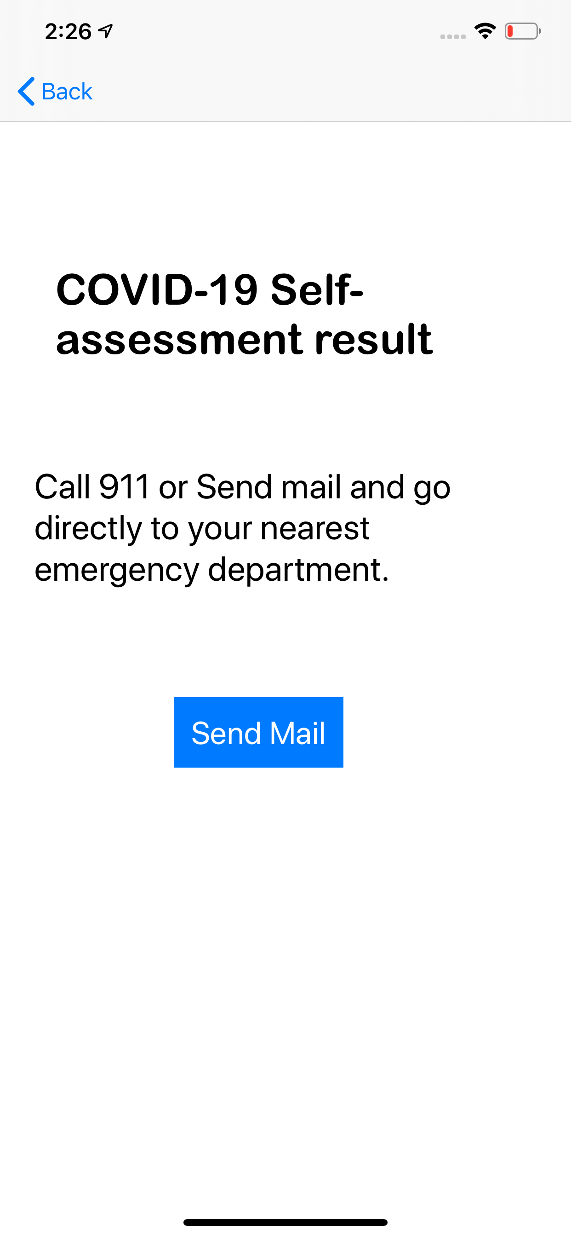
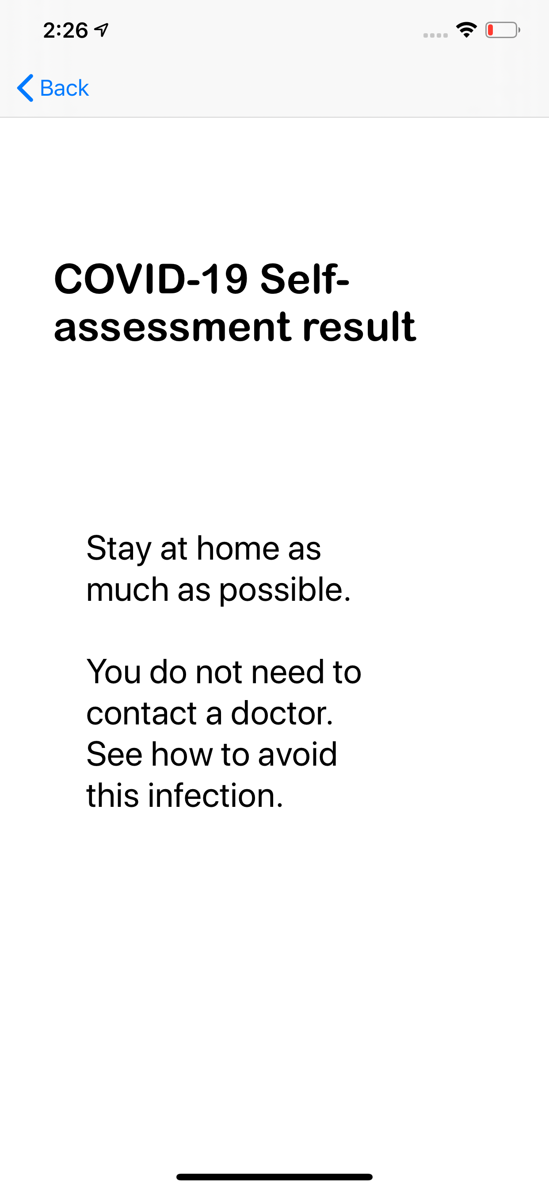

Slide 6
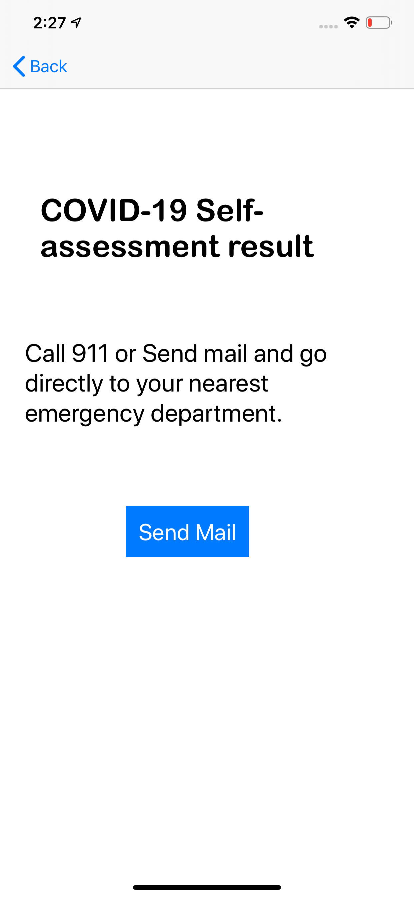
New features
When user start to assessment and when he or she found symptoms of Corona then he or she directly mail to the hospital by clicking on the Send Mail button.

Slide 7
Future Scope
I wanted to implement User notification as user get notified when he or she change their Location.
So that is my future Scope for this Application

Slide 8
Thank You

