Slide 1
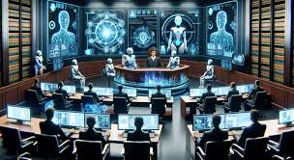
Court Cases Priorities and Timeline: Analysis and Prediction
Vidyavardhini’s College of Engineering and Technology, India
Mr. Vipul Bhoir,
Mr. Mrudul Chaudhari,
Ms. Khushi Sinha,
Mrs. Smita Jawale

Slide 2
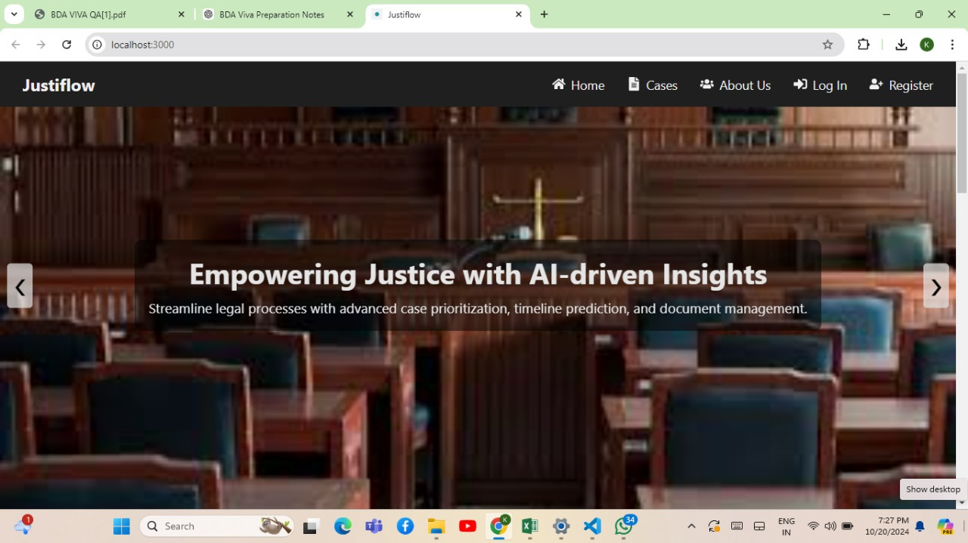
Introduction & Problem Statement
Brief overview of judicial backlog issues in India (30M+ pending cases).
Impact of delayed justice on governance and society.
Lack of AI-driven prioritization in existing case management systems.

Slide 3

Objectives of the Research
Develop an AI-driven case flow management system.
Predict court case timelines using ML (Random Forest, Decision Trees).
Automate case complexity assessment for priority handling.

Slide 4
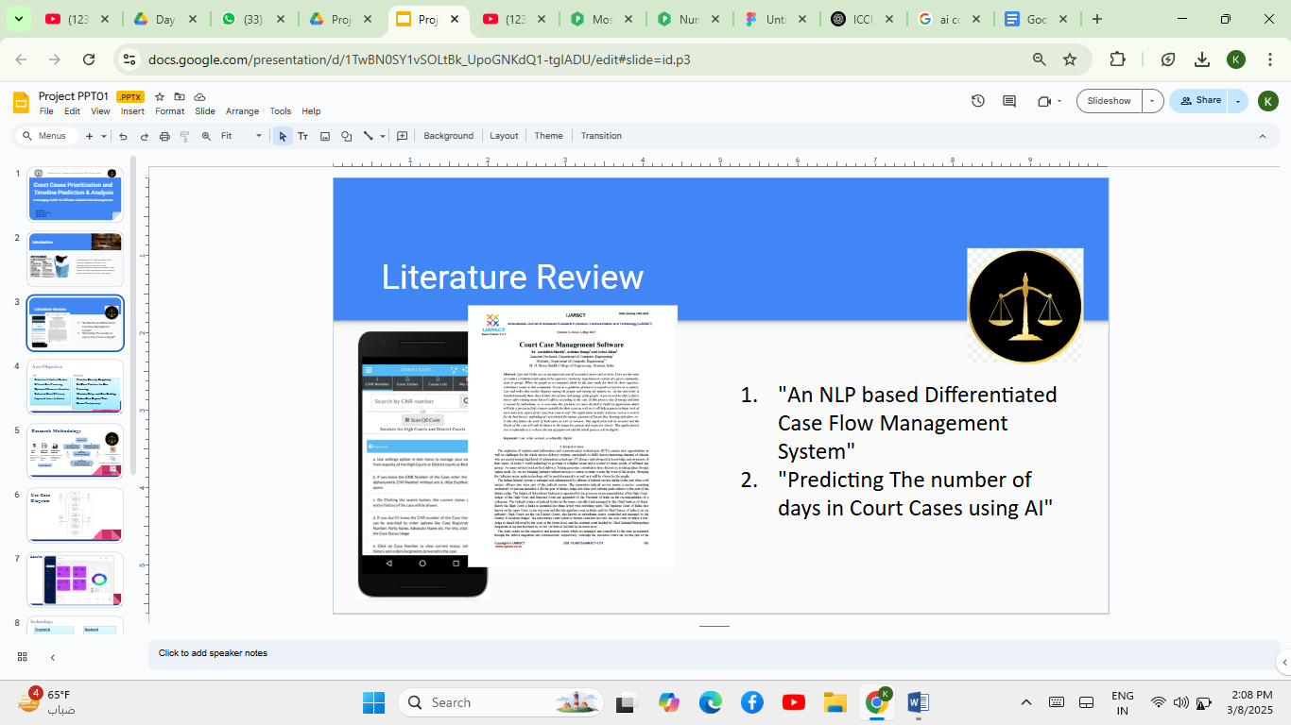
Literature Review (Summarized)
Existing case management techniques: Differentiated Case Management, NLP-based prioritization, Electronic Case Management Systems.
Gaps: Lack of predictive analytics, real-time prioritization, and AI integration.

Slide 5
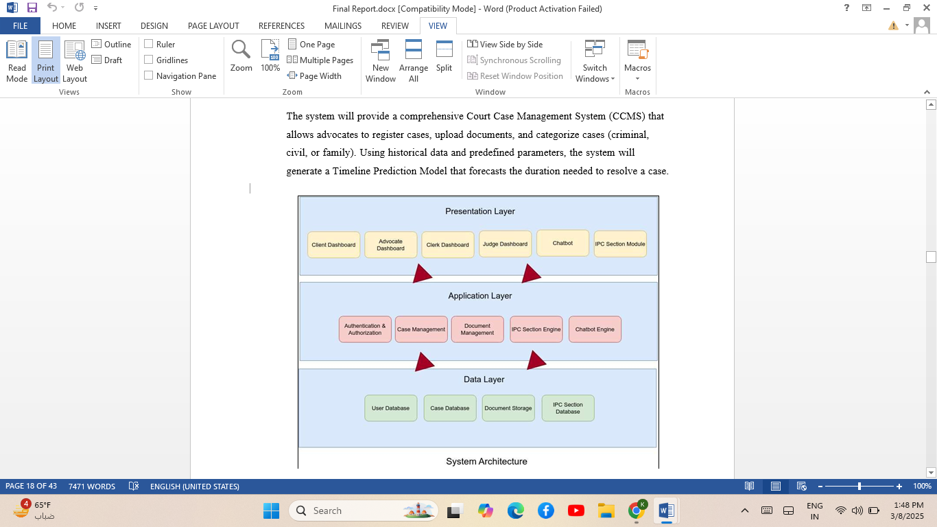
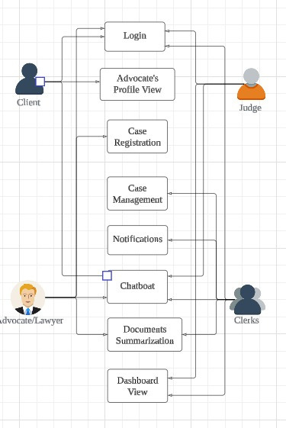
Proposed System Architecture
Role-Based User Authentication
Case Registration & Document Submission
Complexity Scoring & Priority Assignment
Timeline Prediction using ML
AI Chatbot for Legal Assistance

Slide 6
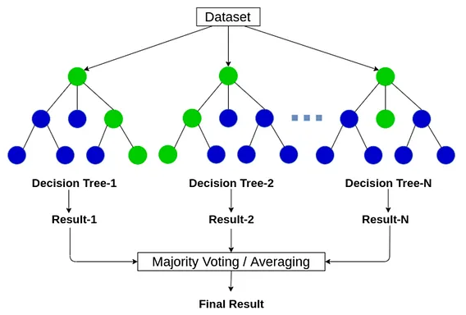
Machine Learning Model (Timeline Prediction)
Algorithm Used: Random Forest.
Dataset Details: Kaggle dataset with 65,224 cases & 14 features.
Key Features Considered: Crime type, Filed case type, DV cases, etc.
Results: 80.09% accuracy in predicting case resolution time

Slide 7
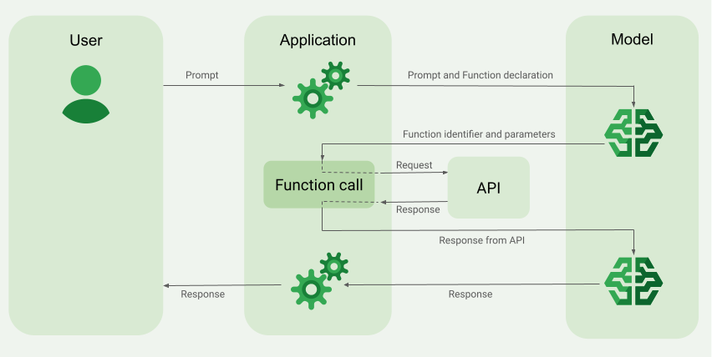
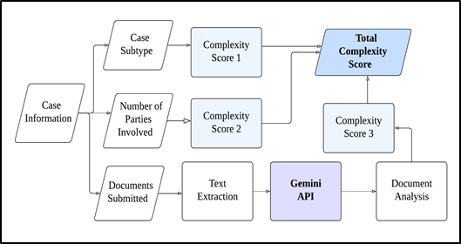
Case Complexity Calculation
Formula: Complexity Score = Case Type + Number of Parties + Number of Documents.
Use of LLM (Gemini): NLP-driven document analysis for complexity assessment.
Example Table: Show different case complexities with scores.

Slide 8
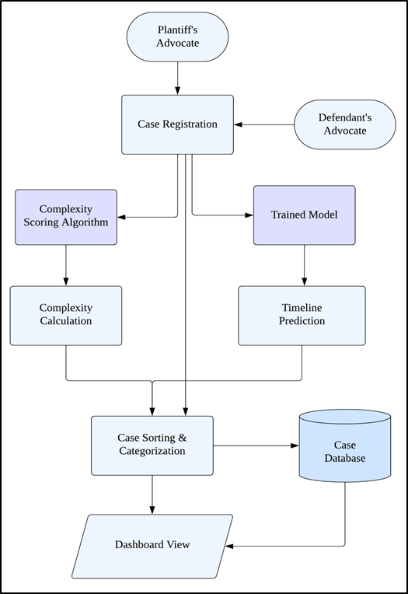
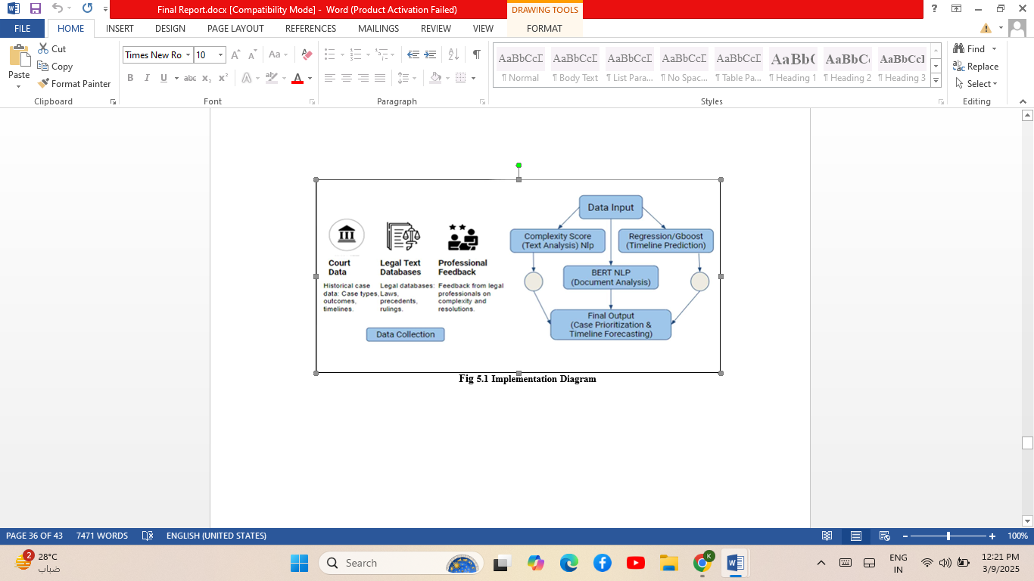
Implementation & System Workflow
Backend: Python, FastAPI, MySQL for data integration.
Frontend: React.js, HTML, CSS for user interaction.
Workflow Diagram: Show steps from case registration to decision-making.

Slide 9
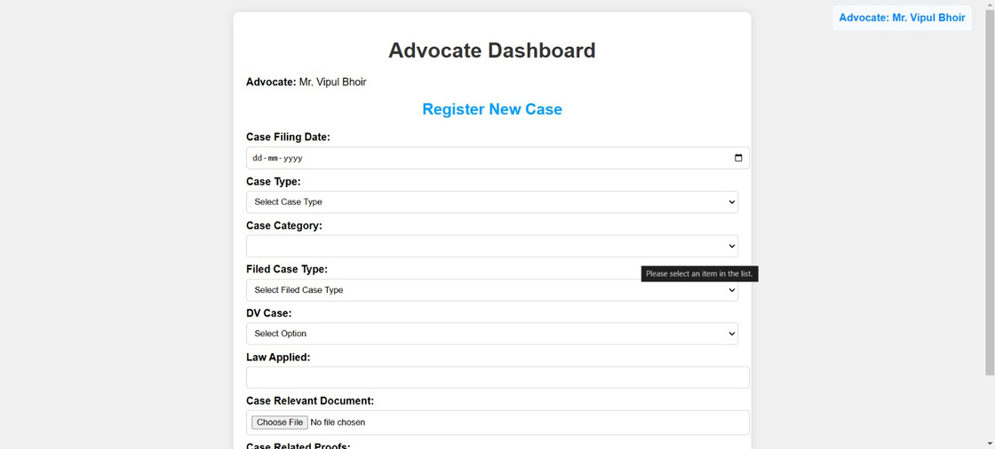
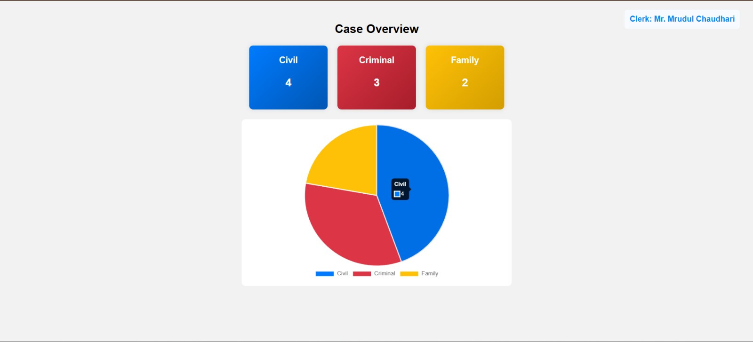
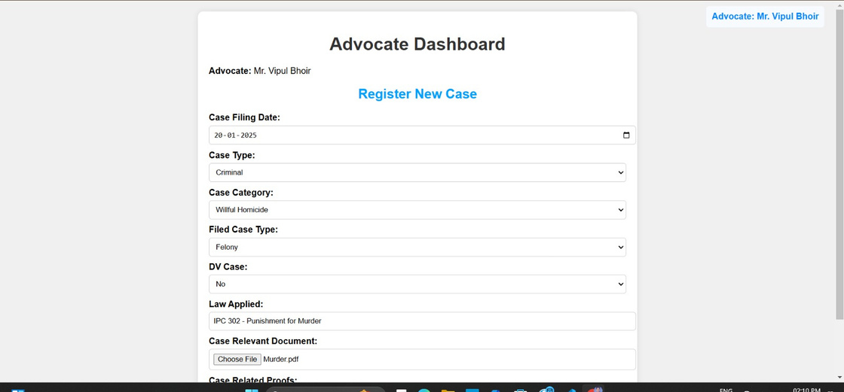
Results & Visualizations
Case Registration Page for Advocates
Case Categorization, visible to the judge & clerks
Filling of new criminal case by Advocate

Slide 10
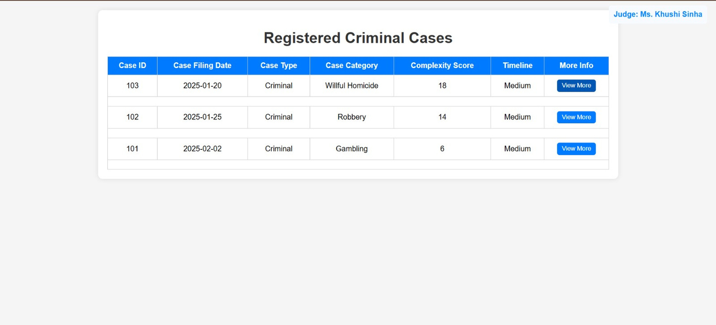
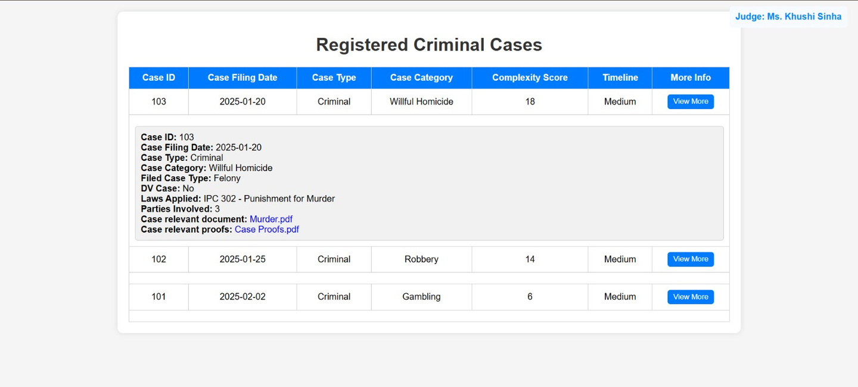
All Registered Criminal Cases with Predicted Timeline and Complexity by the system. Judge and Clerk can view and take action.
In Detail view of Case with submitted docs and proofs by the party.

Slide 11

Discussion & Impact
Improved case tracking and resource allocation.
Faster justice delivery through AI automation.
Legal AI chatbot reduces clerical workload.

Slide 12

Conclusion
AI-based judicial workflows improve efficiency.
Predictive models help reduce backlog issues.
Future Scope: Integrating real-time data from e-Courts.

Slide 13

Q&A Slide
Thank You !

