Slide 1
Training Project
MyStore
By - Khushi Agrawal
Trainer- Mr. Durgesh
Manager - Mr. Neeraj Arora

Slide 2
Content
Introduction
Overview
Technologies used
Annotations Used
Architecture
Hibernate
Services
Repository
Mapping
Exception handling
Security
Swagger
Future Scope

Slide 3
Introduction
The Goal of this project is to create backend of an e-commerce application like amazon, myntra etc. that provides various services to a user to shop online.
It contains modules like user , product, cart, order, etc.
Spring Boot is used to build is this project.

Slide 4
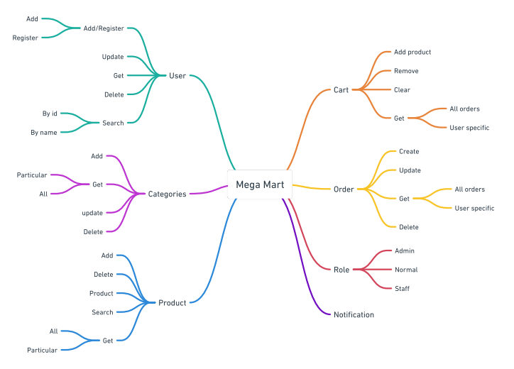
Overview

Slide 5
Some Technologies used
Spring boot
Whimsical
Lombok
ModelMapper
Logger
MySQL workbench
Hibernate
PasswordEncoder
Swagger

Slide 6
Some Annotations used
Spring Annotations are a form of metadata that provides data about a program.
@Service - used with classes that provide some business functionalities.
@Primary - for preference
@ExceptionHandler - used to handle the specific exceptions
@ControllerAdvice - apply exception handling across the whole application, not just to an individual controller.
@Valid - ensures the validation of the whole object.
@Configuration - there is one or more beans that needs to be dealt with on runtime.
@Controller : Annotated class indicates that it is a controller component, and mainly used at the presentation layer.
@Component : It is a basic auto component scan annotation
@RequestMapping - used to map web requests onto specific handler classes or handler methods
@Entity annotation - defines that a class can be mapped to a table.

Slide 7
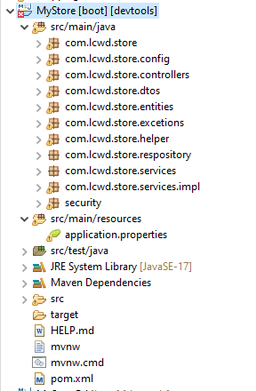
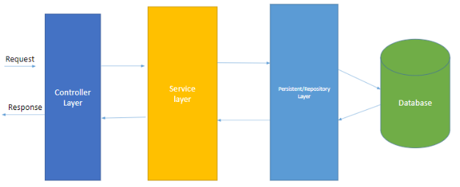
Architecture
Controller layer -> classes that accept the request
Service layer -> classes that process the logic
Persistent layer / Repository -> classes performing db operations / DAO

Slide 8
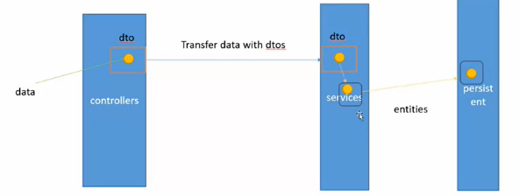

Slide 9
Hibernate
Java Persistence API (JPA) is a Java specification that gives some functionality
and standard to ORM tools. It is used to examine,control, and persist data between Java objects and relational databases.
The main feature of Hibernate is to map the Java classes to database tables.

Slide 10
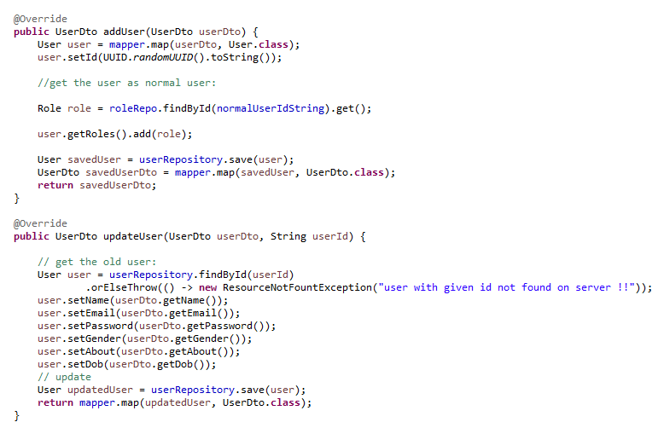
SERVICES
The business logic resides within the service layer so we use the @Service Annotation to indicate that a class belongs to that layer.
● @Service Annotation is it can be applied only to classes.
● Spring context will autodetect these classes when annotation-based configuration and classpath scanning is used.

Slide 11
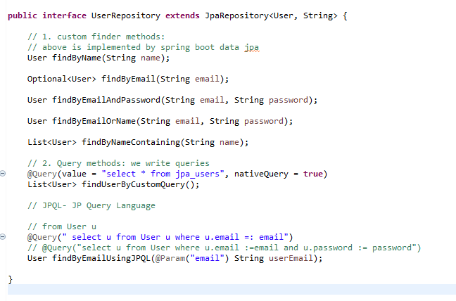
REPOSITORY
JPA Repository is mainly used for managing the data in a Spring Boot Application.
public interface UserRepository extends JpaRepository<User, String> {
// custom finder methods
}

Slide 12
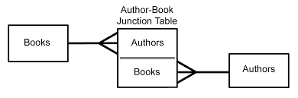
MAPPING
MAPPED ->
One to Many between category and products
Many to Many between user and user_role
One to many between Cart and product
One to many between Order and product

Slide 13
EXCEPTION HANDLING
Controller Specific
Project Specific
Global Exception Handling
In Java, exception handling is done by try, catch blocks but spring boot also allows us to provide customized global exception handling where we need not to add try catch block everywhere, we can create a separate class for handling exceptions and it also separates the exception handling code from business logic code.

Slide 14
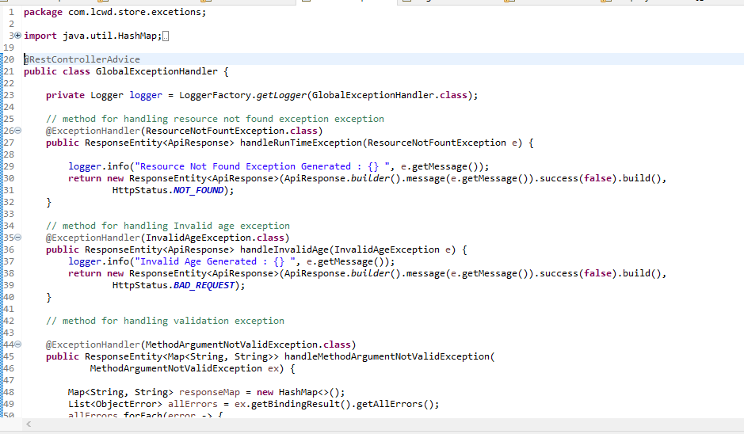

Slide 15
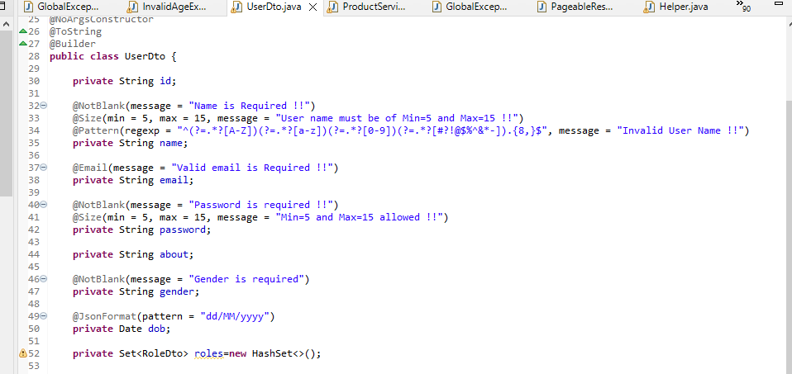
SECURITY
Validation of the request data
Hibernate bean validator
We will do validity when the obj serialize.
So if it doesn't fulfill these validations it will raise exceptions

Slide 16
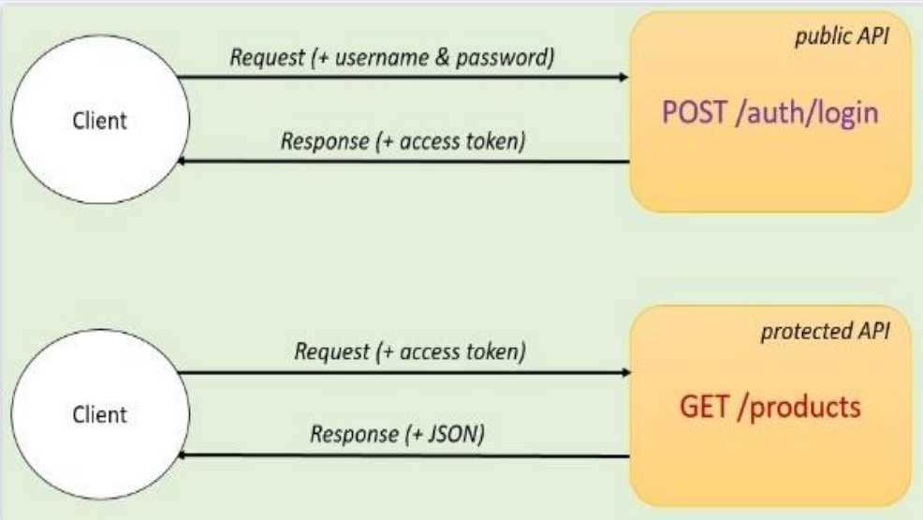
SECURITY
2. Authentication -> token
Http Basic authentication
disadvantage -> for every request send username and password
To access data -> to need token - > JWT Token (JSON Web Token)
The tokens contain claims that are encoded as a JSON object and are digitally signed using a private secret or a public key/private key pair.

Slide 17
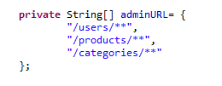
SECURITY
3. Authorization - role
Different user roles have different levels of access to the application.

Slide 18
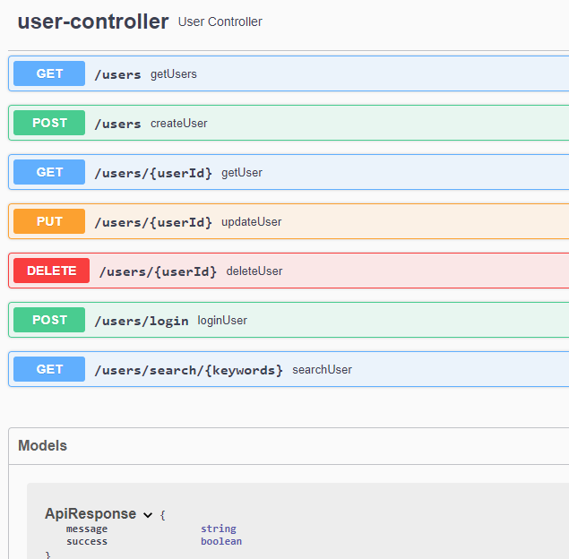
SWAGGER
Swagger is an open source project used to generate the REST API documents for RESTful web services. It provides a user interface to access our RESTful web services via the web browser.

Slide 19
FUTURE SCOPE
Develop a frontend for this application.
Add new modules like email notifications.
Add module of discount coupons.

Slide 20
THANKYOU

