Slide 1


Customer Shopping Behavior Analysis
Uncovering insights from transactional data to guide strategic business decisions.

Slide 2
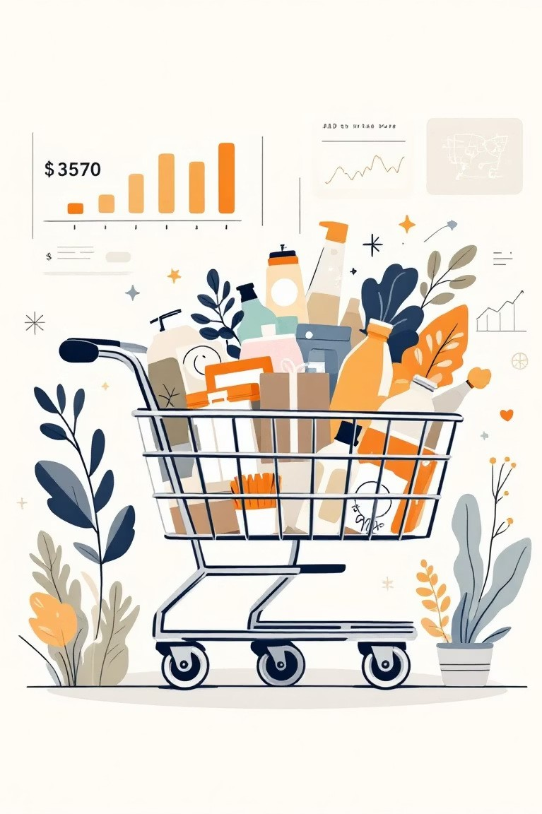
Project Overview
1
2
Data Source
3,900 purchases across various product categories.
Key Goal
Uncover insights into spending patterns and preferences.
3
Strategic Impact
Guide business decisions and optimize operations.

Slide 3

Dataset Summary
Data Points
3,900 Rows
18 Columns
Key Features
Customer demographics (Age, Gender, Location, Subscription)
Purchase details (Item, Category, Amount, Season, Size, Color)
Shopping behavior (Discount, Promo, Previous Purchases, Frequency, Review, Shipping)
Missing Data
37 values in "Review Rating" column.

Slide 4
Exploratory Data Analysis (Python)
01
Data Loading & Exploration
Imported with pandas, checked structure and summary statistics.
03
Column Standardization
Renamed to snake_case for readability.
05
Data Consistency
Dropped redundant "promo_code_used".
02
Missing Data Handling
Imputed "Review Rating" using median per category.
04
Feature Engineering
Created age_group and purchase_frequency_days.
06
Database Integration
Loaded cleaned data to PostgreSQL for SQL analysis.

Slide 5

Data Analysis (SQL)
1
Revenue by Gender
Male customers generated higher revenue.
2
High-Spending Discount Users
Identified customers using discounts with above-average spend.
3
Top 5 Products by Rating
Gloves, Sandals, Boots, Hat, Skirt.
4
Shipping Type Comparison
Express shipping users had higher average purchase amounts.

Slide 6
SQL Insights Continued
1
Subscribers vs. Non-Subscribers
Non-subscribers contributed more total revenue.
2
Discount-Dependent Products
Hat, Sneakers, Coat, Sweater, Pants had highest discount rates.
3
Customer Segmentation
Loyal (3116), Returning (701), New (83).
4
Repeat Buyers & Subscriptions
Repeat buyers are more likely to subscribe.
5
Revenue by Age Group
Young Adult group generated highest revenue.

Slide 7
Top Products Per Category
1 | Accessories | Jewelry | 171
2 | Accessories | Sunglasses | 161
3 | Accessories | Belt | 161
1 | Clothing | Blouse | 171
2 | Clothing | Pants | 171
3 | Clothing | Shirt | 169
1 | Footwear | Sandals | 160
2 | Footwear | Shoes | 150
3 | Footwear | Sneakers | 145
1 | Outerwear | Jacket | 163
2 | Outerwear | Coat | 161

Slide 8
Dashboard in Power BI
Interactive visualization of key customer behavior insights.

Slide 9
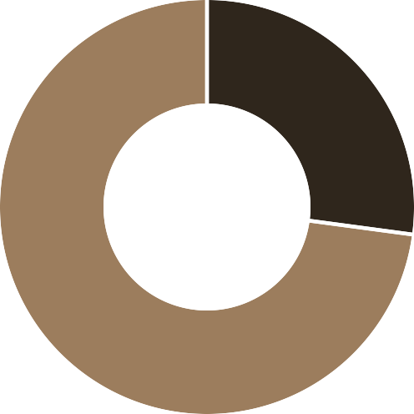


Dashboard Highlights
$1,200,000.00
$800,000.00
$400,000.00
Yes
No
$0.00
Clothing
Accessories
Footwear
Other
27% of customers are subscribers.
Clothing leads in revenue.

Slide 10
Business Recommendations
Boost Subscriptions
Promote exclusive benefits to increase subscriber base.
Customer Loyalty Programs
Reward repeat buyers to foster loyalty.
Review Discount Policy
Balance sales boosts with margin control.
Product Positioning
Highlight top-rated and best-selling products in campaigns.
Targeted Marketing
Focus on high-revenue age groups and express-shipping users.

