Slide 1
Difference Between Raster Scan and Random Scan

Slide 2
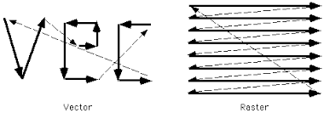
There are two Ways to Represent an object on a screen:

Slide 3
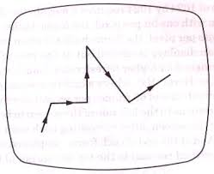
What is Random Scan?
Definition: Random scan (or vector scan) refers to the process of directly drawing images as continuous lines, curves, or shapes.
Representation: Focuses on drawing geometric shapes rather than scanning all screen pixels.
Key Feature: Selective processing of image data.

Slide 4
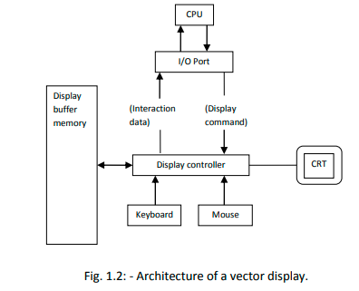
Architecture for Vector Scan (Random Scan)
Display Controller
manages communication between the CPU, input devices, and the CRT. It processes commands, reads data from the display buffer memory, and sends signals to the CRT for rendering vector graphics.
Display Buffer Memory
stores vector data, such as line coordinates and drawing instructions, ensuring smooth and accurate updates to the display.

Slide 5
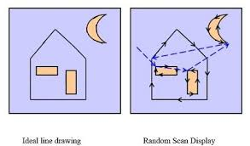
Concept of Random Scan
Electron beam moves directly to the required points on the screen to draw shapes.
Does not scan the entire screen.
Works well with line drawings and wireframe models.

Slide 6
Applications and Uses of Random Scan
Applications:
Early CAD systems and engineering design software.
Oscilloscopes and vector graphic displays.
Uses:
Sharp and precise line drawings.
Best for simple graphics with limited complexity.

Slide 7
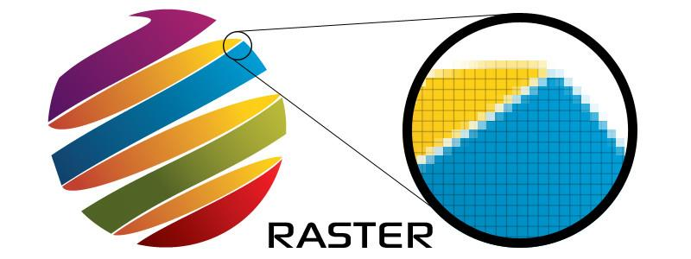

What is Raster Scan?
Definition: Raster scan refers to the method of displaying an image by illuminating pixels row by row, starting from the top-left corner.
Representation: Images are stored as a grid of pixels, also called a raster.
Key Feature: Sequential processing of image data.

Slide 8
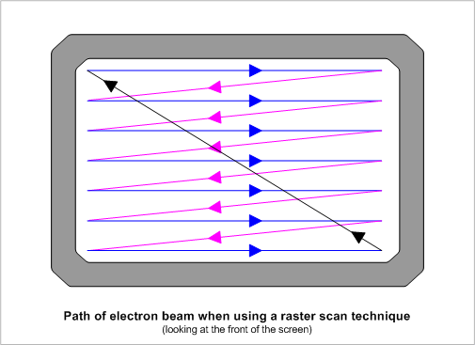
Concept of Raster Scan
Electron beam scans the screen in a fixed pattern from left to right and top to bottom.
After completing one row, the beam returns to the next line (horizontal retrace).
Once the screen is complete, it resets to the top-left corner (vertical retrace).
This Photo by Unknown Author is licensed under CC BY-SA

Slide 9
Working of Raster Scan
Horizontal Scan: The electron beam moves left to right across each row, illuminating pixels to form part of the image.
Horizontal Retrace: After finishing a row, the beam moves back to the start of the next row.
Vertical Retrace: Once the entire screen is scanned, the beam resets to the top-left corner to begin a new frame.
Frame Refresh: This process repeats multiple times per second to create smooth images.

Slide 10
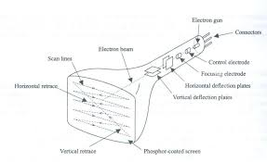

Slide 11
Applications and Uses of Raster Scan
Applications:
Televisions and CRT monitors.
Modern display systems (LCDs, LEDs).
Printers for image reproduction.
Uses:
Ideal for high-resolution color images.
Supports shading and realistic image rendering.

Slide 12
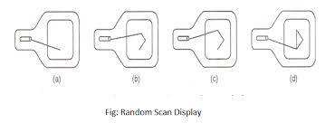
Working of Random Scan
Direct Path Movement: The beam moves only to the points needed for shapes.
Drawing: Lines and curves are drawn directly, bypassing unused areas.
Selective Refresh: Only parts of the screen with changes are redrawn, saving time and processing power.
High Precision: Produces sharp and accurate line drawings.

Slide 13
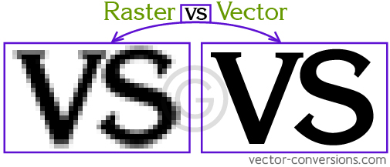
Image Made By Raster and Random

Slide 14
Comparison of Raster Scan and Random Scan
Aspect | Raster Scan | Random Scan
Electron Beam Path | Sequential row-by-row scan across the entire screen | Moves directly to the required points
Picture Definition | Pixel grid (resolution dependent) | Defined by mathematical lines and curves
Refreshing | Entire screen is refreshed in each cycle | Only modified parts of the screen are refreshed
Refresh Rate | Typically fixed and high (e.g., 60-120 Hz) | Variable, depends on complexity of the image
Picture Information | Stored as pixel data in a frame buffer | Stored as vector data (lines, curves)
Resolution | Limited by pixel density of the display | Can be very high due to mathematical precision

Slide 15
Summary
Raster scan is ideal for rendering detailed, pixel-based images.
Random scan excels at drawing vector-based graphics and geometric shapes.
Both techniques have distinct strengths and are suited for different applications in graphics and display systems.

