Slide 1


NEXT GEN EMPLOYABILITY PROGRAM
CREATING A FUTURE-READY WORKFORCE
Student Name :
Khushi Dhir
Student ID :
College Name :
STU673d8d43324801732087107
Hans raj mahila maha vidhyalaya, Jalandhar

Slide 2
CAPSTONE PROJECT SHOWCASE
Project Title
News Application
Abstract | Problem Statement | Project Overview | Proposed Solution | Technology Used | Modelling & Results | Conclusion | Q&A

Slide 3
Abstract
1
Login and Signup: The app lets users create an account or log in to see personalized news. It’s simple and secure.
2
Find News Fast: With a search bar and category filters, users can quickly find news they care about.
3
Responsive Design: The app adjusts perfectly to phones, tablets, and desktops, giving a clean and easy-to-read layout.
4
Quick Access: News loads faster by saving what you've already seen, so you don’t have to wait every time.

Slide 4


Problem Statement
People often struggle to find a reliable and user-friendly platform that provides personalized and up-to-date news. Most news apps lack features like category filtering, combined search options, and smooth navigation between devices, leaving users frustrated when accessing or managing news on the go.

Slide 5

Project Overview
The news application is a platform designed to deliver the latest news to users efficiently. It features a login system to ensure personalized access and lets users browse news articles categorized by topics. A powerful search functionality enables users to find articles based on keywords or categories.

Slide 6
Proposed Solution
Our MERN-based news app provides a simple and user-friendly way to stay updated with the latest news. Users can log in, search for news by keyword or category, and view content in an easy-to-read layout. The app saves user preferences, ensures fast loading with cached news, and lets users access news anytime without hassle. It’s designed to make finding relevant news quick and stress-free.

Slide 7
Technology used
Frontend : React.js with Bootstrap and gsap(for animation)
Backend: Express.js , Node.js
Database: MongoDb
Authentication : JWT(json-web-token)
API Integration: Axios

Slide 8
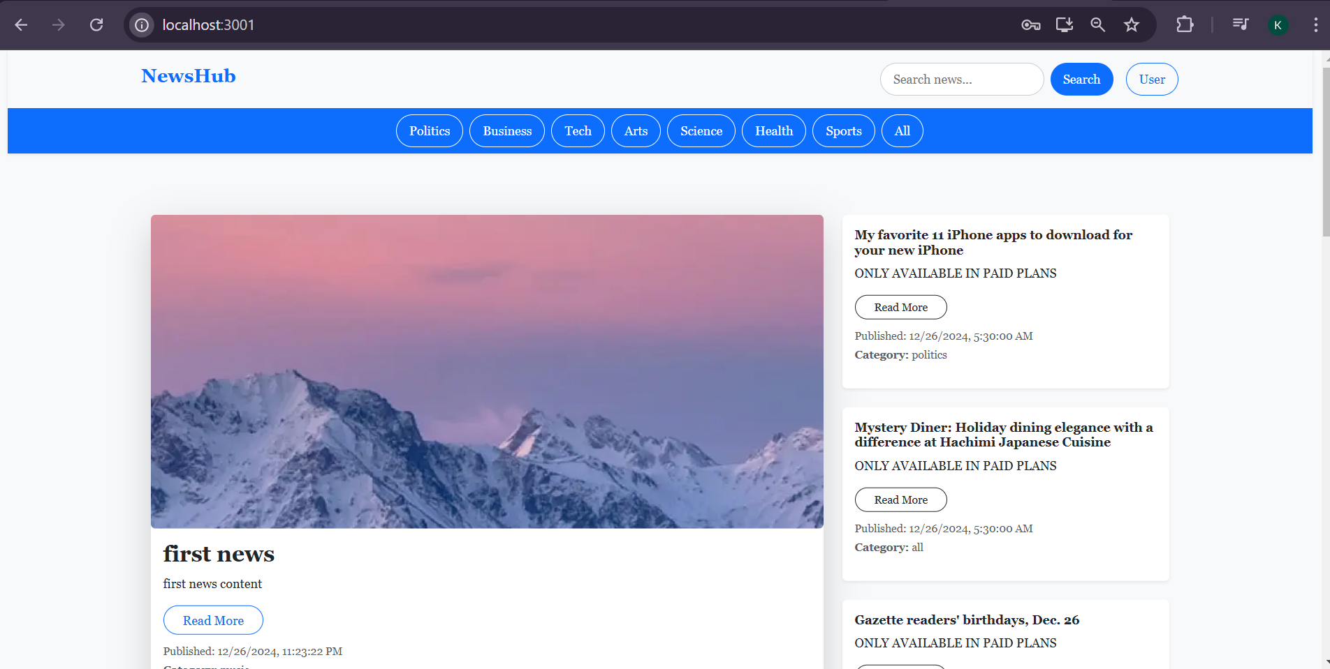
Modelling & Result

Slide 9
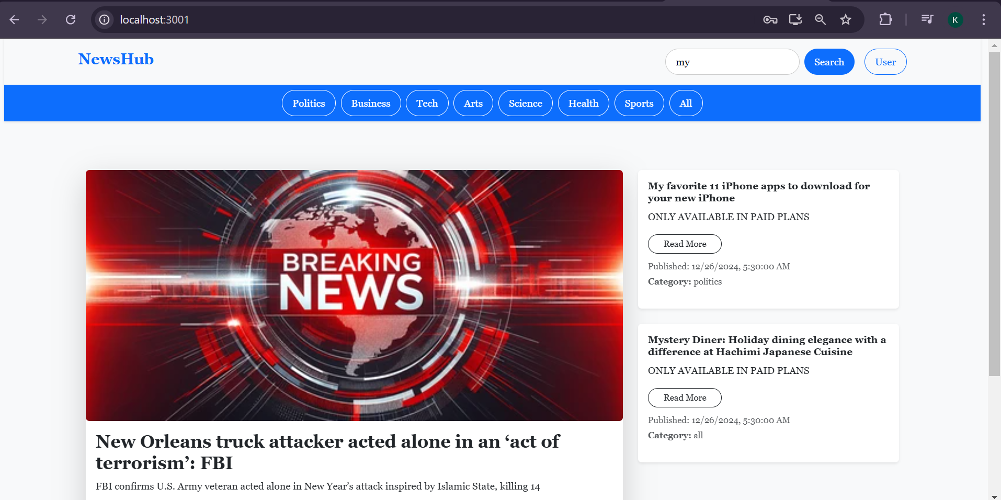
Modelling & Result (Search Box)

Slide 10
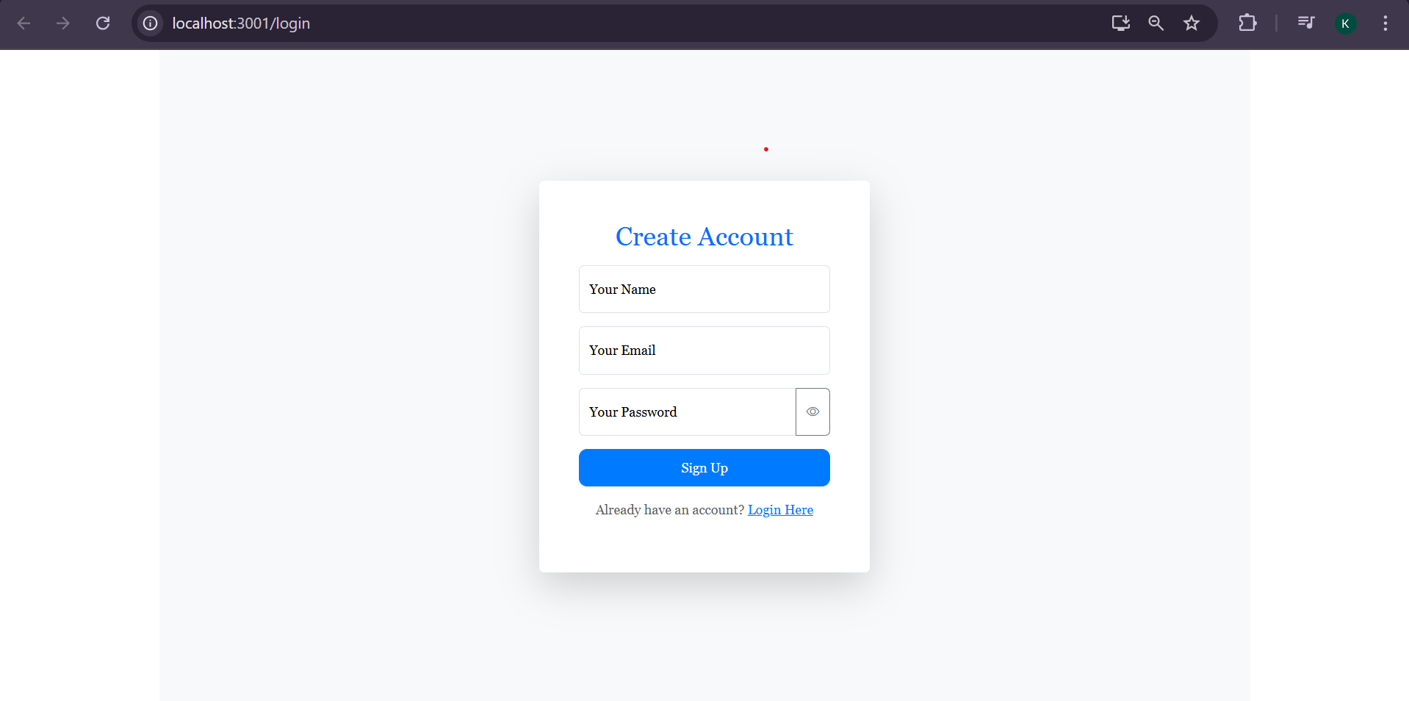
Modelling & Result

Slide 11
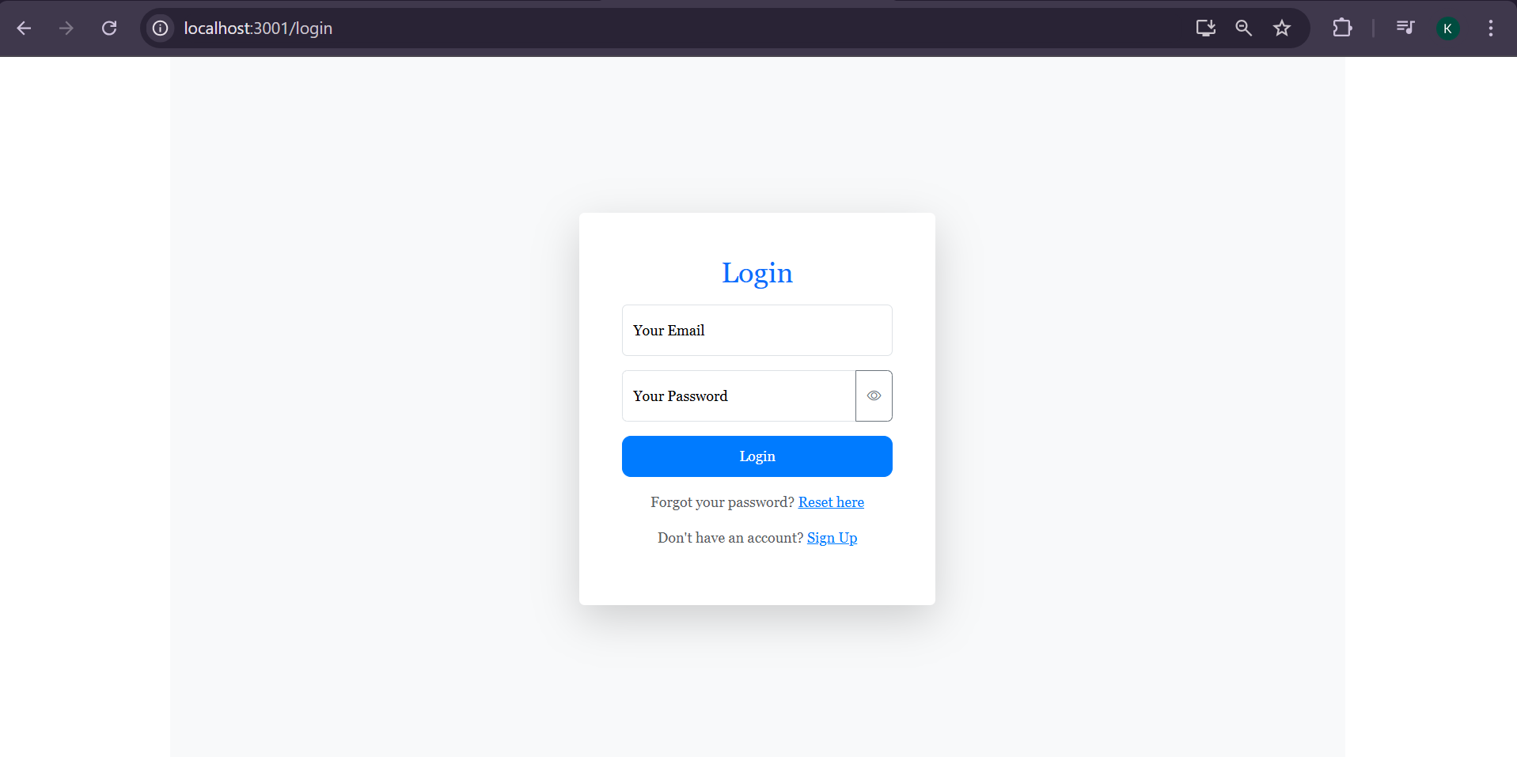
Modelling & Result

Slide 12

Conclusion
This news app makes it simple and quick to stay updated with the latest happenings. With a clean design and easy-to-use features like personalized login, categories, and search, it’s built to give users the news they care about. It’s a reliable and user-friendly platform to stay informed, anytime and anywhere.

Slide 13


Notes:
Thank You !!

