Slide 1



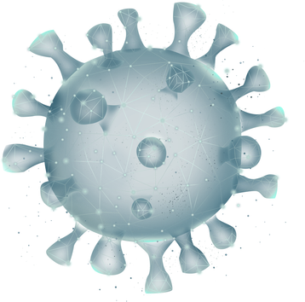
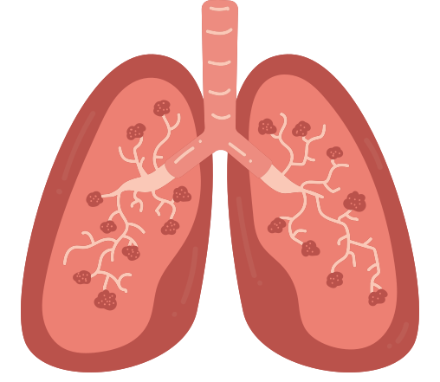
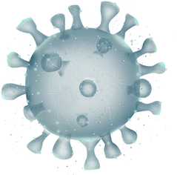



CAREVISION-AI
AI-Assisted Chest X-Ray Analysis & Diagnostic Assistance
Presented by : Khushi Hirapara
Branch : CST
Enroll no. : 23002171310055
Roll no. : 216

Slide 2


INTRODUCTION
CareVision AI is an AI-assisted healthcare application designed to analyze chest X-ray images for pneumonia and covid screening. It uses a deep learning model (EfficientNetB0) to detect pneumonia and covid. It’s provides explainable results using Grad-CAM. The system also includes doctor-patient management, secure authentication, scan history, PDF report generation, and AI-assisted recommendations. It is designed to support healthcare professionals in making faster and more informed decisions, not to replace clinical diagnosis.

Slide 3

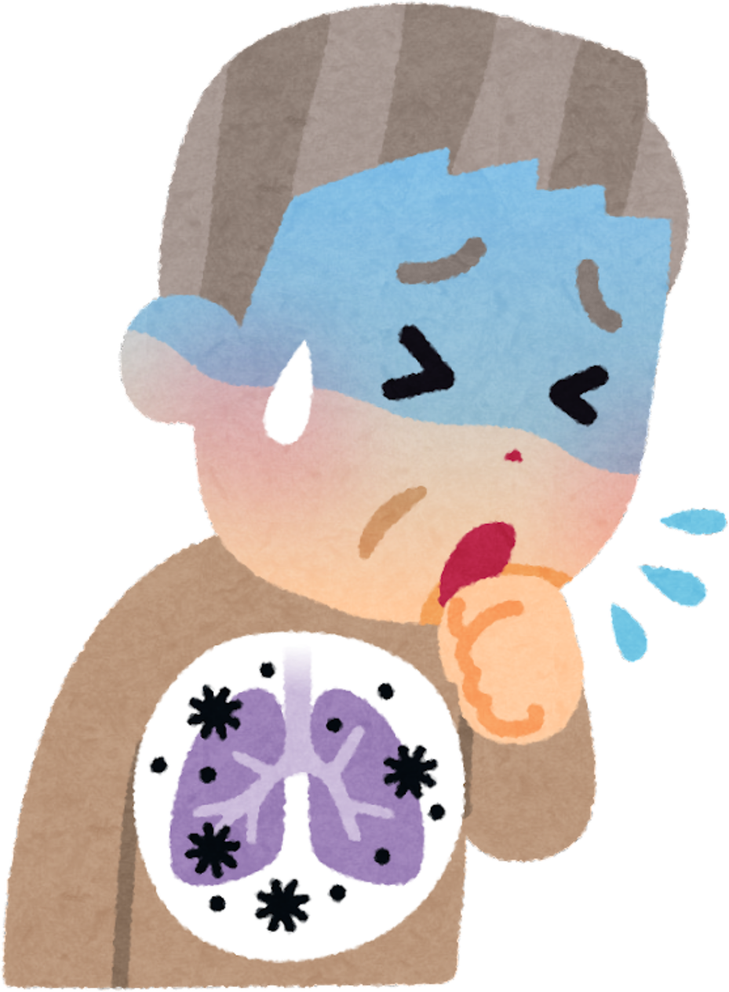

PROBLEM STATEMENT
  Early pneumonia and covid detection is difficult.
  Manual chest X-ray analysis is time-consuming.
  Increasing workload on radiologists.
  Patients struggle to understand medical reports.
  Lack of explainable AI in diagnosis.
  AI should assist doctors, not replace them.

Slide 4

TECHNOLOGY STACK
Frontend : Next.js, React, TypeScript, Tailwind CSS
Backend : FastAPI, Python
Database : PostgreSQL
AI Model : TensorFlow, Keras, EfficientNetB0

Slide 5

KEY FEATURES
  Authentication & Security
  Patient Management
  AI-Powered X-ray Analysis
  Scan Management & Report Generation
  Explainable AI
  AI-Based Scan Comparison

Slide 6
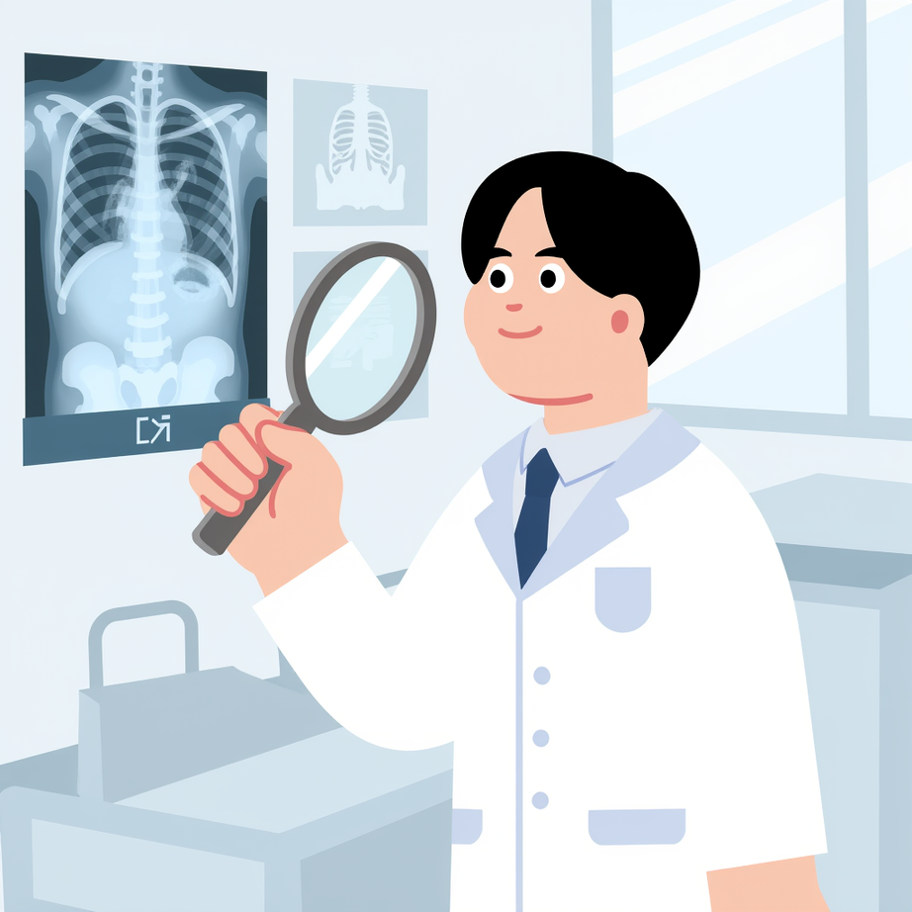
AI MODEL
  TensorFlow
  Open-source Deep Learning Framework
  Used to load and run the trained AI model
  EfficientNetB0
  Pre-trained CNN using Transfer Learning
  Classifies Chest X-rays into NORMAL or PNEUMONIA
  Prediction & Confidence
  Generates Disease Prediction
  Provides Confidence Score & Configurable Prediction Threshold
4. Grad-CAM (Explainable AI)
  Generates Heatmap
  Highlights affected lung regions
  Explains why the AI made the prediction

Slide 7

FUTURE SCOPE
  Multi-language support
  Voice-based report explanation
  Hospital management integration
  Mobile application
  Cloud deployment with scalable inference
  Healthy lifestyle guidance

Slide 8


THANK YOU
Take care of your lungs, take care of your life.

