Slide 1



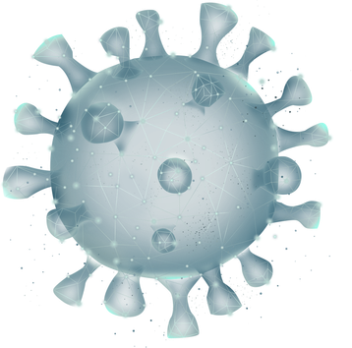
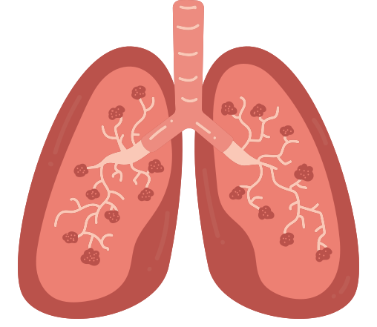




XRAYSENSE-AI
AI-Assisted Chest X-Ray Analysis & Diagnostic Assistance

Slide 2


INTRODUCTION
XRaySense AI is an AI-assisted healthcare application designed to analyze chest X-ray images for Normal, Pneumonia, and COVID-19 detection using the EfficientNetB0 deep learning model. It provides explainable results through Grad-CAM and includes secure authentication, doctor-patient management, scan history, PDF report generation, and AI-assisted recommendations. It aims to support healthcare professionals in making faster and more informed decisions without replacing clinical diagnosis.

Slide 3



PROBLEM STATEMENT
  Early pneumonia and covid detection is difficult.
  Manual chest X-ray analysis is time-consuming.
  Increasing workload on radiologists.
  Patients struggle to understand medical reports.
  Lack of explainable AI in diagnosis.
  AI should assist doctors, not replace them.

Slide 4

TECHNOLOGY STACK
Frontend : Next.js, React, TypeScript, Tailwind CSS
Backend : FastAPI, Python
Database : PostgreSQL
AI Model : TensorFlow, Keras, EfficientNetB0

Slide 5

KEY FEATURES
  Authentication & Security
  Patient Management
  AI-Powered X-ray Analysis
  Scan Management & Report Generation
  Explainable AI
  AI-Based Scan Comparison

Slide 6

AI MODEL
  TensorFlow
  Open-source Deep Learning Framework
  Used to load and run the trained AI model
  EfficientNetB0
  Pre-trained CNN using Transfer Learning
  Classifies Chest X-rays into NORMAL or PNEUMONIA or COVID
  Prediction & Confidence
  Generates Disease Prediction
  Provides Confidence Score & Predicts the class with the highest probability (Argmax)
4. Grad-CAM (Explainable AI)
  Generates Heatmap
  Highlights affected lung regions
  Explains why the AI made the prediction

Slide 7

FUTURE SCOPE
  Multi-language support
  Voice-based report explanation
  Hospital management integration
  Mobile application
  Cloud deployment with scalable inference
  Healthy lifestyle guidance

Slide 8


THANK YOU
Take care of your lungs, take care of your life.

