Slide 1
Category review: Chips
June 2020
Retail Analytics
Brand note: If client logo is not required, use alternate title page layout right click slide thumbnail > Layout > Title

Slide 2
Notes:
To view Privacy video explaining how important data privacy is to Quantium, please click here: https://www.youtube.com/watch?v=Zq1QDAkoRzU
or here Q:\Company Reference\Brand & Design\Brand videos\Q Privacy.mp4
At Quantium, we believe that data is the behavioural footprint of humanity and that it has to be treated with the utmost care and responsibility.
Histories, attitudes, indeed lives are stored within it in ways that aren’t always apparent – and that’s what makes its potential so powerful.
To work with it responsibly, sensitively, we set ourselves the highest data privacy protection and governance standards.
We have spent 17 years perfecting privacy-by-design and secure-by-design principles. Central to this is not holding any personally identifiable information about people –
we neither receive it, and put the necessary protections in place to be unable to decipher it.
Every aspect of handling data is safeguarded: from its de-identification, to its encryption – data security is paramount and of the highest grade.
We pride ourselves on gaining the trust of iconic organisations around the world through years of securely working with their data,
and in turn the trust that builds with their stakeholders.

Slide 3
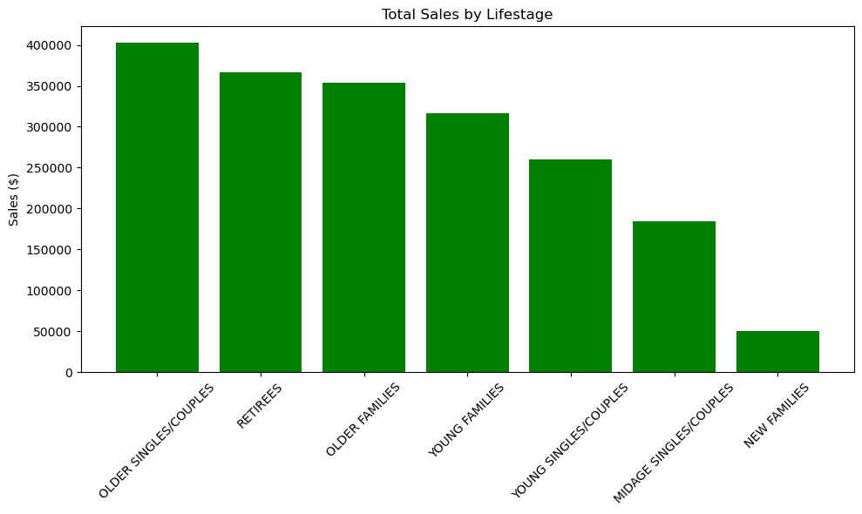
Executive summary
01
Task 1
02
Task 2
Store: 77 – 233
T-statistic: 1.0590935477424306
P-value: 0.3389336098077161
Store: 88 – 178
T-statistic: 5.97551183716088
P-value: 0.001279899432293259
Store: 86 – 155
T-statistic: 0.9914861460518972
P-value: 0.3567116251995605

Slide 4
01
Category

Slide 5
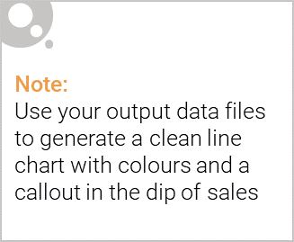
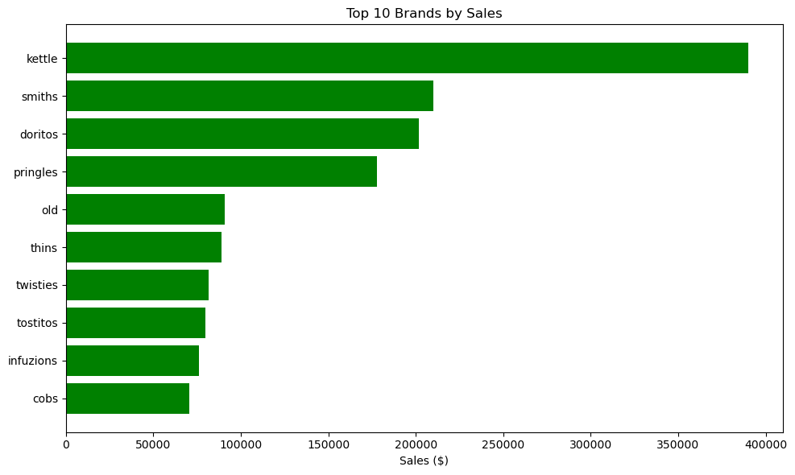
Category Overview

Slide 6
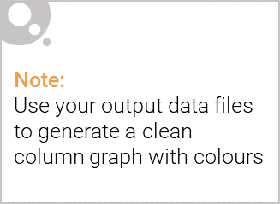
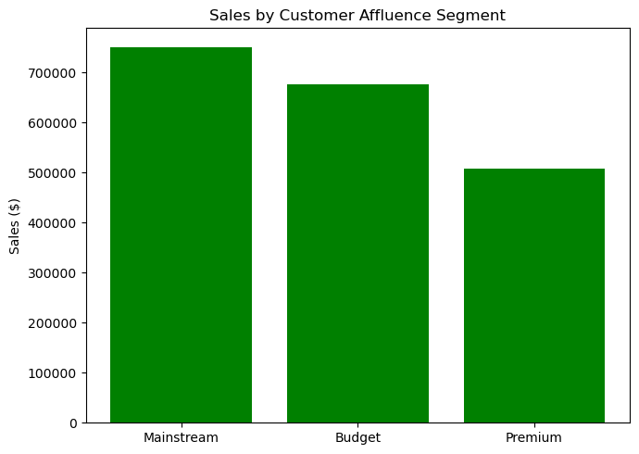
This slide will be commentary on affluence and its effect on consumer buying for the category of chips

Slide 7
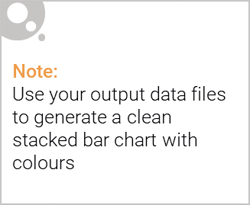
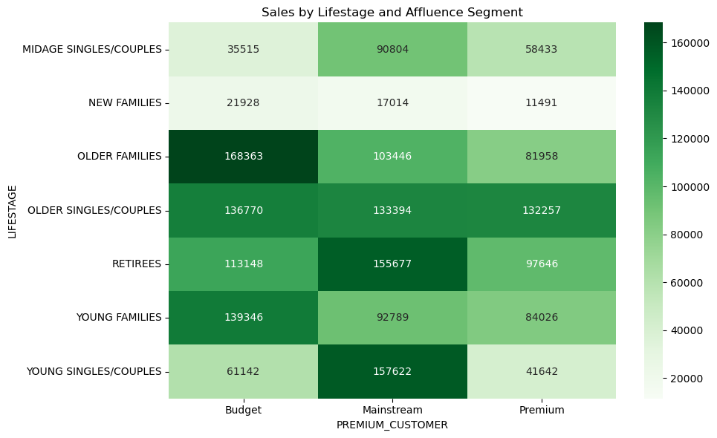
Editable (delete this)
Stretch: Try visualising the proportion of customers by affluence and life stage on this slide

Slide 8
02
Trial store performance

Slide 9
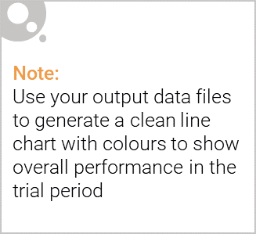
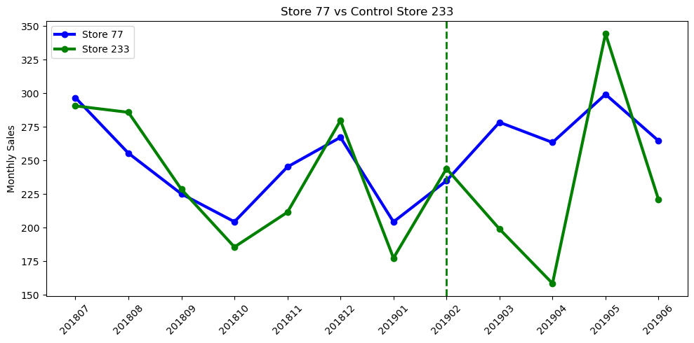
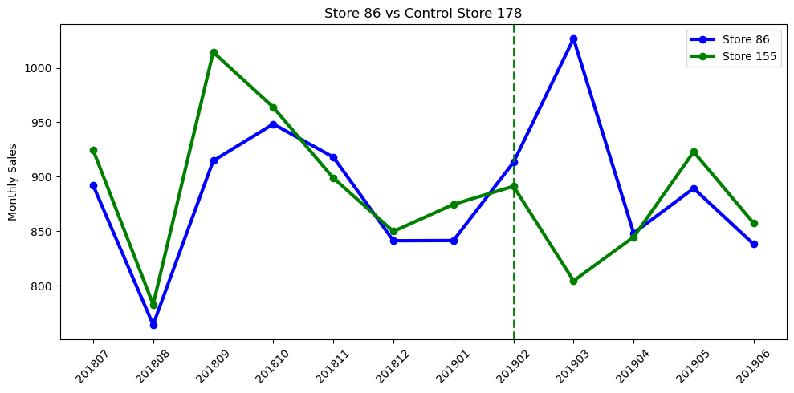
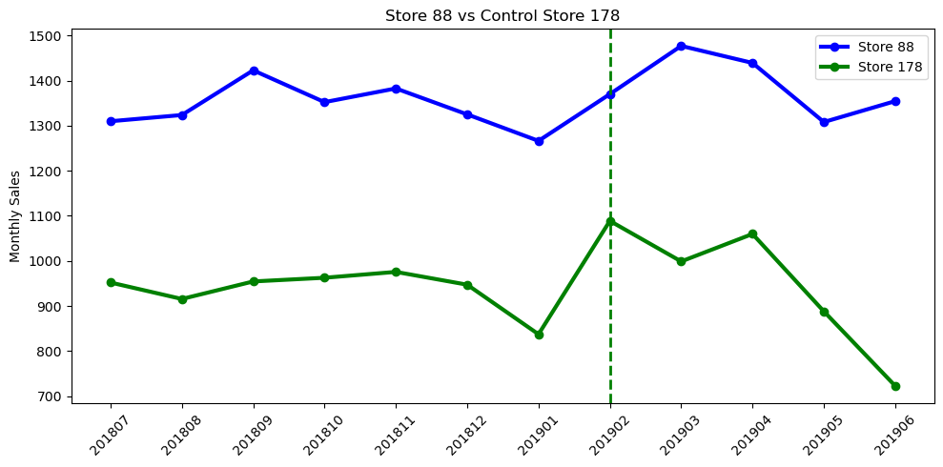
Explanation of the control store vs other stores

Slide 10
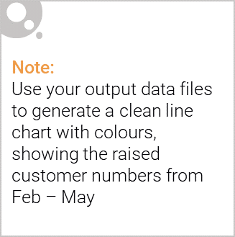
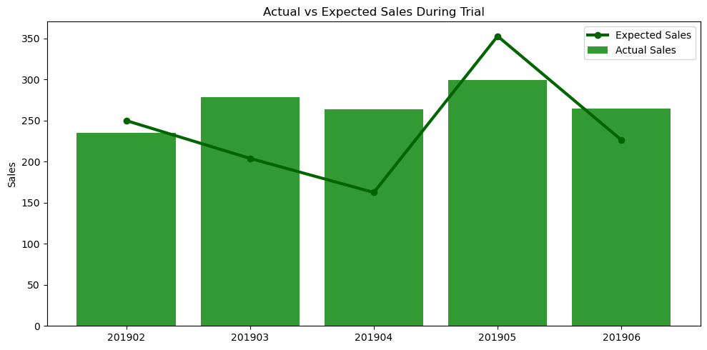
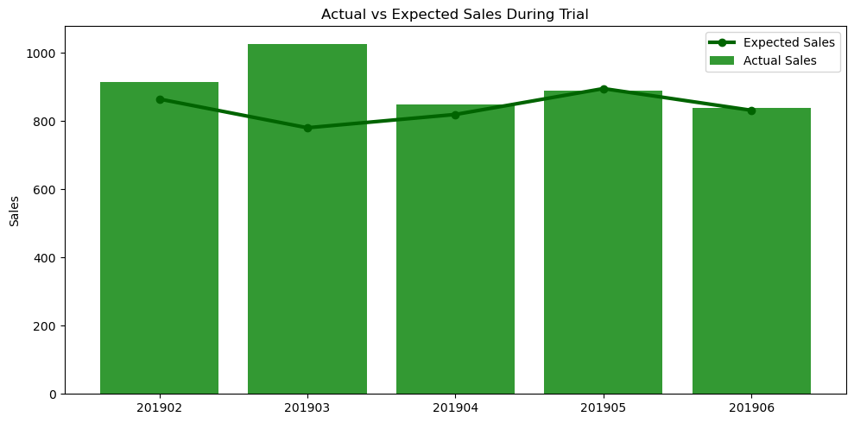
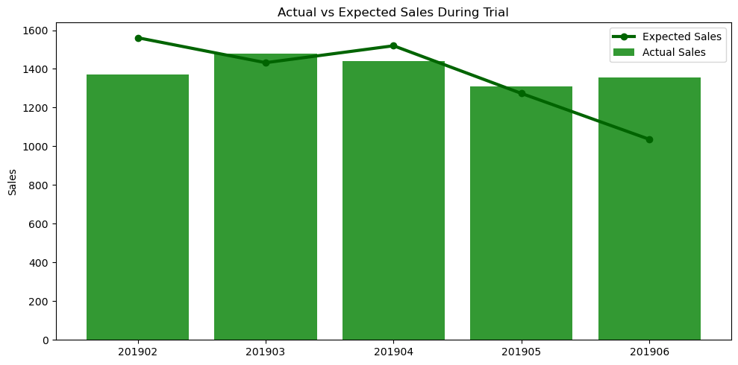
Call out of the performance in the trial store, determining if it was successful

Slide 11
Recommendations
Focus on High-Value Customer Segments
Prioritize Older Singles/Couples, Retirees, and Older Families through targeted promotions, loyalty programs, and personalized offers.
Strengthen Mainstream Customer Engagement
Drive category growth with promotions, cross-selling, and loyalty rewards for Mainstream customers.
Optimize Brands and Pack Sizes
Ensure strong availability and promotional support for top brands (Kettle, Doritos, Pringles).
Prioritize 150g–175g pack sizes in inventory planning, merchandising, and promotions.
Scale Successful Trial Initiatives
Roll out proven trial-store strategies to similar stores and monitor performance to ensure sustained results.

Slide 12
Next Steps
Short-Term (0–3 Months)
Launch targeted campaigns for key customer segments.
Increase visibility of leading brands.
Maintain adequate stock of 150g–175g products during promotions.
Medium-Term (3–6 Months)
Expand successful trial strategies to comparable stores.
Refine customer segmentation and evaluate promotional effectiveness.
Long-Term
Develop customer-centric category strategies based on life stage and buying behavior.
Enhance demand forecasting and continue monitoring trial outcomes.

