Slide 1
Predicting And Analyzing Urban Water Quality Using IBM Watson Machine Learning Service
Created By:
Anushka Bisani 20BCE1885
Khushi Mattu 20BCE1189
P Karthikeya 18MIS7063
S.Kalyan Sai 18MIS7065
V. Akhil 18MIS7199

Slide 2
Why do we need to do this project?
Water is considered as a vital resource that affects various aspects of human health and lives. The quality of water is a major concern for people living in urban areas. Quality of water serves as a powerful environmental determinant and a foundation for the prevention and control of waterborne diseases.
However predicting the urban water quality is a challenging task since the water quality varies in urban spaces non-linearly and depends on multiple factors, such as meteorology, water usage patterns, and land uses, so this project aims at building a Machine Learning (ML) model by considering all water quality standard indicators.

Slide 3
JUPYTER NOTEBOOK
We applied various operations on the dataset.
First we checked if it has missing values. Then we changed some of the object datatypes to float datatype and then again checked for missing values. We then replaced the missing values with mean or mode depending on the distrubution. We then dropped similar columns.
We then calculated ph, dissolved oxygen, total coliform, B.D.O, electrical conductivity, nitra and then applied the necessary formulas. We then found the wqi using mean.
We then visualised the data with the help of boxplot and scatterplot and countplot.
After that, We fit the model using random forest and applied feature scaling. We then split the data into train and test. We applied random forest regressor and found the score and y_pred.
We analysed and evaluated the model.
Finally, We saved the model by importing pickle.

Slide 4
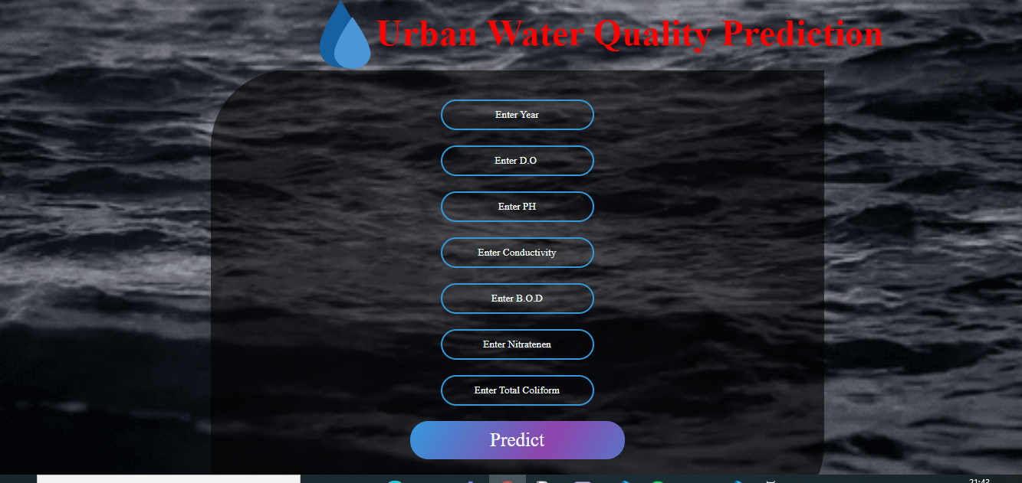
UI Interface

Slide 5
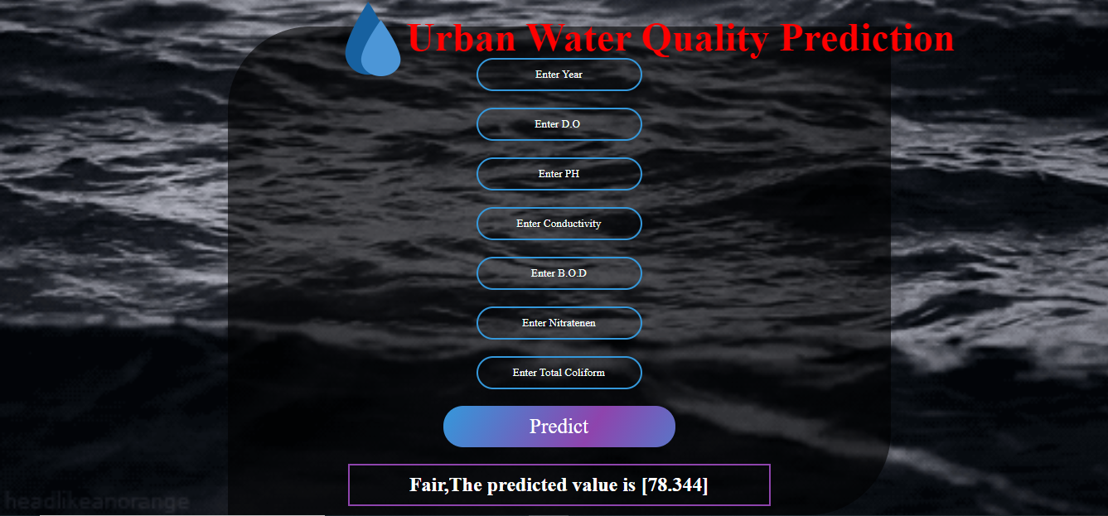
Output

Slide 6
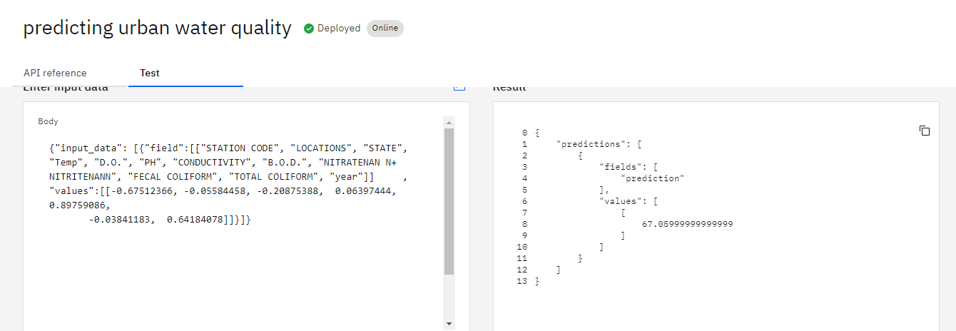
Testing on IBM

Slide 7
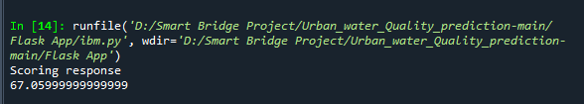
After running the code in spyder

