Slide 1



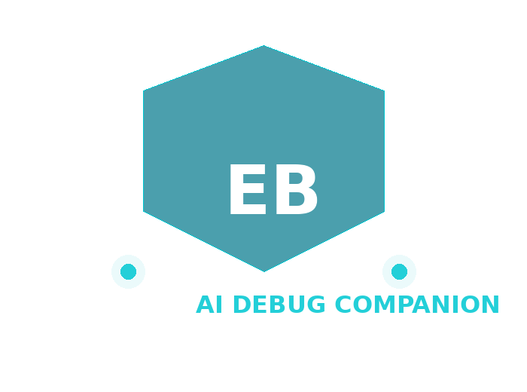
HACK MATRIX HACKATHON
PROJECT TITLE : ErrorBuddy — AI Debug Companion
TEAM NAME : HackMatrix 2026 | VIT Bhopal | 2nd April 2026
TEAM MEMBERS : Khushi • Jash • and team

Slide 2

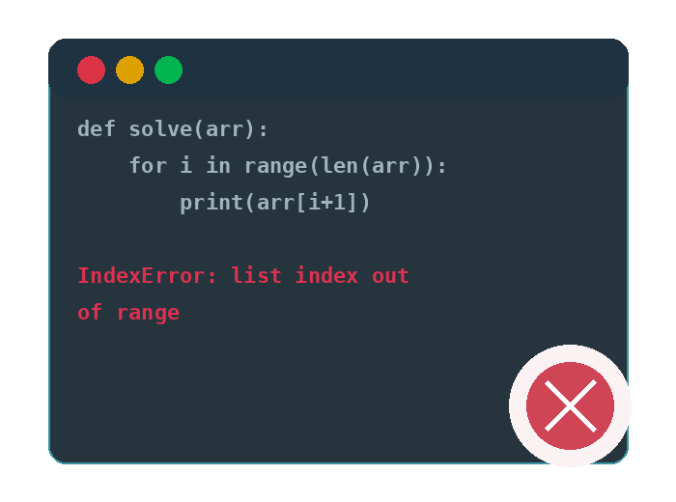
PROBLEM STATEMENT
Error messages are cryptic, overwhelming and demotivating for freshers learning DSA, ML and full-stack dev.
Affected: Thousands of VIT Bhopal students — unresolved errors kill coding confidence and increase learning dropout rates.
Without instant visual help, beginners spend 30+ minutes on a single error — ErrorBuddy solves it in 30 seconds.

Slide 3
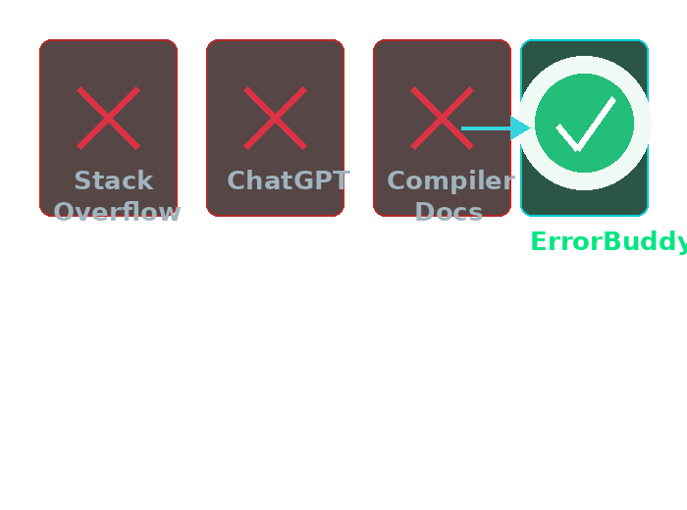
EXISTING SOLUTIONS AND GAPS
Existing tools: Stack Overflow, ChatGPT, compiler docs — give generic answers with no visual intuition or beginner-friendly fixes.
Limitations: No auto-corrected code, no live simulations, context-free responses — students still spend hours stuck on one error.
Gap we fill: Instant plain-English explanation + auto-fixed code + live DSA/ML visuals.

Slide 4
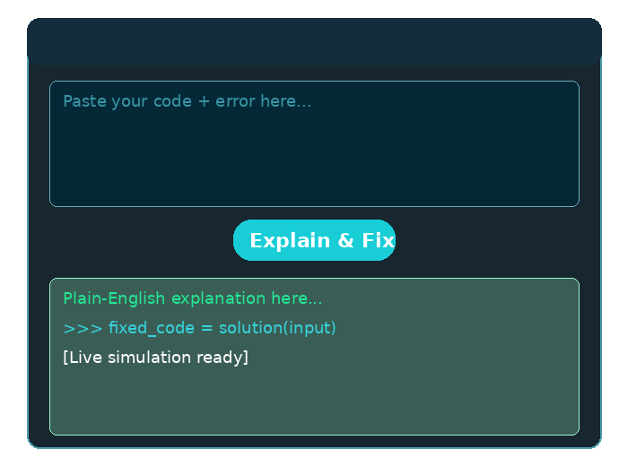
PROPOSED SOLUTION
Paste code + error → Gemini returns plain-English explanation + corrected code + visual simulation.
Features: Gemini AI fix | Live DSA/ML animations | Flutter desktop codebase scanner.
Transforms 30-minute debugging nightmares into 30-second “Aha!” moments — turning confused coders into confident VIT developers.

Slide 5
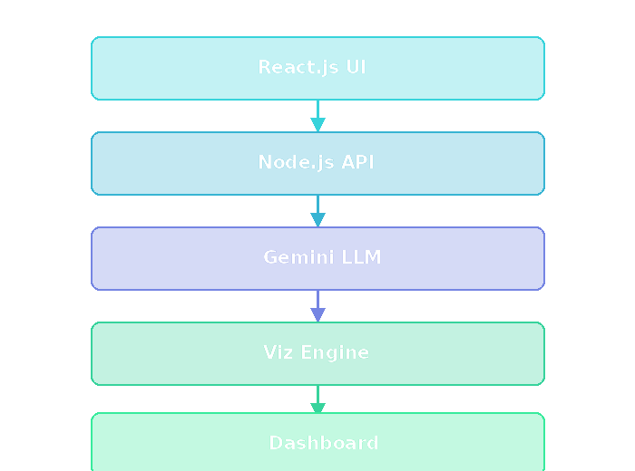
SYSTEM ARCHITECTURE
React.js Frontend → Node.js API → Gemini 1.5 Flash LLM → Viz Layer → Dashboard
Components: React UI, Node.js API, Gemini LLM, Flutter Desktop App, LocalStorage
Data Flow: Code + error → Node.js → Gemini → fix + explanation → React live visual simulation

Slide 6
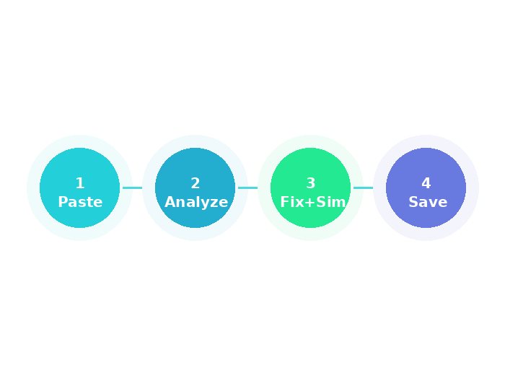
FLOWCHART / WORKING PROCESS
Step 1: Paste code + error into React web app OR open project folder in Flutter desktop app.
Step 2: Click Explain & Fix → Gemini returns explanation + corrected code + sim type.
Step 3: React renders live DSA/ML simulation. Error saved to History Dashboard.

Slide 7
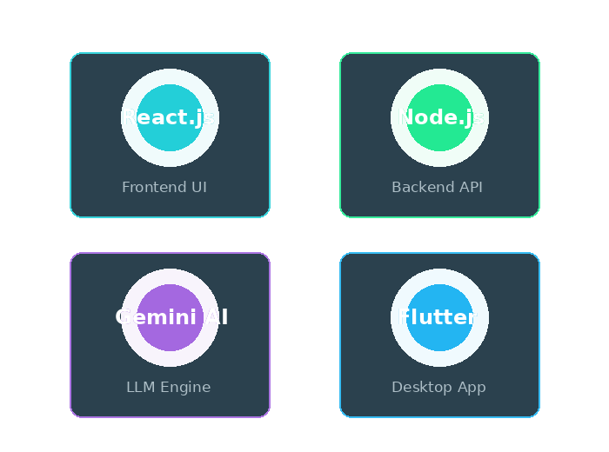
TECH STACK
Frontend: React.js + Tailwind CSS — fast, component-driven UI with live code editor and real-time visual simulation rendering.
Backend: Node.js + Express — lightweight REST API, handles prompt engineering and Gemini API integration with low latency.
Storage: LocalStorage (web) + local file system (Flutter) — fully offline-capable, zero deployment cost, instant access to error history.
AI + Desktop: Gemini 1.5 Flash (LLM) + Flutter (desktop codebase scanner & auto-patcher).

Slide 8
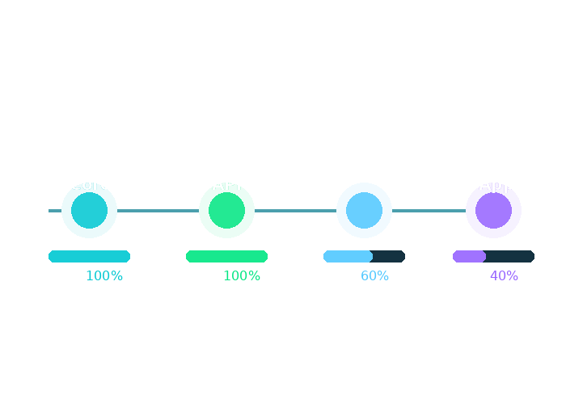
IMPLEMENTATION PLAN
Roadmap: React UI → Gemini API → DSA/ML simulations → Flutter codebase scanner (40% done).
Modules: Input Interface | Gemini Engine | Viz Renderer | History Dashboard | Flutter App
Timeline: Core web prototype (40% complete) → Gemini integration today → Flutter desktop app + visual animations → Full polished prototype ready for offline round tomorrow.

Slide 9
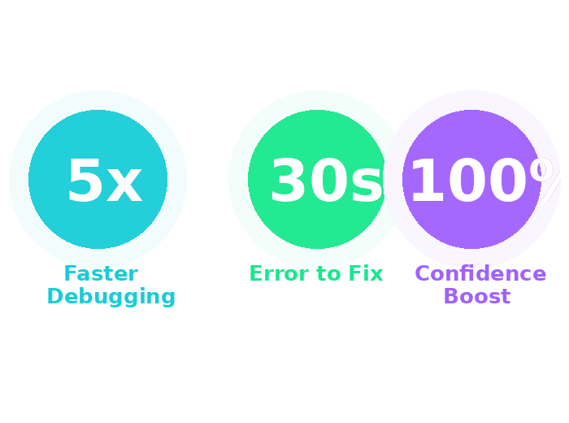
EXPECTED OUTCOME / IMPACT
Working prototype delivers: Instant plain-English explanation + auto-corrected code + interactive visual simulation — all within 30 seconds of pasting an error.
User Benefits: Debug 5x faster. Understand WHY errors happen. Build real confidence.
Real-World Impact: Empowers every VIT Bhopal student — reducing learning friction, accelerating placement readiness, and making coding accessible to all.

Slide 10
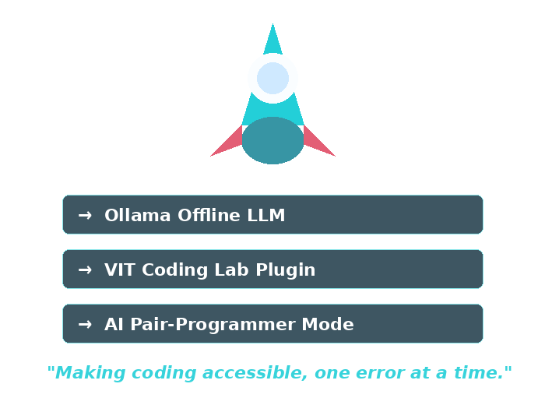
FUTURE SCOPE AND CONCLUSION
Future: Ollama offline LLM | DSA/ML sim library | VIT Coding Lab plugin | AI pair-programmer
Scalability: ErrorBuddy can evolve into the go-to debugging companion for all Indian engineering students — deployable as a campus-wide SaaS platform.
Conclusion: ErrorBuddy doesn’t just fix errors — it transforms confused coders into confident developers. “Making coding accessible, one error at a time.” | Team: Khushi | Jash

