Slide 1
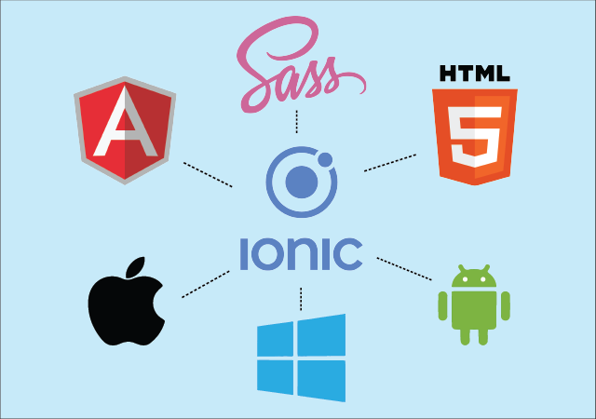
Introduction to Ionic Framework

Slide 2

What is Ionic?
Definition:
Ionic is an open-source framework for building cross-platform mobile applications using web technologies such as HTML, CSS, and JavaScript.
Features:
Cross-platform development
Native-like UI components
Built on Angular framework
Access to native device features

Slide 3

Why Ionic?
Advantages:
Single codebase for multiple platforms (iOS, Android, etc.)
Faster development with web technologies
Rich UI components for a native look and feel
Extensive community support

Slide 4

Ionic Architecture
Components:
Angular: Core framework for building web applications
Ionic CLI: Command-line interface for development tasks
Capacitor/Cordova: Bridge to access native device features
UI Components: Pre-built components for building the app's user interface

Slide 5
Key features of Ionic Framework
Responsive Design: Adapts well to different devices and screen sizes.
Easy Creation: Simple setup for creating slides in the application.
Navigation Integration: Seamless integration with navigation features.
Pagination and Dots: Built-in support for pagination with navigation dots.
Swipe and Gesture Support: Intuitive navigation through swipe gestures.
Customization: Flexible styling and animation options for slides.
Looping and Autoplay: Supports automatic looping and autoplay features.
Dynamic Generation: Can dynamically generate slides based on data.
Events and Hooks: Triggers actions based on slide changes.
Performance Optimization: Ensures smooth transitions even in resource-constrained environments.

Slide 6
Getting Started
Prerequisites:
Node.js installed
Ionic CLI installed (npm install -g @ionic/cli`)
Text editor (VSCode, Sublime, etc.)
Creating a new Ionic project:
ionic start myApp

Slide 7
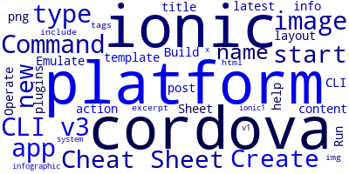

Ionic CLI Commands
Run
`ionic serve`: Run the app in the browser during development
Build
`ionic build`: Build the app for production
Build
`ionic cordova build <platform>`: Build for a specific platform (iOS, Android, etc.)
Generate
`ionic generate`: Generate components, pages, services, etc.
Add
`ionic capacitor add <platform>`: Add native platforms using Capacitor

Slide 8
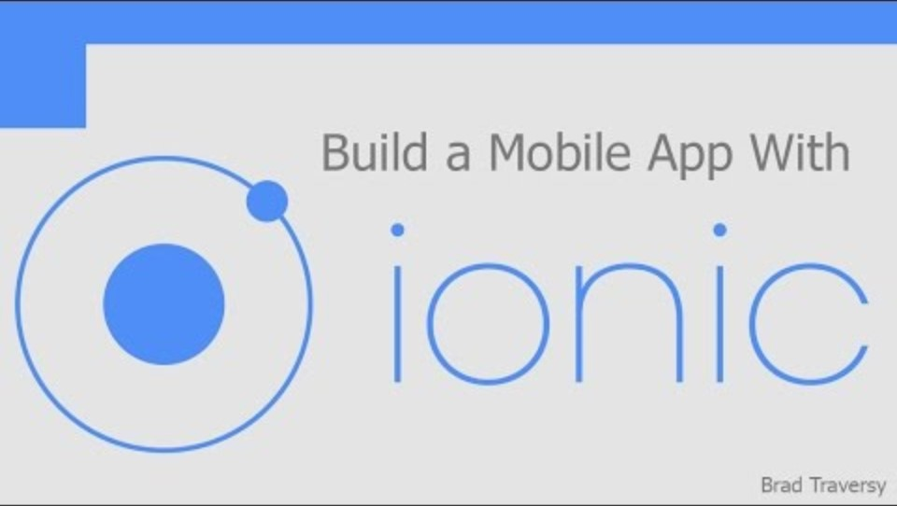
Creating Your First Ionic App

Slide 9
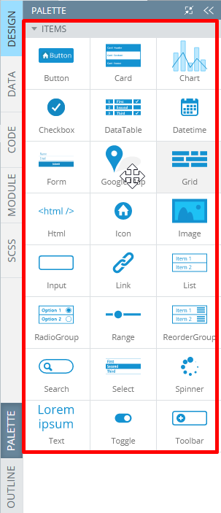
Ionic UI Components
Ionic apps are made of high-level building blocks called Components, which allow you to quickly construct the UI for your app. Ionic comes stock with a number of components, including cards, lists, and tabs.
https://ionicframework.com/docs/components

Slide 10
Styling and Theming
1.Default themes
The default theme uses a light background, but everything from the background color to the text color is fully customizable
2.CSS in Ionic
Theming Ionic apps is now easier than ever. Because the framework is built with CSS, it comes with pre-baked default styles which are extremely easy to change and modify. The Ionic Framework components are themed using CSS properties (variables). CSS variables add dynamic values to an otherwise static language. This is something that has traditionally required a CSS preprocessor like Sass.

Slide 11
Testing and Debugging
Use the Ionic Lab
01
Use the Ionic DevApp
02
Use the Ionic CLI testing commands
03
Use the Ionic CLI debugging commands
04
Use the Ionic CLI linting command
05
Use the Ionic CLI docs command
06

Slide 12

SIMPLE IONIC APPLICATION https://khushivekariya28.github.io/IonicApp/

Slide 13
Resources
Official Ionic Documentation: ionicframework.com/docs
Community Forums: forum.ionicframework.com
GitHub Repository: github.com/ionic-team/ionic-framework

Slide 14
A SMALL CLASS ACTIVITY
Let’s play a small quiz to check the basic learning from the above presentation:

Slide 15

THANK YOU
Khushi Patel - 200539535
Khushi Vekariya - 200543219

