Slide 1

WIPRO NGA Program – DWS
Capstone Project Presentation – 17th June & 18th June 2025
Project Title Here – Insert Custom Actions in MSI
Presented by – Khushi Pandey
www.rpsconsulting.in

Slide 2
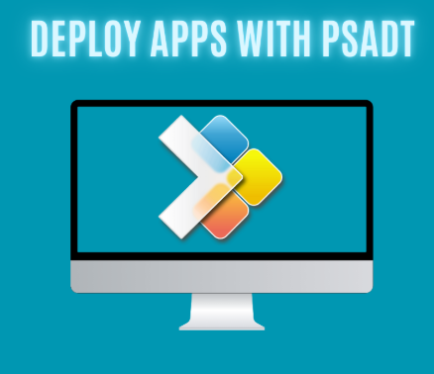

INTRODUCTION
Custom actions can be added to an MSI installer to run PowerShell scripts, CMD commands, executables, or other logic either before, during, or after the installation or uninstallation process.
This approach offers powerful flexibility for customizing application deployment, but it should be used cautiously to avoid potential system issues.
2024 - RPS Consulting all rights reserved

Slide 3
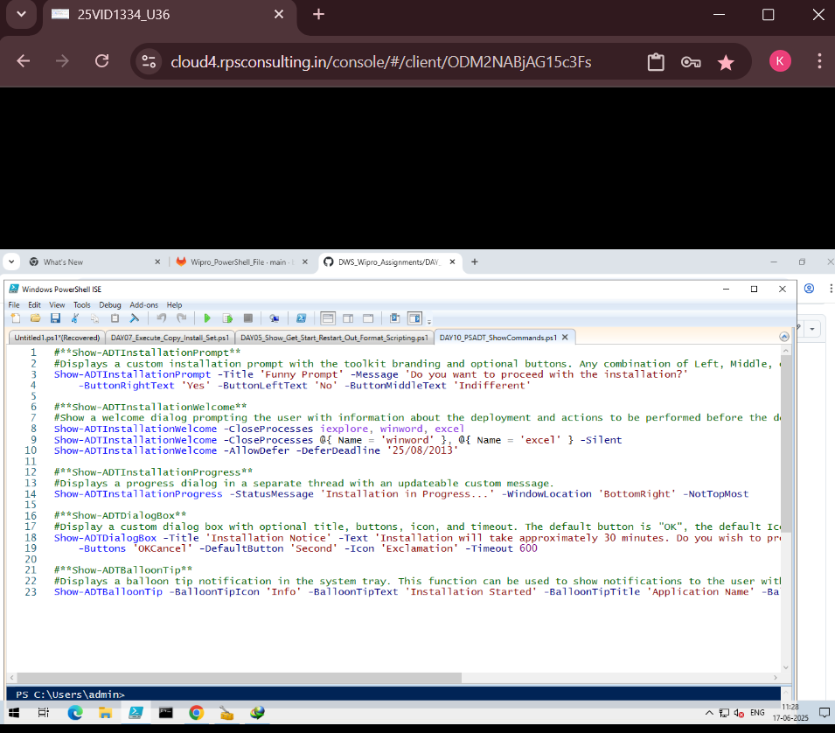
Project Requirement
Windows Operating System(Windows 10/11)
PowerShell ISE or PowerShell Console
PowerShell App Deployment Toolkit (PSADT)
Basic Knowledge of scripting in PowerShell
Optional : Notepad++ or Visual Studio Code for script editing
2024 - RPS Consulting all rights reserved

Slide 4
Tools and Technologies Used
PowerShell & ISE – An essential Integrated Development Environment providing a robust environment for writing PowerShell scripts efficiently
PSAppDeployToolkit – A comprehensive toolkit that significantly enhances PowerShell’s capabilities by providing pre-built functions.
Windows 10 VM - Safe testing
Task Manager/System Tray – Utilize these system components to effectively test and confirm the proper display and behavior of visual notifications, including critical ballon tips
2024 - RPS Consulting all rights reserved

Slide 5
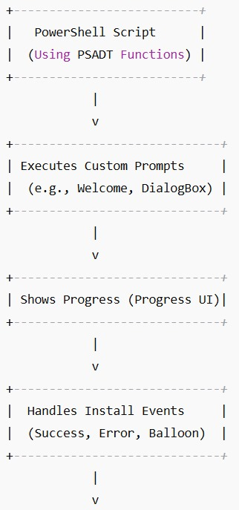
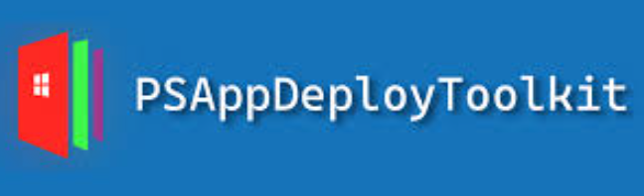

Architecture Diagram
MSI → PowerShell Script → PSADT → Execution → GUI + Deployment Actions
2024 - RPS Consulting all rights reserved

Slide 6
Usage Process
Install PSADT and extract it to a working directory
Open PowerShell ISE and load the Add-AppDevPackage.ps1 script
Modify the script to insert custom GUI interactions using these PSADT commands
Run the script in PowerShell to test custom actions
Verify behaviour during install, uninstall or error scenarios
2024 - RPS Consulting all rights reserved

Slide 7
Execution Overview
- Show-ADTInstallationPrompt - Displays a custom interactive prompt window (GUI) with a message and up to three buttons (e.g., Yes/No/Cancel or custom text).
- Show-ADTInstallationWelcome - Displays a welcome dialog box with instructions or warnings and automatically detects if specific applications need to be closed before continuing.
- Show-ADTInstallationProgress - Displays a progress window with a customizable message showing that installation is in progress.
- Show-ADTDialogBox- Displays a custom dialog box with OK/Cancel buttons, custom icons, and optional timeouts.
- Show-ADTBalloonTip - Displays a balloon notification in the Windows system tray with a message, icon, and title.
2024 - RPS Consulting all rights reserved

Slide 8
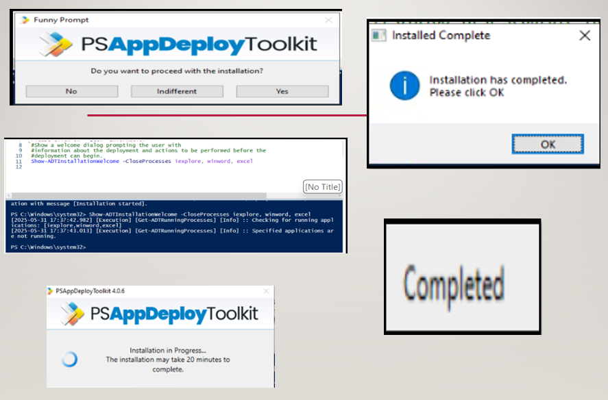
Output
2024 - RPS Consulting all rights reserved

Slide 9
Task Performed
Created scripts for user prompts and feedback
Example: Show-ADTInstallationPrompt with message and buttons
Close conflicting apps before install using Show-InstallationWelcome
2024 - RPS Consulting all rights reserved

Slide 10
Function Breakdown
- Show-ADTInstallationPrompt: User choice for setup
- Show-ADTInstallationWelcome: Closes apps safely
- Show-ADTInstallationProgress: Status bar
- Show-ADTDialogBox: Important warnings
- Show-ADTBalloonTip: Non-intrusive notifications
2024 - RPS Consulting all rights reserved

Slide 11
Analysis Result
Execution: Prompts and logic worked as expected
User Interaction: Smooth experience
Performance: Low resource use, stable deployment
2024 - RPS Consulting all rights reserved

Slide 12
Resources/References
https://github.com/PSAppDeployToolkit/PSAppDeployToolkit
https://psappdeploytoolkit.com/docs/reference/functions/Show-ADTInstallationPrompt
https://openai.com/index/chatgpt/
https://learn.microsoft.com/
2024 - RPS Consulting all rights reserved

