Slide 1

WIPRO NGA Program – DWS
Capstone Project Presentation – 17th June & 18th June 2025
Project Title Here - Embedding License File into MSI Installer
Presented by – Khushi Pandey
www.rpsconsulting.in

Slide 2



Introduction
Slide details here The project focuses on modifying an MSI installer to embed a license file(license.key) into the appropriate installation directory. This ensures that when the application is installed, the license file is automatically placed in the specified folder without manual user intervention.
2024 - RPS Consulting all rights reserved

Slide 3
Project Requirements
Orca Editor (via Windows SDK) (Run as administrator)
WiX Toolset (wix314.exe)
Dummy MSI: DummyProduct.msi
License Key File: license.key
Folder: C:\Users\sachi\Documents\Project2
Text editor and Developer Command Prompt (Run as administrator)
2024 - RPS Consulting all rights reserved

Slide 4
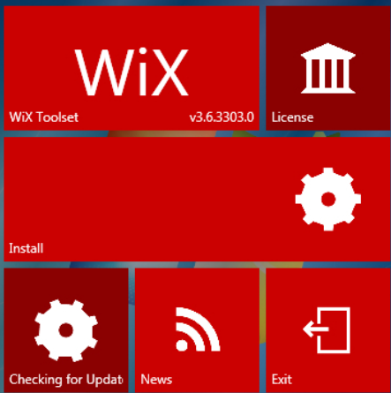
Technologies / Tools Used
Orca Editor
WiX Toolset: Candle & Light
PowerShell / Command Prompt
Notepad
Windows 10 OS
2024 - RPS Consulting all rights reserved

Slide 5
Task Summary
Installed Orca and WiX Toolset
Configured .wxs file
Built updated MSI with embedded license
Tested installer output for validation
2024 - RPS Consulting all rights reserved

Slide 6
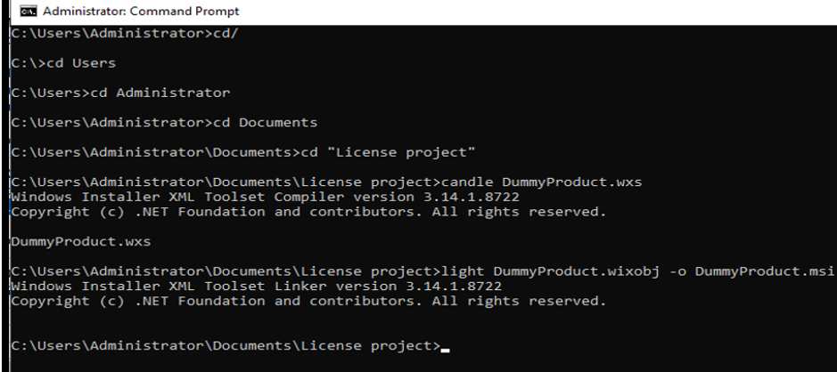
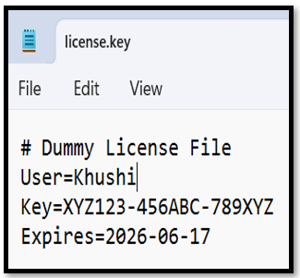
Steps 1-5: Setup & File Prep
1. Install Orca via Windows SDK
2. Install WiX Toolset (wix314.exe)
3. Extract DummyProduct.msi to Project2 folder
4. Create license.key in Notepad
5. Use candle/light commands to build MSI
2024 - RPS Consulting all rights reserved

Slide 7
Steps 6-10: Embedding License
6. Open MSI with Orca
7. Add row in 'File' table
8. Match entries with .wxs file
9. Save and close MSI
10. Run installer and verify license placement
2024 - RPS Consulting all rights reserved

Slide 8
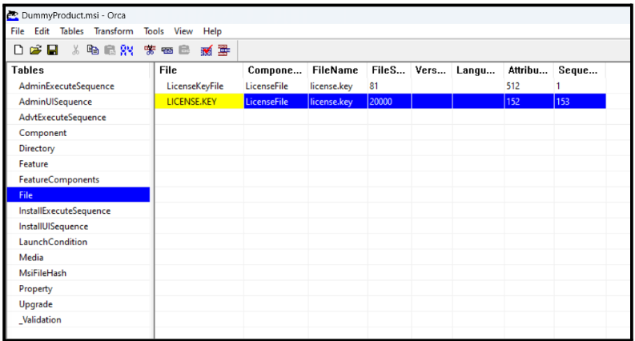
Execution Process Overview
1.Preparation
->Set up folder: C:\Users\sachi\Documents\Project2
2.Open Developer Command Prompt
->Candle DummyProduct.wxs
->Light DummyProduct.wixobj –o DummyProduct.msi
3.Modify with Orca
->Open DummyProduct.msi in Orca
->Go to “File” table
->Right-click > Add Row
->Enter license file details (Name, Size, Path)
2024 - RPS Consulting all rights reserved

Slide 9
Execution Process Overview Continue
4.Save and Exit
->Save the modified .msi
-> Close Orca
5. Test Installation
->Run the .msi installer
->Check install directory for presence of license.key
2024 - RPS Consulting all rights reserved

Slide 10
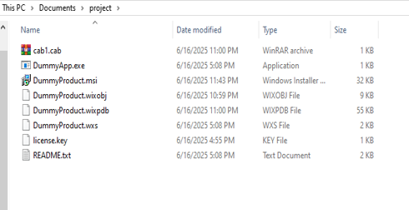
Final Outcome & Validation
License file embedded successfully
MSI works as expected
Validated by reinstallation and folder checks
2024 - RPS Consulting all rights reserved

Slide 11
Resources reference Links to download
Download wix314.exe from https://github.com/wixtoolset/wix3/releases(Wix toolset)
Open https://developer.microsoft.com/en-us/windows/downloads/windows-sdk/ (Orca)
2024 - RPS Consulting all rights reserved

