Slide 1
COMPUTER ORGANIZATION
CREDITS - 5 (LTP:3, 1,2)

Slide 2
Course Objective: To impart knowledge of the basic structure of digital computer, its operation, design of basic processors, memory organization and its interface with various memory & input/output devices.

Slide 3
List of References:
1. Hamacher, Vranesic, Zaky, “Computer Organization”, McGraw Hill
2. M. Morris Mano, “Computer System Architecture”, Pearson Education
3. Andrew S. Tanenbaum and Todd Austin, “Structured Computer Organization”,
Pearson Education
4. N D Jotwani, “Computer system organization”, McGraw Hill
5. R.S.Gaonkar, “Microprocessor Architecture, Programming and Applications
with 8085”, Penram International
6.Computer organization and design by David Patterson and john hennessy

Slide 4
Course Outcomes (COs): After successful completion of the course, the students will be able to…
Understand the organization of the control unit, arithmetic and logical unit, memory unit and I/O unit.
Apply knowledge of the processor’s internal registers and operations for assembly programming to provide solutions of given problems.
Compare execution time of instructions in terms of machine cycles and T states.
Design a basic central processing unit.
Design interfacing of memory and I/O modules with CPU.
Compare performance of different types of computer architectures.

Slide 5
Computer architecture & Organization
Architecture describes what the computer does organization describes how it does it.
Computer Architecture deals with functional behavior of computer system.
The architecture of a computer is the set of resources seen by the computer programmer. It includes general purpose registers, the status word, the instruction set, the address space, etc.
Computer organization is how operational attributes are linked together and contribute to realize the architectural specifications. Computer Organization comes after the decide of Computer Architecture first. Computer Organization deals with structural relationship.
80x86 ISAs : instructions, operands, operations etc

Slide 6
The term organization includes the high-level aspects of a computer's design, such as the memory system, the memory interconnect, and the design of the internal processor or CPU (central processing unit—where arithmetic, logic, branching, and data transfer are implemented).
For example, two processors with the same instruction set architectures but very different organizations are the
AMD Opteron 64 and the Intel Pentium 4. Both processors implement the x86 instruction set, but they have very different pipeline and cache organizations.
E.g. multiplication instruction is there or not is architecture but how it built is organization
word architecture covers all three aspects of computer design—instruction set architecture, organization, and hardware.

Slide 7
The components from which computers are built, i.e., computer organization.
•In contrast, computer architecture is the science of integrating those components to achieve a level of functionality and performance.
•It is as if computer organization examines the bricks, nails, and other building material, While computer architecture looks at the design of the house.

Slide 8
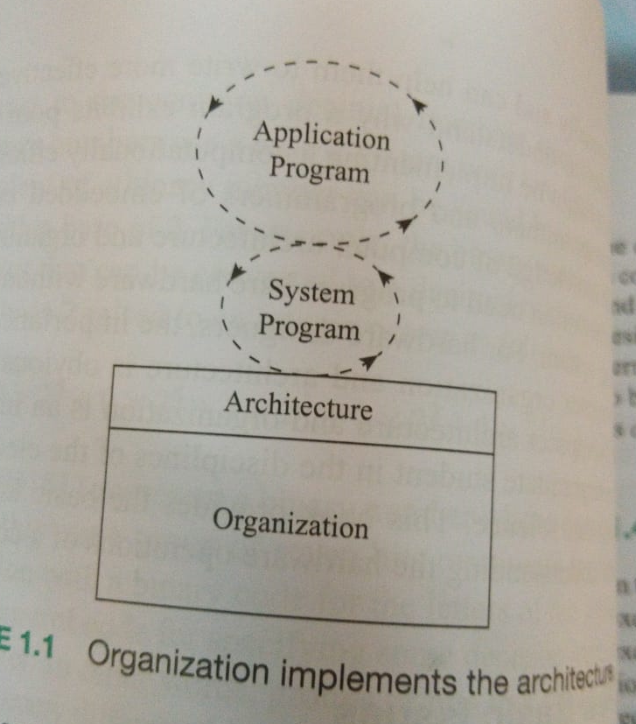
Architecture is the external view of a computer that is essential to properly understood by anyone who is likely to program a computer using machine or assembly languages
A knowledge of organization can help one to understand the internal operations that are carried out by a computer while program is being executed
Organization deals with the internal view of the computer

Slide 9
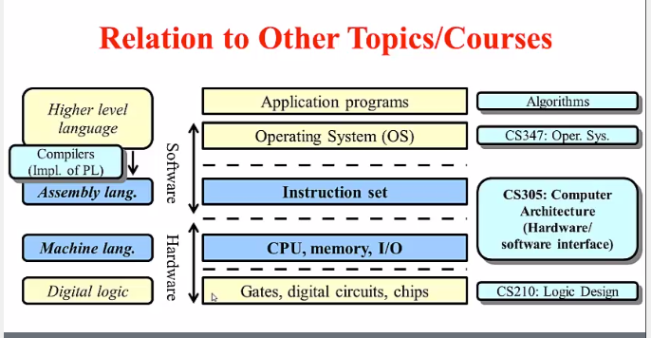

Slide 10
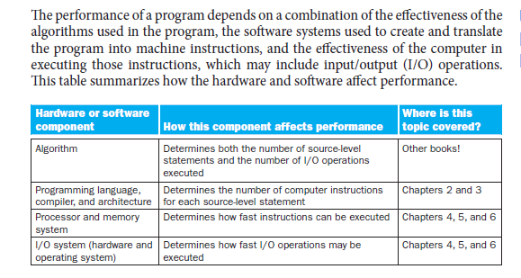

Slide 11
Why to study this subject?
As a programmer we should no how a computer executes programs internally ? Can help to write more effective programs
It also helps them to understand why a program exhibits poor performance even though it might be implementing a computationally efficient algorithm?
You can program bare hardware without the support of any os

Slide 12
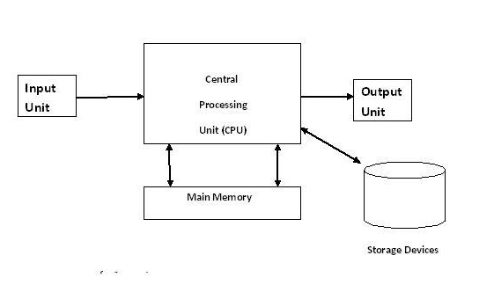
Block diagram of computer

Slide 13
What is a computer?
Simply put, a computer is a sophisticated electronic calculating machine that:
  Accepts input information,
  Processes the information according to a list of internally stored instructions and
  Produces the resulting output information.
Functions performed by a computer are:
  Accepting information to be processed as input.
  Storing a list of instructions to process the information.
  Processing the information according to the list of instructions.
  Providing the results of the processing as output.
What are the functional units of a computer?

Slide 14
Functional units of a computer
Input unit accepts
information:
Human operators,
Electromechanical devices
Other computers
Arithmetic and logic unit(ALU):
Performs the desired
operations on the input
information as determined
by instructions in the memory
Memory
Arithmetic
& Logic
Input
Instr1
Instr2
Instr3
Data1
Data2
Output
Control
I/O
Stores
information:
Instructions,
Data
Processor
Control unit coordinates
various actions
Input,
Output
Processing
Output unit sends
results of processing:
To a monitor display,
To a printer

Slide 15
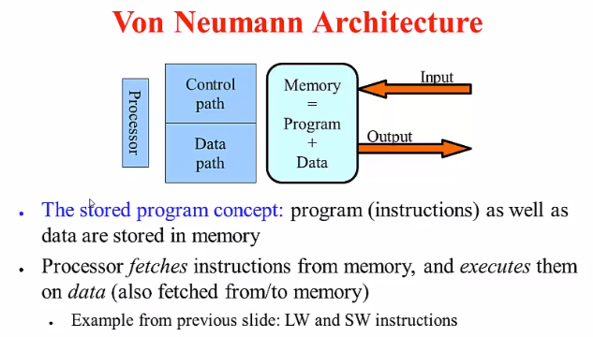

Slide 16
limitation
Limitation of von Neumann : a single connection exists between processor and memory
So at a time either an instruction can be fetched or a data item can be accessesed
The Harvard architecture is a computer architecture with separate storage and signal pathways for instructions and data.

Slide 17
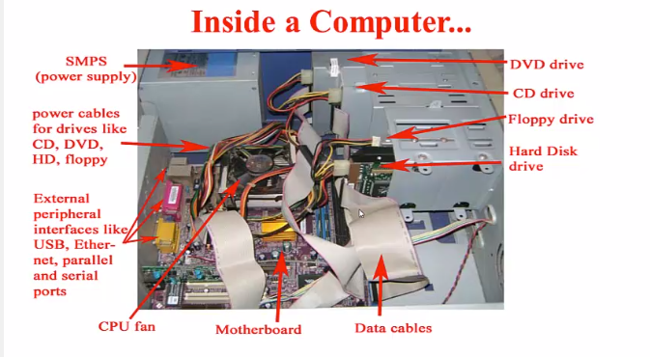

Slide 18
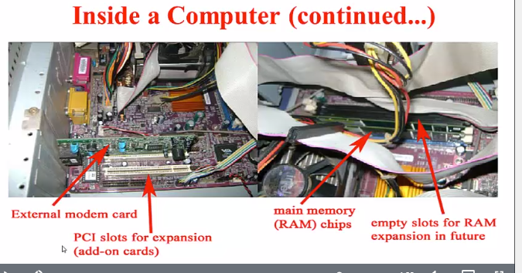

Slide 19
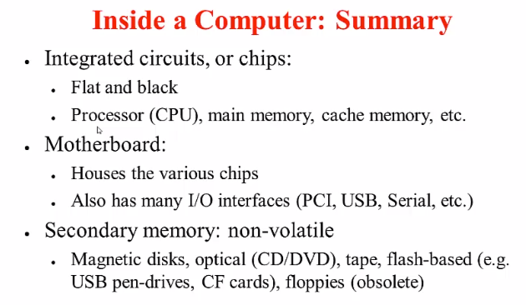

Slide 20
Microprocessor
It is a single chip which consists of ALU, control unit and registers
It is a programmable integrated device that has computing and decision making capabilities similar to CPU of a computer
The microprocessor is being used in a wide range of products called microprocessor based products or systems or embedded in a device
Or it can function as CPU of computer called a microcomputer
We are going to discuss 8 bit microprocessor 8085 used in microprocessor based products or systems or embedded in a device not used as CPU in computer
Three types of microcompuetres : PC,PC XT and PC AT

Slide 21
Micropocessor
Microprocessor communicates and operates in the binary numbers 0 and 1 called bits
Each microprocessor has a fixed set of instructions in the form of binary patterns called a machine language
However it is difficult for human to communicate in the language 0s and 1s.
Therefore the binary instructions are given abbreviated names called mnemonics and program written using mnemonics called assembly language for a given microprocessor

Slide 22
Information in a computer -- Instructions
Instructions specify commands to:
  Transfer information within a computer (e.g., from memory to ALU)
  Transfer of information between the computer and I/O devices (e.g., from keyboard to computer, or computer to printer)
  Perform arithmetic and logic operations (e.g., Add two numbers, Perform a logical AND).
A sequence of instructions to perform a task is called a program, which is stored in the memory.
Processor fetches instructions that make up a program from the memory and performs the operations stated in those instructions.
What do the instructions operate upon?

Slide 23
Information in a computer -- Data
Data are the “operands” upon which instructions operate.
Data could be:
  Numbers,
  Encoded characters.
Data, in a broad sense means any digital information.
Computers use data that is encoded as a string of binary digits called bits.

Slide 24
Input unit
Binary information must be presented to a computer in a specific format. This
task is performed by the input unit:
- Interfaces with input devices.
- Accepts binary information from the input devices.
- Presents this binary information in a format expected by the computer.
- Transfers this information to the memory or processor.
Real world
Computer
Memory
Input Unit
Keyboard
Audio input
……
Processor

Slide 25
Memory unit
Memory unit stores instructions and data.
  Recall, data is represented as a series of bits.
  To store data, memory unit thus stores bits.
  Two types: primary and secondary (storage) memory
  RAM is made of registers and each register has group of flip-flops or FET known as memory cells. The number of bits stored in register is called memory word
Processor reads instructions and reads/writes data from/to the memory during the execution of a program.
  In practice, a group of bits is fetched at a time.
  Group of bits stored or retrieved at a time is termed as “word”
  Number of bits in a word is termed as the “word length” of a computer.
In order to read/write to and from memory, a processor should know where to look:
  “Address” is associated with each word location.

Slide 26
Memory unit (contd..)
Processor reads/writes to/from memory based on the memory address:
  Access any word location in a short and fixed amount of time based on the address.
  Random Access Memory (RAM) provides fixed access time independent of the location of the word.
  Access time is known as “Memory Access Time”.
Memory and processor have to “communicate” with each other in order to read/write information.
  In order to reduce “communication time”, a small amount of Cache is tightly coupled with the processor.
Modern computers have three to four levels of RAM units with different speeds and sizes:
  Fastest, smallest known as Cache
  Slowest, largest known as Main memory.
Notes:
Since the instructions and data need to be feteched from the memory in order to perform a task, the time it takes to access and fetch this information will be one factor influencing how fast a given task will complete. In order to increase the speed of performing a task, one way is to reduce the amount of time it takes to fetch the data and the instructions. This time is called as “access time”.
Suppose if we want to fetch the data at memory location with the address 10. In case of sequential access, we have to access locations 1-9, and then access location 10. Clearly, in case of sequential access the access times increase as memory locations with higher access times are accessed. We need some kind of memory which provides fixed and short access time irrespective of the memory location being accessed. That is, it provides random access.
Why is the access time faster for the Cache than it is for primary storage? I haven’t yet discussed how the various units communicate with each other. In a few minutes I will discuss that, and it will become clear.

Slide 27
Memory unit (contd..)
Primary storage of the computer consists of RAM units.
  Fastest, smallest unit is Cache.
  Slowest, largest unit is Main Memory.
Primary storage is insufficient to store large amounts of data and programs.
  Primary storage can be added, but it is expensive.
Store large amounts of data on secondary storage devices:
  Magnetic disks and tapes,
  Optical disks (CD-ROMS).
  Access to the data stored in secondary storage in slower, but take advantage of the fact that some information may be accessed infrequently.
Cost of a memory unit depends on its access time, lesser access time implies higher cost.

Slide 28
Arithmetic and logic unit (ALU)
Operations are executed in the Arithmetic and Logic Unit (ALU).
  Arithmetic operations such as addition, subtraction.
  Logic operations such as comparison of numbers.
In order to execute an instruction, operands need to be brought into the ALU from the memory.
  Operands are stored in general purpose registers available in the ALU.
  Access times of general purpose registers are faster than the cache.
Results of the operations are stored back in the memory or retained in the processor for immediate use.

Slide 29
Output unit
Computers represent information in a specific binary form. Output units:
- Interface with output devices.
- Accept processed results provided by the computer in specific binary form.
- Convert the information in binary form to a form understood by an
output device.
Computer
Real world
Memory
Printer
Graphics display
Speakers
……
Output Unit
Processor

Slide 30
Control unit
Operation of a computer can be summarized as:
  Accepts information from the input units (Input unit).
  Stores the information (Memory).
  Processes the information (ALU).
  Provides processed results through the output units (Output unit).
Operations of Input unit, Memory, ALU and Output unit are coordinated by Control unit.
Instructions control “what” operations take place (e.g. data transfer, processing).
Control unit generates timing signals which determines “when” a particular operation takes place.

Slide 31
How are the functional units connected?
For a computer to achieve its operation, the functional units need to
communicate with each other.
In order to communicate, they need to be connected.
Input
Output
Memory
Processor
Bus
Functional units may be connected by a group of parallel wires.
The group of parallel wires is called a bus.
Each wire in a bus can transfer one bit of information.
The number of parallel wires in a bus is equal to the word length of
a computer
Notes:
What is a word? What is a word length? During the discussion of which functional unit did we come across this concept?

