Slide 1
BASIC PROCESSING UNIT

Slide 2
Processing Unit
So far we have discussed the computer from the programmer’s point of view. Now we will discuss the organization and operation of the different components that form a computer system
We explore the organization of the hardware that enables a processor(CPU) to perform its main function: to fetch and execute instruciotns

Slide 3
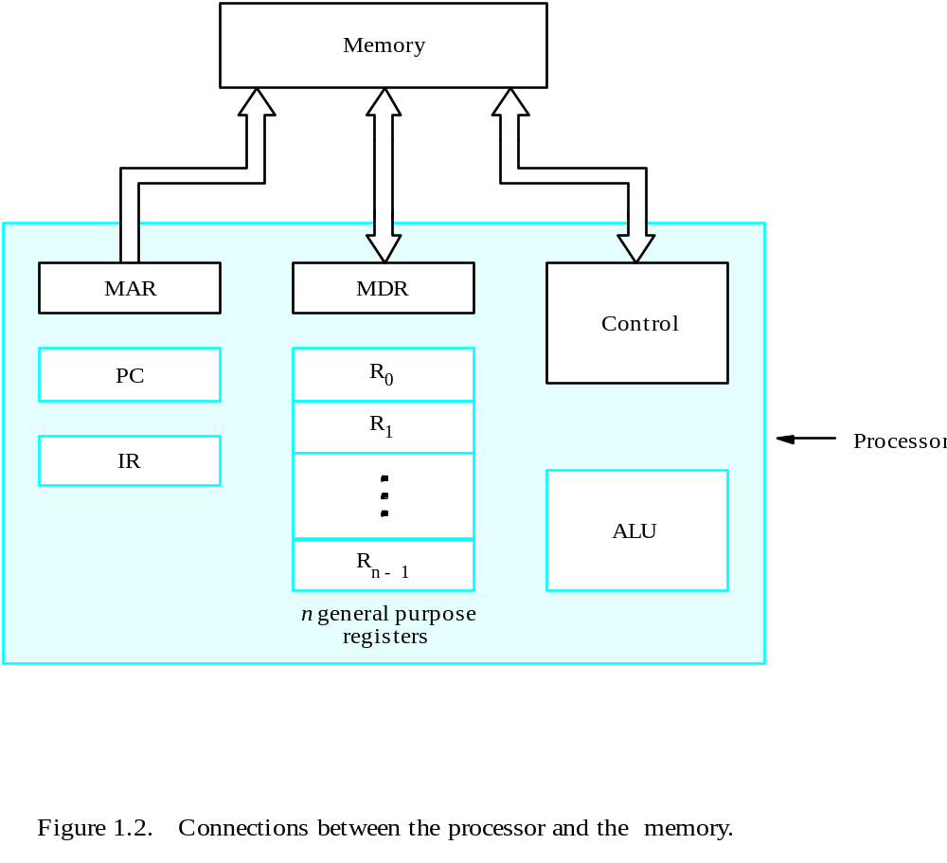
Connection Between the Processor and the Memory

Slide 4
Overview
A typical computing task consists of a series of steps specified by a sequence of machine instructions that constitute a program.
An instruction is executed by carrying out a sequence of more basic operations.

Slide 5
Fundamental Concepts
Processor fetches one instruction at a time and perform the operation specified.
Instructions are fetched from successive memory locations until a branch or a jump instruction is encountered.
Processor keeps track of the address of the memory location containing the next instruction to be fetched using Program Counter (PC).
Instruction Register (IR) is used to hold opcode

Slide 6
Executing an Instruction perform three steps
Fetch the contents of the memory location pointed to by the PC. The contents of this location are loaded into the IR (fetch phase).
IR ← [[PC]]
Assuming that the memory is byte addressable, increment the contents of the PC by 4 (fetch phase).
PC ← [PC] + 4
Carry out the actions specified by the instruction in the IR (execution phase).

Slide 7
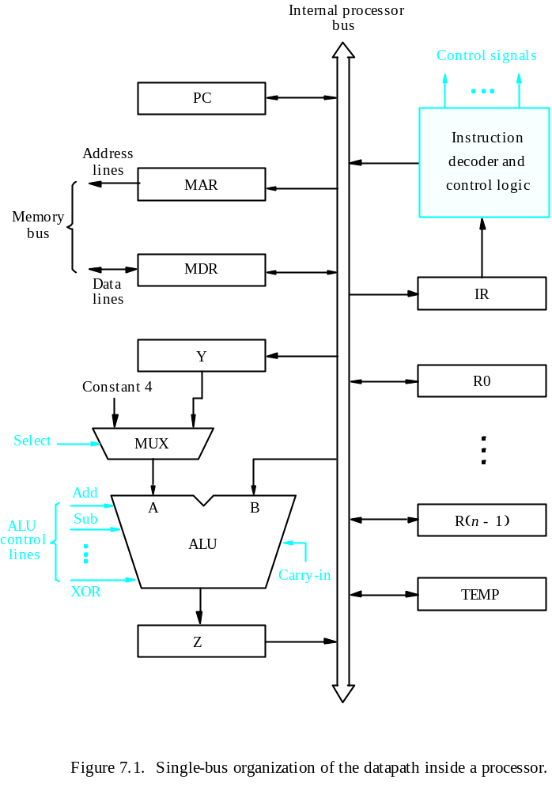
Processor Organization
ALU and these registers are refer as data path
Datapath
The IR and instruction decoder are integral part of CU

Slide 8
Executing an Instruction
Most of the operations needed to execute an instruction can be carried out by performing one or more of the following functions
Transfer a word of data from one processor register to another or to the ALU.
Perform an arithmetic or a logic operation and store the result in a processor register.
Fetch the contents of a given memory location and load them into a processor register.
Store a word of data from a processor register into a given memory location.

Slide 9
Register Transfers
Internal processor
b
us
R
i
in
R
i
Consider transfer the content of R1 to R4
R1out,R4in
R
i
out
Y
in
Y
Constant 4
Select
MUX
A
B
ALU
Z
in
Z
Z
out
Figure 7.2. Input and output gating for the registers in Figure 7.1.

Slide 10
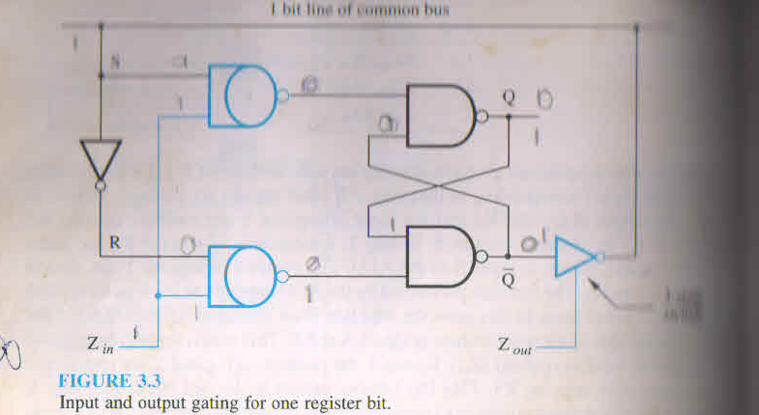
Input and output gating for one register bit

Slide 11
Performing an Arithmetic or Logic Operation
The ALU is a combinational circuit that has no internal storage.
ALU gets the two operands from MUX and bus. The result is temporarily stored in register Z.
What is the sequence of operations to add the contents of register R1 to those of R2 and store the result in R3?
  R1out, Yin
  R2out, SelectY, Add, Zin
  Zout, R3in

Slide 12
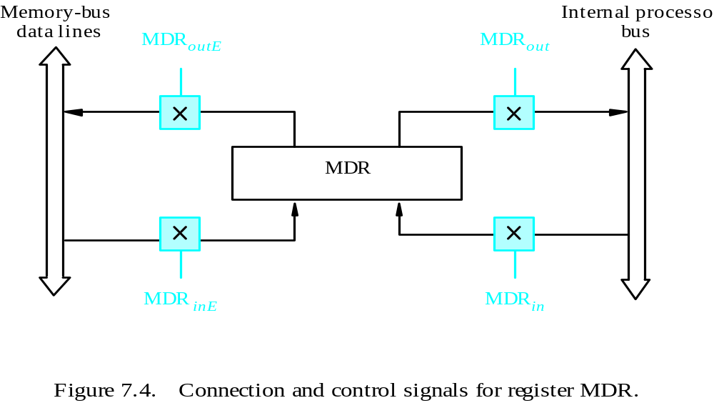
Fetching a Word from Memory
Address into MAR; issue Read operation; data into MDR. Assume address of memory location is in R1 and content to be loaded into R2

Slide 13
Fetching a Word from Memory
The response time of each memory access varies
The processor waits until it receives an MFC indication .
Move (R1), R2
  MAR ← [R1]
  Start a Read operation on the memory bus
  Wait for the MFC response from the memory
  Load MDR from the memory bus
  R2 ← [MDR]
  Memory Function Completed (MFC)
A data transfer in which one device initiates the transfer and wait until the other device responds is referred as asynchronous transfer.
This mechanism enables the transfer of data between two independent devices that have different speeds of operation

Slide 14
Fetching a Word from Memory
These actions can be carried out as separate steps but some can be combined into a single step
Move (R1), R2
Memory READ operation requires three steps which can be described by the signals being activated as follows:
  R1out, MARin, Read
  MDRinE, WMFC
  MDRout, R2in

Slide 15
Storing a word in memory
Writing a word to memory is almost similar procedure
Move R2, (R1)
      MAR ← [R1]
      [MDR] ← [R2], Write, Wait for MFC
Memory WRITE operation requires three steps which can be described by the signals being activated as follows:
  R1out, MARin,
  R2out, MDRin, Write
  MDRoutE, WMFC

Slide 16
Architecture
Internal processor
b
us
R
i
in
R
i
R
i
out
Y
in
Y
Constant 4
Select
MUX
A
B
ALU
Z
in
Z
Z
out
Figure 7.2. Input and output gating for the registers in Figure 7.1.

Slide 17
Execution of a Complete Instruction
Add (R3), R1
  Fetch the instruction
  Fetch the first operand (the contents of the memory location pointed to by R3)
  Perform the addition
  Load the result into R1
First three steps are Instruction Fetch and will be common in all instructions:
    PC -> MAR, PC+4 -> Zin
    Zout ->PC
    MDRout-> IRin

Slide 18
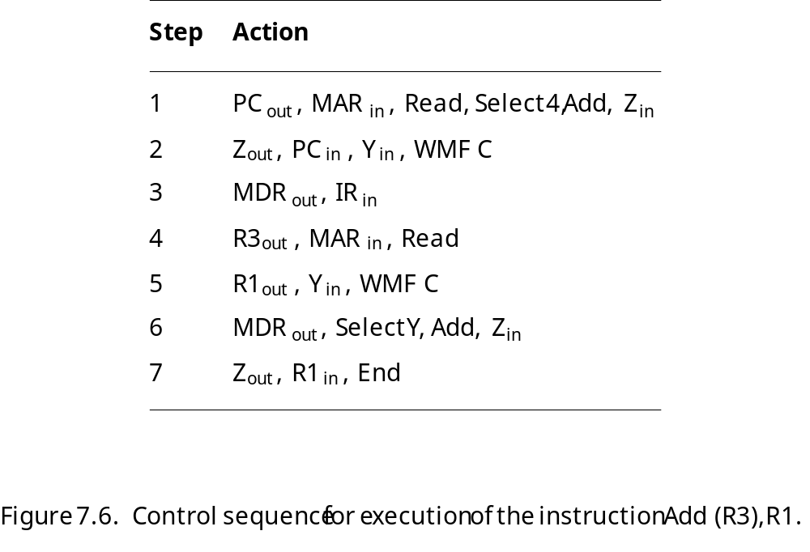
Execution of a Complete Instruction
Add (R3), R1

Slide 19
Execution of a Complete Instruction
Add R2, R1
R2_{out}

Slide 20
Execution of Branch Instructions
A branch instruction replaces the contents of PC with the branch target address, which is usually obtained by adding an offset X given in the branch instruction.
The offset X is usually the difference between the branch target address and the address immediately following the branch instruction.
Conditional branch

Slide 21
Execution of Branch Instructions
Step
Action
1
PC
out
,
MAR
in
,
Read,
Select4,
Add,
Z
in
2
Z
out
,
PC
in
,
Y
in
,
WMF
C
3
MDR
out
,
IR
in
4
Offset-field-of-IR
,
Add,
Z
Select y
out
in
5
Z
out
,
PC
in
,
End
Figure 7.7. Control sequence for an unconditional branch instruction.

Slide 22
Conditional baranch
During step 4 check condition
E.g. Branch on negeative
step4: if N=0 then End
4. Offset-field-of-IRout, Add, Zin,Select y, If N=0 then End

Slide 23
Hardwired Control

Slide 24
Overview
To execute instructions, the processor must have some means of generating the control signals needed in the proper sequence.
Computer designers have used two approaches
Two categories: hardwired control and microprogrammed control
Hardwired system can operate at high speed; but with little flexibility.

Slide 25
Hardwired control
Control unit may be based on the use of a counter driven by clock signal. Each state or count of this counter corresponds to one of the steps
Contents of the instruction register
Contents of the condition code and other external inputs like MFC

Slide 26
Control Unit Organization
Clock
CLK
Control step
counter
External
inputs
Decoder/
IR
encoder
Condition
codes
Decoder/encoder is combinational circuit
Control signals
Figure 7.10. Control unit organization.

Slide 27
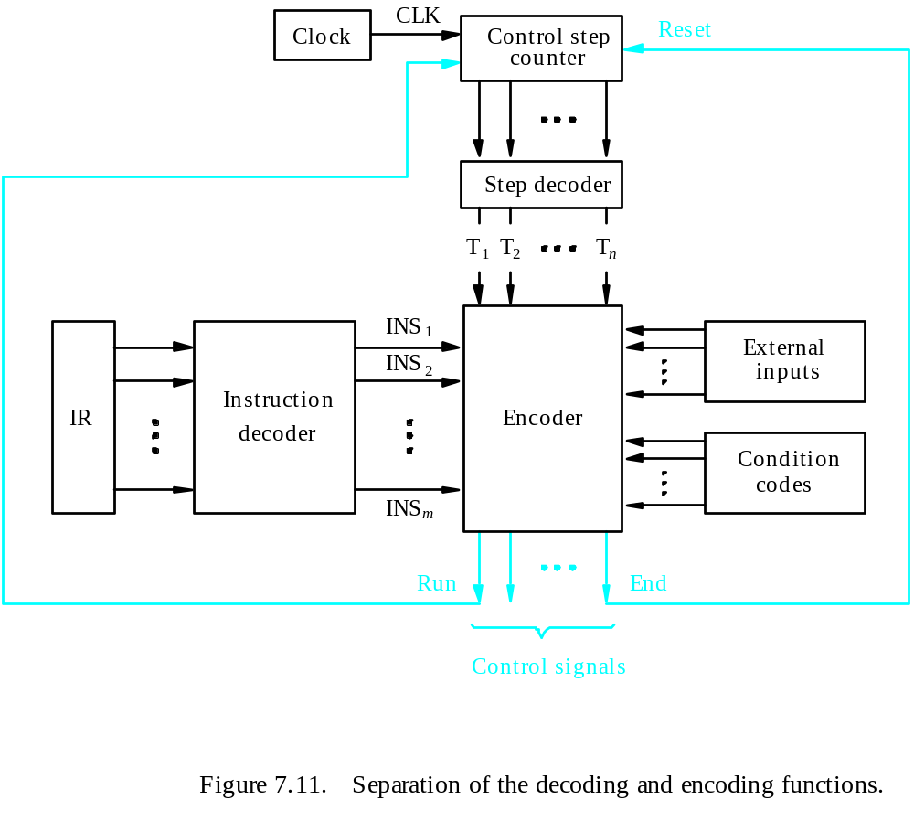
Detailed Block Description

Slide 28
Generating Z_{in} (Encoder)
Z_{in} = T₁ + T₆ • ADD + T₄ • BR + …
Branch
Add
T
4
T
6
T
1
Figure 7.12. Generation of the Z_{in} control signal for the processor in Figure 7.1.

Slide 29
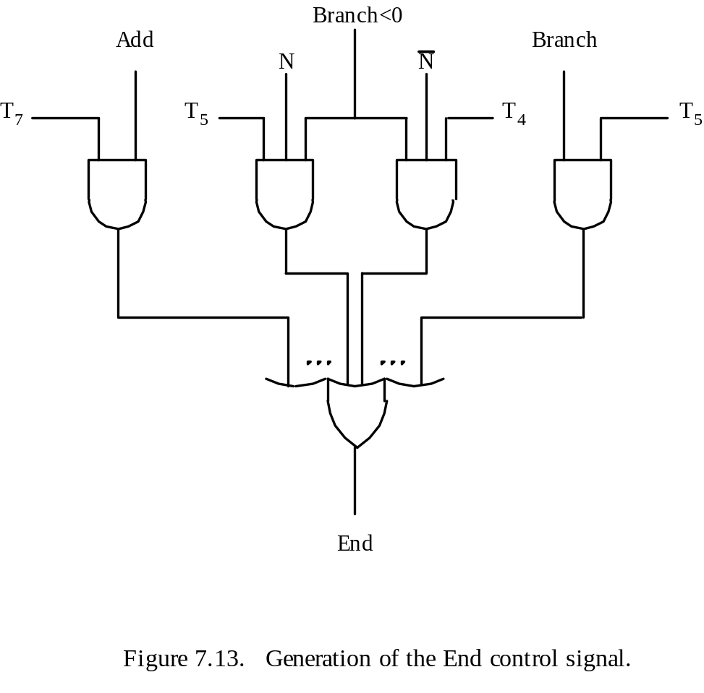
Generating End
End = T₇ • ADD + T₅ • BR + (T₅ • N + T₄ • N) • BRN +…

Slide 30
CPU-Memory interaction
Internal control signals generated during a given control step are activate only for the duration of that step
But slow memory required for more than one clock cycle
Internal control signal read and write activate only for the duration of that step. So external circuit required to generate external read and write may remain activate for more than one clock cycle

Slide 31
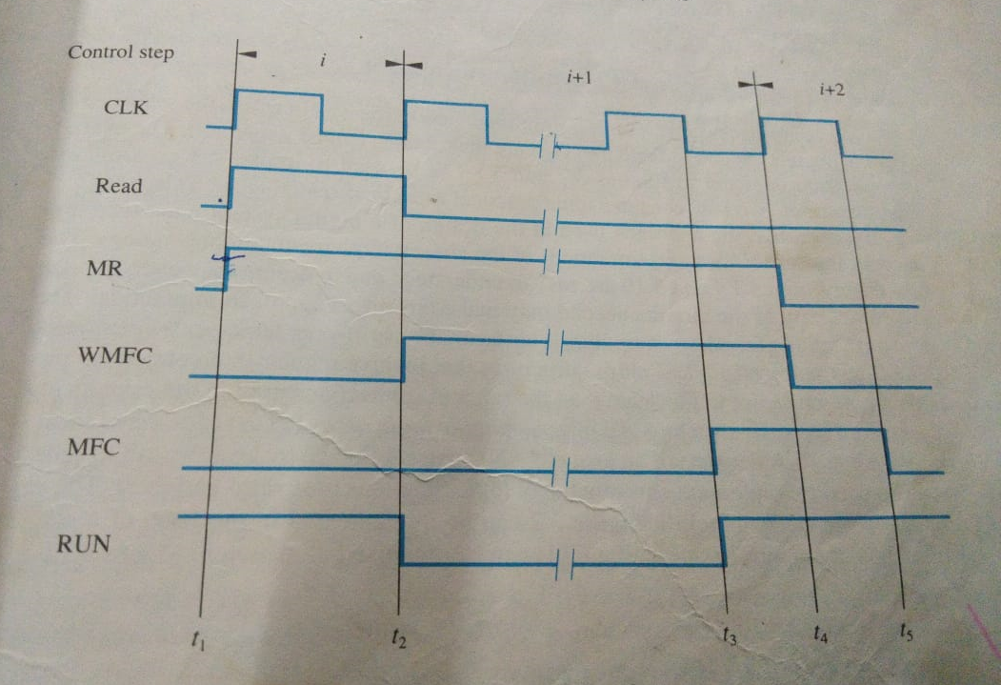

Slide 32
In 8085 ready signal used to synchronize processor and memory
During T2 of each machine cycle microprocessor check ready, if it is low it add wait state until READY become high, otherwise goes to T3 state

Slide 33
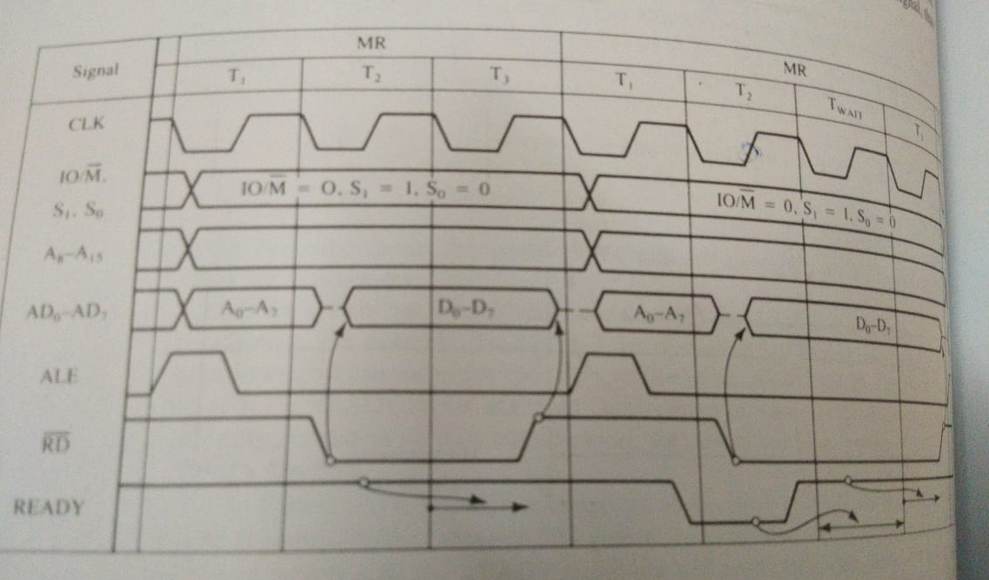

Memory read with wait state and w/o wait state

Slide 34
Practical implementation
PLA : consists of an array of AND gates followed by an array of OR gates

Slide 35
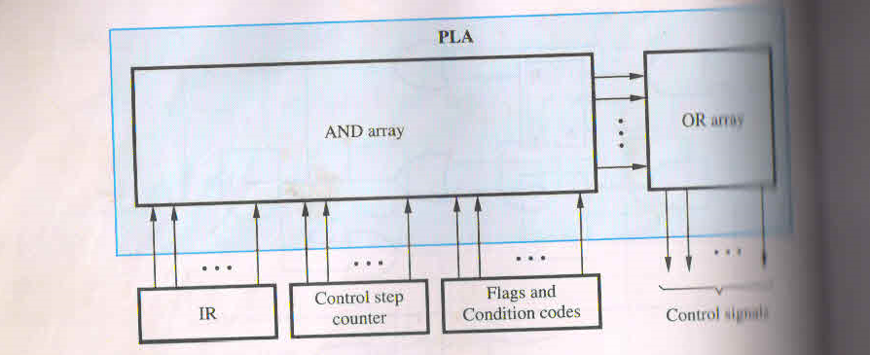

Slide 36
Performance considerations
Performance of computer depend on many factors some of which are related to the design of CPU . Three most important factor
Power of the instructions : powerful instruction performs a complex multistep task
Clock cycle time: depend on the technology used to implement the electronics circuits and the complexity of function units such as ALU
Number of clock cycles per instruction : multiple buses within the CPU

Slide 37
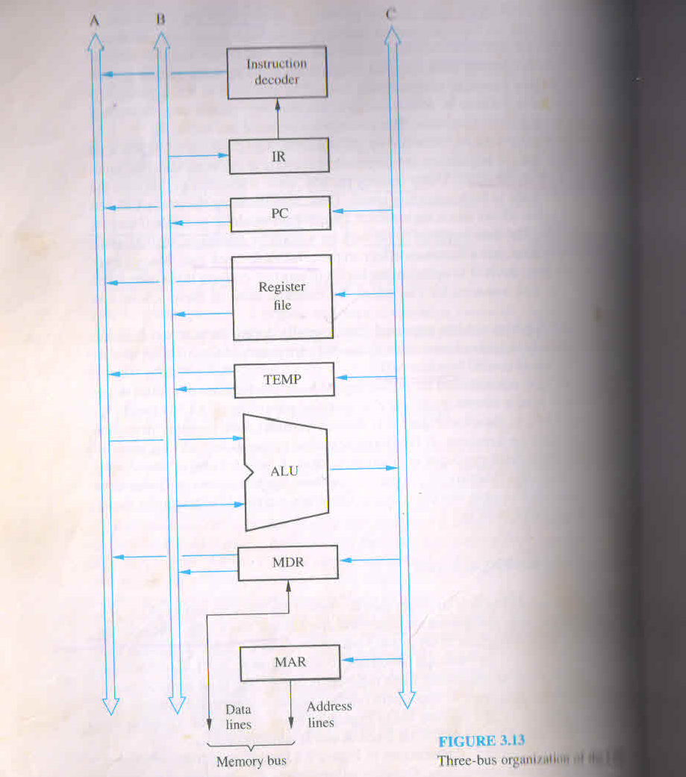
Multi-bus organization
All general purpose registers are combined into a single block called register file

Slide 38
Multi-bus organization
Control sequence of inst.
Add R4, R5, R6
PCout, R=B, MARin, Read, IncPC
WMFC
MDRoutB, R=B, IRin
R4outA, R5outB, Select A, Add, R6in, END

Slide 39
A Complete Processor
Instruction
Inte
ger
Floating-point
unit
unit
unit
Instruction
Data
cache
cache
Bus interf
ace
Pr
ocessor
System b
us
Main
Input/
memory
Output
Figure 7.14.
Block diagram of a complete processor
.

Slide 40
Microprogrammed Control

Slide 41
Microprogrammed Control
Control signals are generated by a program similar to machine language programs.
Control Word (CW): whose individual bits represent the various control signals
in
out
Micro -
in
out
MAR
Read
MDR
in
in
Select
Add
out
out
in
out
WMFC
End
instruction
PC
PC
IR
Y
Z
in
Z
R1
R1
R3
1
0
1
1
1
0
0
0
1
1
1
0
0
0
0
0
0
2
1
0
0
0
0
0
1
0
0
0
1
0
0
0
1
0
3
0
0
0
0
1
1
0
0
0
0
0
0
0
0
0
0
4
0
0
1
1
0
0
0
0
0
0
0
0
0
1
0
0
5
0
0
0
0
0
0
1
0
0
0
0
1
0
0
1
0
6
0
0
0
0
1
0
0
0
1
1
0
0
0
0
0
0
7
0
0
0
0
0
0
0
0
0
0
1
0
1
0
0
1
Figure 7.15
An e
xample of microinstructions for Figure 7.6.
Micro routine : A sequence of CWs corresponding control sequence of a machine instruction called micro-routine of that instruction. Individual CW in micro-routine are referred as microinstructions
Micro-program: A sequence of micro-instructions is called a micro-program, which is stored in a ROM called a Control Memory (CM).

Slide 42
Overview

Slide 43
in
out
Micro -
in
out
out
out
instruction
PC
PC
MAR
Read
MDR
in
in
Select
Add
in
out
R1
in
WMFC
End
IR
Y
Z
Z
R1
R3
1
0
1
1
1
0
0
0
1
1
1
0
0
0
0
0
0
2
1
0
0
0
0
0
1
0
0
0
1
0
0
0
1
0
3
0
0
0
0
1
1
0
0
0
0
0
0
0
0
0
0
4
0
0
1
1
0
0
0
0
0
0
0
0
0
1
0
0
5
0
0
0
0
0
0
1
0
0
0
0
1
0
0
1
0
6
0
0
0
0
1
0
0
0
1
1
0
0
0
0
0
0
7
0
0
0
0
0
0
0
0
0
0
1
0
1
0
0
1
Figure 7.15
An e
xample of microinstructions for Figure 7.6.

Slide 44
Basic organization of a microprogrammed control unit
Control store
Micro-routines of all instructions are stored in a special memory called the control store
Starting
IR
address
generator
Clock
μ
P
C
Control
CW
store
Figure 7.16.
Basic organization of a microprogrammed control unit.

Slide 45
microprogrammed control unit
To read the control words sequentially from the control store a microprogram counter (uPC) is used
Every time a new instruction is loaded into the IR, the output of the block labeled starting address generator is loaded into the uPC.
The uPc is then automatically incremented by the clock, causing successive microinstructions to be read from the control store

Slide 46
Conditional branch
The previous organization cannot handle the situation when the control unit is required to check the status of the condition codes or external inputs to choose between alternative courses of action.
Use conditional branch microinstruction.
Address
Microinstruction
0
PC
out
,
MAR
in
,
Read,
Select4,
Add,
Z
in
1
Z
out
,
PC
in
,
Y
in
,
WMF
C
2
MDR
out
,
IR
in
3
Branch
to
starting
address
of
appropriate
microroutine
.
.
.
.
.
.
.
.
.
.
.
.
.
.
.
.
.
.
.
.
.
.
.
.
.
.
.
.
.
.
.
.
.
.
.
.
.
.
.
.
.
.
.
.
.
.
.
.
.
.
.
.
.
.
.
.
.
.
.
.
.
.
.
.
.
.
25
If
N=0,
then
branch
to
microinstruction
0
26
Offset-field-of-IR
out
,
SelectY,
Add,
Z
in
27
Z
out
,
PC
in
,
End
Figure 7.17. Microroutine for the instruction Branch<0.

Slide 47
Microprogrammed Control
External
inputs
When an end instruction is encountered uPC is loaded with address 0 to start fetch cycle
Starting and
IR
branch address
Condition
generator
codes
Clock
μ
P
C
Control
CW
store
Figure 7.18. Organization of the control unit to allow
conditional branching in the microprogram.

Slide 48
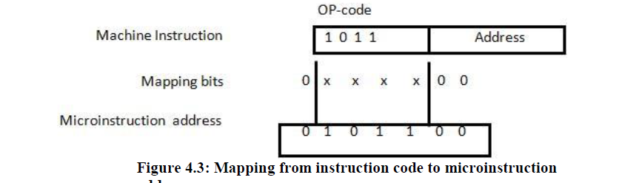

Slide 49
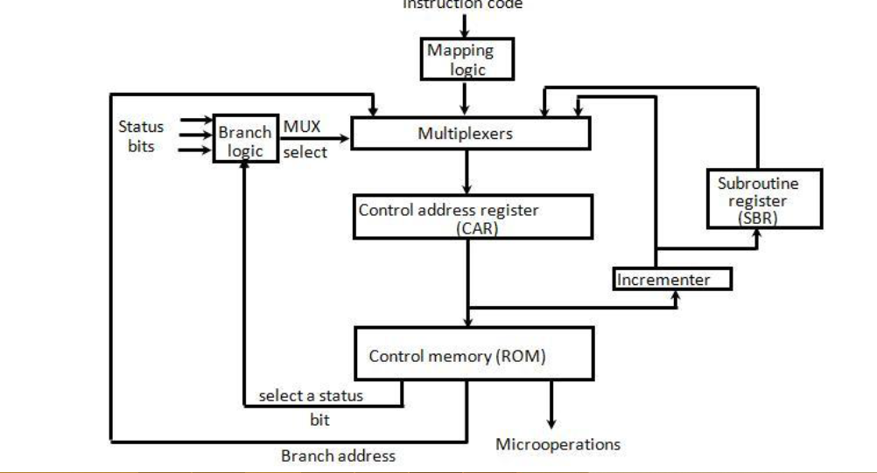
Microprogrammed Control

Slide 50
Difference between Hardwired Control and Microprogrammed Control
Hardwired Control | Microprogrammed Control
Technology is circuit based. | Technology is software based.
It is implemented through flip-flops, gates, decoders etc. | Microinstructions generate signals to control the execution of instructions.
Fixed instruction format. | Variable instruction format (16-64 bits per instruction).
Instructions are register based. | Instructions are not register based.
ROM is not used. | ROM is used.
It is used in RISC. | It is used in CISC.
Faster decoding. | Slower decoding.
Difficult to modify. | Easily modified.

Slide 51
Microinstructions
A straightforward way to structure microinstructions is to assign one bit position to each control signal.
However, this is very inefficient. because many are zero
Suppose 42 control signals, what is the size of control store memory?
The length can be reduced: most signals are not needed simultaneously, and many signals are mutually exclusive. e.g. only one function of ALU can be activated at a time
All mutually exclusive signals are placed in the same group in binary coding.one microoperation per group

Slide 52
Partial Format for the Microinstructions
Microinstruction
F1
F2
F3
F4
F5
F1 (4 bits)
F2 (3 bits)
F3 (3 bits)
F4 (4 bits)
F5 (2 bits)
0000: No transfer
000: No transfer
000: No transfer
0000: Add
00: No action
0001: PC
001: PC
001: MAR
0001: Sub
01: Read
out
in
in
0010: MDR
010: IR
010: MDR
10: Write
0011: Z
out
011: Z
in
in
out
in
011: TEMP
0100: R0
100: R0
100: Y
in
1111: XOR
out
in
in
0101: R1
101: R1
out
in
16 ALU
0110: R2
110: R2
out
in
functions
0111: R3
111: R3
out
in
1010: TEMP
out
1011: Offset
out
What is the price paid for
this scheme?
F6
F7
F8
F6 (1 bit)
F7 (1 bit)
F8 (1 bit)
Require a little more hardware
0: SelectY
0: No action
0: Continue
1: Select4
1: WMFC
1: End
Figure 7.19.
An example of a partial format for field-encoded microinstructions.

Slide 53
Further Improvement
Enumerate the patterns of required signals in all possible microinstructions. Each meaningful combination of active control signals can then be assigned a distinct code.
Vertical organization
Horizontal organization

Slide 54
Vertical & Horizontal
Highly encoded schemes that use compact codes to specify only a small number of control functions in each microinstruction are referred as a vertical organization
Minimally encoded scheme in which many resources can be controlled with a single microinstruction is called horizontal organization
Horizontal approach is useful when higher operating speed is desired and when the machine structure allows parallel use of resources

Slide 55
Consider a CPU where all the instructions require 7 clock cycles to complete execution. There are 140 instructions in the instruction set. It is found that 125 control signals are needed to be generated by the control unit. While designing the horizontal microprogrammed control unit, single address field format is used for branch control logic. What is the minimum size of the control word and control address register?
(A) 125, 7
(B) 125, 10
(C) 135, 7
(D) 135, 10

Slide 56
Explanation: As each instruction takes 7 cycles
=> 140 instructions will take = 140*7 cycles
=> 2^{m}>=980
=>m>=10
=> 10+125 bits and 10 bits

Slide 57
A micro program control unit is required to generate a total of 25 control signals. Assume that during any micro instruction, at most two control signals are active. Minimum number of bits required in the control word to generate the required control signals will be:
2
2.5
10
12

Slide 58
In instruction set of a processor has 125 signals which can be divided into 5 groups of mutually exclusive signals as follows:
Group 1 : 20 signals, Group 2 : 70 signals, Group 3 : 2 signals, Group 4 : 10 signals, Group 5 : 23 signals.
How many bits of the control words can be saved by using vertical microprogramming over horizontal microprogramming?
(A) 0
(B) 103
(C) 22
(D) 55

Slide 59
In horizontal microprogramming, each control signal is represented by one bit in the microinstruction.
Therefore, total number of bits of the control words required in Horizontal microprogramming :
= 20 + 70 + 2 + 10 + 23 = 125 bits
In vertical microprogramming, ‘n’ control signals encoded into log₂ n bits.
group 1 : log₂ 20 = 5 bits
group 2 : log₂ 70 = 7 bits
group 3 : log₂ 2 = 1 bits
group 4 : log₂ 10 = 4 bits
group 5 : log₂ 23 = 5 bits
Total number of bits required in vertical microprogramming = 5 + 7 + 1 + 4 + 5 = 22 bits
So, number of bits saved= 125 – 22 = 103 bits.

Slide 60
Nano programming

Slide 61
Introduction
In conventional microprogrammed computers each instruction fetched from main memory is interpreted by micro program stored in a single control memory CM.
The micro instructions do not directly issue the signals that control the hardware.
They are used to access a second control memory termed a nano control memory nCM,that directly controls the hardware.
2 LEVELS OF CONTROL MEMORY
Microcontrolled memory- higher level
Nanocontrol memory(Nanoinstructions)-lower level

Slide 62
From instruction
register IR
μPC
μPC
Micro control
Memory (μcm)
Nano control
Memory (ncm)
Microinstruction
Register μIR
Nanoinstruction
Register nIR
Control Signals
Two Level control store organization for nano programming

Slide 63
Nanoprogramming
The microprograms are encoded in a narrow vertical format H_{m}
Where Hm represents the number of words in the high level memory, Wm represents the size of word in the high level memory. Usually, the microprograms are vertically organized so Hm is large and Wm is small.
Nano instructions have a highly parallel horizontal format
which makes Wn large and Hn is small. Hn represents the number of words in the low level memory
Wn represents the size of word in the low level memory
Advantages
If Nanocontrol memory is used it will reduce the total size.
It will provide greater design flexibility. Because of two level memories organization more design flexibility exists between instructions and hardware
Nano programming concept was first used in QM-1 computer design
It is also employed in more recent motorolla 68000 series of microprocessors.

Slide 64
Nanoprogram Control
The nano control memory nCM has a capacity of 1024 nano instructions
The nano instructions are 360 bits long.
Nano instruction addresses are generated by a nano program counter and nano instructions are placed in a register nIR.
The next address is generated by either incrementing the nano program counter or loading it from external source(branch field or address from micro instruction opcode)

Slide 65
Disadvantage of nano programming
The main disadvantage of the two level memory approaches is the loss of speed due to the extra memory access required for nano control memory.

