Slide 1
Reduced Instruction Set Computers
Vs
Complex Instruction Set
Computers

Slide 2
What is CISC?
CISC is an acronym for Complex Instruction Set Computer and are chips that are easy to program and which make efficient use of memory. Since the earliest machines were programmed in assembly language and memory was slow and expensive, the CISC philosophy made sense
Most common microprocessor designs such as the Intel 80x86 and Motorola 68K series followed the CISC philosophy.
But recent changes in software and hardware technology have forced a re-examination of CISC and many modern CISC processors are hybrids, implementing many RISC principles.
CISC was developed to make compiler development simpler. It shifts most of the burden of generating machine instructions to the processor. For example, instead of having to make a compiler write long machine instructions to calculate a square-root, a CISC processor would have a built-in ability to do this.

Slide 3
Driving force for CISC
Increasingly complex high level languages (HLL) – structured and object-oriented programming
Leads to:
  Large instruction sets
  More addressing modes

Slide 4
Intention of CISC
Ease compiler writing (narrowing the semantic gap)
Improve execution efficiency
  Complex operations in microcode (the programming language of the control unit)
Support more complex HLLs

Slide 5
Most CISC hardware architectures have several characteristics in common:
Complex instruction-decoding logic, driven by the need for a single instruction to support multiple addressing modes.
A small number of general purpose registers. This is the direct result of having instructions which can operate directly on memory and the limited amount of chip space not dedicated to instruction decoding, execution, and microcode storage.
Several special purpose registers. Many designs set aside special registers for the stack pointer, interrupt handling, and so on. This can simplify the hardware design somewhat, at the expense of making the instruction set more complex.
A “Condition code" register which is set as a side-effect of most instructions. This register reflects whether the result of the last operation is less than, equal to, or greater than zero and records if certain error conditions occur.

Slide 6
RISC
Although RISC systems have been defined and designed in a variety of ways by
different groups, the key elements shared by most designs are these:
• A large number of general-purpose registers, and/or the use of compiler technology to optimize register usage
• A limited and simple instruction set
• An emphasis on optimizing the instruction pipeline

Slide 7
What is RISC?
RISC?
RISC, or Reduced Instruction Set Computer. is a type of microprocessor architecture that utilizes a small, highly-optimized set of instructions, rather than a more specialized set of instructions often found in other types of architectures.
History
The first RISC projects came from IBM, Stanford, and UC-Berkeley in the late 70s and early 80s. The IBM 801, Stanford MIPS, and Berkeley RISC 1 and 2 were all designed with a similar philosophy which has become known as RISC. Certain design features have been characteristic of most RISC processors:
  one cycle execution time: RISC processors have a CPI (clock per instruction) of one cycle. This is due to the optimization of each instruction on the CPU and a technique called PIPELINING
  pipelining: a techique that allows for simultaneous execution of parts, or stages, of instructions to more efficiently process instructions;
  large number of registers: the RISC design philosophy generally incorporates a larger number of registers to prevent in large amounts of interactions with memory

Slide 8
CISC &RISC Attributes
The main characteristics of CISC microprocessors are:
Extensive instructions.
Complex and efficient machine instructions.
Micro-encoding of the machine instructions.
Extensive addressing capabilities for memory operations.
Relatively few registers.
In comparison, RISC processors are more or less the opposite of the above:
Reduced instruction set.
Less complex, simple instructions.
Hardwired control unit and machine instructions.
Few addressing schemes for memory operands with only two basic instructions, LOAD and STORE
Many symmetric registers which are organized into a register file.

Slide 9
CISC versus RISC
CISC | RISC
Emphasis on hardware | Emphasis on software
Includes multi-clock complex instructions | Single-clock, reduced instruction only
Memory-to-memory: "LOAD" and "STORE" incorporated in instructions | Register to register: "LOAD" and "STORE" are independent instructions
Small code sizes, high cycles per second | Low cycles per second, large code sizes
Transistors used for storing complex instructions | Spends more transistors on memory registers

Slide 10
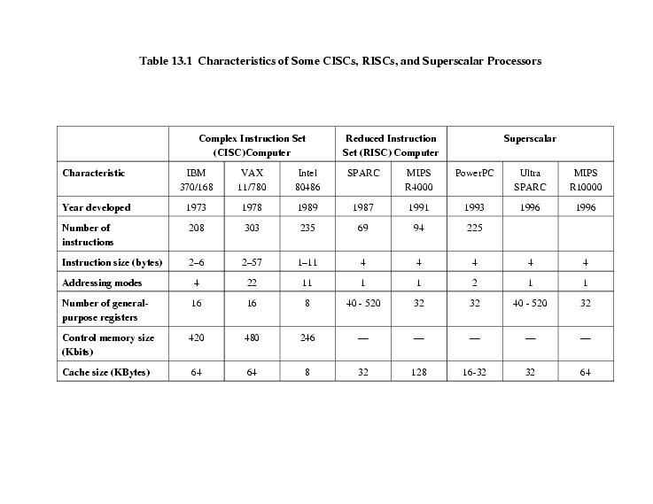
Comparison of processors

