Slide 1
Memory
Programs and the data they operate on are held in the main memory of the computer during execution
The execution speed of programs is highly dependent on the speed at which instructions and data transferred between the CPU and the main memory
Ideally the memory would be very fast, large and inexpensive
But technology do not permit such single memory, so hirechay of memory is used
First we discuss main memory (RAM and ROM)

Slide 2
Basic Concepts
The maximum size of the memory that can be used in any computer is determined by the addressing scheme.
16-bit addresses = 2¹⁶ = 64K memory locations
Most modern computers are byte addressable.: successive addresses refer to successive byte locations
W
ord
address
Byte address
Byte address
0
0
1
2
3
0
3
2
1
0
4
4
5
6
7
4
7
6
5
4
•
•
•
•
•
•
2
k
-
4
2
k
-
4
2
k
-
3
2
k
-
2
2
k
-
1
2
k
-
4
2
k
-
1
2
k
-
2
2
k
-
3
2
k
-
4
(a) Big-endian assignment
(b) Little-endian assignment

Slide 3
memeory
Let address is 32 bit. When 32 bit address is sent from the CPU to memory unit, the higher order 30 bit determine which word will be accessed.
If a byte quantity is specified the lower order 2 bit of the address specify which byte location is specified.
In byte addressable computers another control line may be added to indicate when only a byte rather than a full word of n bits is transferred.

Slide 4
Traditional Architecture
Processor
Memory
k
-bit
address bus
MAR
n
-bit
data bus
Up to 2
k
addressable
MDR
locations
Word length =
n
bits
Control lines
R
/
W
( , MFC, etc.)
Figure 5.1. Connection of the memory to the processor.

Slide 5
Basic Concepts
Memory access time : time that elapses between the initiation of an operation and the completion of that operation e.g. the time between the read and MFC signals
Memory cycle time: minimum time delay required between the initiation of two successive memory operations. E.g. time between two successive read operation. This cycle time is longer than access time
RAM – any location can be accessed for a Read or Write operation in some fixed amount of time that is independent of the location’s address.
The basic technology for implementing main memories uses a semiconductor integrated circuits.
The CPU process instructions and data faster than they can be fetched form a main memory. Memory cycle time is the bottleneck in the system

Slide 6
RAM
The memory cycle time is bottleneck in the sytem
One way to reduce the memory access time is Cache memory and interleaving
Cache is small and faster memory inserted between CPU and larger, slower main memory
Virtual memory increase apparent size of the main memory, memory management unit

Slide 7
Semiconductor RAM Memories
Semiconductor memories are available in a wide range of speeds
Their cycle time range from few hundred ns to less than 10nsec

Slide 8
RAM
Memory cells are usually organized in the form of an array in which each cell is capable of storing one bit of information
Each row of cells constitutes a memory word and all cell of a row are connected to a common line referred to as the word line, which is driven by the address decoder on the chip.
The cells in each column are connected to a Sense/Write circuit by two bit lines
The Sense/Write circuits are connected to the data input/output lines of the chip
During a read operation these circuits sense to read the information stored in the cells selected by a word line

Slide 9
Internal Organization of Memory Chips
b
7
b
′
7
b
1
b
′
1
b
0
b
′
0
W
0
•
•
•
FF
FF
A
0
W
1
•
•
•
A
1
Address
Memory
decoder
•
•
•
•
•
•
•
•
•
•
•
•
•
•
•
•
•
•
cells
A
2
A
3
W
15
•
•
•
16 words of 8 bits each: 16x8 memory org.. It has 16 external connections: addr. 4, data 8, control: 2, power/ground: 2
1K memory cells(1K X1): 128x8 memory, external connections: ? 19(7+8+2+2)
1Kx1:? 15 (10+1+2+2)
Sense / Write
Sense / Write
Sense / Write
R
/
W
circuit
circuit
circuit
CS
Data input
/output lines:
b
7
b
1
b
0
Figure 5.2. Organization of bit cells in a memory chip.

Slide 10
A Memory Chip
5-bit row
address
W
0
W
1
5-bit
32
×
32
decoder
memory cell
array
W
31
Sense
/
Write
circuitry
10-bit
address
32-to-1
output multiplexer
R
/
W
and
CS
input demultiplexer
5-bit column
address
Data
input/output
Figure 5.3. Organization of a 1K × 1 memory chip.

Slide 11
Static Memories
The circuits are capable of retaining their state as long as power is applied. Two inverters are cross-connected to form a latch. The latch is connected to two bit lines by transistors T1 and T2.
Read: word line is activated to close switch T1 and T2
Write : put appropriate value on b and activate word line
b
b
′
T
1
X
Y
T
2
Word line
Bit lines
Figure 5.4. A static RAM cell.

Slide 12
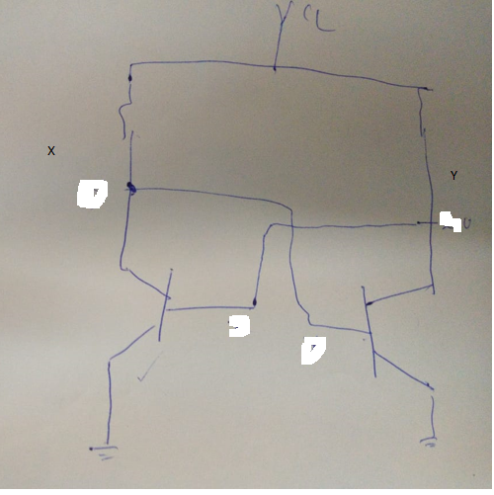

Slide 13
Static Memories
CMOS cell: low power consumption. Current only flow when the cell is being accessed. X is 1 when T3 and T6 on while T4 and T5 off
b
V
b
′
supply
Advantage of CMOS RAM is low power consumption.
Because current flow in the cell only when cell is being accessed.
Otherwise there is no continuous electrical path bet Vsupply and ground.
T
3
T
4
T
1
T
2
X
Y
T
5
T
6
Word line
Bit lines
Figure 5.5.
An example of a CMOS memory cell.

Slide 14
Structures of Larger Memories uisng static memory chips
21-bit
A
addresses
19-bit internal chip address
A
0
1
A
19
A
20
2-bit
decoder
512
K
×
8
memory chip
D
D
D
D
31-24
23-16
15-8
7-0
512
K
×
8
memory chip
2M X 32 memory using 512K X8
19-bit
8-bit data
address
input/output
Chip select
Figure 5.10. Organization of a 2M × 32 memory module using 512K × 8 static memory chips.

Slide 15
Show organization of 64KX8 using 16K X 1 static memory chips

Slide 16
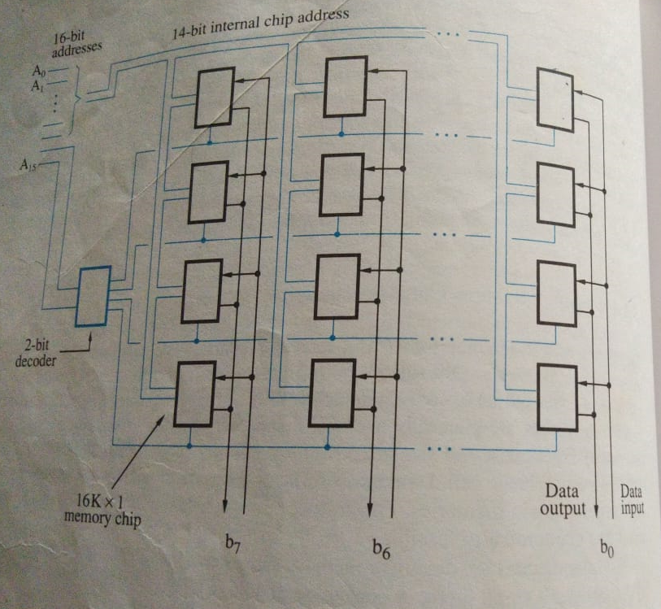


Slide 17
Asynchronous DRAMs
Static RAMs are fast(10ns), but they cost more because their cells required several transistors so are more expensive.
Dynamic RAMs (DRAMs) are cheap and area efficient, but they can not retain their state indefinitely (only a few milliseocnds)– need to be periodically refreshed. they stored information in form of charge on capacitor
Bit line
Word line
T
C
Figure 5.6. A single-transistor dynamic memory cell

Slide 18
DRAM
After transistor is turned off capacitor begins to discharge because of capacitor’s own leakage resistance and transistor continues to conduct a tiny amount of current even it is off
In order to retain the information stored in the cell, DRAM includes special circuitry that writes back the values that has been read. Each row of the cells must be accessed periodically, Once every 2 to 16 milliseconds. Refresh circuity usually performs this function automatically.
Because of their high density and low cost DRAM are widely used as main memory in computer

Slide 19
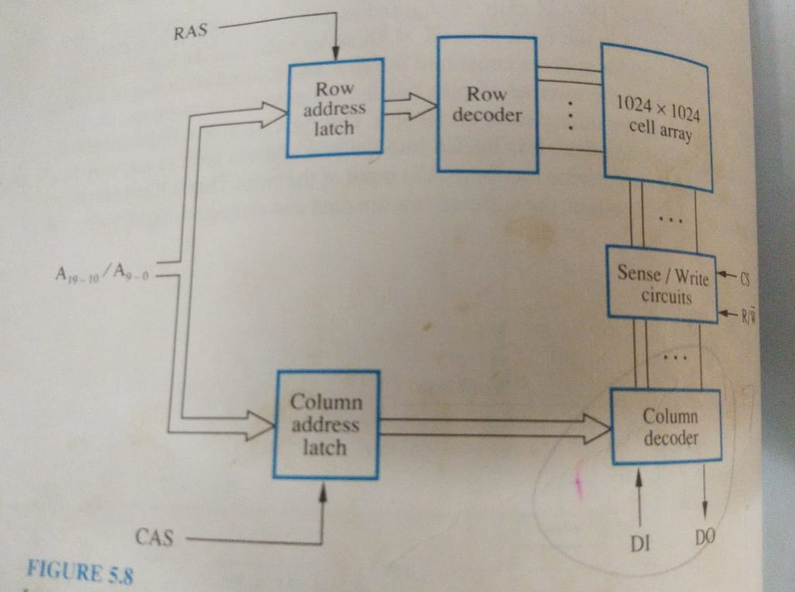
1M X 1 DRAM

Slide 20
A Dynamic Memory Chip
R
A
S
Row Addr. Strobe
Row
Row
4096
×
(
512
×
8
)
address
decoder
cell array
latch
A
20
-
9
⁄
A
8
-
0
Sense / Write
CS
circuits
R
/
W
Column
Column
address
decoder
latch
C
A
S
D
7
D
0
Column Addr. Strobe
Figure 5.7. Internal organization of a 2M × 8 dynamic memory chip.

Slide 21
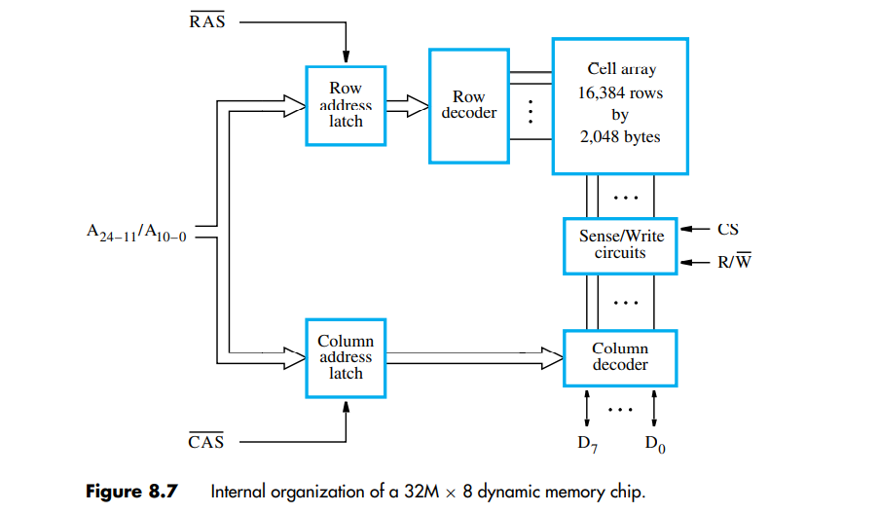

Slide 22
DRAM
RAS and CAS signals are generated by a memory controller circuit external to the chip when the processor issue a read or write command
During read operation the output data are transferred to processor after a delay equivalent to memory access time. Such memories are called asynchronous DRAM.
The memory controller is also responsible for refreshing the data stored in the memory

Slide 23
Problem
Memory cycle time of 64nsec. It has to refreshed 100times per msec and refresh takes 100nsec. What % of memory cycle time is used for refreshing

Slide 24
Answer
No of refresh=64 X100ns/1X10⁻³=64 X10⁻⁴
Time=64X10⁻⁴X100ns=64X10⁻¹¹
So 64X10⁻¹¹/64X10⁻⁹ =1%

Slide 25
Fast Page Mode
When the DRAM in last slide is accessed, the contents of all 4096 cells in the selected row are sensed, but only 8 bits are placed on the data lines D₇₋₀, as selected by A₈₋₀.
A simple addition to the circuit makes it possible to access the other bytes in the same row without having to reselect the row. Each sense amplifier act as latch. When a row address is applied the contents of all the cells are loaded into corresponding latch
Thus a block of data can be transferred at a much faster rate. The block transfer capability is referred to as the Fast page mode (a large block of data is called a page)–Good for bulk transfer.

Slide 26
Synchronous DRAM
DRAM whose operation is synchronized with a clock signal called SDRAM
SDRAM have several different modes of operation
E.g Burst mode :
. First the row address is latched under the control of RAS line. Memory cell takes 5 or 6 clock cycles to activate the selected row.
Then column address is latched under the control of CAS. After delay of 1 cycle, the first set of data bits is placed on the data lines. The SDRAM automatically increments the column address
It is not necessary to provide externally generated pulses on the CAS line to select successive columns. The necessary control signals are generated internally using a column counter and the clock signal. New data are placed on the data lines at the rising edge of each clock pulse
SDRAM can deliver data at a very high rate because all the control signals are generated inside the chip. SDRAM can work at 1GHZ

Slide 27
Synchronous DRAMs
The operations of SDRAM are controlled by a clock signal.
Refresh
counter
Row
Ro
w
address
decoder
Cell array
latch
Row/Column
address
Column
Co
lumn
Read/Write
address
decoder
circuits & latches
counter
Clock
R
A
S
Mode register
C
A
S
and
Data input
Data output
R
/
W
timing control
register
register
C
S
Figure 5.8. Synchronous DRAM.
Data

Slide 28
Synchronous DRAMs
Clock
R
/
W
R
A
S
C
A
S
Address
Row
Col
Data
D0
D1
D2
D3
Figure 5.9. Burst read of length 4 in an SDRAM.

Slide 29
Synchronous DRAMs
No CAS pulses is needed in burst operation.
Refresh circuits are included (every 64ms).
Clock frequency > 100 MHz

Slide 30
Latency and Bandwidth
Data transfers to and from the main memory often involve blocks of data. The speed of these transfers has a large impact on the performance of a computer system.
The memory access time defined earlier is not sufficient for describing the memory’s performance when transferring blocks of data
Memory access time is not sufficient for describing the memory performance when transferring block of data.
During block transfers, Memory latency – the amount of time it takes to transfer the first word of data to or from the memory.
The time required to transfer a complete block depends also on the rate at which successive words can be transferred and on the size of the block.
The latency of previous SDRAM is 5 cycles

Slide 31
Bandwidth
The example above illustrates that we need a parameter other than memory latency to describe the memory’s performance during block transfers.
Memory bandwidth – the number of bits or bytes that can be transferred in one second. It is used to measure how much time is needed to transfer an entire block of data.
Bandwidth depends on the speed of access to the stored data and on the number of bits that can be accessed in parallel. It is the product of the rate at which data are transferred (and accessed) and the width of the data bus.

Slide 32
DDR SDRAM
Double-Data-Rate SDRAM
The key idea is to take advantage of the fact that a large number of bits are accessed at the same time inside the chip when a row address is applied.
Standard SDRAM performs all actions on the rising edge of the clock signal.
DDR SDRAM accesses the cell array in the same way, but transfers the data on both edges of the clock. DDR2, DDR3, DDR4
The cell array is organized in two banks. Each can be accessed separately.
DDR SDRAMs and standard SDRAMs are most efficiently used in applications where block transfers are prevalent.

Slide 33
For example, DDR2 and DDR3 can operate at clock frequencies of 400 and 800 MHz, respectively. Therefore, they transfer data using the effective clock speeds of 800 and 1600 MHz, respectively
DDR3 stands for Double Data Rate version 3.
Whereas DDR4 stands for Double Data Rate version 4. While it’s speed is faster than DDR3.
The clock speed of DDR3 vary from 800 MHz to 2133 MHz. While the minimum clock speed of DDR4 is 2133 MHz and it has no defined maximum clock speed.

Slide 34
DRAM
They use less power and have considerably low cost per bit
Memory module house many memory chips in the range of 16 to 32
Memory modules are called SIMM (single in line) and DIMM (Dual In-Line Memory Module) depending on the configuration of pins
In SIMM, Pins present in either facet are connected. There are two type of SIMM presents, one with 30 pins and another one is with 72 pins.
There are three type of DIMM presents which are used by modern motherboard, one with 168 pins and second one is with 184 pins and third one is 240 pins.
SIMM supports 32 bit channel for data transferring. DIMM supports 64 bit channel for data transferring.

Slide 35
Memory System Considerations
The choice of a RAM chip for a given application depends on several factors:
Cost, speed, power, size…
SRAMs are faster, more expensive, smaller.
DRAMs are slower, cheaper, larger. Refresh overhead
Which one for cache and main memory, respectively?

Slide 36
Memory Controller
Row/Column
Address
address
R
A
S
R
/
W
Memory
C
A
S
Request
controller
R
/
W
Processor
Memory
C
S
Clock
Clock
Data
Figure 5.11. Use of a memory controller.

Slide 37
Read-Only Memories

Slide 38
Read-Only-Memory
Volatile / non-volatile memory
ROM, PROM: programmable ROM
EPROM: erasable, reprogrammable ROM
EEPROM: can be programmed and erased electrically
Bit line
Word line
T
Not connected to store a 1
P
Connected to store a 0
Figure 5.12. A ROM cell.

Slide 39
ROM
A logic 0 is stored in the cell if the transistor is connected to ground at point P otherwise a 1 is stored.
Bit line is connected through register to power supply
ROM: data are written into ROM when it is manufactured
PROM : put fuse at P. provide flexibility and convenience compared to ROM
EPROM : ultraviolet light to erase information. Special transistor is used at P, which has ability to function either as a normal transistor or as a disable transistor which is turned off by injecting a charge into it.
.

Slide 40
E²PROM (EEPROM) : to erase the cell contents selectively. Byte level erasing required. Disadvantage is the different voltages are needed for erasing, writing and reading the stored data which increases circuit complexity

Slide 41
Flash Memory
Similar to EEPROM
Difference: only possible to write an entire block of cells instead of a single cell. Have greater density which leads to higher capacity and lower cost per bit.
Require a single power supply voltage and consume less power in their operation
Use in portable equipment. Hand-held computers, cell phone, digital camera, Mp3 player etc. in hand held computers and cell phones a flash memory holds the software needed to operate equipment, so no need for disk drive
Implementation of such modules
  Flash cards : USB interface flash cards known as memory keys. 32Gbytes. Hence, a 32-Gbyte flash card can store approximately 500 hours of music
  Flash drives : 64 to 128Gbytes. Sloid state electronics so no moving parts. So shorter access times low power consumption so popular for batter driven applications

Slide 42
Speed, Size, and Cost
Pr
ocessor
Re
gisters
Increasing
Increasing
Increasing
size
speed
cost per bit
Primary
L1
cache
Secondary
L2
cache
Main
memory
Magnetic disk
secondary
memory
Figure 5.13. Memory hierarchy.

Slide 43
Cache Memories

Slide 44
Cache
What is cache?
It is a small and very fast memory, interposed between the processor and main memory
Why we need it?
Its purpose is to make the main memory appear to the processor to be much faster than it actually is.
Locality of reference (very important)
- temporal :during execution of the programmed small group of instructions are executed repeatedly during some time period. It means a recently executed instruction is likely to be executed again very soon known as temporal locality
- spatial : generally found in data, i.e. data close to recently used also required very soon so load entire block
Cache block – cache line
  A set of contiguous address locations of some size

Slide 45
Cache
Main
Processor
Cache
memory
Figure 5.14. Use of a cache memory.
When processor issues a read request, the contents of a block of memory words containing the location specified are transferred into the cache. The correspondence between the main memory blocks and those in the cache is specified by a mapping function.
Replacement algorithm : when cache is full and memory word refereed not in cache then cache control hardware must decide which block should be removed to create space for the new block

Slide 46
cache
Hit / miss : found not found
Write-through : both the cache location and the memory location is updated
Write-back : only cache copy is updated and to set dirty bit of the block. Memory block updated later on when corresponding cache block is removed form the cache to make room for new block
Cache miss : Read miss: Two approach : first block is loaded and then requested word is transferred. Second approach is as son as requested word read it is send to processor known as load through or early restart. Reduce waiting time of processor
When write miss occur, if write through protocol is used then information is written directly into the main memory. For the write back is use then first block is loaded into cache and desired word is modified

Slide 47
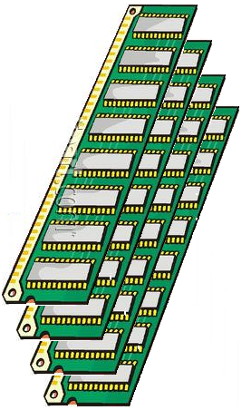
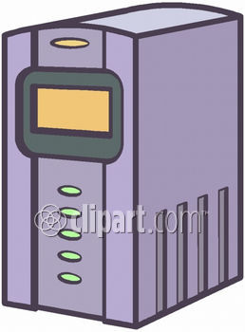
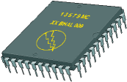
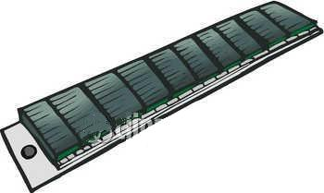


Memory Hierarchy
Main Memory
I/O Processor
CPU
Cache
Magnetic Disks
Magnetic Tapes
<number> / 19

Slide 48
Cache Memory
High speed (towards CPU speed)
Small size (power & cost)
Main
Memory
(Slow)
τ_{Mem}
Miss
CPU
Cache
(Fast)
τ_{Cache}
Hit
95% hit ratio
τ_{Access} = 0.95 τ_{Cache} + 0.05 τ_{Mem}
<number> / 19

Slide 49
Cache Memory
Main
Memory
1 Gword
CPU
30-bit Address
Cache
1 Mword
Only 20 bits !!!
<number> / 19

Slide 50
Cache Memory
Main
Memory
00000000
00000001
•
•
•
•
•
•
•
•
•
•
3FFFFFFF
Cache
00000
00001
•
•
•
•
FFFFF
Address Mapping !!!
<number> / 19

Slide 51
Where memory blocks are placed in the cache?
Three mapping techniques

Slide 52
Direct Mapping
Cache size is 2K words and block size is 16words main memory size is 64Kwords.
Block j of main memory maps onto block
j modulo no of cache blocks
Cache block=j%128
Main
memory
Block 0
Block 1
Placement of a block in the cache is determined from the memory address
Cache
Block 127
tag
Block 0
Block 128
tag
Block 1
Block 129
4: one of 16 words. (each block has 16=2⁴ words)
7: points to a particular block in the cache (128=2⁷)
5: 5 tag bits are compared with the tag bits associated with its location in the cache. Identify which of the 32 blocks that are resident in the cache (4096/128).
tag
Block 127
Block 255
Block 256
Block 257
Figure 5.15. Direct-mapped cache.
Block 4095
T
ag
Block
W
ord
5
7
4
Main memory address

Slide 53
Direct mapping
Limitation
Since more than memory block is mapped onto a given cache block position, contention may arise for that position even when cache is not full

Slide 54
Direct Mapping
T
ag
Block
W
ord
5
7
4
Main memory address
11101,1111111,1100
Tag: 11101
Block: 1111111=127, in the 127th block of the cache
Word:1100=12, the 12th word of the 127th block in the cache

Slide 55
Consider a machine with a byte addressable main memory of 2²⁰ bytes, block size of 16 bytes and a direct mapped cache having 2¹² cache lines. Find no of bit for TAG, block and word?
What are the tag and cache line address (in hex) for main memory address (E201F)₁₆?

Slide 56
Part 1: Finding the number of bits for TAG, Block, and Word
We are given:
Main memory size = 2202^{20}220 bytes (1 MB)
Block size = 16 bytes
Cache size = 2122^{12}212 cache lines (4096 lines)
The address for the main memory will be split into three parts: Tag bits, Index bits, and Word bits.
Step 1: Word bits
The block size is 16 bytes, meaning 16 addresses can fit in one block. To address the 16 bytes within a block, we need:
Word bits=log⁡2(Block size)=log⁡2(16)=4 bits\text{Word bits} = \log_2(\text{Block size}) = \log_2(16) = 4 \text{ bits}Word bits=log2​(Block size)=log2​(16)=4 bitsStep 2: Index bits (Cache line bits)
The cache has 2122^{12}212 cache lines, and each cache line can hold one block. To address these lines, we need:
Index bits=log⁡2(Number of cache lines)=log⁡2(212)=12 bits\text{Index bits} = \log_2(\text{Number of cache lines}) = \log_2(2^{12}) = 12 \text{ bits}Index bits=log2​(Number of cache lines)=log2​(212)=12 bitsStep 3: Tag bits
The main memory address is 20 bits, as 2202^{20}220 bytes is the total memory size. The remaining bits, after accounting for the index and word bits, are the tag bits:
Tag bits=Total address bits−(Index bits+Word bits)=20−(12+4)=4 bits\text{Tag bits} = \text{Total address bits} - (\text{Index bits} + \text{Word bits}) = 20 - (12 + 4) = 4 \text{ bits}Tag bits=Total address bits−(Index bits+Word bits)=20−(12+4)=4 bitsSo, we have:
Tag bits = 4
Index (Block) bits = 12
Word bits = 4

Slide 57
The memory address (E201F)16\text{(E201F)}_{16}(E201F)16​ in binary is:
(E201F)16=1110 0010 0000 0001 11112\text{(E201F)}_{16} = 1110\ 0010\ 0000\ 0001\ 1111_2(E201F)16​=1110 0010 0000 0001 11112​This is a 20-bit address: 11100010000000011111211100010000000011111_2111000100000000111112​.
Splitting the address:
Word bits (last 4 bits): 11112=F161111_2 = F_{16}11112​=F16​
Index bits (next 12 bits): 0010000000012001000000001_20010000000012​
Tag bits (first 4 bits): 11102=E161110_2 = E_{16}11102​=E16​
Now let's convert the index bits 0010000000012001000000001_20010000000012​ to hexadecimal:
0010000000012=20116001000000001_2 = 201_{16}0010000000012​=20116​So, the correct cache line index is 20116201_{16}20116​.
Final corrected result:
Tag for the address (E201F)₁₆: E16E_{16}E16​
Cache line index: 20116201_{16}20116​

Slide 58
Associative Mapping
Main
memory
Block 0
Block 1
Cache
tag
Block 0
tag
Block 1
Block
i
tag
Block 127
4: one of 16 words. (each block has 16=2⁴ words)
12: 12 tag bits Identify which of the 4096 blocks that are resident in the cache 4096=2¹².
Block 4095
T
ag
W
ord
12
4
Main memory address
Figure 5.16. Associative-mapped cache.

Slide 59
Associative Mapping
T
ag
W
ord
12
4
Main memory address
111011111111,1100
Tag: 111011111111
Word:1100=12, the 12th word of a block in the cache

Slide 60
Associative mapping
Give freedom in choosing the cache location in which to place the memory block, resulting in a more use of space in the cache
When a new block is brought into the cache, it replaces an existing block only if cache is full. In this case we need an algorithm to select the block to be replaced
Associative search required to minimize delay

Slide 61
Set-Associative Mapping
Main
memory
Block 0
Block 1
Cache
tag
Block 0
Set 0
Block 63
tag
Block 1
tag
Block 64
Set 1
Block 2
tag
Block 65
Block 3
4: one of 16 words. (each block has 16=2⁴ words)
6: points to a particular set in the cache (128/2=64=2⁶)
6: 6 tag bits is used to check if the desired block is present (4096/64=2⁶).
tag
Block 127
Set 63
Block 126
tag
Block 128
Block 127
Block 129
Block 4095
Figure 5.17. Set-associative-mapped cache with two blocks per set.
T
ag
Set
W
ord
6
6
4
Main memory address

Slide 62
Set-Associative Mapping
T
ag
Set
W
ord
6
6
4
Main memory address
111011,111111,1100
Tag: 111011
Set: 111111=63, in the 63th set of the cache
Word:1100=12, the 12th word of the 63th set in the cache

Slide 63
Set-associative
The number of blocks per set is a parameter that can be selected to suit the requirements of a particular computer
A cache that has k blocks per set is referred to as a k way set associative cache

Slide 64
Replacement Algorithms
Difficult to determine which blocks to kick out
Objective is to keep blocks in the cache that are likely to be referred in near future.
Least Recently Used (LRU) block
The cache controller tracks references to all blocks as computation proceeds.

Slide 65
LRU
In 4 way set associative cache 2 bit counter can be used for each block
When hit occurs the counter of that block is set to 0. counters with values originally lower than the referenced one are incremented by one. And all others remain unchanged.
When miss occur, if set is not full then counter associated with new block is set to zero and the values of other counters are incremented by one.
When miss occur and set is full, the block with the counter 3 is removed, new block is put in its place and counter set to 0. the other block counters are incremented by one.

Slide 66
Replacement Algorithms
CPU Reference
A
B
C
A
D
E
A
D
C
F
Miss
Miss
Miss
Hit
Miss
Miss
Miss
Hit
Hit
Miss
Cache
FIFO ➔
A
A
A
A
A
E
E
E
E
E
B
B
B
B
B
A
A
A
A
C
C
C
C
C
C
C
F
D
D
D
D
D
D
Hit Ratio = 3 / 10 = 0.3
<number> / 19

Slide 67
Replacement Algorithms
CPU Reference
A
B
C
A
D
E
A
D
C
F
Miss
Miss
Miss
Hit
Miss
Miss
Hit
Hit
Hit
Miss
Cache
LRU ➔
A
B
C
A
D
E
A
D
C
F
A
B
C
A
D
E
A
D
C
A
B
C
A
D
E
A
D
B
C
C
C
E
A
Hit Ratio = 4 / 10 = 0.4
<number> / 19

Slide 68
Performance Considerations

Slide 69
Overview
Two key factors: performance and cost
Price/performance ratio
Performance depends on how fast machine instructions can be brought into the processor for execution and how fast they can be executed.
memory hierarchy . The main purpose of this hierarchy to create a memory that the CPU sees as having short access time and a large capacity.
it is beneficial if transfers to and from the faster units can be done at a rate equal to that of the faster unit.

Slide 70
Hit Rate and Miss Penalty
An excellent indication of success of the memory hierarchy is the success rate in accessing information at various levels of the hierarchy
The successful access to data in a cache is called – hit .the number of hits stated as a fraction of all attempted access is called hit rate
Ideally, the entire memory hierarchy would appear to the processor as a single memory unit that has the access time of a cache on the processor chip and the size of a magnetic disk – depends on the hit rate (>>0.9).
A miss causes extra time needed to bring the desired information into the cache. Total access time seen by the processor when a miss occurs is called miss penalty

Slide 71
Hit Rate and Miss Penalty (cont.)
T_{ave}=hC+(1-h)M
  T_{ave:} average access time experienced by the processor
  h: hit rate
  M: miss penalty, the time to access information in the main memory i.e. total access time seen by processor
  C: the time to access information in the cache
= 4.7

Slide 72
How to Improve Hit Rate?
Use larger cache – increased cost
Increase the block size while keeping the total cache size constant. Achieve higher data rate
However, if the block size is too large, some items may not be referenced before the block is replaced – it take more time to load so increase miss penalty so block size should be neither too small nor too large. Generally block size of 16 to 128 bytes are most popular choice
Hit rate depends on the size of the cache, its design, and the instruction and data access patterns of the program being executed
Miss penalty can be reduced if Load-through approach

Slide 73
Caches on the Processor Chip
On chip vs. off chip
Two separate caches for instructions and data, respectively
Single cache for both
Which one has better hit rate? -- Single cache
What’s the advantage of separating caches? – parallelism, better performance
Level 1 and Level 2 caches
L1 cache – faster and smaller. Access more than one word simultaneously and let the processor use them one at a time. Tens of kilobytes
L2 cache – slower and larger. Hundreds of kilobytes or several megabytes
How about the average access time?
Average access time: t_{ave} = h₁C₁ + (1-h₁)(h₂C₂ + (1-h₂)M)
=h1c1 +(1-h1)h2c2+(1-h1)(1-h2)M
where h is the hit rate, C is the time to access information in cache, M is the time to access information in main memory.
No of misses in secondary cache is given by (1-h1)(1-h2)

