Slide 1
CSS (cascaded style sheet)

Slide 2
CSS is the acronym for: ‘Cascading Style Sheets’.
CSS is an extension to basic HTML that allows you to style your web pages.

Slide 3
General form of rule
Selector {property : value}
Or
Selector {
property1 : value1;
property2 : value2;
propertyN : valueN
}
"Property" is the CSS element you wish to manipulate and "VALUE" represents the value of the specified property.

Slide 4
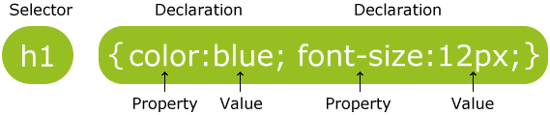
Example:
p { color:red; text-align:center; }

Slide 5
CSS Comments
Comments are used to explain your code, and may help you when you edit the source code at a later date. Comments are ignored by browsers.
A CSS comment begins with "/*", and ends with "*/", like this:
Example:
/*This is a comment*/ p { text-align:center; /*This is another comment*/ color:black; font-family:arial; }

Slide 6
When a browser reads a style sheet, it will format the document according to it.
Three Ways to Insert CSS
There are three ways of inserting a style sheet:
External style sheet
Internal style sheet
Inline style

Slide 7
External Style Sheet
An external style sheet is ideal when the style is applied to many pages.
With an external style sheet, you can change the look of an entire Web site by changing one file.
Each page must link to the style sheet using the <link> tag.
The <link> tag goes inside the head section:
<head> <link rel="stylesheet" type="text/css" href="mystyle.css" />
</head>
An external style sheet can be written in any text editor. The file should not contain any html tags. Your style sheet should be saved with a .css extension.
An example of a style sheet file is shown below:
hr {color:red;} p {margin-left:20px;} body {background-image:url("images/back40.gif");}

Slide 8
Internal Style Sheet
An internal style sheet should be used when a single document has a unique style.
You define internal styles in the head section of an HTML page, by using the <style> tag, like this:
<head> <style type="text/css"> hr {color:sienna;} p {margin-left:20px;} body {background-image:url("images/back40.gif");} </style> </head>

Slide 9
Inline Styles
An inline style loses many of the advantages of style sheets by mixing content with presentation. Use this method sparingly!
To use inline styles you use the style attribute in the relevant tag.
The style attribute can contain any CSS property.
The example shows how to change the color and the left margin of a paragraph:
<p style="color:red;margin-left:20px">This is a paragraph.</p>

Slide 10
Example : internal style sheet
<html>
<head>
<style type="text/css">
body
{
background-color:#b0c4de;
}
</style>
</head>
<body>
<h1>My CSS web page!</h1>
<p>Hello world! This is a W3Schools.com example.</p>
</body>
</html>

Slide 11
External style sheet
First.css
body
{
background-color:#b0c4de;
}
Cssex2.html
<html>
<head> <link rel="stylesheet" type="text/css" href=“first.css" />
</head>
<body>
<h1>My CSS web page!</h1>
<p>Hello world! This is a W3Schools.com example.</p>
</body>
</html>

Slide 12
Inline Styles
<html>
<body style=“background-color:#b0c4de” >
<h1>My CSS web page!</h1>
<p>Hello world! This is a W3Schools.com example.</p>
</body>
</html>
Cssex3.html

Slide 13
Id selector
The id selector is used to specify a style for a single, unique element.
The id selector uses the id attribute of the HTML element, and is defined with a "#".
The style rule below will be applied to the element with id="para1":
Example
#para1 { text-align:center; color:red; }

Slide 14
Class selector
The class selector is used to specify a style for a group of elements.
Unlike the id selector, the class selector is most often used on several elements.
This allows you to set a particular style for any HTML elements with the same class.
The class selector uses the HTML class attribute, and is defined with a "."
In the example below, all HTML elements with class="center" will be center-aligned:
Example
.center {text-align:center;}

Slide 15
P.right {text-align:right}
P.left{text-align:left}
To actually use this within HTML document use class attribute:
<p class=“right”> This para will be right aligned</p>
<p class=“left”> This para will be left aligned </p>
To define a global style class omit the element name
.left{ text-align:left}
<h1 class=“left”>this heading will be left aligned</h1>
<p class=“left”> This para will be left aligned </p>

Slide 16
CSS Background
CSS background properties are used to define the background effects of an element.
CSS properties used for background effects:
background-color
background-image
background-repeat
background-attachment
background-position

Slide 17
Background Color
The background-color property specifies the background color of an element.
The background color of a page is defined in the body selector:
Example
body {background-color:#b0c4de;}
The background color can be specified by:
name - a color name, like "red"
RGB - an RGB value, like "rgb(255,0,0)"
Hex - a hex value, like "#ff0000“
Example
h1 {background-color:#6495ed;} p {background-color:#e0ffff;} div {background-color:#b0c4de;}

Slide 18
Background Image
The background-image property specifies an image to use as the background of an element.
By default, the image is repeated so it covers the entire element.
The background image for a page can be set like this:
Example
body {background-image:url('paper.gif');}

Slide 19
Background Image - Repeat Horizontally or Vertically
background-repeat
By default, the background-image property repeats an image both horizontally and vertically.
Some images should be repeated only horizontally or vertically, or they will look strange, like this:
Example
body { background-image:url('gradient2.png'); }
If the image is repeated only horizontally (repeat-x), the background will look better:
Example
body { background-image:url('gradient2.png'); background-repeat:repeat-x; }

Slide 20
repeat :-The background image will be repeated both vertically and horizontally. This is default
repeat-x:- The background image will be repeated only horizontally
repeat-y:- The background image will be repeated only vertically
no-repeat:- The background-image will not be repeated
inherit :-Specifies that the setting of the background-repeat property should be inherited from the parent element

Slide 21
background-attachment
The background-attachment property sets whether a background image is fixed or scrolls with the rest of the page.
scroll :-The background image scrolls with the rest of the page. This is default
Fixed :- The background image is fixed

Slide 22
background-position
The background-position property sets the starting position of a background image.
left top left center left bottom right top right center right bottom center top center center center bottom
If you only specify one keyword, the second value will be "center"

Slide 23
x% y%
The first value is the horizontal position and the second value is the vertical. The top left corner is 0% 0%. The right bottom corner is 100% 100%. If you only specify one value, the other value will be 50%. . Default value is: 0% 0%
xpos ypos The first value is the horizontal position and the second value is the vertical. The top left corner is 0 0. Units can be pixels (0px 0px) or any other CSS units. If you only specify one value, the other value will be 50%. You can mix % and positions

Slide 24
Background - Shorthand property
To shorten the code, it is also possible to specify all the properties in one single property. This is called a shorthand property.
- The shorthand property for background is simply "background":
Example
body {background:#ffffff url('img_tree.png') no-repeat right top;}
-When using the shorthand property the order of the property values are:
background-color
background-image
background-repeat
background-attachment
background-position
It does not matter if one of the property values is missing, as long as the ones that are present are in this order.

Slide 25
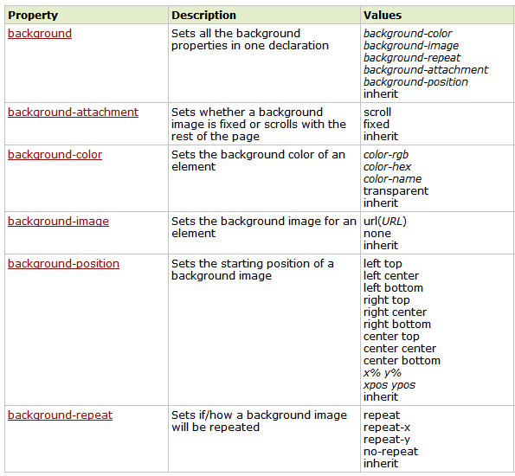

Slide 26
Grouping
If multiple selectors share the same CSS properties, they can be declared together. This is called "grouping". For example, if <h1>, <h2>, and <h3> share they same style, they can be declared together as follows:
H1, h2, h3 { property:value; ... }
div,p { background-color:yellow; }

Slide 27
Descendant Selectors
We can specify the style of an element only when it is inside another element. To accomplish this, we use the concept of descendant selectors.
The syntax for declaring a descendant selector is:
[Parent Selector] [Child Selector] { property:value; ... }
The style defined above will apply to child selectors only when they are inside the parent selector. Such declarations can go on for more than two levels.
For example, in the declaration below,
li b { color:yellow; }
means that text in the <b> element inside the <li> element will be yellow. Text in the <b> elements not within the <li> element will not be affected by this stylesheet.
div p { background-color:yellow; }

Slide 28
CSS Links
Styling Links
Links can be styled with any CSS property (e.g. color, font-family, background, etc.).
Special for links are that they can be styled differently depending on what state they are in.
The four links states are:
a:link - a normal, unvisited link
a:visited - a link the user has visited
a:hover - a link when the user mouses over it
a:active - a link the moment it is clicked

Slide 29
Example
a:link {color:#FF0000;} /* unvisited link */ a:visited {color:#00FF00;} /* visited link */ a:hover {color:#FF00FF;} /* mouse over link */ a:active {color:#0000FF;} /* selected link */

Slide 30
Manipulating Text
Text Color
With CSS, a color is most often specified by:
a HEX value - like "#ff0000"
an RGB value - like "rgb(255,0,0)"
a color name - like "red"
The default color for a page is defined in the body selector.
Text Alignment
The text-align property is used to set the horizontal alignment of a text.
Text can be centered, or aligned to the left or right, or justified.
h1 {text-align:center;} p.date {text-align:right;} p.main {text-align:justify;}

Slide 31
Manipulating Text
Text Decoration
The text-decoration property is used to set or remove decorations from text.
The text-decoration property is mostly used to remove underlines from links for design purposes:
h1 {text-decoration:overline;} h2 {text-decoration:line-through;} h3 {text-decoration:underline;} h4 {text-decoration:blink;}
h5 {text-decoration:none;};

Slide 32
Manipulating Text
Text Transformation
The text-transform property is used to turn everything into uppercase or lowercase letters, or capitalize the first letter of each word.
p.uppercase {text-transform:uppercase;} p.lowercase {text-transform:lowercase;} p.capitalize {text-transform:capitalize;}
Text Indentation
The text-indentation property is used to specify the indentation of the first line of a text.
p {text-indent:100px;}

Slide 33
List Properties in CSS
CSS Lists
The CSS list properties allow you to:
Set different list item markers for unordered lists
ul.a {list-style-type: circle;} ul.b {list-style-type: square;}
Set different list item markers for ordered lists ol.c {list-style-type: upper-roman;} ol.d {list-style-type: lower-alpha;}
Set an image as the list item marker ul { list-style-image: url('sqpurple.gif'); }

Slide 34
List Properties in CSS
CSS List Shorthand Property
It is also possible to specify all the list properties in one, single property. This is called a shorthand property.
When using the shorthand property, the order of the values are:
list-style-type
list-style-position ( Inside or Outside)
list-style-image
ul { list-style: square url("sqpurple.gif"); }

Slide 35
Table Properties in CSS
Table Borders
table, th, td { border: 1px solid black;
border-collapse:collapse; }
The border-collapse property sets whether the table borders are collapsed into a single border or separated
Table Width & Text Alignment
table { width:100%; }
th { height:75px; }
td
{
text-align:right;
vertical-align:bottom;
}

Slide 36
Table Properties in CSS
Table Color
<style type="text/css">
table, td, th {
border:1px solid green;
}
th {
background-color:green;
color:white;
}
</style>
Table Padding
To control the space between the border and content in a table, use the padding property on td and th elements:
td { padding:15px; } or padding-left:50px;

Slide 37
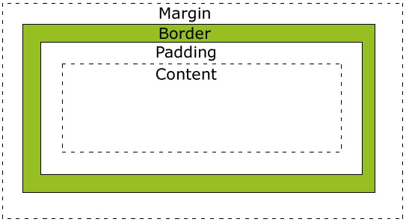
The CSS Box Model
The CSS box model is essentially a box that wraps around HTML elements, and it consists of: margins, borders, padding, and the actual content.
The box model allows us to place a border around elements and space elements in relation to other elements.
width:250px; padding:10px; border:5px solid gray; margin:10px;

Slide 38
The CSS Box Model
Margin - Clears an area around the border. The margin does not have a background color, it is completely transparent
Border - A border that goes around the padding and content. The border is affected by the background color of the box
Padding - Clears an area around the content. The padding is affected by the background color of the box
Content - The content of the box, where text and images appear
Total element width = width + left padding + right padding + left border + right border + left margin + right margin
Total element height = height + top padding + bottom padding + top border + bottom border + top margin + bottom margin

Slide 39
The CSS Border
The border-style property specifies what kind of border to display.
border-style values:
None ,dotted , dashed , solid , double , groove , ridge
inset ,outset
border-style:solid;
border-top-style:dotted;
border-style:dotted solid double dashed;
border-style:dotted solid double;
border-style:dotted solid;
margin:100px 50px;
margin-left:50px;

Slide 40
CSS Positioning
The CSS positioning properties allow you to position an element. It can also place an element behind another, and specify what should happen when an element's content is too big.
Static Positioning
HTML elements are positioned static by default. A static positioned element is always positioned according to the normal flow of the page.
Fixed Positioning
An element with fixed position is positioned relative to the browser window.
It will not move even if the window is scrolled:
Fixed positioned elements can overlap other elements.

Slide 41
CSS Positioning
p.pos_fixed {
position:fixed;
top:30px;
right:5px; }
Relative Positioning
A relative positioned element is positioned relative to its normal position.
The content of relatively positioned elements can be moved and overlap other elements
h2.pos_left { position:relative; left:-20px; }

Slide 42
CSS Positioning
Absolute Positioning
An absolute position element is positioned relative to the first parent element that has a position other than static. If no such element is found, the containing block is <html>:
h2 { position:absolute; left:100px; top:150px; }
Overlapping Elements
When elements are positioned outside the normal flow, they can overlap other elements.
The z-index property specifies the stack order of an element which element should be placed in front of, or behind, the others.

Slide 43
CSS Positioning
img { position:absolute; left:0px; top:0px; z-index: -1 }
CSS Float
With CSS float, an element can be pushed to the left or right, allowing other elements to wrap around it.
Elements are floated horizontally, this means that an element can only be floated left or right, not up or down.
The elements after the floating element will flow around it.
If an image is floated to the right, a following text flows around it, to the left:

Slide 44
CSS Positioning
img
{ float:right; }
Floating Elements Next to Each Other
If you place several floating elements after each other, they will float next to each other if there is room.
.thumbnail
{
float:left;
width:110px;
height:90px;
margin:5px;
}
No Floating
The clear property specifies which sides of an element other floating elements are not allowed.
Add a text line into the image gallery, using the clear property:
.text_line
{ clear:both; }

Slide 45
CSS Layout and Structure
The idea behind CSS was to separate the formatting and styling rules from the content.
Structure of document can be maintain by breaking the page into logical sections with div elements.
CSS Navigation Bars
With CSS you can transform boring HTML menus into good-looking navigation bars.
Navigation Bar = List of Links
A navigation bar needs standard HTML as a base.
A navigation bar is basically a list of links, so using the <ul> and <li> elements makes perfect sense

Slide 46
CSS Layout and Structure
Vertical Navigation Bar
To build a vertical navigation bar we only need to style the <a> elements in addition to the list code.
a { display:block; width:60px; }
display:block - Displaying the links as block elements makes the whole link area clickable (not just the text), and it allows us to specify the width
Horizontal Navigation Bar
There are two ways to create a horizontal navigation bar. Using inline or floating list items.

Slide 47
CSS Layout and Structure
if you want the links to be the same size, you have to use the floating method.
Inline List Items
To build a horizontal navigation bar is to specify the <li> elements as inline
li { display:inline; }
display:inline; - By default, <li> elements are block elements. Here, we remove the line breaks before and after each list item, to display them on one line
Floating List Items
For all the links to have an equal width, float the <li> elements and specify a width for the <a> elements

Slide 48
CSS Layout and Structure
li { float:left; } a { display:block; width:60px; }
float:left - use float to get block elements to slide next to each other
display:block - Displaying the links as block elements makes the whole link area clickable (not just the text), and it allows us to specify the width

